Slide 1
Meta-assessment: Evaluating the Quality of Academic Program Assessment
Allison Ames, Ph.D.
Nick Curtis, M.A., Ed.s.
Scott Strickman, M.S.
12/3/2016

Slide 2
Workshop Objectives
As a result of this workshop, participants will be able to:
  Describe a general, six-step assessment model
  Navigate JMU’s meta-assessment rubric
  Practice using JMU’s meta-assessment rubric to evaluate a real academic program assessment report
  Provide feedback to your home institution about meta-assessment of this six-step cycle

Slide 3
Overview
Purpose, Background
Intro to Assessment Practice,
  Meta-Assessment and the APT rubric
Practice Rating
  Comments
Logistics
  Meta-assessment at JMU
Notes:
Poll people about student affairs/academic affairs…. Is the majority of your job assessment?

Slide 4
Overview
Purpose, Background
Intro to Assessment Practice,
  Meta-Assessment and the APT rubric
Practice Rating
  Comments
Logistics
  Meta-assessment at JMU
Notes:
Poll people about student affairs/academic affairs…. Is the majority of your job assessment?

Slide 5
Purpose & Background
How do we assess the quality of 120+ academic program assessment plans?
  Trained raters evaluate and provide diagnostic comments to individual academic degree programs about the strengths and weaknesses of their assessment reports and practice.
  End goal: Help academic degree and certificate programs make decisions to improve student learning.
  Our hope is that programs respond to this feedback, making their assessment process stronger and more useful for decision making about student learning.

Slide 6
Overview
Purpose, Background
Intro to Assessment Practice,
  Meta-Assessment and the APT rubric
Practice Rating
  Comments
Logistics
  Meta-assessment at JMU
Notes:
Poll people about student affairs/academic affairs…. Is the majority of your job assessment?

Slide 7
Why do assessment?
Three reasons:
Intrinsic Reasons
  To improve the effectiveness of a program, particularly as it pertains to student learning
Extrinsic Reasons
  To be accountable to stakeholders
  To justify programmatic changes and resource allocation

Slide 8
Assessment Quality: Two Big Questions
What criteria are used by academic programs regarding the validity of inferences made from their assessment results?
  These criteria are based on an “assessment cycle”
  Connects all the main stages of a comprehensive assessment plan
  Quality indicators for each stage
Were these assessment results used logically to improve the program?
  Because the end goals are program improvement and student learning, the assessment plan should also include logical, actionable improvements
  “Closing the loop”
Notes:
So when assessing the assessment, we ask ourselves two big questions:

Slide 9
The Assessment Cycle
1) State Learning Outcomes
2) Map to Courses
3) Select Methods
4) Analyze and Interpret Results
6) Use Results for Improvement
5) Report to Stakeholders
Notes:
Assessment practice can be thought of as a cycle. It is not just the test or score, but a system.
Before we get in to rating these stages, let’s look at the details of each.

Slide 10
The Assessment Cycle
1) State Learning Outcomes
2) Map to Courses
3) Select Methods
4) Analyze and Interpret Results
6) Use Results for Improvement
5) Report to Stakeholders
Notes:
Assessment practice can be thought of as a cycle. It is not just the test or score, but a system.
Before we get in to rating these stages, let’s look at the details of each.

Slide 11
Stage 1: State Student
Learning Objectives
1) Establish Objectives
6) Use Results to Improve Program
2) Map Objectives to Experiences
5) Report to Stakeholders
3) Select and/or Design Instruments
4) Collect and Analyze Data, Assess Fidelity
Student Learning Objectives (SLOs) are what students should know, think, or do as a result of an academic program
Specific and observable student learning and/or developmental objectives
  They define the knowledge, skills, behaviors, or attitudes that students are expected to achieve as a function of your program
High Quality Indicators:
  Student-centered objectives
  Specify what type/level of student
  Use clear verbs (avoid understand and know)
  Clarify knowledge, skill, or ability (KSA)

Slide 12
The Assessment Cycle
1) Establish Objectives
6) Use Results to Improve Program
2) Map Objectives to Experiences
5) Report to Stakeholders
3) Select and/or Design Instruments
4) Collect and Analyze Data, Assess Fidelity
1) State Learning Outcomes
2) Map to Courses
3) Select Methods
4) Analyze and Interpret Results
6) Use Results for Improvement
5) Report to Stakeholders
Notes:
Assessment practice can be thought of as a cycle. It is not just the test or score, but a system.
Before we get in to rating these stages, let’s look at the details of each.

Slide 13
Stage 2: Mapping SLOs to Courses
1) Establish Objectives
6) Use Results to Improve Program
2) Map Objectives to Experiences
5) Report to Stakeholders
3) Select and/or Design Instruments
4) Collect and Analyze Data, Assess Fidelity
Identify courses in which students should be learning knowledge/skills articulated in SLOs
Program theory: how the design of the program should theoretically affect students
Opportunities to learn
High Quality Indicators:
Clear mapping helps interpret results
Each objective should map to at least one element of the program or curriculum
Be specific!
  To what extent is the objective covered in that class?
  What specific components of the activity or items on the test address the objective?

Slide 14
The Assessment Cycle
1) State Learning Outcomes
2) Map to Courses
3) Select Methods
4) Analyze and Interpret Results
6) Use Results for Improvement
5) Report to Stakeholders
Notes:
Assessment practice can be thought of as a cycle. It is not just the test or score, but a system.
Before we get in to rating these stages, let’s look at the details of each.

Slide 15
Stage 3: Selecting Assessment
Methods
1) Establish Objectives
6) Use Results to Improve Program
2) Map Objectives to Experiences
5) Report to Stakeholders
3) Select and/or Design Instruments
4) Collect and Analyze Data, Assess Fidelity
Many different types of instruments
Existing, or new
  Rubrics
  Questionnaires
  Tests (multiple-choice and open-ended)
  Behavioral Observations
Direct vs. indirect measures of learning

Slide 16
Stage 3: Select Methods
1) Establish Objectives
6) Use Results to Improve Program
2) Map Objectives to Experiences
5) Report to Stakeholders
3) Select and/or Design Instruments
4) Collect and Analyze Data, Assess Fidelity
Existing Measure
New Measure
  Pros:
    Already created
    Convenient
    Evaluated
  Cons:
    Not customized
    May differ in theoretical orientation
  Pros:
    Strong alignment with objectives
  Cons:
    Requires time
    Requires resources

Slide 17
Stage 3: Select Methods
1) Establish Objectives
6) Use Results to Improve Program
2) Map Objectives to Experiences
5) Report to Stakeholders
3) Select and/or Design Instruments
4) Collect and Analyze Data, Assess Fidelity
Indirect Measures
  Self-appraisals
  May not be indicative of learning
  Ex: Ex: Students report (on a 5-point scale) how much they feel they learned during a guest speaker presentation.
  Ex: “I have mastered the skill of 80s pop culture movement identification.”

Slide 18
Stage 3: Select Methods
1) Establish Objectives
6) Use Results to Improve Program
2) Map Objectives to Experiences
5) Report to Stakeholders
3) Select and/or Design Instruments
4) Collect and Analyze Data, Assess Fidelity
Direct Measures
  Direct appraisals
  Provides stronger evidence of learning
  Ex: Students are rated on their written evaluation of 80s hair styles.
  Ex: “Please choose one of the following prompts and construct an essay, of 1200 to 1500 words, on the topic. You will be evaluated using the Pop Culture Rubric.”

Slide 19
Stage 3: Selecting Assessment
Methods
1) Establish Objectives
6) Use Results to Improve Program
2) Map Objectives to Experiences
5) Report to Stakeholders
3) Select and/or Design Instruments
4) Collect and Analyze Data, Assess Fidelity
Many different types of instruments
Existing, or new
  Rubrics
  Questionnaires
  Tests (multiple-choice and open-ended)
  Behavioral Observations
Direct vs. indirect measures of learning
High Quality Indicators:
Match instrument to SLO
Choose direct and/or indirect measures
Establish criteria for success
Select data collection method
Collect additional reliability and validity information

Slide 20
The Assessment Cycle
1) State Learning Outcomes
2) Map to Courses
3) Select Methods
4) Analyze and Interpret Results
6) Use Results for Improvement
5) Report to Stakeholders
Notes:
Assessment practice can be thought of as a cycle. It is not just the test or score, but a system.
Before we get in to rating these stages, let’s look at the details of each.

Slide 21
Stage 4: Analyze and Interpret
Results
1) Establish Objectives
6) Use Results to Improve Program
2) Map Objectives to Experiences
5) Report to Stakeholders
3) Select and/or Design Instruments
4) Collect and Analyze Data, Assess Fidelity
What did you find, and what does it mean in relation to each SLO?
How did results compare to your criteria for success?
Did your analysis reveal any obvious strengths or gaps?
Are the findings unique this year or are they part of a trend?
How trustworthy are your results?
High Quality Indicators:
Organize results and map back to SLOs
Use appropriate analyses
Interpretation must flow logically
Link findings back to objectives and other parts of the process

Slide 22
The Assessment Cycle
1) State Learning Outcomes
2) Map to Courses
3) Select Methods
4) Analyze and Interpret Results
6) Use Results for Improvement
5) Report to Stakeholders
Notes:
Assessment practice can be thought of as a cycle. It is not just the test or score, but a system.
Before we get in to rating these stages, let’s look at the details of each.

Slide 23
Stage 5: Reporting to Stakeholders
1) Establish Objectives
6) Use Results to Improve Program
2) Map Objectives to Experiences
5) Report to Stakeholders
3) Select and/or Design Instruments
4) Collect and Analyze Data, Assess Fidelity
Identify stakeholders and what they want and need to know.
  Faculty in the program
  University administration
  Students
  Accrediting bodies and external boards
Provide timely and appropriate information
High Quality Indicators:
Identify best mode(s) of communication
Avoid jargon
Make sure all faculty within the program receive information
Share results outside of program/department

Slide 24
The Assessment Cycle
1) State Learning Outcomes
2) Map to Courses
3) Select Methods
4) Analyze and Interpret Results
6) Use Results for Improvement
5) Report to Stakeholders
Notes:
Assessment practice can be thought of as a cycle. It is not just the test or score, but a system.
Before we get in to rating these stages, let’s look at the details of each.

Slide 25
Stage 6: Using Results for Improvement
1) Establish Objectives
6) Use Results to Improve Program
2) Map Objectives to Experiences
5) Report to Stakeholders
3) Select and/or Design Instruments
4) Collect and Analyze Data, Assess Fidelity
Program improvement based on solid evidence is the main purpose of assessment
High Quality Indicators:
Take curricular or pedagogical actions based on results and interpretation
  Specific
Provide information about improving future iterations of assessment
Including a timeline of events for proposed changes to a program

Slide 26
The Assessment Cycle
1) State Learning Outcomes
2) Map to Courses
3) Select Methods
4) Analyze and Interpret Results
6) Use Results for Improvement
5) Report to Stakeholders
Notes:
Assessment practice can be thought of as a cycle. It is not just the test or score, but a system.
Before we get in to rating these stages, let’s look at the details of each.

Slide 27
Overview
Rationale for assessment evaluation rubric
Assessment process (the six-step cycle)
Assessment evaluation rubric
Apply the rubric to an academic program assessment report
Logistics
Conclusions

Slide 28
Scoring
Now we know: what assessment is and is not, as well as what “good” assessment practice looks like.
But how do we systematically and consistently assign scores to these APT reports?
  The APT Rubric
Notes:
NICK

Slide 29
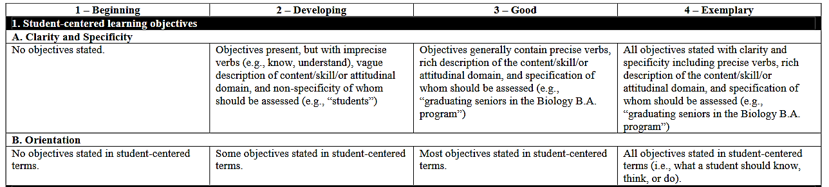
Assessing Quality: Assessment Evaluation Rubric
The indicators of quality are mapped onto a rubric
  Recall: Stage 1 is about stating student learning outcomes
    Student-centered, specific, clear, and describe the KSA
  The rubric has two parts for Stage 1: clarity/specificity, and orientation

Slide 30
Assessing Quality: Assessment Evaluation Rubric
The rubric has a section for each stage of the assessment cycle.
  Some stages have multiple quality indicators
  14 total elements to rate
Beyond numeric ratings, diagnostic feedback

Slide 31
Agenda: Opportunity to Meet Objectives
Rationale for assessment evaluation rubric
Assessment process (the six-step cycle)
Assessment evaluation rubric
Apply the rubric to an academic program assessment report
Logistics
Conclusions

Slide 32
The report clearly states what level of student is being assessed. This is a component of Element I. A.
Assessment Progress Template - Example: Computer Information Systems
I&II. Objective, course/learning experience
Students graduating with a BBA in Computer Information Systems will achieve the following objectives:
Programming
Students will demonstrate proficiency in the programming of object-oriented, GUI, event-driven, database-enabled applications in at least two modern programming languages. Programming proficiency will include conceptual design, elegant and efficient coding, complete testing/debugging, and meaningful documentation.
Database Management Systems
Students will demonstrate understanding of database concepts, and proficiency in developing effective data models, designing and implementing relational databases, and manipulating data using SQL.
This statement also indicates that the following learning objectives apply to students. Using student centered objectives is a component for Element IB.

Slide 33
Assessment Progress Template - Example: Computer Information Systems
I&II. Objective, course/learning experience
Students graduating with a BBA in Computer Information Systems will achieve the following objectives:
Programming
Students will demonstrate proficiency in the programming of object-oriented, GUI, event-driven, database-enabled applications in at least two modern programming languages. Programming proficiency will include conceptual design, elegant and efficient coding, complete testing/debugging, and meaningful documentation.
Database Management Systems
Students will demonstrate understanding of database concepts, and proficiency in developing effective data models, designing and implementing relational databases, and manipulating data using SQL.
The program objectives are written using a rich description of the content/skill/attitudinal domain. Using these rich descriptions can help guide decisions further in the assessment process. Description of the domain relates to Element I.A. of the APT rubric.

Slide 34
Assessment Progress Template - Example: Computer Information Systems
I&II. Objective, course/learning experience
Students graduating with a BBA in Computer Information Systems will achieve the following objectives:
Programming
Students will demonstrate proficiency in the programming of object-oriented, GUI, event-driven, database-enabled applications in at least two modern programming languages. Programming proficiency will include conceptual design, elegant and efficient coding, complete testing/debugging, and meaningful documentation.
Database Management Systems
Students will demonstrate understanding of database concepts, and proficiency in developing effective data models, designing and implementing relational databases, and manipulating data using SQL.
This objective could be improved by using a more precise verb. It is difficult to assess “understanding.” An alternative phrasing might be: “Students will describe database concepts and develop effective data models...” assuming the program wants to assess students ability to describe database concepts.

Slide 35
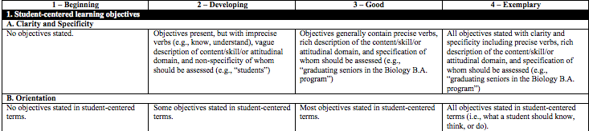
I&II. Objective, course/learning experience
Students graduating with a BBA in Computer Information Systems will achieve the following objectives:
Programming
Students will demonstrate proficiency in the programming of object-oriented, GUI, event-driven, database-enabled applications in at least two modern programming languages. Programming proficiency will include conceptual design, elegant and efficient coding, complete testing/debugging, and meaningful documentation.
Database Management Systems
Students will demonstrate understanding of database concepts, and proficiency in developing effective data models, designing and implementing relational databases, and manipulating data using SQL.

Slide 36
I&II. Objective, course/learning experience
Computer Information Systems:
Coverage of Objectives 0 = No Coverage, 1 = Slight Coverage, 2 = Moderate Coverage, 3 = Major Coverage
 | Obj 1: Programming | Obj 2: Database Management Systems | Obj 3: Systems Analysis & Design | Obj 4: System Architectures & Technology Tools | Obj 5: Telecomm | Obj 6: Business & Interpersonal skills
COB204 Computer Info Systems | 0 | 2 | 2 | 2 | 2 | 2
CIS 221 Principles of Programming | 3 | 0 | 0 | 0 | 0 | 0
CIS 301 Operating Sys & Server Admin | 0 | 0 | 0 | 3 | 2 | 2
CIS 304 Enterprise Architecture | 0 | 0 | 2 | 3 | 2 | 2
This chart shows what courses map to which objectives. In addition, the chart also indicates the degree to which the objectives are covered in each course.
Including the degree of alignment between the student learning outcomes corresponds to Element II of rubric.

Slide 37
Computer Information Systems:
Coverage of Objectives 0 = No Coverage, 1 = Slight Coverage, 2 = Moderate Coverage, 3 = Major Coverage
 | Obj 1: Programming | Obj 2: Database Management Systems | Obj 3: Systems Analysis & Design | Obj 4: System Architectures & Technology Tools | Obj 5: Telecomm | Obj 6: Business & Interpersonal skills
COB204 Computer Info Systems | 0 | 2 | 2 | 2 | 2 | 2
CIS 221 Principles of Programming | 3 | 0 | 0 | 0 | 0 | 0
CIS 301 Operating Sys & Server Admin | 0 | 0 | 0 | 3 | 2 | 2
CIS 304 Enterprise Architecture | 0 | 0 | 2 | 3 | 2 | 2

Slide 38
III. Evaluation/Assessment Methods
The BBA program in Computer Information Systems uses several methods for its assessment. This table summarizes the process involving these methods. More detail about the methodology follows the table.
 | Assessment Method | Corresponding Objective | Type | Data Collection | Expected Results
A | Assessment Day Test | 1 (programming) 2 (database) 3 (SAD) 4 (Architecture) 5 (Telecomm) | Direct | Examination of all junior and senior CIS majors on assessment day | Major revisions were done to this test this year. A preliminary analysis was done for this report. Results will be further analyzed over the summer and reported next year
B | Embedded assessment in CIS221 | 1 (programming) | Direct | Based upon final exams/Course embedded | 70% of students will be proficient based upon redesign of course in 2010 and additional hands-on activities in Spring 2012
C | Embedded assessment in CIS331 | 1 (programming) | Direct | Skills and concepts based upon quizzes. Development skills based upon programming assignments. Course embedded. | 70% of students will be proficient based upon changes made in Spring 2010.
D | Embedded assessment in CIS454 | 3 (Systems Analysis and Design) | Direct | Based upon all problem solving problems on the three exams | 70% of students will be proficient based upon changes in Fall 2011.
E | Embedded assessment in CIS301 | 4 (Architecture) | Direct | Based upon selected problems on the final exam | 70% of students will be proficient
F | Embedded assessment in CIS 320 | 5 (Telecomm) 6 (Interpersonal skills) | Direct | Based upon selected problems on the final exam. Based upon peer evaluations on a group project | 70% of students will be proficient based upon redesign in 2011-2012.
G | Writing rubric CIS 454 | 6 (Writing) | Direct | Random sample of students based upon 1 writing assignment. Course embedded. | 70% of students will be proficient based upon improvements in teaching writing throughout curriculum
The table summarizes what measures will be used and important information about each.
Explicitly indicating the alignment between objectives and measures relates to Element III. A.

Slide 39
III. Evaluation/Assessment Methods
The BBA program in Computer Information Systems uses several methods for its assessment. This table summarizes the process involving these methods. More detail about the methodology follows the table.
 | Assessment Method | Corresponding Objective | Type | Data Collection | Expected Results
A | Assessment Day Test | 1 (programming) 2 (database) 3 (SAD) 4 (Architecture) 5 (Telecomm) | Direct | Examination of all junior and senior CIS majors on assessment day | Major revisions were done to this test this year. A preliminary analysis was done for this report. Results will be further analyzed over the summer and reported next year
B | Embedded assessment in CIS221 | 1 (programming) | Direct | Based upon final exams/Course embedded | 70% of students will be proficient based upon redesign of course in 2010 and additional hands-on activities in Spring 2012
C | Embedded assessment in CIS331 | 1 (programming) | Direct | Skills and concepts based upon quizzes. Development skills based upon programming assignments. Course embedded. | 70% of students will be proficient based upon changes made in Spring 2010.
D | Embedded assessment in CIS454 | 3 (Systems Analysis and Design) | Direct | Based upon all problem solving problems on the three exams | 70% of students will be proficient based upon changes in Fall 2011.
E | Embedded assessment in CIS301 | 4 (Architecture) | Direct | Based upon selected problems on the final exam | 70% of students will be proficient
F | Embedded assessment in CIS 320 | 5 (Telecomm) 6 (Interpersonal skills) | Direct | Based upon selected problems on the final exam. Based upon peer evaluations on a group project | 70% of students will be proficient based upon redesign in 2011-2012.
G | Writing rubric CIS 454 | 6 (Writing) | Direct | Random sample of students based upon 1 writing assignment. Course embedded. | 70% of students will be proficient based upon improvements in teaching writing throughout curriculum
Notice that all objectives are assessed using at least one direct measure of student learning. Having each objective assessed by at least one direct measure is a component of Element III. B.

Slide 40
III. Evaluation/Assessment Methods
The BBA program in Computer Information Systems uses several methods for its assessment. This table summarizes the process involving these methods. More detail about the methodology follows the table.
 | Assessment Method | Corresponding Objective | Type | Data Collection | Expected Results
A | Assessment Day Test | 1 (programming) 2 (database) 3 (SAD) 4 (Architecture) 5 (Telecomm) | Direct | Examination of all junior and senior CIS majors on assessment day | Major revisions were done to this test this year. A preliminary analysis was done for this report. Results will be further analyzed over the summer and reported next year
B | Embedded assessment in CIS221 | 1 (programming) | Direct | Based upon final exams/Course embedded | 70% of students will be proficient based upon redesign of course in 2010 and additional hands-on activities in Spring 2012
C | Embedded assessment in CIS331 | 1 (programming) | Direct | Skills and concepts based upon quizzes. Development skills based upon programming assignments. Course embedded. | 70% of students will be proficient based upon changes made in Spring 2010.
D | Embedded assessment in CIS454 | 3 (Systems Analysis and Design) | Direct | Based upon all problem solving problems on the three exams | 70% of students will be proficient based upon changes in Fall 2011.
E | Embedded assessment in CIS301 | 4 (Architecture) | Direct | Based upon selected problems on the final exam | 70% of students will be proficient
F | Embedded assessment in CIS 320 | 5 (Telecomm) 6 (Interpersonal skills) | Direct | Based upon selected problems on the final exam. Based upon peer evaluations on a group project | 70% of students will be proficient based upon redesign in 2011-2012.
G | Writing rubric CIS 454 | 6 (Writing) | Direct | Random sample of students based upon 1 writing assignment. Course embedded. | 70% of students will be proficient based upon improvements in teaching writing throughout curriculum
The chart also provides expected results for each assessment measure. Brief rationale supporting these desired results are provided subsequently. This aspect of the APT corresponds to Element III C.

Slide 41
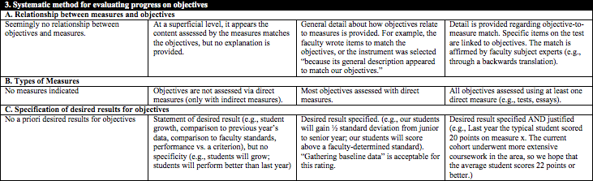
III. Evaluation/Assessment Methods
The BBA program in Computer Information Systems uses several methods for its assessment. This table summarizes the process involving these methods. More detail about the methodology follows the table.
 | Assessment Method | Corresponds to which objective(s) | Type of Measure | Data Collection | Expected Results
A | Assessment Day Test | 1 (programming) 2 (database) 3 (SAD) 4 (Architecture) 5 (Telecomm) | Direct | Examination of all junior and senior CIS majors on assessment day | Major revisions were done to this test this year. A preliminary analysis was done for this report. Results will be further analyzed over the summer and reported next year
B | Embedded assessment in CIS221 | 1 (programming) | Direct | Based upon final exams/Course embedded | 70% of students will be proficient based upon redesign of course in 2010 and additional hands-on activities in Spring 2012
C | Embedded assessment in CIS331 | 1 (programming) | Direct | Skills and concepts based upon quizzes. Development skills based upon programming assignments. Course embedded. | 70% of students will be proficient based upon changes made in Spring 2010.
D | Embedded assessment in CIS454 | 3 (Systems Analysis and Design) | Direct | Based upon all problem solving problems on the three exams | 70% of students will be proficient based upon changes in Fall 2011.
E | Embedded assessment in CIS301 | 4 (Architecture) | Direct | Based upon selected problems on the final exam | 70% of students will be proficient
F | Embedded assessment in CIS 320 | 5 (Telecomm) 6 (Interpersonal skills) | Direct | Based upon selected problems on the final exam. Based upon peer evaluations on a group project | 70% of students will be proficient based upon redesign in 2011-2012.
G | Writing rubric CIS 454 | 6 (Writing) | Direct | Random sample of students based upon 1 writing assignment. Course embedded. | 70% of students will be proficient based upon improvements in teaching writing throughout curriculum

Slide 42
Data Collection. All junior and senior CIS majors are required to take the test during a week of assessment. A query is done from the Student Information System to determine who is a junior or senior. All of these students are sent e-mails informing them that they are required to take the test or there will be a hold placed upon their records. The only students excused from the test are those who are classified as a junior but not officially accepted in to the COB and so not officially a CIS major (verified against their transcript,) students who change majors between the time of the query and the time of the test (verified by department,) or students who are away from the campus that semester, usually studying abroad.
This paragraph notes how students are being assessed. All graduating students are assessed so the results are representative of those students. (Element III D)

Slide 43
Reliability Calculations:
Cronbach’s alpha for all 60 questions on the Assessment exam calculated as .45.
For each of the areas, the Cronbach’s alpha was:
Architecture: 12 questions Cronbach’s alpha: .33
Database: 12 questions Cronbach’s alpha: .08
Programming language: 15 questions, Cronbach’s alpha: .23
Systems Analysis: 10 questions, Cronbach’s alpha .47
Telecommunications: 11 questions, Cronbach’s alpha .05
We will discuss these reliability estimates with CARS in the fall.
Cronbach’s alpha is an estimate of internal consistency reliability. (Element IIIE)
Reliability estimates greater than .60 are generally acceptable for program assessment.
Additional validity evidence would have strengthened this section.

Slide 44
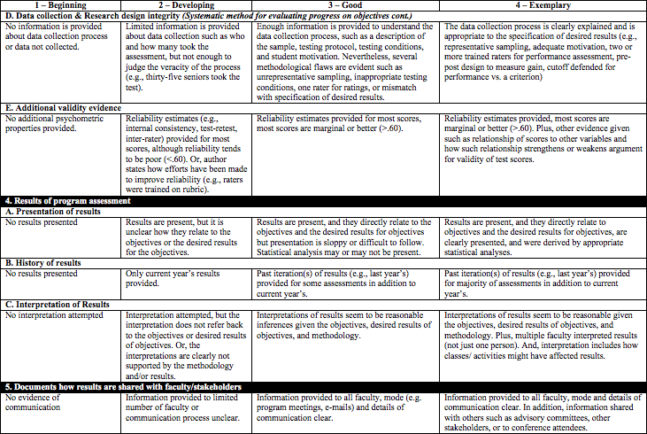
Data Collection. All junior and senior CIS majors are required to take the test during a week of assessment. A query is done from the Student Information System to determine who is a junior or senior. All of these students are sent e-mails informing them that they are required to take the test or there will be a hold placed upon their records. The only students excused from the test are those who are classified as a junior but not officially accepted in to the COB and so not officially a CIS major (verified against their transcript,) students who change majors between the time of the query and the time of the test (verified by department,) or students who are away from the campus that semester, usually studying abroad.
Reliability Calculations:
Cronbach’s alpha for all 60 questions on the Assessment exam calculated as .45.
For each of the areas, the Cronbach’s alpha was:
Architecture: 12 questions Cronbach’s alpha: .33
Database: 12 questions Cronbach’s alpha: .08
Programming language: 15 questions, Cronbach’s alpha: .23
Systems Analysis: 10 questions, Cronbach’s alpha .47
Telecommunications: 11 questions, Cronbach’s alpha .05
We will discuss these reliability estimates with CARS in the fall.

Slide 45
Objective | Juniors |  |  | Seniors |  |  | Juniors lower than senior
 | 2010 | 2011 | 2012 | 2010 | 2011 | 2012
Overall Score |  |  | 28.5 |  |  | 31.5 | Yes
Programming | 52 | 41 | 32.4 | 65 | 54 | 31.6 | No
Database | 42 | 41 | 26.7 | 66 | 58 | 25.9 | No
Systems Analysis | 43 | 46 | 38.0 | 56 | 55 | 49.3 | Yes
Architecture | -- | -- | 29.7 | -- | -- | 35.7 | Yes
Telecommunications | 32 | 34 | 15.2 | 50 | 43 | 16.9 | Yes
This table (and similar tables for each instrument) clearly link the results back to each objective. (Element IV A)
Interpretation of Assessment Day Test: Juniors versus Seniors. As expected, overall junior scores averaged lower than seniors. Systems Analysis which is a course taken in the senior year was significantly lower. The architecture class which is normally taken as Junior but is reinforced with senior level courses was also significantly lower.
Areas of concern are Programming and Database which are courses traditionally taken as a junior and had slightly higher scores for juniors indicating drop off of knowledge. This had not been true in the past.
Overall percentages were considerably lower than in past years. The questions were similar to prior years so the new format which was an online test and a longer test with less instructor supervision might have contributed to the lower scores. We need to take a look at this to see if we can determine what caused the drop. These results will be discussed with the CIS faculty in the fall.

Slide 46
Objective | Juniors |  |  | Seniors |  |  | Juniors lower than senior
 | 2010 | 2011 | 2012 | 2010 | 2011 | 2012
Overall Score |  |  | 28.5 |  |  | 31.5 | Yes
Programming | 52 | 41 | 32.4 | 65 | 54 | 31.6 | No
Database | 42 | 41 | 26.7 | 66 | 58 | 25.9 | No
Systems Analysis | 43 | 46 | 38.0 | 56 | 55 | 49.3 | Yes
Architecture | -- | -- | 29.7 | -- | -- | 35.7 | Yes
Telecommunications | 32 | 34 | 15.2 | 50 | 43 | 16.9 | Yes
This table (and similar tables for each instrument) also provide past iterations of results for multiple years. (Element IV B)
Interpretation of Assessment Day Test: Juniors versus Seniors. As expected, overall junior scores averaged lower than seniors. Systems Analysis which is a course taken in the senior year was significantly lower. The architecture class which is normally taken as Junior but is reinforced with senior level courses was also significantly lower.
Areas of concern are Programming and Database which are courses traditionally taken as a junior and had slightly higher scores for juniors indicating drop off of knowledge. This had not been true in the past.
Overall percentages were considerably lower than in past years. The questions were similar to prior years so the new format which was an online test and a longer test with less instructor supervision might have contributed to the lower scores. We need to take a look at this to see if we can determine what caused the drop. These results will be discussed with the CIS faculty in the fall.

Slide 47
Interpretation of Assessment Day Test: Juniors versus Seniors. As expected, overall junior scores averaged lower than seniors. Systems Analysis which is a course taken in the senior year was significantly lower. The architecture class which is normally taken as Junior but is reinforced with senior level courses was also significantly lower.
Areas of concern are Programming and Database which are courses traditionally taken as a junior and had slightly higher scores for juniors indicating drop off of knowledge. This had not been true in the past.
Overall percentages were considerably lower than in past years. The questions were similar to prior years so the new format which was an online test and a longer test with less instructor supervision might have contributed to the lower scores. We need to take a look at this to see if we can determine what caused the drop. These results will be discussed with the CIS faculty in the fall.
This section indicates that the program has interpreted the results of the assessment in the context of the curriculum. Areas of concern are identified. (Element IV C)

Slide 48
Objective | Juniors |  |  | Seniors |  |  | Juniors lower than senior
 | 2010 | 2011 | 2012 | 2010 | 2011 | 2012
Overall Score |  |  | 28.5 |  |  | 31.5 | Yes
Programming | 52 | 41 | 32.4 | 65 | 54 | 31.6 | No
Database | 42 | 41 | 26.7 | 66 | 58 | 25.9 | No
Systems Analysis | 43 | 46 | 38.0 | 56 | 55 | 49.3 | Yes
Architecture | -- | -- | 29.7 | -- | -- | 35.7 | Yes
Telecommunications | 32 | 34 | 15.2 | 50 | 43 | 16.9 | Yes
Interpretation of Assessment Day Test: Juniors versus Seniors. As expected, overall junior scores averaged lower than seniors. Systems Analysis which is a course taken in the senior year was significantly lower. The architecture class which is normally taken as Junior but is reinforced with senior level courses was also significantly lower.
Areas of concern are Programming and Database which are courses traditionally taken as a junior and had slightly higher scores for juniors indicating drop off of knowledge. This had not been true in the past.
Overall percentages were considerably lower than in past years. The questions were similar to prior years so the new format which was an online test and a longer test with less instructor supervision might have contributed to the lower scores. We need to take a look at this to see if we can determine what caused the drop. These results will be discussed with the CIS faculty in the fall.

Slide 49
V. Dissemination
This report is shared with the CIS faculty, the College of Business faculty, and the administration.
The CIS faculty meets regularly to discuss the results of assessment. All CIS faculty are invited to the meetings but those who teach in the area being assessed are the majority of the attendees. Minutes for all meetings are kept and posted in the CIS & MS faculty Blackboard site.
As noted in Section I, we are in the midst of a long-term redesign of objectives and assessment. This is a faculty-led initiative.
This section states that the report is shared with faculty. The dissemination method is clear (meetings/blackboard).
This section could be strengthened by disseminating results to other stakeholders such as students, advisory committees, or conference attendees. (Element V)

Slide 50
V. Dissemination
This report is shared with the CIS faculty, the College of Business faculty, and the administration.
The CIS faculty meets regularly to discuss the results of assessment. All CIS faculty are invited to the meetings but those who teach in the area being assessed are the majority of the attendees. Minutes for all meetings are kept and posted in the CIS & MS faculty Blackboard site.
As noted in Section I, we are in the midst of a long-term redesign of objectives and assessment. This is a faculty-led initiative.

Slide 51
VI. Uses of Evaluation/Assessment Results and Actions Taken
Some of the changes we have made in the past 3 years or plan in the next year are listed in the table.
This table communicates changes in the assessment process itself and to the program based on assessment data. The program has clearly given thoughtful consideration to both. These areas correspond to Elements VI A and VI B of the APT rubric.
Objective | Change in Curriculum | Date of change | Reason(s) for change
Assessment | Change in assessment exam | Spring 2012 | --It was becoming increasingly difficult to find a room big enough for all students in our major on Assessment day. --Having all students do the same exam made it easier to develop questions. --Having all questions on the same exam made it easier to do reliability calculations.
Assessment | Added assessment of CIS minor and embedded assessment of CIS 304, and CIS 484 | Fall 2010 – Spring 2011 | To provide more complete assessment of the program
Programming | Increase discussion of inheritance and polymorphism | Fall 2011 | Poor results on this topic in CIS 331 assessment
Programming | Change in CIS 331 to cover topics such as temp variables that students did not do well on in 2009 assessment | Spring 2010 | Poor results in these areas on 2009 assessment day exam
Systems Analysis and Design | Change in CIS 454 objectives. Provide students with a clearer link between course objectives and daily activities. | Fall 2011 | Objectives did not accurately reflect course as currently taught.
Systems Analysis and Design | Change in chapters for Sequence Diagram in CIS 454 | Fall 2009 | Assessment day exam consistently showed that students were having problems with Sequence Diagrams. We wrote a chapter to supplement the book coverage. The problem went away on the 2010 exam.
Particularly noteworthy are examples where changes were made to the program in past years and the assessment results improved thereafter. In other words, the CIS program provides evidence that changes faculty made to the program resulted in documented improvement.

Slide 52
Using Results to Improve Student Learning
1) Establish Objectives
6) Use Results to Improve Program
2) Map Objectives to Experiences
5) Report to Stakeholders
3) Select and/or Design Instruments
4) Collect and Analyze Data, Assess Fidelity
In general, institutions seem to be good at collecting data…
…but not so good at using the results to improve student learning.
Blaich, C., & Wise, K. (2011). From gathering to using assessment results: Lessons from the Wabash national study. Occasional Paper # 8. Champaign, IL: National Institute for Learning Outcomes Assessment.

Slide 53
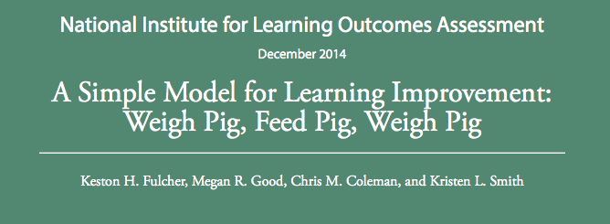

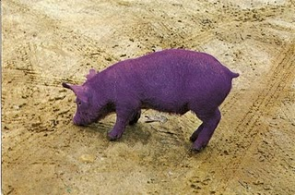


Learning Improvement

Slide 54
Misconceptions
Simply making a change is an improvement
2) Conducting assessment automatically leads to improved learning
+
=
?
=

Slide 55
Learning Improvement
1) Establish Objectives
6) Use Results to Improve Program
2) Map Objectives to Experiences
5) Report to Stakeholders
3) Select and/or Design Instruments
4) Collect and Analyze Data, Assess Fidelity
Criteria for achieving national model of learning improvement at JMU:
  Strong evidence, from direct measures, supporting substantive learning improvement due to program modifications.
  Program responds to previous assessment results
  Makes curricular and/or pedagogical modifications
  RE-assesses and finds that student learning improved.

Slide 56
Learning Improvement
1) Establish Objectives
6) Use Results to Improve Program
2) Map Objectives to Experiences
5) Report to Stakeholders
3) Select and/or Design Instruments
4) Collect and Analyze Data, Assess Fidelity
Criteria for achieving national model of learning improvement at JMU:
  The rationale and explanation of the modifications leading to the change are clearly laid out.
  The methodology is of sufficient strength that most reasonable alternative hypotheses can be ruled out (e.g., sampling concerns, validity issues with instrument or student motivation).
  In essence, the improvement interpretation can withstand reasonable critique from faculty, curriculum experts, assessment experts, and external stakeholders.

Slide 57
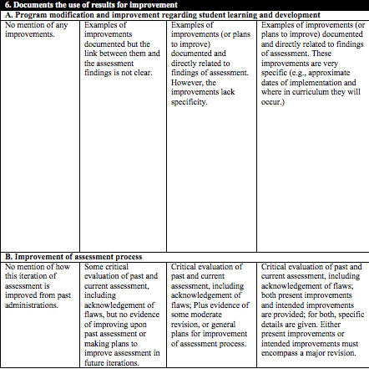
VI. Uses of evaluation/Assessment Results and Actions Taken
Some of the changes we have made in the past 3 years or plan in the next year are listed in the table.
Objective | Change in Curriculum | Date of change | Reason(s) for change
Assessment | Change in assessment exam | Spring 2012 | --It was becoming increasingly difficult to find a room big enough for all students in our major on Assessment day. --Having all students do the same exam made it easier to develop questions. --Having all questions on the same exam made it easier to do reliability calculations.
Assessment | Added assessment of CIS minor and embedded assessment of CIS 304, and CIS 484 | Fall 2010 – Spring 2011 | To provide more complete assessment of the program
Programming | Increase discussion of inheritance and polymorphism | Fall 2011 | Poor results on this topic in CIS 331 assessment
Programming | Change in CIS 331 to cover topics such as temp variables that students did not do well on in 2009 assessment | Spring 2010 | Poor results in these areas on 2009 assessment day exam
Systems Analysis and Design | Change in CIS 454 objectives. Provide students with a clearer link between course objectives and daily activities. | Fall 2011 | Objectives did not accurately reflect course as currently taught.
Systems Analysis and Design | Change in chapters for Sequence Diagram in CIS 454 | Fall 2009 | Assessment day exam consistently showed that students were having problems with Sequence Diagrams. We wrote a chapter to supplement the book coverage. The problem went away on the 2010 exam.

Slide 58
Providing Comments

Slide 59
Why Are Comments Important?
To provide formative feedback
  Programs should be able to use comments to improve their assessment process ← Primary goal
To explain/justify numerical ratings
  Comments should provide detail as to why the program obtained a specific score
To show that the APT has been carefully read/rated
  APTs are difficult and time-consuming to create. We want to respect the coordinators time by showing we carefully read each document
Notes:
Primary goal is to provide feedback that leads to improvements to the assessment process
Comment should provide explicit detail… enough that the program should understand why they obtained a specific score. Try to avoid comments that do not match with score (overly positive or negative)
APT is difficult and time consuming. Want to respect the coordinators time by showing that we carefully read each one of these documents.

Slide 60
Writing Comments
Two typical approaches
  Rate the APT on all 14 elements, then go back through and type in comments
  Comment on each element when going through APT
Comment on every element (can be brief)
  Typically, longer comments for areas that need improvement
Also provide an “overall” (15th) comment

Slide 61
Writing Comments
Both raters type in comments separately
Comments should be discussed each day
The lead rater consolidates the two sets
  Example: if the averaged rating is a 3.75, make sure there’s a negative comment included
Final comments will be QC’d later by PASS

Slide 62
Golden Rules
1. Use a professional, courteous tone
  Hint: avoid 2nd-person pronouns (e.g., you)
2. Frame feedback positively
  Nothing wrong with compliments!
  Can comment on positive aspects in conjunction with addressing flaws
3. Suggest, don’t prescribe
  “Consider adding validity information”, not “Add…”
4. Be specific
  Use illustrative examples; tie to rubric terms

Slide 63
1. Professional, Courteous Tone
Not ideal:
  You failed to describe your data collection design.
Better:
  Limited information found about the data collection process in the current report. This part of the report could be strengthened by the inclusion of more data collection details (e.g., testing conditions, attendance, motivation).

Slide 64
2. Positively-framed Feedback
Not ideal:
  No past results were provided.
Better:
  Good job clearly presenting the current year’s results. Could the results table be expanded to include data from past cohorts? The comparisons would be efficient/interesting. When multiple years of data are available, including them here will allow program faculty to see learning trends over time.

Slide 65
3. Specificity
Not ideal:
  Some of the objectives are poorly worded.
Better:
  Most objectives are clear and specific. A couple of them (e.g., #4 and #6) could be strengthened by changing the verb “understand” to something more active, like “summarize” or “explain.”
  Generally strong objectives. Objective #5 might be clearer if a few examples of the “fundamental concepts of astronomy” were added.

Slide 66
Example Comments
You failed to include adequate reliability or validity information for some of your measures.
  Bad comment
  Issues: accusatory (“you”); lacks specificity (which measures?); does not include suggestions for improvement (e.g., “contact PASS”)
There did not appear to be results presented for the program. Including results in tables can help identify patterns that may help improve program assessment.
  Good comment
  Strengths: “There did not appear to be” is a soft way of saying “You didn’t include this”; includes specific suggestions for how to improve; ties things back to improving assessment

Slide 67
Do…
Read the APTs carefully
Use positive, professional language
Give kudos where you can
Be specific in identifying flaws (examples!)
Provide helpful ideas for improvement

Slide 68
Try not to…
Use the phrase, “To get a higher score…”
Give too many (or unrealistic) suggestions for improvement; focus on next logical step
Forget to root your comments in rubric descriptors
Create a mismatch between numerical ratings and comments

Slide 69
“Overall” Comments
Brief summary: highlights, next logical steps
Give credit when programs point out their own weaknesses (e.g., We agree that it will be useful to estimate reliability in the future. In addition, PASS can suggest strategies for gathering validity evidence.)
Sandwich technique (+, -, +)
Finish with a general summary sentence

Slide 70
“Overall” Comments: Example
The program has a good foundation for assessment, especially in terms of student-learning objectives and faculty-developed direct measures. There are a few areas that could be strengthened with relative ease. Among these, the most important might be (1) increased detail about the data collection process (IIID), and (2) evidence of reliability and validity (IIIE). The PASS office provides consultation help in these and other areas. Overall, the program’s assessment process is coming along nicely!

Slide 71
APT Rating Example
2015-16 Independent Scholars program
Actual APT
Special thanks to Fletcher Linder, Assessment Coordinator of the IS program at James Madison University

Slide 72
The report clearly states what level of student is being assessed. This is a component of Element I. A.
Assessment Progress Template - Example: Independent Scholars
Student learning objectives
IS is designed to accommodate 10-15 students per year. Because of the relatively low number of majors, IS will track student learning as each student pursues her/his individual curriculum through graduation.
Graduating seniors in IS will demonstrate that they have
  developed topic-based interests and inquiry strategies to pursue those interests.
  enhanced creativity, self-directedness, and perseverance required for inquiry.
  learned research, technical, and communication skills relevant to their inquiry.
  situated their inquiry in relation to contemporary notions of disciplinary thinking.
  enhanced aptitude and confidence in working independently and collectively.
  applied knowledge and skills in experiential-learning settings.
This statement also indicates that the following learning objectives apply to students. Using student centered objectives is a component for Element IB.

Slide 73
Assessment Progress Template - Example: Independent Scholars
Student learning objectives
IS is designed to accommodate 10-15 students per year. Because of the relatively low number of majors, IS will track student learning as each student pursues her/his individual curriculum through graduation.
Graduating seniors in IS will demonstrate that they have
  developed topic-based interests and inquiry strategies to pursue those interests.
  enhanced creativity, self-directedness, and perseverance required for inquiry.
  learned research, technical, and communication skills relevant to their inquiry.
  situated their inquiry in relation to contemporary notions of disciplinary thinking.
  enhanced aptitude and confidence in working independently and collectively.
  applied knowledge and skills in experiential-learning settings.
These statements by themselves are more similar to goal statements than specific student learning objectives.
However, these statements are very helpful in supporting the SLOs on the next page

Slide 74
Assessment Progress Template - Example: Independent Scholars
Learning Outcome | How the Major Meets the Learning Outcomes
The ability to effectively communicate orally and in writing (89%). | writing the IS inquiry proposal writing and executing the IS curriculum plan IND 300 workshops | IS portfolio IS coursework IS senior project General Education, cluster 1
Critical thinking and analytical reasoning skills (81%). | writing the IS inquiry proposal writing and executing the IS curriculum plan IND 300 workshops | IS portfolio IS coursework IS senior project General Education, cluster 1
The ability to apply knowledge and skills to real-world settings through internships or other hands-on experiences (79%). | out-of-classroom experiential learning
The ability to analyze and solve complex problems (75%). | writing the IS inquiry proposal writing and executing the IS curriculum plan IS senior project
Teamwork skills and the ability to collaborate with others in diverse group settings (71%). | writing the IS inquiry proposal writing and executing the IS curriculum plan IND 300 workshops | work with IS coordinator & other faculty work with IS senior project committee internship
The ability to innovate and be creative (70%). | writing the IS inquiry proposal writing and executing the IS curriculum plan IS senior project
These statements provide specific and measureable SLOs.
It is especially helpful to the program that these SLOs are explicitly linked to what employers are asking for.
These objectives could be improvement by adding more rich detail about the content of each SLO

Slide 75
Learning Outcome | How the Major Meets the Learning Outcomes
The ability to effectively communicate orally and in writing (89%). | writing the IS inquiry proposal writing and executing the IS curriculum plan IND 300 workshops | IS portfolio IS coursework IS senior project General Education, cluster 1
Critical thinking and analytical reasoning skills (81%). | writing the IS inquiry proposal writing and executing the IS curriculum plan IND 300 workshops | IS portfolio IS coursework IS senior project General Education, cluster 1
The ability to apply knowledge and skills to real-world settings through internships or other hands-on experiences (79%). | out-of-classroom experiential learning
The ability to analyze and solve complex problems (75%). | writing the IS inquiry proposal writing and executing the IS curriculum plan IS senior project
Teamwork skills and the ability to collaborate with others in diverse group settings (71%). | writing the IS inquiry proposal writing and executing the IS curriculum plan IND 300 workshops | work with IS coordinator & other faculty work with IS senior project committee internship
The ability to innovate and be creative (70%). | writing the IS inquiry proposal writing and executing the IS curriculum plan IS senior project

Slide 76
The curriculum map below links IS learning objectives to IS learning experiences. The number of checks in each cell indicates the estimated relative importance of each learning experience. No checks indicate almost no contribution, one check indicates a modest contribution, two checks indicate a moderate contribution, and three checks indicate a substantial contribution.
 |  | Learning Experiences
 |  | IND 200 | IND 300 workshops | IS curricula | IS portfolio | Internships, study away/abroad, field experiences | IS senior project
IS Learning Objectives | develop topic- based interests and inquiry strategies to pursue those interests | ✔✔✔ | ✔✔ | ✔✔✔ | ✔ |  | ✔✔✔
 | enhance creativity, self-directedness, and perseverance required for inquiry | ✔✔✔ | ✔✔ | ✔✔✔ | ✔✔ | ✔ | ✔✔✔
 | learn research, technical, and communication skills relevant to inquiry | ✔✔ | ✔✔✔ | ✔✔✔ | ✔✔ | ✔ | ✔✔✔
 | situate inquiry in relation to contemporary notions of disciplinary thinking | ✔✔ | ✔ | ✔✔ | ✔ |  | ✔✔✔
 | enhance aptitude and confidence in working independently and collectively | ✔✔ | ✔ | ✔✔ | ✔ | ✔✔ | ✔✔✔
This chart shows what courses map to which objectives. In addition, the chart also indicates the degree to which the objectives are covered in each course.
Including the degree of alignment between the student learning outcomes corresponds to Element II of rubric.

Slide 77
 |  | Learning Experiences
 |  | IND 200 | IND 300 workshops | IS curricula | IS portfolio | Internships, study away/abroad, field experiences | IS senior project
IS Learning Objectives | develop topic- based interests and inquiry strategies to pursue those interests | ✔✔✔ | ✔✔ | ✔✔✔ | ✔ |  | ✔✔✔
 | enhance creativity, self-directedness, and perseverance required for inquiry | ✔✔✔ | ✔✔ | ✔✔✔ | ✔✔ | ✔ | ✔✔✔
 | learn research, technical, and communication skills relevant to inquiry | ✔✔ | ✔✔✔ | ✔✔✔ | ✔✔ | ✔ | ✔✔✔
 | situate inquiry in relation to contemporary notions of disciplinary thinking | ✔✔ | ✔ | ✔✔ | ✔ |  | ✔✔✔
 | enhance aptitude and confidence in working independently and collectively | ✔✔ | ✔ | ✔✔ | ✔ | ✔✔ | ✔✔✔

Slide 78
Systematic method for evaluating progress on objectives.
To capture growth over time, and across all learning objectives, we will use a repeated measures design using direct measures of student KSAs. We will have two primary assessment points for all of the learning outcomes, one when students complete IND 200 (All Objectives Assessment Time 1), and one when students complete the senior project (All Objectives Assessment Time 2). Here we see that the senior project serves as both a learning experience and a student-generated “end product” to be assessed. The instrument to be used in future All Objectives Assessment Times 1 & 2 will be a rubric applied to student inquiry proposals/curriculum plan (at Time 1) and applied again to student senior projects (at Time 2). The rubric is under development, a beginning outline of which is below.
The rubric will be used by multiple raters (probably three IS faculty) at Times 1 and 2, and will follow a process involving individual raters rating each student’s work, followed by a group meeting of the raters to adjudicate discrepancies in rating scores. The relative low number IS students will make the assessment process feasible.
This section details the data collection process. (element IIID)
 |  | 1-Beginning | 2-Developing | 3-Good | 4-Exemplary
IS Learning Objectives | develop topic- based interests and inquiry strategies to pursue those interests
 | enhance creativity, self- directedness, and perseverance required for inquiry
 | learn research, technical, and communication skills relevant to inquiry
 | situate inquiry in relation to contemporary notions of disciplinary thinking
 | enhance aptitude and confidence in working independently and collectively

Slide 79
 |  | 1-Beginning | 2-Developing | 3-Good | 4-Exemplary
IS Learning Objectives | develop topic- based interests and inquiry strategies to pursue those interests
 | enhance creativity, self- directedness, and perseverance required for inquiry
 | learn research, technical, and communication skills relevant to inquiry
 | situate inquiry in relation to contemporary notions of disciplinary thinking
 | enhance aptitude and confidence in working independently and collectively
This table is a draft of a rubric that will be used for IS program assessment.
This assessment instrument is clearly linked to objectives and represents a direct assessment of Student Learning.
(Elements IIIA and IIIB)
The rubric will be improved by adding behavioral anchors to define the statements of proficiency along the horizontal axis

Slide 80
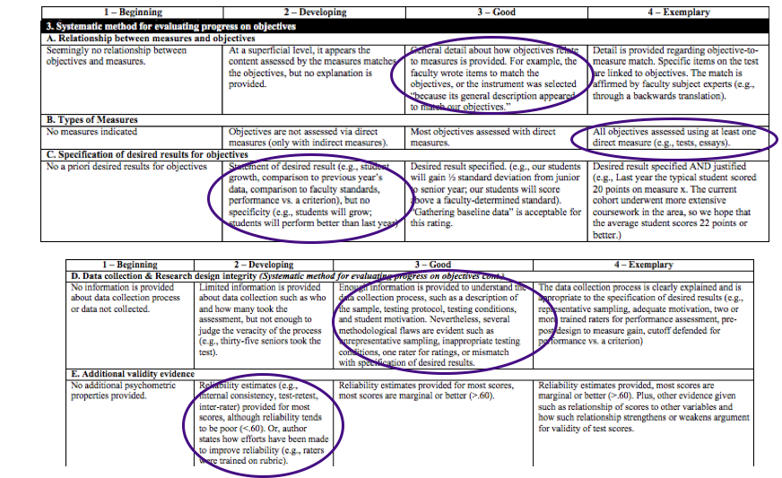

Slide 81
It is clear from this statement that only baseline data are available.
The link between the results and the objectives is not clear and would strengthen future assessment processes. (Element IVA)
At the end of the IND 200 course in fall 2015, IS coordinators/IND 200 instructors (Chamberlin, Frana, Linder) evaluated the four student inquiry project proposals and curriculum plans. IND instructors determined at the beginning of the fall 2015 IND 200 course that they would provide only minimal guidance to students regarding the structure required of inquiry project proposals/curriculum plans, opting to see what the students themselves could came up with. The minimal guidance from faculty included a clear statement of purpose and rationale regarding the proposed inquiry project, a brief review of relevant literature, a curriculum plan complete with rationale, and a GANTT chart to map out how the inquiry project and curriculum would be completed in the student’s time at JMU.
While all four students’ proposals demonstrated an acceptable level of development to allow each of them to continue on in the major, the proposals could have been strengthened by more structure provided by faculty. Detailed comments on each of the proposals was provided to students.
Because this is the first year collecting data, no history of results is available.
(Element IVB)
A brief interpretation of the baseline results is attempted. A more in depth interpretation of future results will help with program improvement.
(Element IVC)

Slide 82
At the end of the IND 200 course in fall 2015, IS coordinators/IND 200 instructors (Chamberlin, Frana, Linder) evaluated the four student inquiry project proposals and curriculum plans. IND instructors determined at the beginning of the fall 2015 IND 200 course that they would provide only minimal guidance to students regarding the structure required of inquiry project proposals/curriculum plans, opting to see what the students themselves could came up with. The minimal guidance from faculty included a clear statement of purpose and rationale regarding the proposed inquiry project, a brief review of relevant literature, a curriculum plan complete with rationale, and a GANTT chart to map out how the inquiry project and curriculum would be completed in the student’s time at JMU.
While all four students’ proposals demonstrated an acceptable level of development to allow each of them to continue on in the major, the proposals could have been strengthened by more structure provided by faculty. Detailed comments on each of the proposals was provided to students.

Slide 83
On January 26, 2016, IND 200 instructors shared the four student proposals and curriculum plans with a faculty advisory committee consisting of Brad Newcomer (honors & physics), H Gelfand (history), Erica Cavanah (English), and Mikaela Schmitt- Harsh (IdLS & biology). Based on evaluations of and recommendations from IND 200 instructors, the faculty advisory committee agreed to allow all four students to pursue the Independent Scholars major.
These assessments were also shared with Linda Halpern (Vice Provost of University Programs) on January 27, 2016, as part of the normal administrative oversight.
This section states that the report was shared with faculty and administration.
However, the dissemination method is not clear (meetings/blackboard/email, etc.)
This section could be strengthened by disseminating results to other stakeholders such as students, advisory committees, or conference attendees. (Element V)

Slide 84
On January 26, 2016, IND 200 instructors shared the four student proposals and curriculum plans with a faculty advisory committee consisting of Brad Newcomer (honors & physics), H Gelfand (history), Erica Cavanah (English), and Mikaela Schmitt- Harsh (IdLS & biology). Based on evaluations of and recommendations from IND 200 instructors, the faculty advisory committee agreed to allow all four students to pursue the Independent Scholars major.
These assessments were also shared with Linda Halpern (Vice Provost of University Programs) on January 27, 2016, as part of the normal administrative oversight.

Slide 85
As a result of the IND 200 proposal assessment process described in point 4, above, the following requirements have been developed for IND 200 inquiry project proposals & curriculum plan.
part 1: Summary of the inquiry project plan
  (see full report)
part 2: Curriculum
  (see full report)
part 3: Independent work/research
  (see full report)
part 4: Reflection and assessment
  (see full report)
Improvements to the program are noted.
However, it is unclear they explicitly link to the assessment results
Critical evaluation of the prior implementation of assessment in the IND 200 class and plans to improve the assessment process noted
More detail about proposed changes would make this area stronger
Beginning fall 2016, students in IND 200 will submit inquiry proposals following the outline above and students will present and defend the proposals to IS instructors and the faculty advisory committee before the course ends in December. This schedule represents a improvement from the first time IND 200 was taught in fall 2015 and moves forward the evaluation process required for students to continue in the IS major.

Slide 86
As a result of the IND 200 proposal assessment process described in point 4, above, the following requirements have been developed for IND 200 inquiry project proposals & curriculum plan.
part 1: Summary of the inquiry project plan
  (see full report)
part 2: Curriculum
  (see full report)
part 3: Independent work/research
  (see full report)
part 4: Reflection and assessment
  (see full report)
Beginning fall 2016, students in IND 200 will submit inquiry proposals following the outline above and students will present and defend the proposals to IS instructors and the faculty advisory committee before the course ends in December. This schedule represents a improvement from the first time IND 200 was taught in fall 2015 and moves forward the evaluation process required for students to continue in the IS major.

Slide 87
Practice Writing Comments

Slide 88
Example Comments: Independent Scholars
I.A. Student-centered learning objectives - Clarity and Specificity
Nice job specifying who will be assessed and detailing the content and skills related to each objective! Great level of detail and research supporting the development of the IS student-learning objectives.

Slide 89
Example Comments: Independent Scholars
II. Course/learning experiences that are mapped to objectives
Nicely done - all objectives have learning experiences mapped to them. The information regarding coverage is extremely helpful in determining that all objectives are addressed in multiple learning experiences!

Slide 90
Example Comments: Independent Scholars
III.D. Data collection & Research design integrity
Nice specification of data collection procedures. As mentioned in the report, comparison of pre/posttest scores on the Objective Assessment at times 1 and 2 should be beneficial to accurately assess the related objectives from a cohort perspective, but also to provide feedback at an individual level. In addition, the plan to use multiple raters will be helpful when the time comes to collect overall reliability of the ratings. This section may be improved by tying desired results back to the data collection procedures.

Slide 91
Example Comments: Independent Scholars
IV.C. Interpretation of results
Baseline data are still being collected, though a brief interpretation of results is present. This area could be stronger through in-depth analysis of results with regard to the objectives. What inferences about student learning can be made based on the results? Additionally, referring interpretations back to specific objectives will improve this section.

Slide 92
Example Comments: Independent Scholars
VI.A. Improvement of programs regarding student learning and development
Improvements are documented; however, the link between assessment results and those improvements is not entirely clear. To strengthen this area, explicitly describe how specific assessment findings relate directly to the program's intended improvements.

Slide 93
Example Comments: Independent Scholars
VI.B. Improvement of assessment process
Assessment process critically evaluated. Specific plans to improve different parts of the IND 200 inquiry project proposals have been developed, and intentional revisions to improve the assessment process were documented. Greater detail would make this area even stronger.

Slide 94
Agenda: Opportunity to Meet Objectives
Rationale for assessment evaluation rubric
Assessment process (the six-step cycle)
Assessment evaluation rubric
Apply the rubric to an academic program assessment report
Logistics
Conclusions

Slide 95
Logistics
How does JMU use this rubric?
  JMU has approximately 120 academic programs, and each academic program submits an assessment report
  Graduate students, faculty, and staff from across campus rate these reports (14-20 total raters)
    Two full days of training
      Half-day on uses of assessment, assessment cycle, “Assessment 101”-type material
      One and a half days on calibration to the rubric

Slide 96
Logistics
What happens after the training?
  Raters rate in pairs: Independently, then adjudicate
  Approximately 6 days total to complete
  Rigorous quality control process to ensure:
    Comments provide diagnostic feedback
    Scores are consistent and valid

Slide 97
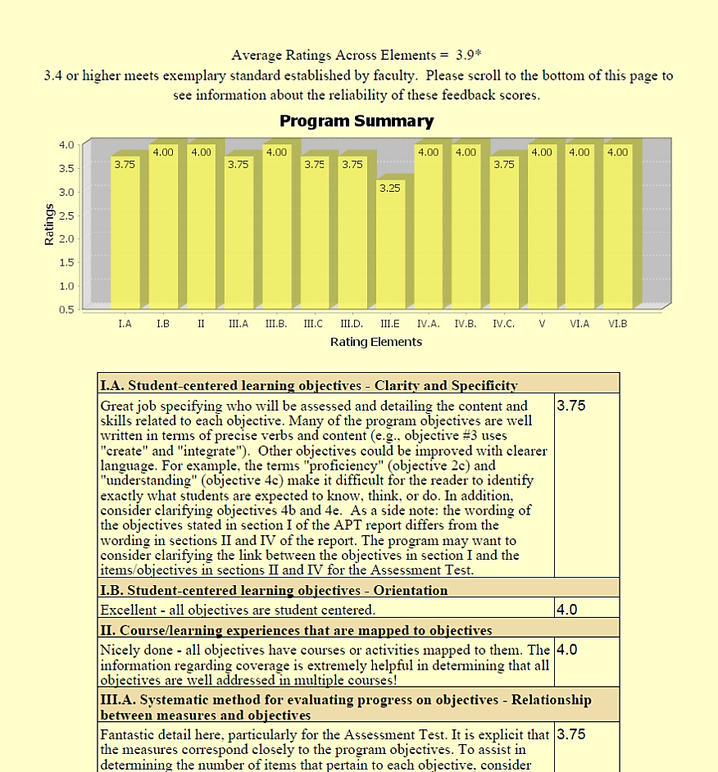
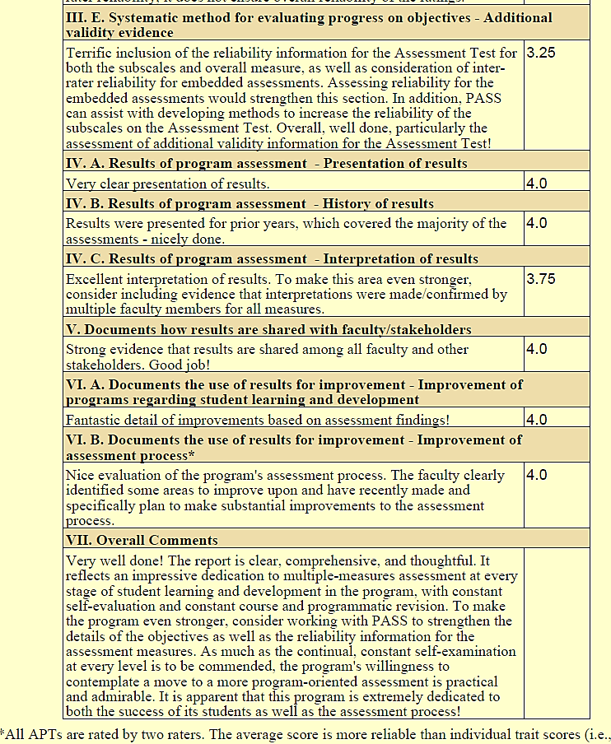
Logistics
Example feedback report of CIS program (2013-2014)

Slide 98
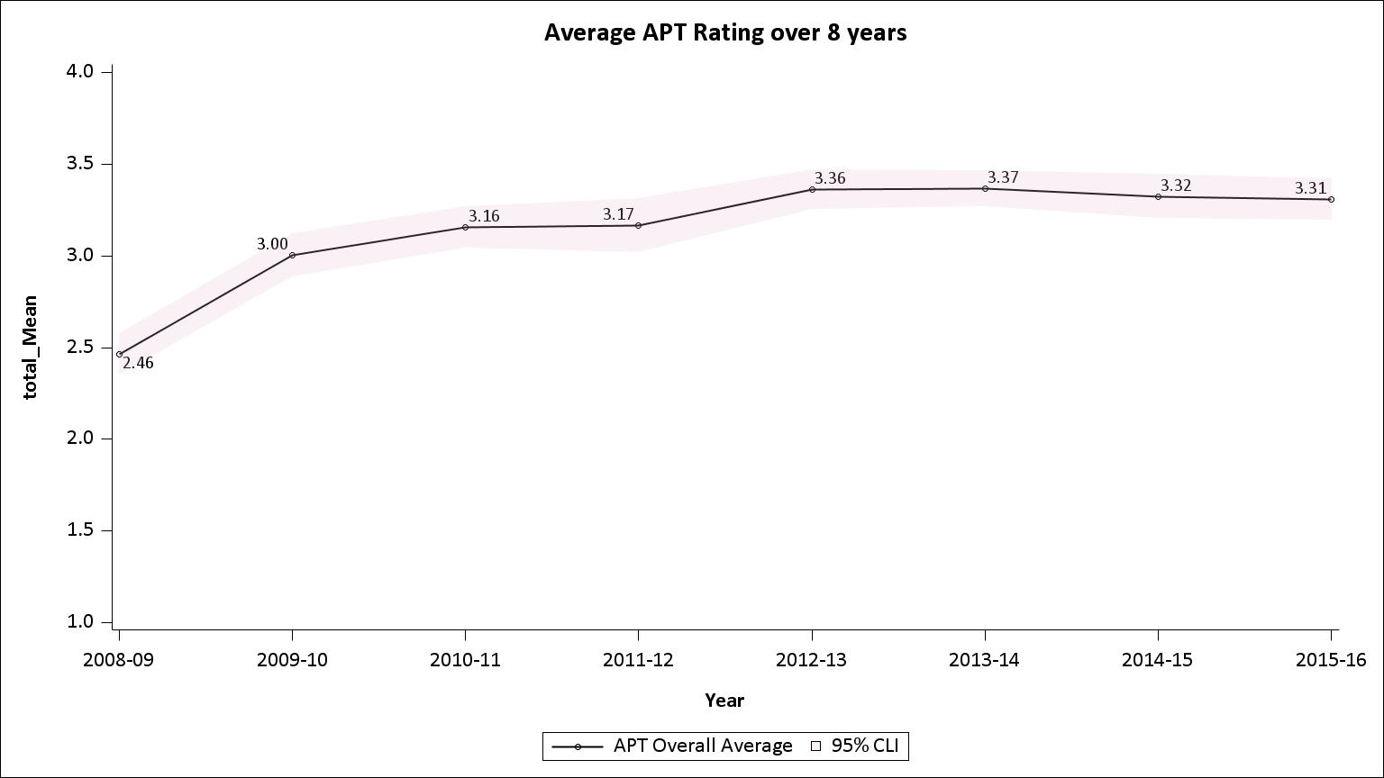
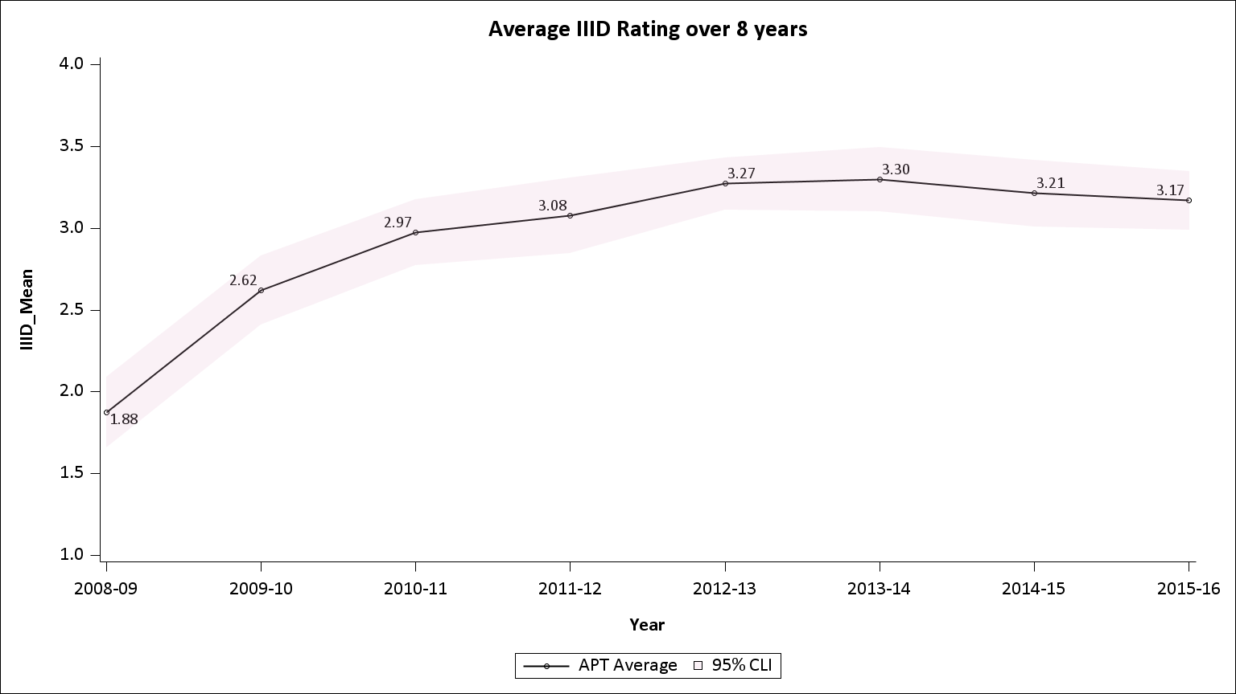
Logistics
Do we have evidence that the feedback is being used, and used in a way such that assessment plans are improving?
On average, scores have increased significantly since this process began in 2008/2009.
Individual elements have shown even more change – for example, IIId (data collection design and integrity) has shown considerable improvement.

Slide 99
Overview
Rationale for assessment evaluation rubric
Assessment process (the six-step cycle)
Assessment evaluation rubric
Apply the rubric to an academic program assessment report
Logistics
Conclusions

Slide 100
Conclusions
As a result of this workshop, participants will be able to:
  Describe a general, six-step assessment model
  Navigate JMU’s meta-assessment rubric
  Practice using JMU’s meta-assessment rubric to evaluate a real academic program assessment report
  Provide feedback to your home institution about meta-assessment of this six-step cycle

Slide 101
Conclusions
Want more information?
Visit JMU and CARS’ assessment website:
http://www.jmu.edu/assessment/Visitor/AssessmentResources.shtml#APT
Contact Program Assessment Support Services (PASS): programassessment@jmu.edu

Slide 102


Thank you for your time and attention.

