Slide 1
The following materials were prepared for use by CARS and SASS consultants.
James Madison University

Slide 2
Implementation Fidelity
What?
Why?
How?
Sara Finney, PhD
Associate Assessment Specialist &
Associate Professor of Graduate Psychology
Jerusha Gerstner, MA
Assessment Consultant
James Madison University

Slide 3
Overview of Workshop
What is Implementation Fidelity?
Why is it Important to Assess?
How is it Assessed?

Slide 4
Objectives for the Workshop
By the end of the workshop, attendees will know or be able to do the following:
  EXPLAIN implementation fidelity and its importance to evaluating program effectiveness
  DESCRIBE how to practically implement program fidelity assessment
  DEVELOP an implementation fidelity checklist
  DESCRIBE how to use program fidelity assessment results to make informed changes to programming

Slide 5
Making Evidence-Based Decisions
We strive for educational and innovation excellence
  Innovations (new programming, curriculum, instructional strategies, interventions) are adopted to improve (student) performance.
  Practitioners, instructors, and researchers must determine if the anticipated benefits (increased performance) occur and if they can be attributed to the new (and sometimes costly) intervention.
  The intent of assessment or effectiveness studies is to investigate if changes in the outcome (performance) are a result of the intervention (new program, curriculum, programming).
  Failure to assess the effectiveness of interventions can contribute to the use of ineffective programming, curriculum, or strategies or the termination of effective programming, curriculum, or strategies.

Slide 6
Standard Assessment Cycle
This same cycle applies to assessing a “program”, “intervention”, “curriculum”, “treatment”,
“workshop”,
“innovation” or
“course” of any length or strength.
-It’s a process of evaluating if “what” you developed results in the intended outcomes.
-The “what” can be a variety of things.
-We use generic words “program” or “intervention.”
Establishing Program Outcomes
Creating & Mapping Programming to Outcomes
Selecting/
Designing Instrument
Collecting
Outcomes Information
Analyzing/
Maintaining Information
Using Information

Slide 7
Incorporating Implementation Fidelity to the Assessment Cycle
Establishing Program Outcomes
Creating & Mapping Programming to Outcomes
Selecting/
Designing Instrument
Collecting Information
Analyzing/
Maintaining Information
Using Information
Implementation Fidelity

Slide 8
What is Implementation Fidelity?

Slide 9
What is Implementation Fidelity?
“The bridge between a promising idea and the impact on students is implementation, but innovations are seldom implemented as intended” (Berman and McLaughlin, 1976, p. 349).

Slide 10
What is Implementation Fidelity?
When developing an intervention or program, a great deal of attention is given to:
  Designing the intervention (e.g., curriculum, programming, strategies)
  Training those who will implement the intervention (e.g., instructors, practitioners, interventionists). That is, the intervention procedures, curriculum, and/or guidelines must be well-specified and understood by teachers or program implementers.
However, rarely is the alignment of the planned intervention and the implemented intervention assessed.

Slide 11
What is Implementation Fidelity?
“an assessment of the degree to which group leaders deliver the intervention completely and according to protocol” (Breitenstein et al., 2010)
“determination of how well a program is being implemented in comparison with the original program design during an efficacy and/or effectiveness study” (O’Donnell, 2008)
“the extent to which participants (e.g., teachers) deliver the intended innovation and whether other participants (e.g., students) accept or receive or are responsive to the intended services, at the intended level of treatment strength (Hulleman & Cordray, 2009)

Slide 12
What is Implementation Fidelity?
Also called…
  Treatment Integrity in behavioral consultation
    “Treatment Integrity reflects the accuracy and consistency with which each component of the treatment is implemented” (Lane et al., 2004, p. 37).

Slide 13
What is Implementation Fidelity?
Also called…
  Treatment Integrity in behavioral consultation
  Opportunity to Learn (OTL) in K-12 education
    Winfield (1987) notes that OTL relates to "the provision of adequate and timely instruction of specific content and skills prior to taking a test" (p. 438). She adds that OTL may be measured by "time spent in reviewing, practicing, or applying a particular concept or by the amount and depth of content covered with particular groups of students" (p. 439).
    When students are tested, evidence must be provided that students had adequate opportunity to learn the material on which they are being tested.
    "It is immoral to begin by measuring outcomes before we have seriously engaged the equitable and sufficient distribution of inputs--that is, opportunities and resources essential to the development of intellect and competence" (Gordon 1992, p. 2).

Slide 14
What is Implementation Fidelity?
Also called…
  Treatment Integrity in behavioral consultation
  Opportunity to Learn (OTL) in K-12 education
  Manipulation Fidelity/Check in experimental research
    “If interventions or experimental manipulations were used, provide evidence on whether they were delivered as intended. In basic experimental research, this might be the results of checks on the manipulation. In applied research, this might be, for example, records and observations of intervention delivery sessions and attendance records” (APA manual version 6, p. 35)

Slide 15
Assumption about “Planned” Intervention
Planned Intervention
Outcome
Outcome Measure
Notes:
Sara
-Drug example
-Weight example coupled with info-merial.
Intervention: hope implemented & theoretical intervention matches outcomes.
This allows us to look at what was planned

Slide 16
“Actual” Intervention is a “Black Box”
Actual Intervention/Program/Curriculum
Actual
Intervention
Outcome
Outcome Measure
Notes:
Sara
-Drug example
-Weight example coupled with info-merial.
Intervention: hope implemented & theoretical intervention matches outcomes.
This allows us to look at what was planned

Slide 17
Open the “Black Box”
Actual
Intervention
Outcome
Outcome Measure
Fidelity Measures
Implementation Fidelity Assessment can open the “black box”
Notes:
Create fidelity measures to operationalize program just as outcome measures operationalize the intended outcome/objective

Slide 18
“Planned” Drug Intervention
Planned Intervention
(4 drugs per day
for 2 months)
Outcome
(Eliminate Presence of Disease)
Outcome Measure
(Blood Test)
Notes:
Sara
-Drug example
-Weight example coupled with info-merial.
Intervention: hope implemented & theoretical intervention matches outcomes.
This allows us to look at what was planned

Slide 19
“Actual” Drug Intervention is “Black Box”
Actual
Intervention
Outcome
(Eliminate Presence of Disease)
Outcome Measure
(Blood Test)
If patient tests positive for disease, does that mean the planned intervention (drug treatment) is ineffective?

Slide 20
Measure Actual Drug Treatment Employed
Actual Intervention
Outcome
(Eliminate Presence of Disease)
Outcome Measure
(Blood Test)
Fidelity Measures
(e.g., record # of drugs for # of days)
Implementation Fidelity Assessment can open intervention "black box”

Slide 21
“Planned” Physical Fitness Program
Planned Program
(Exercise & diet regimes)
Outcome
(Become more physically fit)
Outcome Measures
(Weight; measurements; stamina; pictures)

Slide 22
“Actual” Fitness Program is “Black Box”
Actual
Program
Outcome
(Become more physically fit)
Outcome Measures
(Weight; measurements; stamina; pictures)
If person doesn’t lose weight, change in measurements or stamina, and pictures look the same as prior to the program, does that mean the planned fitness program is ineffective?

Slide 23
Measure Actual Fitness Program Employed
Actual Intervention
Outcome
(Become more physically fit)
Outcome Measures
(Weight; measurements; stamina; pictures)
Fidelity Measures
(e.g., record food intake and exercise)
Implementation Fidelity Assessment can open program "black box”

Slide 24
“Planned” Independent Variable Manipulation
Planned IV Manipulation
(manipulate mood to be either good or bad by showing movies, reading stories, etc.)
Outcome
(Performance)
Outcome Measure
(# of puzzles solved)

Slide 25
“Actual” Mood is “Black Box”
Actual
Level of IV
(Mood)
Outcome
(Performance)
Outcome Measure
(# of puzzles solved)
If participants in “bad” mood don’t solve fewer puzzles than participants in “good” mood, does that mean mood doesn’t affect performance?

Slide 26
Measure Actual Mood
Actual Level of IV
(mood)
Outcome
(Performance)
Outcome Measure
(# of puzzled solved)
Manipulation Fidelity
(assess mood in addition to recording if participants watched movie and read stories)
Manipulation Fidelity Assessment can open IV "black box”

Slide 27
“Planned” Curriculum
Planned Curriculum
(Assigned Readings XX and XX; Lectures 1-3; In-class activity that distinguishes between ANOVA and MANOVA)
Outcome
(Accurately compare and contrast ANOVA and MANOVA)
Outcome Measure
(Essay detailing similarities & differences between ANOVA &MANOVA; appropriate selection of technique on midterm)

Slide 28
“Actual” Delivered Curriculum is “Black Box”
Actual
Curriculum
Outcome
(Accurately compare and contrast ANOVA and MANOVA)
Outcome Measure
(Essay detailing similarities & differences between ANOVA & MANOVA; appropriate selection of technique on midterm)
If students can’t compare/contrast the two techniques, does that mean the planned curriculum is ineffective?

Slide 29
Measure Actual Curriculum Delivered
Actual Curriculum
Outcome
(Accurately compare and contrast ANOVA and MANOVA)
Outcome Measure
(Essay detailing similarities & differences between ANOVA & MANOVA; appropriate selection of technique on midterm)
Fidelity Measures
(e.g., record curriculum & activities actually completed)
Implementation Fidelity Assessment can open the curriculum "black box” (i.e., make the delivered curriculum more transparent). Did students have the OTL the material?

Slide 30
Why is Fidelity Important to Assess?

Slide 31
Why is Fidelity Assessment Important?
Implementation fidelity data help answer “Why” program outcomes are not being observed.
Common (not necessarily well-supported) answers to “Why?”
  Poor Measurement
    “Maybe the measure we developed is of low quality”
    “Maybe the measure we selected isn’t well aligned with the outcomes”
    Both of these “maybe’s” can be evaluated prior to evaluating program effectiveness, thus these “maybe’s” should already be ruled out.
  Programming simply doesn’t “work” & should be replaced
Another possible hypothesis, which is often overlooked and not assessed, is the planned program wasn’t implemented
  If programming intended to facilitate meeting program outcomes is not implemented as planned, the outcome measures reveal nothing about the efficacy of the planned program; the planned program was not actually administered, thus it wasn’t assessed

Slide 32
Why is Fidelity Assessment Important?
Research has shown that effective programs implemented with high fidelity result in better outcomes (e.g., Hagermoser Sanetti & Kratochwill, 2008).
  That is, low levels of implementation fidelity can make an effective program appear less effective or less efficient.
The combination of low implementation fidelity and the lack of its assessment can result in practitioners changing or terminating a program that would be effective if implemented as planned
As a scientific community, we should require implementation fidelity data in order to make valid inferences about program effectiveness.
  Drug treatment studies must document if the patients received the “planned” treatment before making claims about drug effectiveness.
  Journal editors and reviewers often request information pertaining to “manipulation checks” before allowing authors to make claims about cause (i.e., intervention) and effect (i.e., the outcome) relationships.
  Educators, the government, and parents of K-12 students want to know if students had the OTL course material before interpreting student test scores and making inferences about student ability or planned curriculum quality.

Slide 33
The POWER of Coupling Fidelity & Outcomes Data (1)
Realities | Fidelity Assessment Results | Outcomes Assessment Results | Conclusions without Fidelity | Conclusions with Fidelity
1 | High (+) | Good (+) | Program looks great! | Program may be effective.
2 | Low (-) | Poor (-) | Program is not working. | No conclusions can be made about the planned program.
3 | High (+) | Poor (-) | Program is not working. | Program is ineffective in meeting outcomes.
4 | Low (-) | Good (+) | Program looks great! | No conclusions can be made about the planned program.

Slide 34
The POWER of Coupling Fidelity & Outcomes Data (2)
Fidelity Results | Outcomes Results | Conclusions that can be made
High (+) | Good (+) | The program was implemented as planned and the outcomes were met, thus the program may be effective. That is, the program may be contributing to meeting the intended outcomes. Good news!
Low (-) | Poor (-) | No claims can be made about the planned program, because the planned program was not implemented. Moreover, the intended outcomes were not observed. A new study should be conducted with increased implementation fidelity to assess the effectiveness of the planned program. Do not claim the planned program was ineffective.
High (+) | Poor (-) | The program was implemented as planned, but the intended outcomes were not observed. Thus, low implementation fidelity can be ruled out as the reason for poor outcomes. Outcome assessment results should contribute to informed changes to the planned program by stakeholders.
Low (-) | Good (+) | The program was not implemented as planned. Thus, the planned program cannot be credited with contributing to students meeting the outcomes. One should not claim the planned program was effective.

Slide 35
Summary and Meta-cognitive Check
Establishing Objectives
Creating & Mapping Programming to Objectives
Selecting/
Designing Instrument
Collecting Information
Analyzing/
Maintaining Information
Using Information
Implementation Fidelity
What is implementation fidelity?
Why is implementation fidelity important?

Slide 36
How is Implementation Fidelity Assessed?

Slide 37
How Do We Assess Fidelity?
After reviewing and integrating the literature, implementation fidelity can be viewed as the following 5 components, each of which will be described in turn:
  Program Differentiation
  Adherence
  Quality
  Exposure
  Responsiveness

Slide 38
Program Differentiation
“identifies the unique features of different components or programs that are reliably differentiated from one another” (Mihalic, 2002, p. 1)
Involves stakeholders detailing significant features of each program component:
  What are the specific features associated with each program component? What is covered or presented in the programming mapped to each objective? What are students “doing” to help them meet the objective?
Essential for assessing other fidelity components
This process is extremely important for making the program “crystal clear” to all those involved.
  Avoid: “Oh, when you said engage students in an exercise regime to facilitate the outcome of weight loss, I thought you meant…..”

Slide 39
Adherence
“The extent to which specified program components were delivered as prescribed in program manuals”
(Dane & Schneider, 1998, p. 45)
Were all the specific features of the program that you laid out during program differentiation actually implemented?
  Did students have an opportunity to learn (OTL)?
Assessment of Adherence
  Create a list of the program features and simply indicate whether or not they were implemented (“yes” or “no”)

Slide 40
Quality
“A measure of qualitative aspects of program delivery that are not directly related to the implementation of prescribed content, such as implementer enthusiasm, leader preparedness, global estimates of session effectiveness, and leader attitudes toward program.” (Dane & Schneider, 1998, p. 45)
How well were the program components administered?
Assessment of Quality
  For those specific features that were implemented (adherence was “yes”), rate the quality of implementation (e.g., organized, engaging, clear, confusing, too fast, awkward)

Slide 41
Exposure
“An index that may include any of the following: (a) the number of sessions implemented; (b) the length of each session; or (c) the frequency with which program techniques were implemented.” (Dane & Schneider, 1998, p. 45)
Although the program intends for all students to receive a full dose of each feature, exposure measures the duration of each program component in actuality and how many students actually attend the various components.
Assessment of Exposure
  Record actual duration of program component
    Amount of the program students are exposed to
  Record attendance at events
    Amount of students exposed to the program

Slide 42
Responsiveness
“A measure of participant response to program sessions, which may include indicators such as levels of participation and enthusiasm.” (Dane & Schneider, 1998, p. 45)
Engagement of participants during the program
Assessment of Responsiveness
  Observe participants’ responsiveness during programming
  Self-report of responsiveness from students

Slide 43
Generic Implementation Fidelity Checklist
Student Learning or Development Objectives | Program Component | Duration of Program Component | Program Features | Adherence to Program Features (Y/N) | Quality
Objective 1 | General program component aligned with objective 1 | Length of the general component | Bulleted list of specific program features | For each specific feature a Y or N would be recorded here | For each specific feature, a quality rating would be recorded here.

Slide 44
Completing the Fidelity Checklist
What is rated?
Who does the rating?
The “live” program
Videotape of the program
Program materials (e.g., curriculum maps, PowerPoint slides, instructions for a group activity) for Adherence
We believe these fall in rank order of validity
Independent auditors of the program
Implementers or facilitators of the program
Participants of the program
Collect from all if possible

Slide 45
Example: Transfer Student Orientation Fidelity Assessment

Slide 46

Auditing Transfer Student Orientation
Pretended to be students and attended all aspects of programming
Implementers rated their adherence and quality

Slide 47
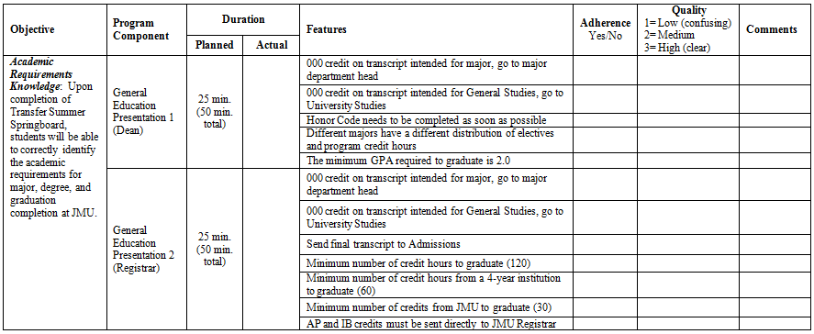
Fidelity Assessment Checklist: TSO (1)
Exposure
Adherence
Quality
Program Differentiation

Slide 48
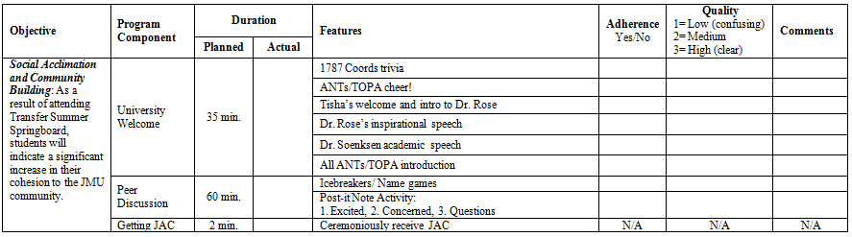
Fidelity Assessment Checklist: TSO (2)

Slide 49
Responsiveness
Observe and rate during the audit the responsiveness of students
    Was difficult given the size of the room and number of students
Survey administered to students regarding responsiveness to material
How attentive were you throughout the day? | How effective were the presenters in providing information? | How engaged were you during the day?
Not all attentive Somewhat attentive Very attentive | Not all effective Somewhat effective Very effective | Not at all engaged Somewhat engaged Very Engaged

Slide 50
Assessing Exposure via Attendance
In addition to attendance and duration, items were added to Transfer Student Orientation posttest to assess exposure of optional programming.
  The majority of events are mandatory for Transfer Student Orientation but not all (this may be the case for your program)
  Questions were added to determine which optional events students attended
    Did you attend a University Tour?
    Did you attend the Student Resource Fair?
  With this information, we can see if students who were exposed to relevant programming, albeit optional, perform better on the objective measures than those who do not

Slide 51
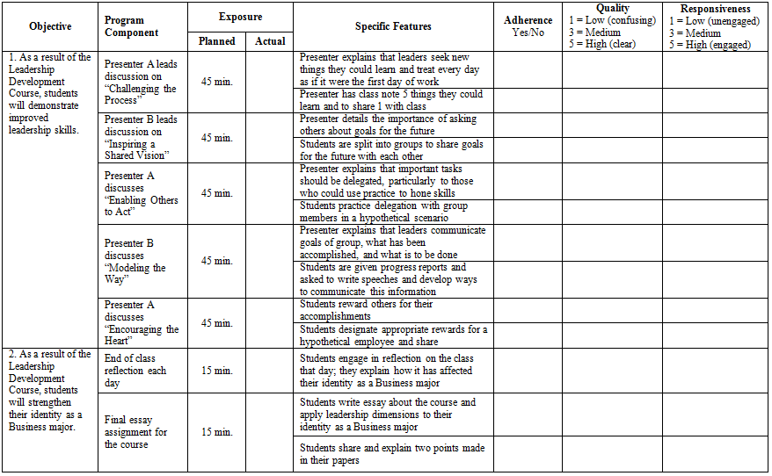
Another Example of Fidelity Checklist: Leadership Development Course

Slide 52
Summary and Meta-Cognitive Check
What are the 5 components of Implementation Fidelity?
How and by whom can Implementation Fidelity data be collected?

Slide 53
Group Activity

Slide 54
Group Activity 1
A colleague indicates s/he is required (by a supervisor, editor, accrediting body, etc.) to document implementation fidelity (for a program, treatment, curriculum, etc.). However, your colleague doesn’t know how to start this process.
What would you tell your colleague to do? That is, how would you get them started on the process of gathering this information?

Slide 55
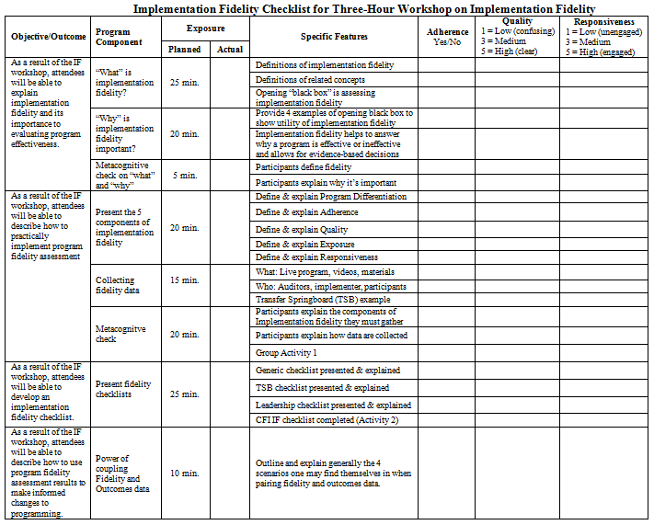

Slide 56
Closing Thoughts

Slide 57
Valid Inferences about Program Inferences
Establishing Program Outcomes
Creating & Mapping Programming to Outcomes
Selecting/
Designing Instrument
Collecting Information
Analyzing/
Maintaining Information
Using Information
Implementation Fidelity
“Outcomes-based assessment uses the results of assessment to change and improve how a program, a department, a division, or an institution contributes to student learning.”
(Bresciani, Gardner, & Hickmott, 2009)
We believe this is difficult (if not impossible) without implementation fidelity data.
If the intended outcomes aren’t observed, practitioners and researchers won’t know if the results are due to a poorly designed program, a well-designed program that matches theory but the theory is wrong, OR due to a lack of high implementation fidelity.
By incorporating Implementation
Fidelity into the Assessment Cycle, we now
have much more information about
the actual program the participants received and thus can make more valid inferences about the impact of our program.

Slide 58
Implementation Fidelity in a Nutshell
Program Differentiation
Definition: detailing the specific features of the program that theoretically enable students to meet the intended outcomes
Adherence
Definition: whether or not the specific features of the general program components were implemented as planned
Quality
Definition: how well the program was implemented or the caliber of the delivered program features
Exposure
Definition: extent to which all students participating in a program receive the full amount of the treatment
Responsiveness
Definition: receptiveness of those exposed to the treatment
Assessment: not "assessed"; involves describing the specific feature of each program component
Assessment: rating the quality of implementation (e.g., 1 = Low to 5 = High)
Assessment: recording the duration of program components and/or the proportion of program participants that received the component
Assessment: students or auditors rating levels of engagement (e.g., 1 = Not engaged to 5 = Very engaged)
Assessment: recording whether or not (i.e., "yes" or "no") each specific program feature was implemented

Slide 59
Barriers to Assessing Implementation Fidelity
Lack of general knowledge of implementation fidelity (The “what” and “why”)
    Practitioners/instructors may assume implementation fidelity is high because implementers/teachers should present program/curriculum exactly as directed. However, this assumption needs to be tested, as research indicates this assumption is often wrong.
    Practitioners/instructors may not understand how lack of fidelity can attenuate program effectiveness.
Lack of specific guidelines on fidelity procedures (The “how”)
Time, cost, and labor demands
    Resources are needed to learn about implementation fidelity and engage in it.
    However, these resources will decrease as implementation fidelity becomes a part of the standard program effectiveness study (i.e., workshops like this won’t be needed) and may result in the need for fewer program effectiveness studies (i.e., a few studies done well vs. many studies with ambiguous results due to a lack of implementation fidelity data).
Lack of requirements to report this information
    Only some scholarly journals will require you to discuss implementation fidelity in the Methods and especially in the Discussion (if hypotheses weren’t supported, was this due to poor experimental; discuss this and hopefully have implementation data to inform the discussion).
    Research has shown that lack of perceived value of implementation fidelity data by administrators or the system serves as a barrier to fidelity assessment (Cochrane & Laux, 2008). Thus, we urge administrators to request these data and the explication of how these data were used to provide a more complete and accurate picture of program effectiveness.

Slide 60
Thank you!
finneysj@jmu.edu
gerstnjj@jmu.edu

