Slide 1

What Goes Around Comes Around:
Continuous Improvement and Impact Measurement Using the Assessment Cycle
Engaged Scholarship Consortium
2015 Conference
Elisabeth M. Pyburn, Heather D. Harris, Kelly J. Foelber,
Monica K. Erbacher, & S. Jeanne Horst
James Madison University

Slide 2
Why Do Assessment?
Intrinsic Reasons
To improve the effectiveness of a program, specifically that students are learning
Extrinsic Reasons
To be accountable to stakeholders
To justify programmatic changes and resource allocation

Slide 3
1) Establish Objectives
6) Use Results to Improve Program
2) Map Objectives to Programming
5) Analyze Data
3) Select and/or Design Instruments
4) Collect Data and Assess Fidelity

Slide 4
1) Establish Objectives
6) Use Results to Improve Program
2) Map Objectives to Programming
5) Analyze Data
3) Select and/or Design Instruments
4) Collect Data and Assess Fidelity

Slide 5
Writing Program Objectives

Slide 6
Establishing Objectives
Goals – broad expectations of programming
Objectives – specifics of how goals are met
  Observable
  Measurable
Objectives identify what individuals should be able to know, think, and do as a result of experiencing the program.

Slide 7
Establishing Objectives
Know, think, and do
  Cognitive
    Demonstrating knowledge and/or skills
  Non-cognitive
    Expressing attitudes, beliefs, and/or values

Slide 8
Establishing Objectives
Workshop Goal:
ESC assessment workshop attendees should be able to begin the assessment process in their own programs upon leaving the workshop.
Objectives: Upon completing the workshop, attendees…
  will be able to identify the 6 steps of the assessment cycle.
  will be able to write measurable learning objectives.

Slide 9
Establishing Objectives
Example Objectives:
  will be able to identify the 6 steps of the assessment cycle.
  will be able to write measurable learning objectives.
Notice
  observable: identify, write, report
  measurable: 6 steps, are the objectives attendees wrote measurable or not?
Several methods – how do we start?

Slide 10
Establishing Objectives
ABCD Method
  A = Audience
    What group of people are you assessing?
  B = Behavior
    What should individuals be able to do/demonstrate?
  C = Conditions
    Under what circumstances do you expect this behavior?
  D = Degree
    How well must the behavior be performed? (Not always applicable)

Slide 11
Establishing Objectives
ABCD Example 1:
  Audience = ESC workshop attendees
  Behavior = Identify steps of assessment cycle
  Condition = Upon completing workshop
  Degree = All 6 steps
Objective:
  Upon completing the workshop, attendees will be able to identify the 6 steps of the assessment cycle.

Slide 12
Establishing Objectives
ABCD Example 2:
  Audience =
  Behavior =
  Condition =
  Degree =
Objective:
  Upon completing the workshop, attendees will be able to write measurable learning objectives.

Slide 13
Establishing Objectives
ABCD Example 2:
  Audience = ESC workshop attendees
  Behavior = write measurable learning objectives
  Condition = upon completing the workshop
  Degree = N/A
Objective:
  Upon completing the workshop, attendees will be able to write measurable learning objectives.

Slide 14
Establishing Objectives
ABCD Example 3:
  Audience = incoming international freshmen
  Behavior = identify 4 academic resources at JMU
  Condition = after completing Transitions (an orientation program)
  Degree = 90%
  Objective:
    Through participating in Transitions, 90% of the new international students will be able to identify 4 academic resources at JMU.

Slide 15
Establishing Objectives
ABCD Example 3:
  Audience = incoming international freshmen
  Behavior = identify 4 academic resources at JMU
  Condition = through participating in Transitions (an orientation program)
  Degree = 90%
  Objective:
    Through participating in Transitions, 90% of the new international students will be able to identify 4 academic resources at JMU.

Slide 16
Establishing Objectives
ABCD Example 4:
  Audience = sophomores
  Behavior = explain why an individual may hold a perspective different from their own
  Condition = completing their sociocultural general education course requirement
  Degree = N/A
  Objective:
    After completing the sociocultural general education course requirement, JMU sophomores will be able to explain why an individual may hold a perspective that differs from their own.

Slide 17
Establishing Objectives
ABCD Example 4:
  Audience = sophomores
  Behavior = explain why an individual may hold a perspective different from their own
  Condition = completing their sociocultural general education course requirement
  Degree = N/A
  Objective:
    After completing the sociocultural general education course requirement, JMU sophomores will be able to explain why an individual may hold a perspective that differs from their own.

Slide 18
Establishing Objectives
Bloom’s Taxonomy
  Classify complexity of objectives
Less Complex
Level | Description
1. Knowledge | Recognize or identify facts, terms, principles
2. Comprehension | Explain or summarize in own words
3. Application | Apply learned material to new situations
4. Analysis | Understand organizational structure of material; draw comparisons and relationships between elements
5. Synthesis | Combine elements to form a new entity or structure
6. Evaluation | Make judgments about extent to which criteria are satisfied
More
Complex

Slide 19
Verbs for Objectives
Bloom’s Level | Verbs
1. Knowledge | match, recognize, select, compute, define, label, name, describe
2. Comprehension | restate, elaborate, identify, explain, paraphrase, summarize
3. Application | give examples, apply, solve problems using, predict, demonstrate
4. Analysis | outline, draw a diagram, illustrate, discriminate, subdivide
5. Synthesis | compare, contrast, organize, generate, design, formulate
6. Evaluation | support, interpret, criticize, judge, critique, appraise

Slide 20
Verbs for Objectives
Non-cognitive | Verbs
Receiving | accept, acknowledge, follow, listen, observe, receive
Responding | agree, attempt, exhibit, display, reply, respond
Valuing | adopt, encourage, endorse, share, suggest, initiate
Organization | anticipate, collaborate, facilitate, establish, specify, lead

Slide 21
Establishing Objectives
Things to keep in mind
  Effortful, thoughtful process
    Easy to go through MANY revisions
  It takes time!
  Now you know where to start

Slide 22
Writing Objectives: Activity!

Slide 23


Writing Objectives: Activity
Provide students with knowledge about how to write resumes.
Graduating psychology students will show an increase in open-mindedness through a 10-point increase on the Open-Mindedness Inventory from when they completed the inventory as incoming first-year students.
Upon completion of the career and life planning course, undeclared students will be able to match 80% of JMU majors to appropriate career choices.

Slide 24
Writing Objectives: Activity
Students will understand the elements of a good philosophical argument.
Students in the Introduction to College program will learn how to take better notes.
As a function of living on campus, residence hall freshman students will develop a greater sense of belonging to JMU compared to off-campus freshman students, as measured by the Sense of Belonging Scale.

Slide 25
1) Establish Objectives
6) Use Results to Improve Program
2) Map Objectives to Programming
5) Analyze Data
3) Select and/or Design Instruments
4) Collect Data and Assess Fidelity

Slide 26
Mapping Objectives
Clear mapping helps interpret results
Each objective should map to at least one element of the program or curriculum
Blueprint
  Linking objectives to courses/activities in your curriculum
  Be specific!
    To what extent is the objective covered in that class?
    What specific components of the activity or items on the test address the objective?
Notes:
Each objective should map to at least one element of the program – otherwise they won’t be met!
Blueprint
Links objectives to courses/activities
Be specific

Slide 27
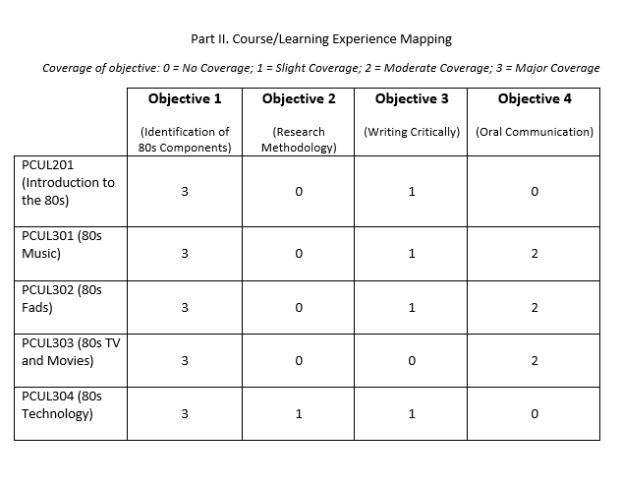
Mapping Objectives
Notes:
Example blueprint (basic)
Extent of coverage in each class is represented by a 1, 2, or 3

Slide 28
Mapping Objectives
Notes:
Example blueprint
Note how specific test items are linked to the objectives
This blueprint also breaks down how the test in question address each objective

Slide 29
Mapping Objectives: Activity!

Slide 30
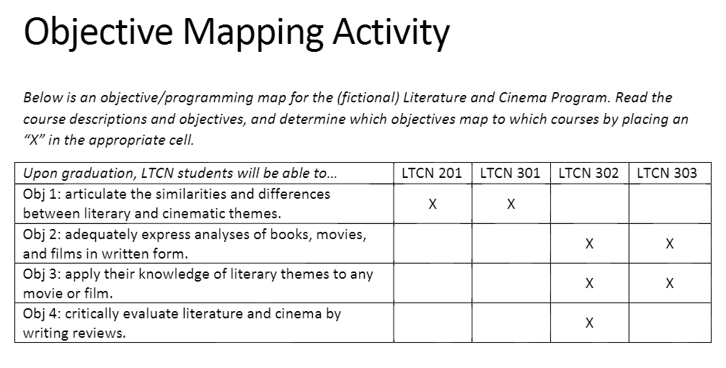
Mapping Key

Slide 31
1) Establish Objectives
6) Use Results to Improve Program
2) Map Objectives to Programming
5) Analyze Data
3) Select and/or Design Instruments
4) Collect Data and Assess Fidelity

Slide 32
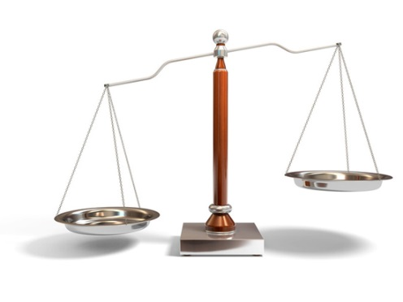
Selecting and/or Designing Instruments
  Where do you start?
Two routes when you need an instrument
Find existing
instrument
Develop a new instrument
Notes:
Existing measures (hopefully) have validity and reliability information available; grunt work is already done; can compare your findings to others who have conducted similar assessment work
BUT might not align well with your specific learning objectives; specific to your population of students
Designing instruments takes time and expertise
BUT you can tailor the instrument to your specific needs
Place to start: Searching for existing measures – see handout for places to look
Evaluate how the existing instruments align with your learning outcomes

Slide 33
Selecting and/or Designing Instruments
Many different types of “Instruments”
  Rubrics
  Questionnaires
  Tests (multiple-choice and open-ended)
  Behavioral Observations
Difference between direct and indirect measures of learning

Slide 34
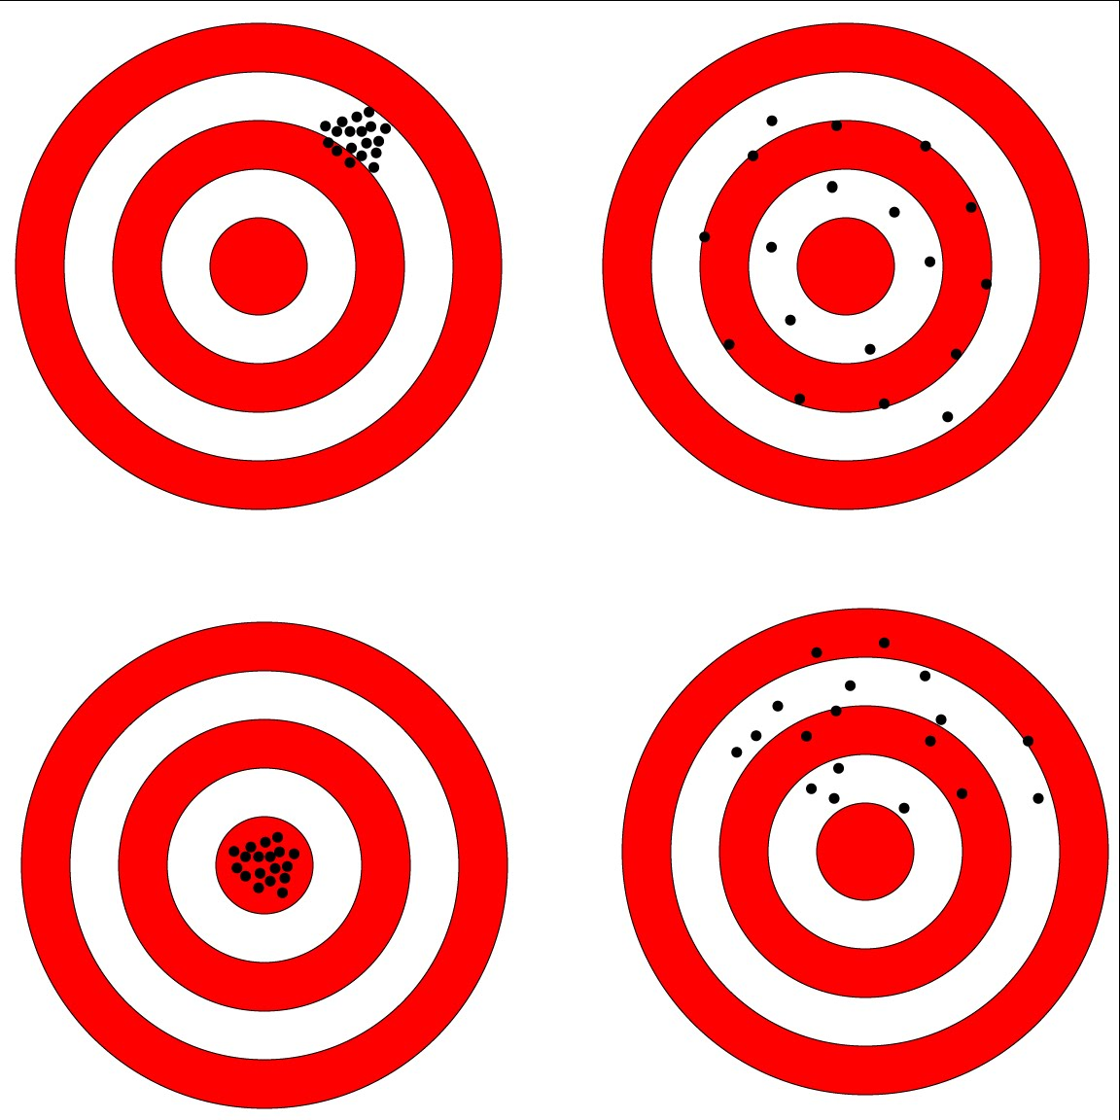
Selecting and/or Designing Instruments
How do you know it’s a good measure?
Reliability Validity

Slide 35
Selecting and/or Designing Instruments
Existing Measure
  Pros:
    Already created
    Convenient
    Evaluated
  Cons:
    Not customized
    May differ in theoretical orientation
New Measure
  Pros:
    Strong alignment with objectives
  Cons:
    Requires time
    Requires resources

Slide 36
Selecting and/or Designing Instruments
Indirect Measures
  Self-appraisals
  May not be indicative of learning
  Ex: Students respond on a 5-point scale how much they feel they learned during a guest speaker presentation.
Direct Measures
  Direct appraisals
  Provides stronger evidence of learning
  Ex: Students are rated on their written evaluation of
  80s hair styles.

Slide 37
1) Establish Objectives
6) Use Results to Improve Program
2) Map Objectives to Programming
5) Analyze Data
3) Select and/or Design Instruments
4) Collect Data and Assess Fidelity

Slide 38
Assessing
Implementation Fidelity
Does the programming that was implemented match the programming that was planned?
Helps us better understand the effectiveness of our planned programming
We don’t know if our planned programming is or is not effective if it’s not actually the programming our students receive.
Gerstner & Finney (2013)
Swain, Finney, & Gerstner (2013)

Slide 39
Assessing
Implementation Fidelity
Objective
Planned
Program
Measured
Outcome
Notes:
To illustrate the concept of implementation fidelity, let’s imagine we have a set of objectives, and we’re going to help our students meet these objectives by implementing our PLANNED program (and the link between our objectives and our programming is evidenced by our objective mapping). And then we’ll measure the student learning outcomes we’re interested in after the program takes place….

Slide 40
Assessing
Implementation Fidelity
Objective
Planned
Program
Measured
Outcome
Notes:
…And what we want to say when we get our results back, is that the outcomes are a reflection of our planned program.
BUT, in reality, at the end of the day, our results are a reflection of…

Slide 41
Assessing
Implementation Fidelity
Objective
Actual
Program
Measured
Outcome
Notes:
…the ACTUAL programming that was implemented in real life. And this ACTUAL programming may or may not be the same thing as the PLANNED programming, but we don’t necessarily know.

Slide 42
Assessing
Implementation Fidelity
Objective
Actual
Program
Measured
Outcome
Notes:
Without collecting implementation fidelity evidence, we don’t know much about the programming that was implemented…

Slide 43
Assessing
Implementation Fidelity
Intended program + other stuff?
Only part of intended program?
Nothing like intended program?
Intended program?
Objective
Actual
Program
Measured
Outcome
Notes:
…was it the intended program? The intended program plus some other stuff that the facilitator/students added in because they thought it would help? Was it only part of the intended program– maybe the facilitator/students ran out of time? Or maybe the facilitator/students didn’t adhere to the plan at all and what they experienced was nothing like the intended program!
Without collecting implementation fidelity evidence, WE DON’T KNOW!

Slide 44
Assessing
Implementation Fidelity
Intended program + other stuff?
Only part of intended program?
Nothing like intended program?
Intended program?
Objective
Actual
Program
Measured
Outcome
Implementation fidelity = the key to unlocking “the black box”
Notes:
Gathering this evidence is the key to determining what’s in this “black box”, aka to determining the extent to which the implemented program aligns with the planned program.

Slide 45
Assessing
Implementation Fidelity
A client you’re working with comes to you and says they have bad news– after telling their students to use a new software program every night for the entire past semester, only one or two students actually saw improvement in their scores. They’re bummed because the new software was expensive and obviously it’s not working.
What might you say to this client?
What might you suggest they do?
Notes:
Let’s think through a hypothetical example… (read slide).
Ask for audience feedback. Keep it brief!!
My thoughts:
Were students using it at all?
Were students using it every night?
Was the TV on while they were “using” it?
→ Maybe the software DOES work, but only 2 students used it properly.

Slide 46
Assessing
Implementation Fidelity: Activity!

Slide 47
Assessing
Implementation Fidelity

Slide 48
Combining Implementation Fidelity with Outcomes Data
Implementation Fidelity Results | Outcomes Measure Results | Appropriate Conclusion
High | Good | The program may be effective. What we like to see.
High | Poor | The program may NOT be effective. Stakeholders use assessment results to inform changes to the planned program.
Low | Good | Results do not provide information about the planned program. Should NOT claim the planned program was effective– we don’t know!
Low | Poor | Results do not provide information about the planned program. Should NOT claim the planned program was ineffective– we don’t know!
Implementation fidelity data is paired with
outcomes data to make more informed and appropriate decisions about programming!
Notes:
Example interpretation of the 1st row of table: Program was implemented as planned and outcomes were met, thus the program may be effective. This is what we like to see.
Example interpretation of the 2nd row of table: Program was implemented as planned, but intended outcomes were not observed. Low implementation fidelity can be ruled out as the reason for poor outcomes. Thus, the program may NOT be effective. Stakeholders are encouraged to use assessment results to inform changes to the planned program.
Example interpretation of the 3rd row of table: Program was not implemented as planned. Thus, planned program cannot be credited with contributing to students meeting the outcomes. One should not claim the planned program was effective.
Example interpretation of the 4th row of table: No claims can be made about the planned program.

Slide 49
Collecting Data
Want meaningful data
From whom should you collect data?
  Representative sample
  Census
What data collection method(s)/design should you use?
  Depends on your objectives!
  Pre and post test
  Single time point
  Group comparisons
Notes:
This is the step most people think of when they think of assessment, but it is only one step in the cycle!

Slide 50
Collecting Data
Want meaningful data
From whom should you collect data?
  Representative sample
  Census
What data collection method(s)/design should you use?
  Depends on your objectives!
  Pre and post test
  Single time point
  Group comparisons
Notes:
This is the step most people think of when they think of assessment, but it is only one step in the cycle!

Slide 51
1) Establish Objectives
6) Use Results to Improve Program
2) Map Objectives to Programming
5) Analyze Data
3) Select and/or Design Instruments
4) Collect Data and Assess Fidelity

Slide 52
Analyzing Data
Four General Questions:
Relationships: What is the relationship between assessment outcomes and program components (i.e., course grades, peer ratings)?
Differences: Do students learn or develop more if they participate in a program compared to students who did not participate?
Change: Do students change over time?
Competency: Do students meet program expectations?
Notes:
Here are 4 general questions you might be seeking to answer. Which question applies will depend on the wording of your objective.

Slide 53
Analyzing Data
“But I’m not a statistician!”
  Learn how to run basic analyses. It’s easier than you think!
  Find the stats-minded people at your institution. They’d probably be glad to help you out ☺

Slide 54
1) Establish Objectives
6) Use Results to Improve Program
2) Map Objectives to Programming
5) Analyze Data
3) Select and/or Design Instruments
4) Collect Data and Assess Fidelity

Slide 55
Using Results to Improve Student Learning
In general, institutions seem to be good at collecting data…
…but not so good at using the results
to improve student learning.
Blaich, C., & Wise, K. (2011). From gathering to using assessment results: Lessons from the Wabash national study. Occasional Paper # 8. Champaign, IL: National Institute for Learning Outcomes Assessment.

Slide 56
Using Results to Improve Student Learning
Why might results not get used?
Reports get filed away and forgotten
Belief that the report itself is enough to prompt and enact action (…false)
Requires collaboration and conversation
  “…but the communication must at some point move from talking about the data to talking about, and then enacting, changes.” – Blaich & Wise, 2011

Slide 57
Using Results to Improve Student Learning
Altering your programming based on the results of your assessment = making a change
Improvement = a change that has had a positive impact
How do you know if your change is an improvement?
  Re-assess!
Notes:
Re-assessment in NEXT assessment cycle

Slide 58
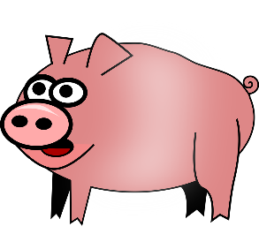

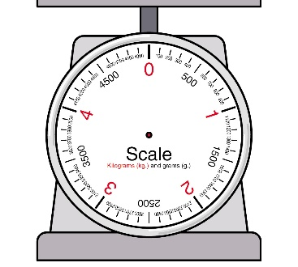

Assessment
Program Change
Re-Assessment
Fulcher, K.H. Good, M.R., Coleman, C.M., & Smith, K.L. (2014). A simple model for learning improvement: Weigh pig, feed pig, weigh pig. Occasional Paper No. 23). Urbana, Il: University of Illinois and Indiana University, National Institute for Learning Improvement.

Slide 59
Using Results to Improve Student Learning
What could we improve that would positively impact student learning?
  Measurement?
  Data collection?
  Data analyses?
Although improvements to all aspects of assessment are important (they help us attain better, more credible evidence of student learning) → they do not impact student learning
  e.g., using a better data collection method will not help your students learn better
Notes:
Not just improving the program for improvement’s sake – want to impact STUDENT LEARNING (the main point of assessment!)

Slide 60
Using Results to Improve Student Learning
“Productively using learning outcomes results to inform decision making and to improve teaching and learning remains the most important unaddressed challenge related to student learning outcomes assessment. Simply posting a number on an institution website or checking a box in an accreditation report are of little value to students, parents, or policy makers. Equally important, such actions do nothing to improve access, affordability, or accomplishment.”
- Kuh & Ikenberry, 2009
Notes:
To drive this message home further…

Slide 61
Summary
Assessment is a tool for continuous program improvement
Put your time in! (what goes around comes around…)
  Carefully align each step of the cycle, starting with learning objectives
What is your takeaway from today?
Notes:
Inferences about student learning are only as good as assessment work
Contact your institution’s assessment office!

Slide 62
Questions?
1) Establish Objectives
6) Use Results to Improve Program
2) Map Objectives to Programming
5) Analyze Data
3) Select and/or Design Instruments
4) Collect Data and Assess Fidelity

