Slide 1
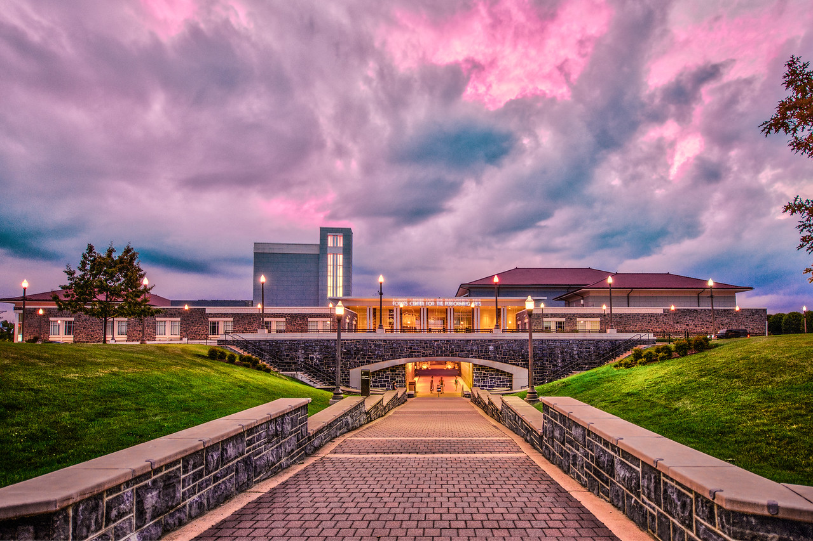
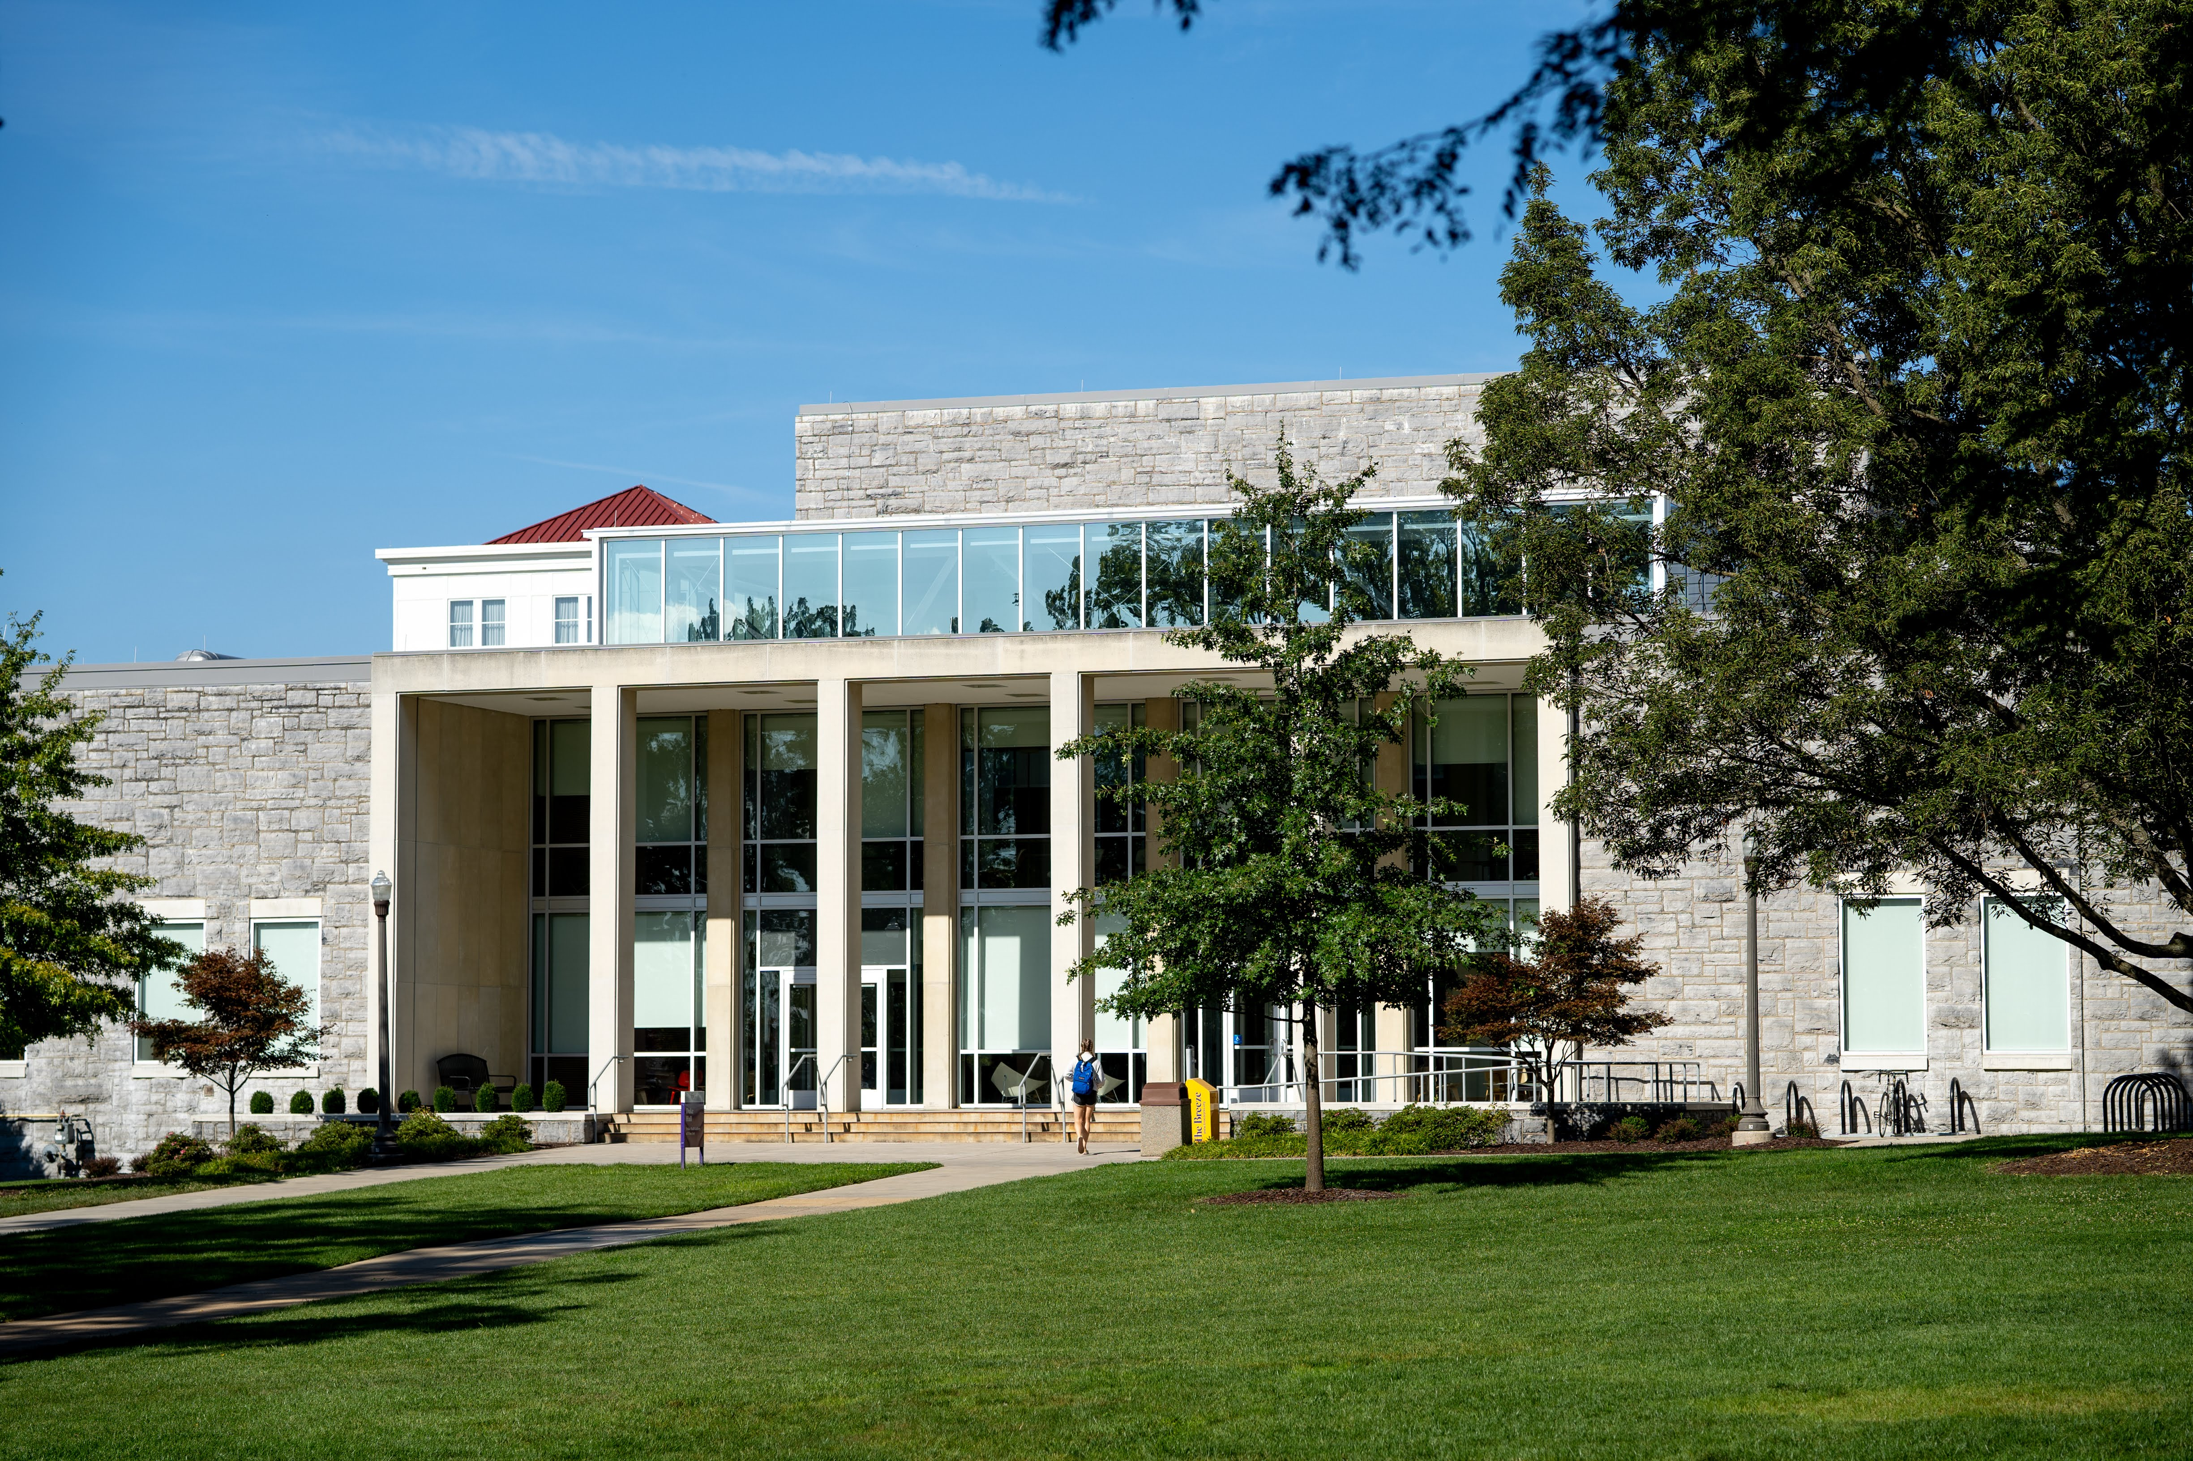
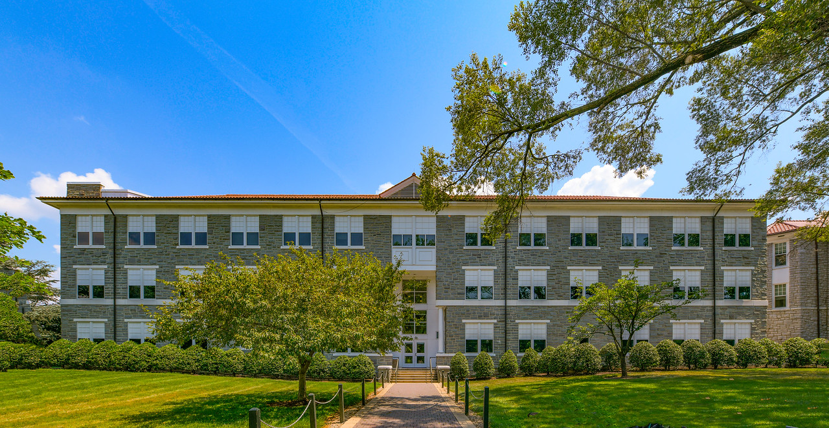
Create Your Path!
College of Visual and Performing Arts
Sign up for our mailing list.
j.mu/moreinfo

Slide 2
School of Art, Design and Art History
Majors:
Art Studio – BA/BS/BFA
Art History – BA
Architectural Design – BFA
Graphic Design – BFA
Industrial Design – BS
Licensures:
Art Education
Minors:
Art
Art History
Book Arts

Slide 3
School of Art, Design and Art History Opportunities
Student Organizations:
Kappa Pi, Art & Art History Co-Ed Fraternity – largest chapter in the nation!
POCIVPA - People of Color in the Visual & Performing Arts
National Art Education Association
Study Abroad:
Michelangelo's Italy
Dutch Design, Art, and the Humanities (summer)
Scandinavian Design and Sustainability (summer)

Slide 4
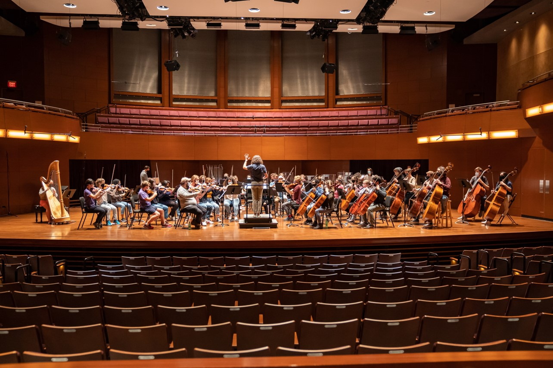
School of Music
Bachelor of Music
Concentrations:​
Composition​
Jazz​
Music Education​
Music Industry​
Performance​
Music Theatre​
Bachelor of Arts
Concentrations:​
Music Industry​
Music Studies
Music Minor:​
General​
Music Industry​
Music and Human Services

Slide 5
School of Music Opportunities
STUDENT INVOLVEMENT
Applied Lessons​
Ensembles​
3 Concert Bands​
5 Choirs​
3 Orchestras​
2 Jazz Ensembles​
Chamber Music​
Studio Ensembles​
Marching Royal Dukes
JMU Brass Band​ - Tour to the Netherlands in July 2022​
Marching Royal Dukes​ - Tour to Rome in December 2022
FACILITIES AND PERFORMANCES
Shirley Hanson Roberts Center for Music Performance​
600 seat Concert Hall​
150 seat Recital Hall​
5 faculty studios​
1 large rehearsal rooms​
Approximately 30 practice rooms
Music Building
Music Office​
Music Library​
1 large instrumental rehearsal room​
Choral rehearsal room​
Four music classrooms/rehearsal rooms​
50 faculty studios​
2 piano labs​
Recording Suite​
25 practice rooms​

Slide 6
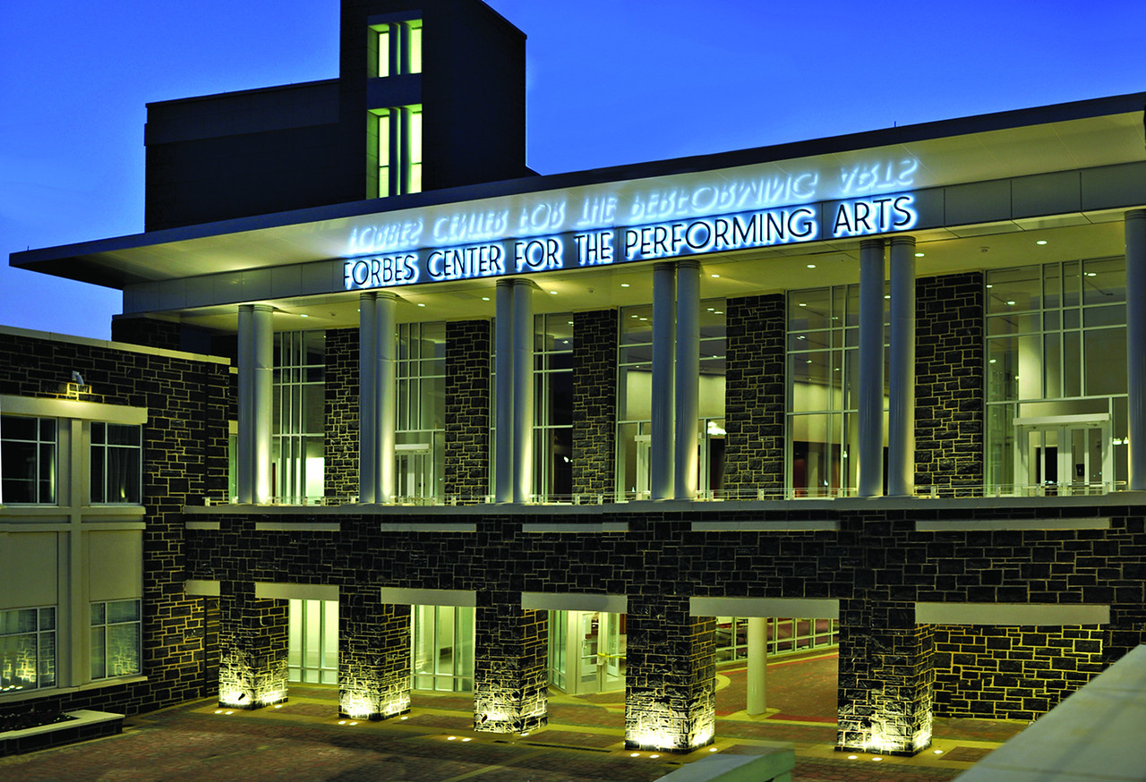
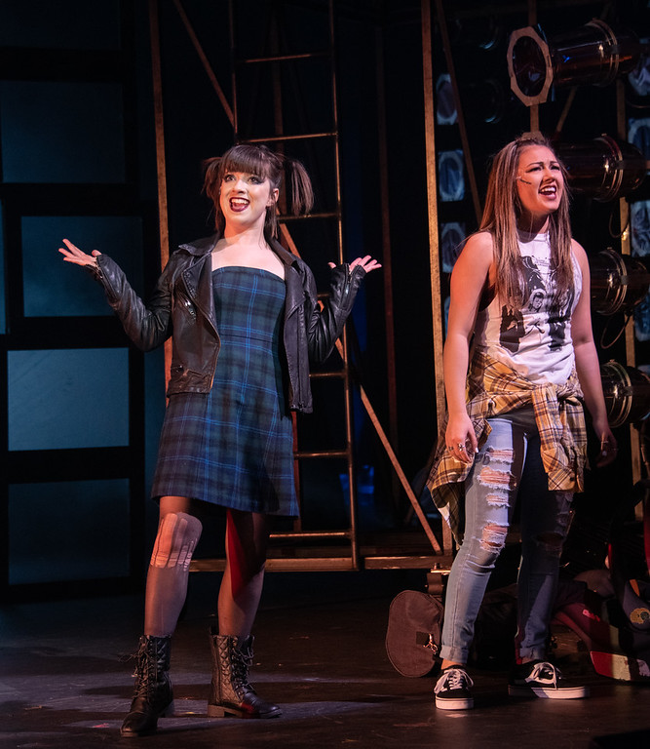
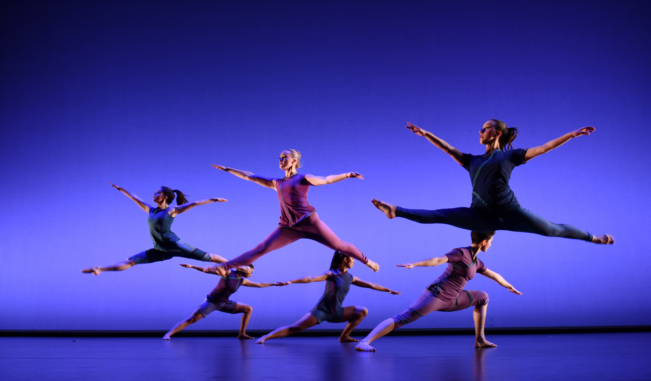
School of Theatre and Dance
Bachelor of Arts Degree
with majors in:
Dance
Pk-12 Dance Licensure available
Musical Theatre
Theatre
Design & Technology
Performance
Theatre Education
Pk-12 Theatre Licensure available
Theatre Studies
Minors:
Dance
Theatre

Slide 7
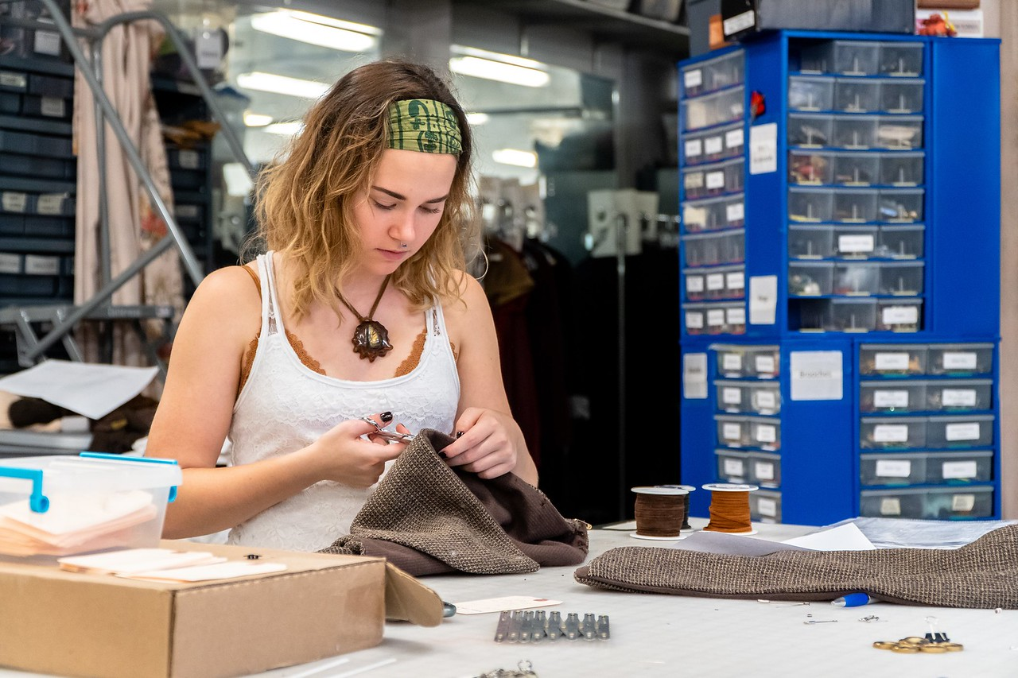
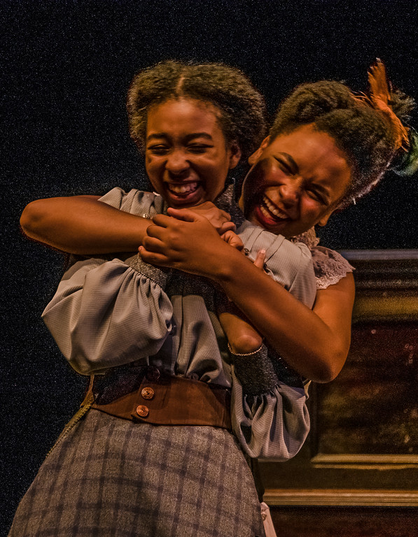
School of Theatre and Dance Opportunities
STUDENT INVOLVEMENT
Opportunities begin in the first year .
2-3 mainstage dance concerts, 2-3 mainstage plays, 2 mainstage musicals each year.
Student-run Studio Theatre plays, musicals, and dance concerts.
Extensive student-developed opportunities:
Devised Work
Choreography Showcases
Playwrights' Workshop
Independent Projects
STUDENT ORGANIZATIONS (including):
Alpha Psi Omega (service/honors)
BIPOC of STAD (service/affinity)
Dance Theatre (social/service)
IMPACT (philanthropy)
NDEO (service/honors)
Stratford Players (social/service)
USITT (professional development)
Weird Cousins (improv)
FACILITIES
450-seat Mainstage Theatre
200-seat Earlynn J. Miller Dance Theatre
200-seat flexible black box Studio Theatre

Slide 8
Application Process
Apply to JMU
Early Action – November 1st
Regular Decision – January 15th
Apply to CVPA – deadlines based on program
SlideRoom Account
Audition & Portfolio Dates
Virtual and in-person
November-February
Required for Scholarships

Slide 9
Follow-up
School of Art, Design and Art History https://www.jmu.edu/artandarthistory/admissions/
artdesignarthistory@jmu.edu
School of Music https://www.jmu.edu/music/admissions/undergraduate.shtml
music_admit@jmu.edu
School of Theatre and Dance https://www.jmu.edu/theatredance/
theatredance@jmu.edu
Director of Recruitment – Adam Anderson andersaf@jmu.edu

