Slide 1

Informal Resolutions for Title IX and Sexual Misconduct Cases
ASCA has been approved by the Higher Education Consortium for Student Affairs Certification to provide CE credit for Certified Student Affairs Educators (CSAEd™). Programs that qualify for CE credit in this program are clearly identified. ASCA is solely responsible for all aspects of this program.

Slide 2
Accessibility Acknowledgement
ASCA is committed to making our events accessible. We encourage you to engage in sessions in ways that fit your abilities and comfort level. In addition to any requested accommodations and use of assistive devices and technology, we encourage attendees to drink or eat during session, stretch, stand up, fidget, stim, take breaks, wear headphones for noise and stimulation reduction, and/or engage in helpful focus/regulation practices such as deep breathing, doodling, using a silent phone app, and more. In general, please engage so far as you feel emotionally and physically able to do so – it is okay to push your comfort zone, and to also prioritize your well-being.
We encourage attendees to understand that focus and engagement can look and feel different for each individual, and that while unfamiliar behaviors may sometimes be initially distracting, they are not intentionally disruptive.
This space should feel comfortable and accessible. If you have any concerns with accessibility, please let Central Office know as soon as possible.

Slide 3
Donald D. Gehring Academy
Language Statement
ASCA asks that all participants in the Donald D. Gehring Academy recognize the diversity of values, opinions, preferences, and practices represented in our academy audience, which includes professionals and students from throughout the United States and the international community. Accordingly, all who are involved in the academy, whether members, presenters, attendees, volunteers, employees, or guests of the Association, are encouraged to use bias-free communication that supports both the letter and the spirit of the Inclusive Language Policy.

Slide 4


Your Presenters
Kristi Patrickus
Michael Fazi

Slide 5
ASCA Knowledge & Skills
Administration
Case Resolution
Law & Policy

Slide 6
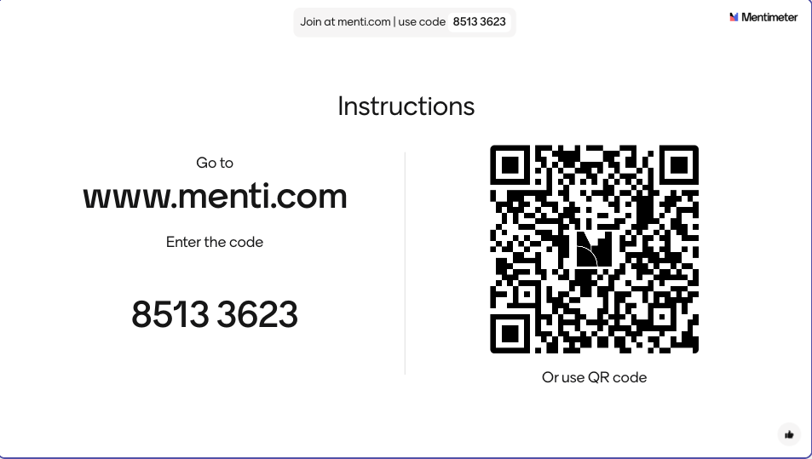

Slide 7
Outline of Topics
Regulatory Requirements & Due Process
Types of Informal Resolution
Determining Threshold & Appropriate Process Options
Institutional Considerations
Case Study
Example Documents & Resources

Slide 8
Expectations for Participants
Not legal advice
Participation
Cameras
Questions
Open-Minded

Slide 9
What are your goals and expectations for today?

Slide 10
Regulatory Requirements and Due Process

Slide 11
§ 106.45(b)(9): Informal Resolutions
© Kristi Patrickus, 2025
Can only offer after a formal complaint is filed.
Cannot be offered as a condition of enrollment, continued enrollment, or continuing employment.
Cannot be offered as a condition of enjoyment of any other right or waiver of the right to the formal process (investigation and adjudication).
Cannot mandate participation in IRs.
Can offer at any time prior to a responsible determination.
Cannot be offered in sexual harassment cases involving Student Cs and Employee Rs.

Slide 12
§ 106.45(b)(9): Informal Resolutions
© Kristi Patrickus, 2025
If offering an IR (such as mediation), recipients must:
Provide a written notice of allegation that includes
  The IR process requirements, including that a final IR determination precludes a formal complaint process on the same allegations.
    Only if the parties do not exit IR prior to reaching an agreement.
  If the parties withdraw prior to reaching an agreement, the formal process resumes.
  How records and consequences resulting from participating in IR are shared and maintained.
Requires the written, voluntary consent of both parties.

Slide 13
Additional Requirements from 2020 Regulations
© Kristi Patrickus, 2025
IR facilitators must not have a conflict of interest or bias for or against complainants or respondents generally, or individual parties.
IR facilitators must receive training on:
  The definition of sexual harassment;
  The scope of the recipient’s education program or activity;
  How to conduct an investigation and grievance process (hearings, appeals, IR processes); and
  How to serve impartially (including avoiding prejudgment of the facts).
IR processes require a reasonably prompt timeline for resolution.

Slide 14
Additional State Requirements
© Kristi Patrickus, 2025
State laws may require additional IR requirements/restrictions.
  Maryland Education Code §11–601
    Cannot offer in cases involving sexual assault or sexual coercision, regardless of the parties.
  Oregon Revised Statutes § 36.220
    Mediation communications are confidential and may not be disclosed to any other person.
Question: are you aware of any additional state laws that govern IRs for your campus?

Slide 15
Due Process Considerations
© Kristi Patrickus, 2025
Do not use IR to substitute your due process obligations.
Regardless of whether the case is TIX or non-TIX, you must honor your due process obligations.
Title IX still requires a signed formal complaint and notice of allegation letter to the parties.
  Cannot force parties into an IR process either.
Non-TIX would function according to your institutional policy.
  Consider following the TIX guidance.

Slide 16
Due Process Considerations
© Kristi Patrickus, 2025
Understand the differences in IR types and how you offer each.
Don’t offer an IR process you can’t sustain. Can lead to concerning procedural violations due to inconsistent application.
TIX requires staff trained on all areas of the formal grievance process, so make sure any off-campus facilitators know your process.
  Lack of knowledge and understanding may lead to procedural concerns and disparate treatment.
  Equally as important for non-TIX cases.

Slide 17
Due Process Considerations
© Kristi Patrickus, 2025
Impose a resolution timeline for IR processes.
Example: 30-days to reach an agreement through facilitated mediation, with an extension if made in good faith. If an agreement is not reached within 30-days and the parties do not request an extension, the case proceeds with the formal grievance process.
TIX requires prompt resolution timelines and those timelines should differ from the formal grievance timelines.
Though IRs are not the “shortcut” to TIX/non-TIX case resolutions, they are highly reliable at producing an outcome quicker than the formal grievance process. Just don’t make this promise to parties or use this as a selling point for pressuring parties into an IR.

Slide 18
Due Process Considerations
© Kristi Patrickus, 2025
Even if not required, consider keeping communications and results confidential.
Certain state laws require the confidentiality of communications made during an IR process. Consider implementing this confidentiality regardless.
  Example: can’t use anyone’s admissions against them in the formal process.
Depending on the IR agreement, consider the confidentiality of that agreement beyond FERPA.
  Can parties speak about the resolution agreement details?
  What information is available in a records check?

Slide 19
Forms of Informal Resolution

Slide 21
Facilitated Mediation
One of the most common forms of IR
Neutral facilitator leads an indirect negotiation process between the parties
Parties are generally responsible for proposing their own terms
Parties retain full discretion to agree or disagree to proposed terms
Also called shuttle diplomacy

Slide 22
Considering Facilitated Mediation
Pros and Cons

Slide 23
Restorative Justice
Focuses on addressing the harm caused to the complainant
Interactive process that brings all parties into the same room
  Complainant or Impacted Party
  Respondent or Responding Party
  Affected Parties
  Support persons for parties
  Facilitator
Discussion addressing:
  What occurred and its impact?
  How can the harm be repaired/remedied?
Participants build out an IR Agreement to resolve the matter

Slide 24

Considering Restorative Justice
Pros and Cons
Image Source: https://drprather.com/2023/12/18/the-misuse-of-restorative-justice/

Slide 25
Facilitated Dialogue
Interactive process aimed at talking through what occurred
Typically between a complainant and respondent in the presence of a facilitator
Parties agree ahead of time to resolve the matter through the conversation(s)
Terms of length and frequency of conversation(s) is pre-determined

Slide 26

Considering Facilitated
Dialogue
Pros and Cons
Image Source: shutterstock.com

Slide 27
Administrative Resolution
Flexible set of alternative processes typically driven by respondent’s interests and desires
  Acceptance of responsibility
  Accepting specific sanction
  Mutual agreement of the parties to an alternative form of decision making

Slide 28
Considering Administrative Processing
Pros and Cons

Slide 29
Which Process When?
What are the underlying allegations?
Who requested the informal resolution?
What are the parties looking to achieve in an informal resolution?
What is your institution’s preferences and risk tolerance?

Slide 30
Case Study Examples

Slide 31
Case Study 1
Complainant and Respondent were friends, sharing many clubs and activities.
Complainant filed a formal complaint, alleging that Respondent “took their friendship too far” while intoxicated at a club event.
Allegations include non-consensual sexual contact and non-consensual penetration.
Complainant stated that he no longer feels safe in the same space as the Respondent.
Complainant is open to IR because he doesn’t want to “relive the trauma,” but thinks the Respondent needs to agree to some form of discipline.

Slide 33
Case Study 2
Complainant was watching a movie with their suitemate’s boyfriend (Respondent) while sitting on a couch in the suite’s common room.
During the movie, Respondent slowly leaned over and sat closer to the Complainant, which did not trigger any red flags for the Complainant at first.
Later in the movie, during a romance scene, the Respondent began rubbing the Complainant’s thigh for 5-10 minutes.
Complainant froze in the moment, but later called out the behavior to the Respondent.
Complainant feels this interaction has harmed their ability to be friends with their suitemates and would like to make sure that the Respondent understands what boundaries were crossed.
Complainant is open minded on the form of IR used, but wants a say in the outcome. Complainant has no interest in a formal process.

Slide 35
Break
15 minutes

Slide 36
Determining Threshold and Appropriate Process Options

Slide 37
Preliminary Questions
© Kristi Patrickus, 2025
How many of you limit the use of informal resolutions on your campus beyond the 2020 limitations?
Do you offer more than one IR process?
Do you offer particular IR processes in some cases and not others?

Slide 38
What do we mean by “Threshold Review”?
© Kristi Patrickus, 2025
When you should or shouldn’t use IR processes.
Can apply to the category of allegations, classification of the parties, and/or severity of the allegations.
Consistent, articulable criteria.

Slide 39
Determining Threshold Review Criteria
© Kristi Patrickus, 2025
Title IX, State Law Restrictions, and CBA restrictions.
  TIX: cannot offer in sexual harassment cases involving Student Cs and Employee Rs.
  Maryland: cannot offer in any sexual assault or sexual coercion cases.
  CBAs: could include IR criteria for non-TIX sexual assault allegations.
Institutional culture of IRs.
  What is your institution’s view/opinion of IRs?
  Where is your institution already using IRs?

Slide 40
Determining Threshold Review Criteria
© Kristi Patrickus, 2025
Specific types of allegations
  Do you wish to limit when you might offer an IR to certain case types?
  Domestic Violence vs Dating Violence vs Sexual Assault vs Stalking
Severity of the allegations
  If the allegations are severe enough, do you not offer an IR option?
  Police involvement/Interim Action considerations
Party classification
  Should you limit the IR offerings in all cases involving Student Cs and Employee Rs?
  Do you only offer certain types of IRs for Student/Student cases?

Slide 41
Threshold Review Considerations
© Kristi Patrickus, 2025
Who conducts the threshold review.
  TIX-C / HR / Director of Student Conduct / Dean of Students?
What cases do and do not qualify for IR offerings.
What IR offerings are available in each case type.
Maintain a threshold matrix / governing document for equitable review considerations.
Complainant’s wishes.
Party advisors.
Notes:
ask participants wrap-up questions based on responses to first questions

Slide 42
Institutional Considerations for Informal Resolution

Slide 43
Advisor Participation Considerations
© Kristi Patrickus, 2025
Any advisor participation restrictions should be clearly articulated similarly to any formal grievance process restrictions.
Consider allowing advisor involvement in the IR process that might exceed their role in the formal process.
  Example: letting attorney advisors negotiate a resolution agreement on behalf of their parties.
  Can limit this involvement depending on the IR type (RJ v Mediation).
At the very least, TIX requires the presence of an advisor “in any meeting or grievance proceeding.”

Slide 44
Moving In and Out of IR
Remind parties that the informal resolution process is voluntary
Provide clear directions for requesting informal resolution
Check in with parties throughout informal resolution
Outline from the beginning what happens when leaving informal resolution
Consider use of an Informal Resolution withdrawal form.

Slide 45
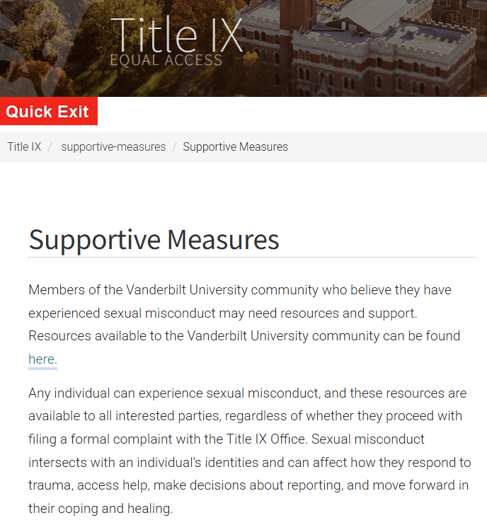
Value of Supportive Measures
Always available to parties
Do not require mutual acceptance by both parties
Can be used to provide supports outside of the IR Agreement

Slide 46
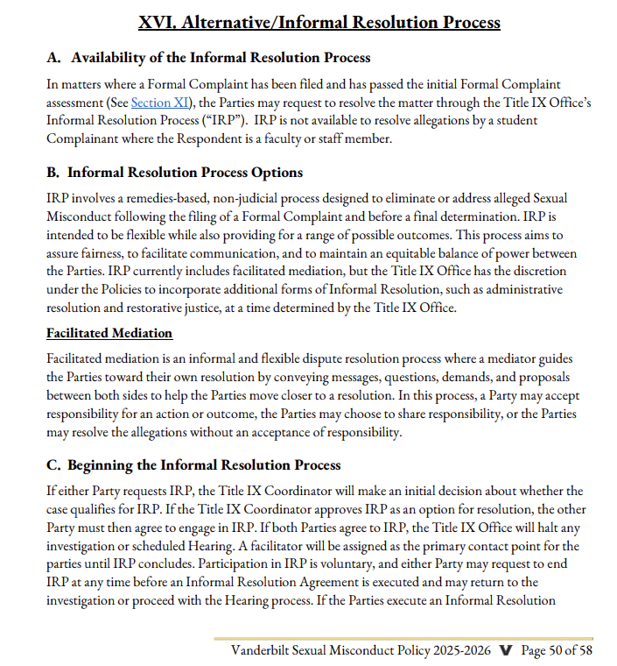
Policy Drafting Considerations
Maintain flexibility for the institution
Value of future proofing your policy language
Clearly outline:
  Who has to consent to begin Informal Resolution
  Who has to consent to Informal Resolution Agreement
  What considerations the institution will use before giving their approval

Slide 47
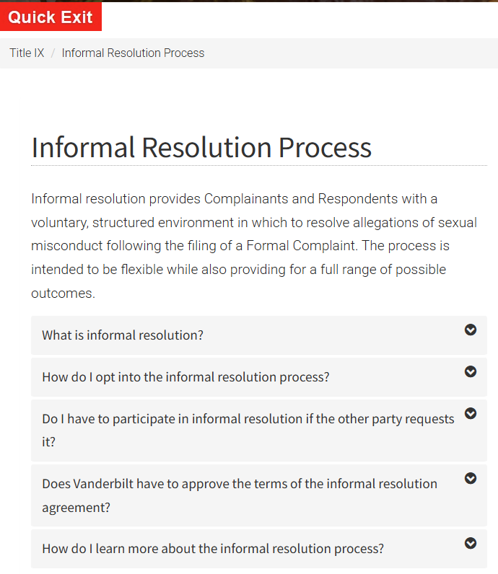
Website/Materials Recommendations
Be proactive in sharing the option in resources
Note strengths and limitations of the process
Be clear about what can and cannot be achieved
Provide guidance on how to request informal resolution

Slide 48
Limitations of Informal Resolution
Depends on type of informal resolution
Outcomes are limited to what parties are comfortable with and institution can enforce
Some types cannot provide formal outcomes or sanctioning of respondent
Loss of day in court feeling

Slide 49
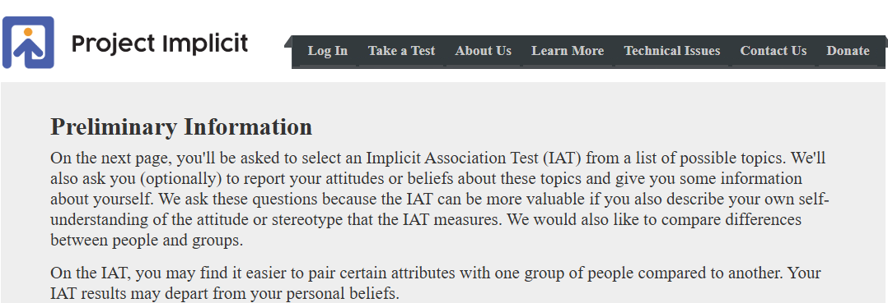
Other Recommendations
Use of Teleconferencing
Consider cultural differences
Document your decisions to show your office’s work/review process
Consistency consistency consistency
  Consistent application of IR
  Monitor for implicit bias

Slide 50
Lunch
1 hour

Slide 51
Case Study
Intake and Initial Review

Slide 52
Initial Considerations
Is this case suitable for an IR?
What types of IR may this case be best suited for?
Other considerations?

Slide 53
Overview of
Facilitated Mediation
Process Deep Dive

Slide 54
Process Overview
IRP Requested
Other Party Approval
Prep Meetings
IR Conference
Sign IR Agreement
One party requests informal resolution and confirms their interest in writing.
Send request for informal resolution to the other party with information about the process and a deadline for response.
Meet with each party individually, provide outline of conference day, gather information about their goals for the process, and have each sign a participation agreements.
Request each party holds the entire day for the conference. Begin day with working draft of agreement and update as you transition between the parties.
Prior to sending for signature have Title IX Coordinator review terms for tentative approval. Send to parties for signature before ending the conference for the day, when possible.
Notes:
Review request for IR
Participation Agreement
Prep Meetings with parties
Planning for the conference
Conference day
Developing the IR Agreement
Agreement approval
Enforcing the agreement

Slide 55
Entering Informal Resolution
Requestor
Check in with parties on interest periodically
Methods for requesting informal resolution
Responder
How to message request for informal resolution
Timeline to respond to request
Methods for responding to the request

Slide 56
Value of Participation Agreements
Establishes written consent
Lays out expectations ahead of time
Lowers institutional risk
Outlines the allegations being addressed

Slide 57
Prep Meeting Agenda
Share order of events for the conference date
Provide expectations of participants on conference date
Discuss what the party is looking to request at the conference
Discuss what the party’s limitations are for terms
Answer questions

Slide 58
Conference Prep
Send calendar holds
Outline requests and limits from each party
Begin draft IR Agreement

Slide 59
Conference Day
Welcome parties into their breakout rooms
Begin with party based on previously shared requests
Update draft agreement along the way
Stay in communication with Title IX Coordinator

Slide 60
IR Agreement
Focus on clarity and enforceability
Work with Title IX Coordinator ahead of time to determine acceptable requests
Take lead on phrasing unless party is absolutely set on language
Minimize opportunity for redlining by parties
Methods for reviewing draft ahead of signing

Slide 61
IR Agreement Approval
Timeline for completing agreement
Who signs the agreement
Order of signing
Methods for acquiring signatures

Slide 62
Enforcing the Agreement
Think through deadlines in agreement
Who will do the enforcement?
Enforcement mechanism options

Slide 63
Case Study
Process Application

Slide 64
Prep Meeting Agenda
Share order of events for the conference date
Provide expectations of participants on conference date
Discuss what the party is looking to request at the conference
Discuss what the party’s limitations are for terms
Answer questions
Notes:
any other considerations for the prep agenda?

Slide 65
Conference Day
Welcome parties into their breakout rooms
Begin with party based on previously shared requests
Update draft agreement along the way
Stay in communication with Title IX Coordinator

Slide 66
IR Agreement
Focus on clarity and enforceability
Work with Title IX Coordinator ahead of time to determine acceptable requests
Take lead on phrasing unless party is absolutely set on language
Minimize opportunity for redlining by parties
Methods for reviewing draft ahead of signing

Slide 67
Document Examples & Other Resources

Slide 68
Example Documents
Email Outreach
Participation Agreement
IR Withdrawal Form
IR Agreement
Model terms language
Example IR Policy Section

Slide 69
Other Resources
USD Center for Restorative Justice
ASCA Consultant Services
Patrickus Consulting
ASCA Sexual Misconduct & Title IX CoP
Reframing Campus Conflict
Difficult Conversations
Beyond Winning

Slide 70


Coming This Fall:
October 12-14, 2025
Vanderbilt University
Nashville, TN
Notes:
Kristi

Slide 71
Final Questions and Discussion

Slide 73
Questions?
Thank you!
patrickusconsulting@gmail.com
michael.fazi@vanderbilt.edu

