Slide 1
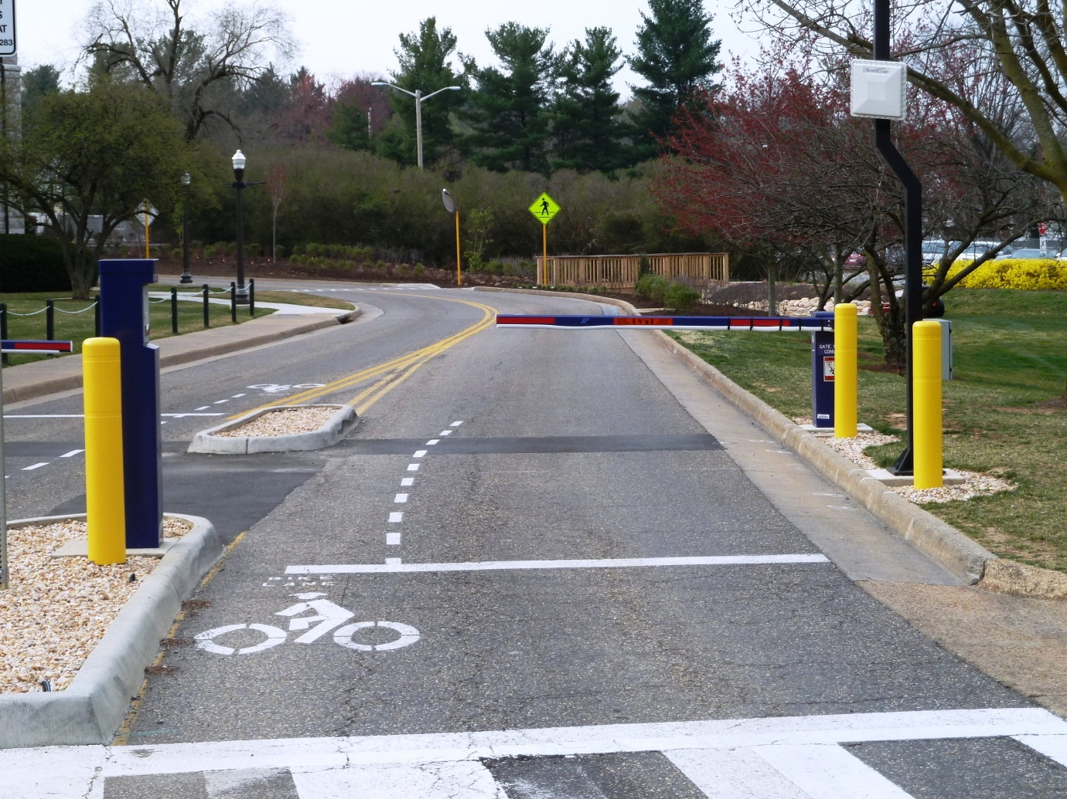
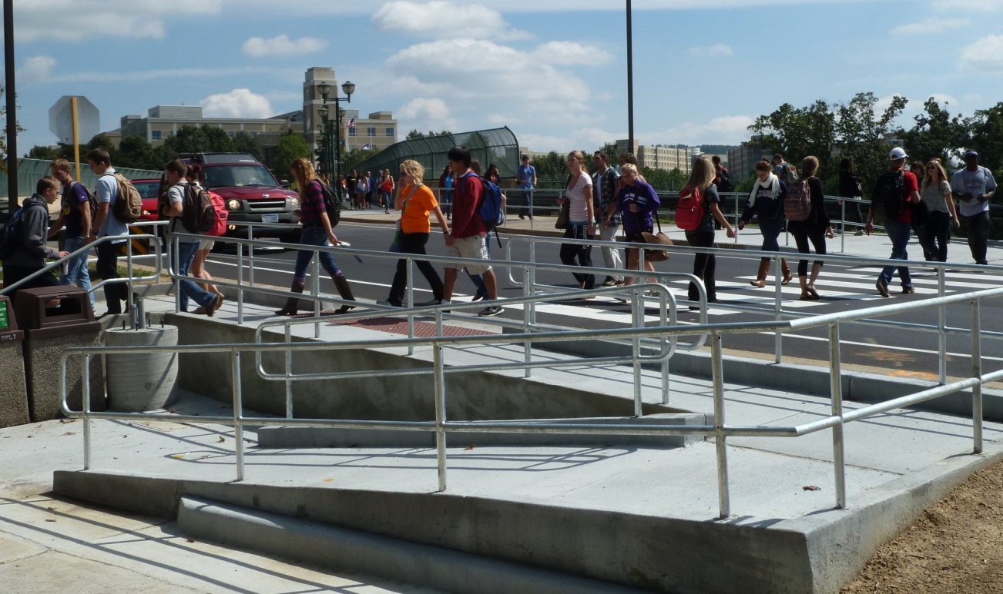
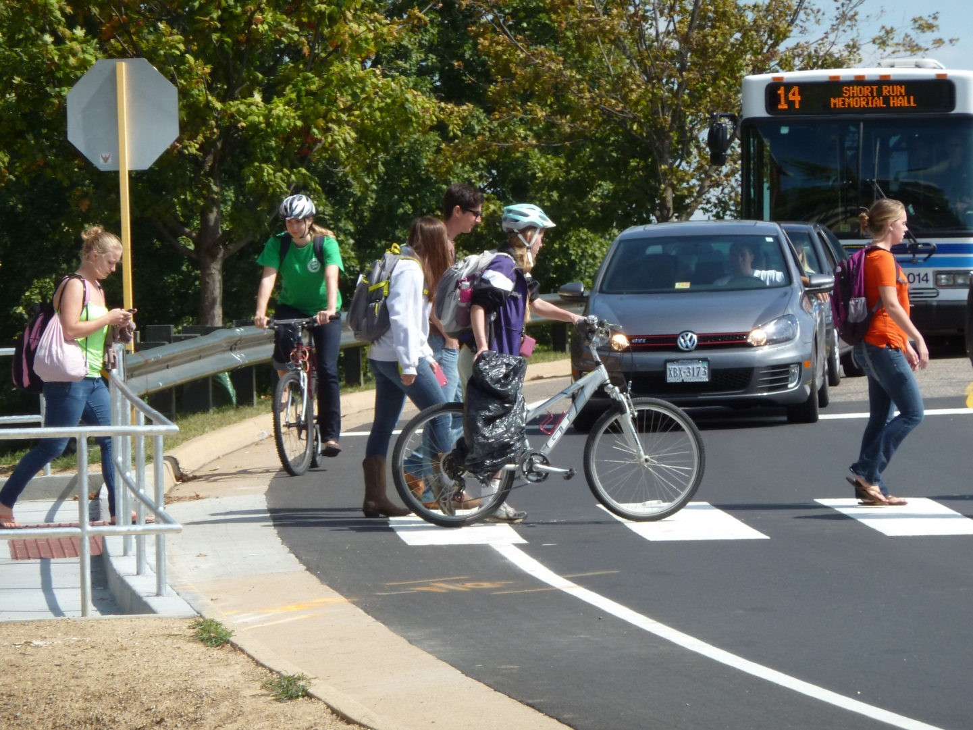
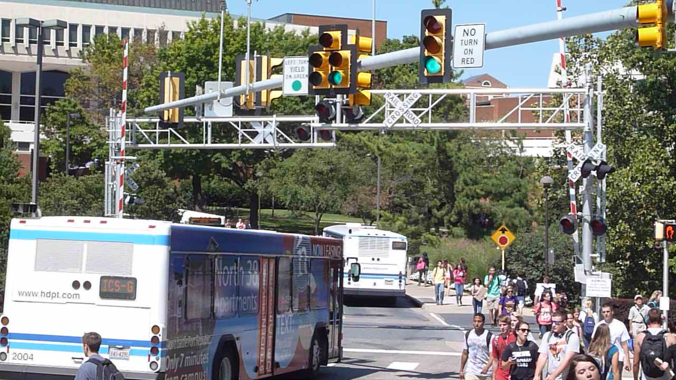
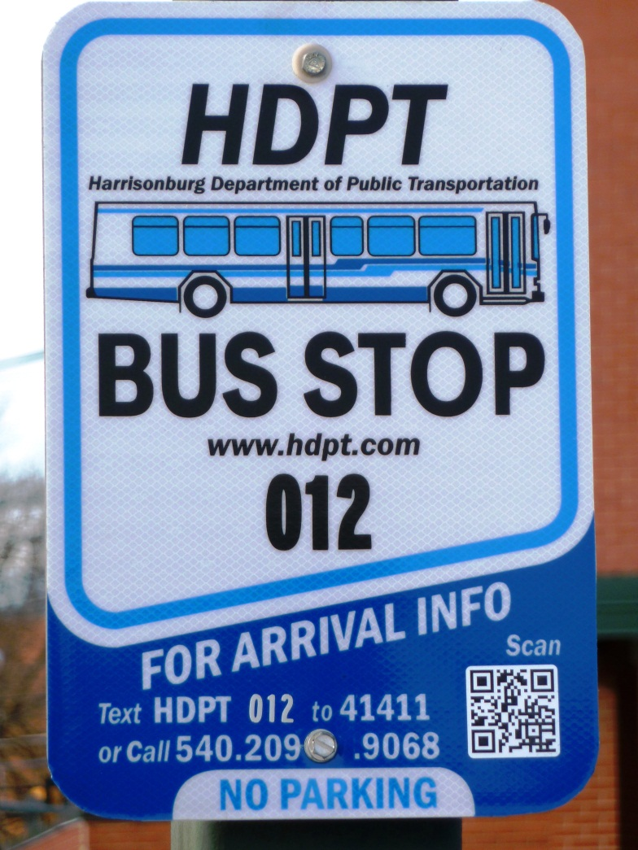
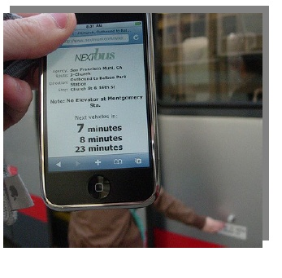
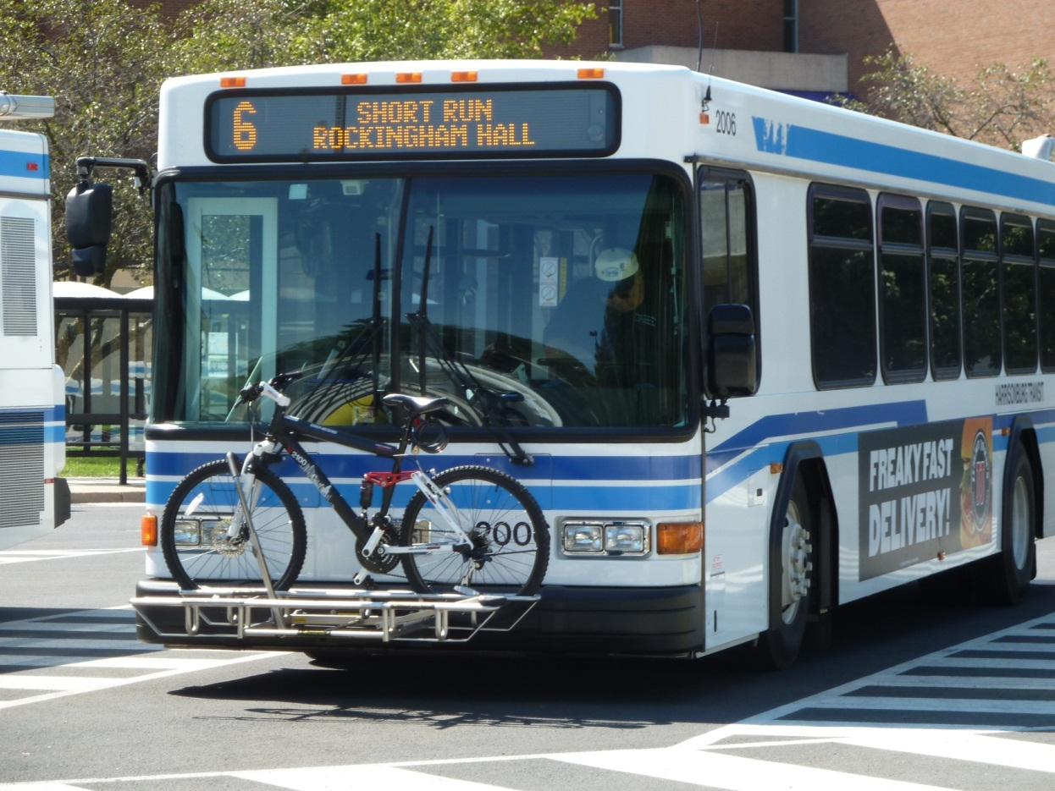
TRANSFORMING CAMPUS TRANSPORTATION, A CASE STUDY
Christie-Joy Hartman, Georgia Polacek, Elise Barrella, Stephanie Baller, and Lee Eshelman
Department of Engineering • Department of Health Sciences •
Office of Police and Public Safety • Office of Environmental Stewardship and Sustainability
Objective
Results
Health and Safety Attitudes
Share ideas for maximizing sustainability outcomes (such as increased transit ridership, greater student learning opportunities, and positive user attitudes) through cross divisional collaboration on campus transportation projects.
Change 1:
Convert the main campus to pedestrian/bicycle/transit access only during main hours
The Fall 2011 conversion included:
adding 4 gates so that private vehicles cannot travel through the Bluestone (West) section of campus on Mondays-Thursdays from 7:00 a.m. until 7:00 p.m., and on Fridays from 7:00 a.m. until 1:00 p.m.
providing turn-around space and call boxes at each gate.
installing RFID technology so that the gates open for emergency, service, and other specially authorized vehicles.
adding bicycle lanes along more streets and through the gates.
There is increasing evidence of serious health effects and chronic diseases correlated with sedentary lifestyles/physical inactivity. Walking and bicycling in lieu of single occupancy vehicle trips obviously increases physical activity. The campus transportation improvements were intended to remove some barriers to walking and bicycling, such as safety concerns, and thus enable increased physical activity. The campus Active Transportation Survey was conducted over four weeks in March and April 2013 to obtain information on student, faculty, and staff behaviors and attitudes toward active travel modes in part to gain insights into health and safety aspects of the university's transportation network. The sample (n=435) included employees (n=216) and students (n=219) with those responding to the optional physical activity questions having a bias towards physical activity. Most respondents (97%) reported feeling safe walking on campus whereas only 65% of students and 83% of employees indicated feeling safe walking in town. Only anecdotal evidence of safety attitudes was available from the time period prior to the transportation changes.
Introduction
"Travel smarter" is one of the World Resources Institute's "top climate action steps for colleges and universities." Commuting represents 23% and 16% of American College and University Presidents' Climate Commitment (ACUPCC) masters and baccalaureate institutions' reported greenhouse gas emissions inventories, respectively. Further, 68% of ACUPCC signatories have selected "encourage use of and provide access to public transportation for all faculty, staff, students and visitors" as one of the two or more (out of a list of seven) tangible action options to reduce greenhouse gases within the two years after the institution's implementation start date.
James Madison University (JMU), a masters-level, residential campus in Harrisonburg, Virginia, is among the many ACUPCC signatories that have prioritized reducing greenhouse gas emissions from transportation. This poster describes:
JMU’s transformation of its transportation system since 2011.
the measurable transportation service results.
factors affecting the changes including resources and challenges.
the ancillary benefits of the campus transportation changes in the areas of student learning, user attitudes, and cross divisional collaboration.
✚
Change 2:
Improve alternative transportation options
Improvements to alternative transportation options included:
converting a parking lot near central campus to an intermodal transportation hub.
scheduling inner-campus shuttle routes so that the wait between buses averaged ten minutes during main business hours.
removing parking spaces along a main route to enable bicycle/pedestrian access.
adding a pedestrian signal at a high traffic area.
adding seven new buses.
implementing a social-media based online ridesharing program, Zimride.
initiating car sharing with two vehicles via Zipcar.
Student Learning Opportunities
Incorporating campus transportation into courses on health and engineering was intended to better engage the students and improve their understanding of environmental effects. This approach was based on evidence in the literature that people are often more interested in learning when an immediate and concrete decision needs to be made, and people can more easily imagine effects on local places, as opposed to distant places, based on personal experience. Further, course and research activities around campus transportation provided a means for students to engage in active service learning that contributed to campus and community goals.
TABLE 1: Authors' recent courses that integrated the campus transportation changes as a real-world problem solving experience
Faculty members observed that students:
needed to be presented with explanations of the logistics and purpose of their project.
produced higher quality work on the practical transportation projects than on other similar projects- likely because they were motivated by their work being utilized.
gained value-added experience presenting findings to practitioners, such as consultants who were assisting the university’s transportation planning efforts.
had the opportunity to prepare conference or journal publications that enhance their professional resumes.
✚
Change 3:
Increase information dissemination
JMU implemented:
a web-based, interactive bus schedule.
a real-time bus arrival tracking system where riders scan QR Codes on bus stop signs.
a web hub for transportation information, NavigateJMU.
awareness campaigns.
comprehensive campus messaging and response.
Factors
=
There were multiple factors that affected the transformation:
Accidents and increased utilization created an urgency.
Environmental stewardship was a priority for campus.
A team from an internal, cross divisional employee leadership development program, IMPACT, recommended transportation improvements.
Senior leadership committed funding for a transportation demand coordinator position in addition to resources for consulting, design, and implementation.
The transportation demand coordinator was empowered.
Students and faculty worked with staff to collect more data than otherwise would have been available.
Measurable Results
As of Winter 2012:
traffic decreased by 36%.
accidents decreased by 25%.
bus ridership increased by 23%.
Estimated savings from the online ridesharing program was over a million vehicle miles. There were more than 9,000 active JMU users.
More than 35 students participated in learning opportunities associated with the data collection and/or planning process.

