Slide 2
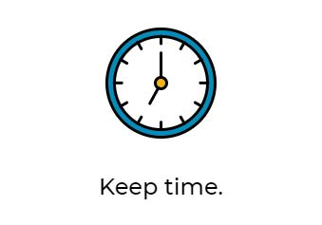
The sun is strongest between 10am and 2pm, so be mindful of how much time you spend outdoors during those hours. If your shadow is shorter than you are, seek shade.

Slide 3
Clouds do not block all UV rays, only some, so it’s important to wear sunscreen no matter what the weather forecast says.

Slide 4
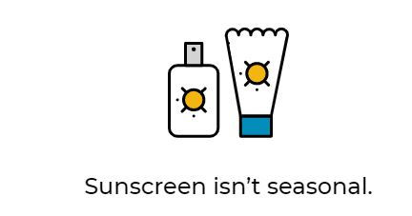
Daily sunscreen use can cut the incidence of melanoma in half. For the most effective protection, apply sunscreen with care 30 minutes before going outdoors, use SPF 30 or higher and reapply every two hours. For more information on how to select sunscreen click here.

Slide 5
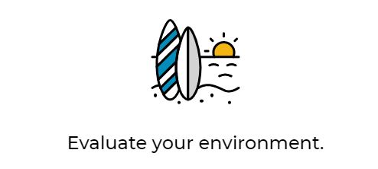
Use extra caution near water, snow and sand, as they reflect the damaging rays of the sun, which can increase your chance of sunburn. UVA rays can also penetrate glass, so apply sunscreen or wear protective clothing (like sleeves) while in the car.

Slide 6
James Madison University Department of Risk Management
www.jmu.edu/riskmgmt

