Slide 1
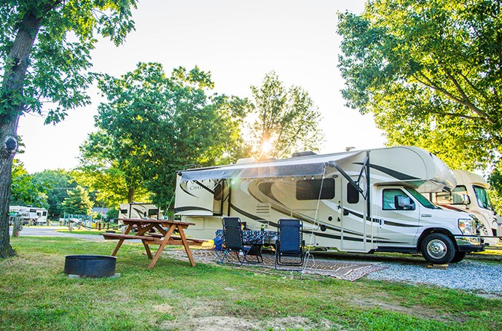
RV Safety
James Madison Department of Risk Management
www.jmu.edu/riskmgmt

Slide 2
RV Safety and Preparedness Tips to Stay Safe While RVing
Is RVing Safe?
Lots of people are curious about safety on the road, and how to prepare for uncertainty while living in such a small space.
It’s good to have a sense of caution when it comes to exploring remote areas and adventuring into the unknown. With the right preparation, RVing can be a safe and a fun way to explore.
Here are some RV travel safety tips, all in one place. Lots of these are useful no matter how you travel or where you live.

Slide 3
This rule of thumb sounds obvious, but it can be easy to forget. Whether you’re parked at a Walmart or in the middle of the forest, always be aware of what’s around you. When you stop somewhere, get out and take a look around before you commit to staying.. Uncomfortable feelings are a matter of perspective. Use your best judgment and only stay in places where you are comfortable.
Be Aware of Your Surroundings

Slide 4
Keep an Eye on the Weather
As RVers, you get up close and personal with the elements, so pay more attention to the weather more than you do living in a house. Keeping an eye on the weather is a key part of RV safety.
Always know the weather forecast for your area, along with your destination and your route on travel days. It doesn’t matter how sunny and nice it is right now. There are so many places where the weather can change from blue sky to angry thunderstorm faster than you’d think.
Heavy rain can mean the difference between a dry campsite and a mud pit that feels more like quicksand. While a bit of mud might dampen your camping experience (pun intended), a lot can extend your stay indefinitely by getting you stuck. RVs are heavy and difficult to pull out, so this can leave you with a large tow bill.
When pulling into a campsite or a boondocking site, look around to see if your site is on higher ground if there’s rain in the forecast. Also make sure you aren’t in the path of a wash. Don’t think you’re safe just because you’re in the desert, either. Flash flooding is common in many parts of the desert out west.

Slide 5
More RV Safety Tips for Weather:
Check the landscape where you are. Can you see clear paths where water flows or pools? You don’t want to be camped in these areas. Higher ground with good drainage is best.
Know the names of any bodies of water near your campsite, in case of a flood warning.
Know which county you’re camping in. Weather warnings and alerts will often be listed by county name, rather than by city. There’s nothing worse than scrambling to figure out whether you’re in the path of a severe storm or not.
Check the National Weather Service website for the updates in the United States.

Slide 6
Plan Ahead
Research the area. A few minutes of research about a place where you’ll be camped can make a huge difference in an emergency situation. Understand what services are available – or not – in your area. Where is the local hospital, vet, or mechanic?
Have an escape plan.
Park in such a way that if something were to happen, you can make a quick exit. Whenever you park for the night, always back into your spot. This way you’re facing the exit and ready to move quickly if needed. In the backcountry, make sure to know the routes in and out. At a campground, know where key resources are located (water, fire extinguishers, bathhouses for shelter, camp hosts, ranger stations, etc.) in case you need them.

Slide 7
Have a Way to Protect Yourself
Whether you’re at a campground or out in the wilderness, there may come a time when you need to protect yourself. This can mean protection from another person, or from a wild animal like a bear or mountain lion.
There is no shortage of choices when it comes to self-defense, from firearms to pepper/bear sprays to blunt objects. Pick the method that you feel most comfortable with. Then, practice using it. Whatever you choose, it’s important that you know how to use it before you ever need to. (And hopefully, you won’t.)

Slide 8
A checklist can help you make sure that loose items get properly secured, bay doors get closed, levelers get pulled up, tires get pressurized to a safe range, and so on. All too often people drive out of the campground with their awning or stairs out, or dragging their power cord behind them.
Create a Pre-departure Checklist

