Slide 1
Slips, Trips and Falls
JMU Risk Management

Slide 2
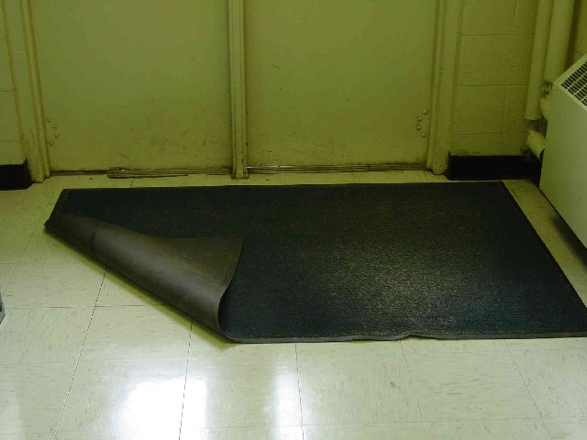
Slip, Trip and Fall Hazard
PROBLEM:
Slip: if it is wet outside and the mat is folded back, then the floor is getting wet instead of the mat absorbing the water.
Trip: the mat is folded back and someone could catch their foot on the mat and trip.
Fall: both a wet floor and caught foot could contribute to a fall.
CORRECT this HAZARD!

Slide 3

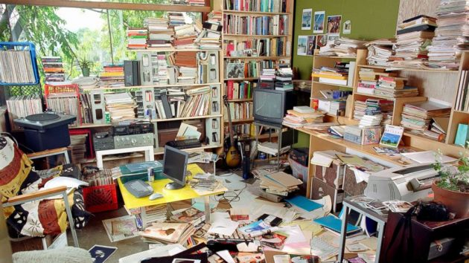
Factors Increasing the Risk
Not Paying Attention
Clutter
Look familiar???

Slide 4
Take Control of Your Environment
To further reduce the risk of falls, you should ensure that:
Aisles are clear
Floors are clean
Signs are present to warn of slippery areas
Wear shoes with good support and slip resistant soles
Cabinets and drawers are closed
Lights are functioning
Never stand on a chair or table – Use a ladder
PAY ATTENTION!

Slide 5
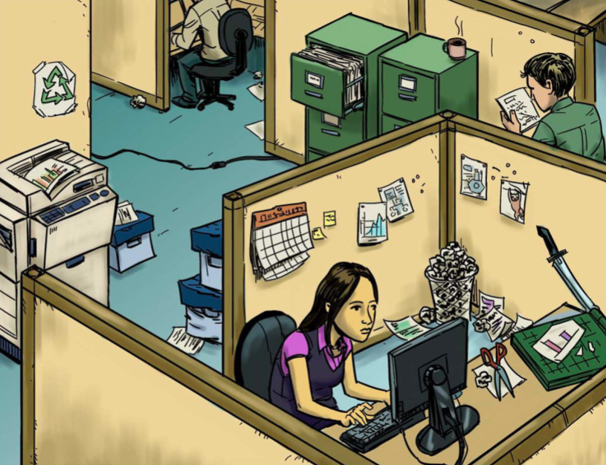
How many hazards do you see?

