Slide 1
Halloween Safety On and Off the Road
Kids love the magic of Halloween: Trick-or-treating, classroom parties and trips to a neighborhood haunted house. But for moms and dads, often there is a fine line between Halloween fun and safety concerns, especially when it comes to road and pedestrian safety.
In 2016, 7,330 pedestrians died in traffic or non-traffic incidents, according to Injury Facts. Non-traffic incidents include those occurring on driveways, in parking lots or on private property.
NSC research reveals about 18% of these deaths occurred at road crossings or intersections. Lack of visibility because of low lighting at night also plays a factor in these deaths.
Here's a scary statistic: Children are more than twice as likely to be hit by a car and killed on Halloween than on any other day of the year. In 2017, October ranked No. 2 in motor vehicle deaths by month, with 3,700. July is No. 1, with 3,830 deaths.

Slide 2
Costume Safety
To help ensure adults and children have a safe holiday, the American Academy of Pediatrics has compiled a list of Halloween safety tips. Before Halloween arrives, be sure to choose a costume that won't cause safety hazards.
All costumes, wigs and accessories should be fire-resistant
Avoid masks, which can obstruct vision
If children are allowed out after dark, fasten reflective tape to their costumes and bags, or give them glow sticks
When buying Halloween makeup, make sure it is nontoxic and always test it in a small area first
Remove all makeup before children go to bed to prevent skin and eye irritation

Slide 3
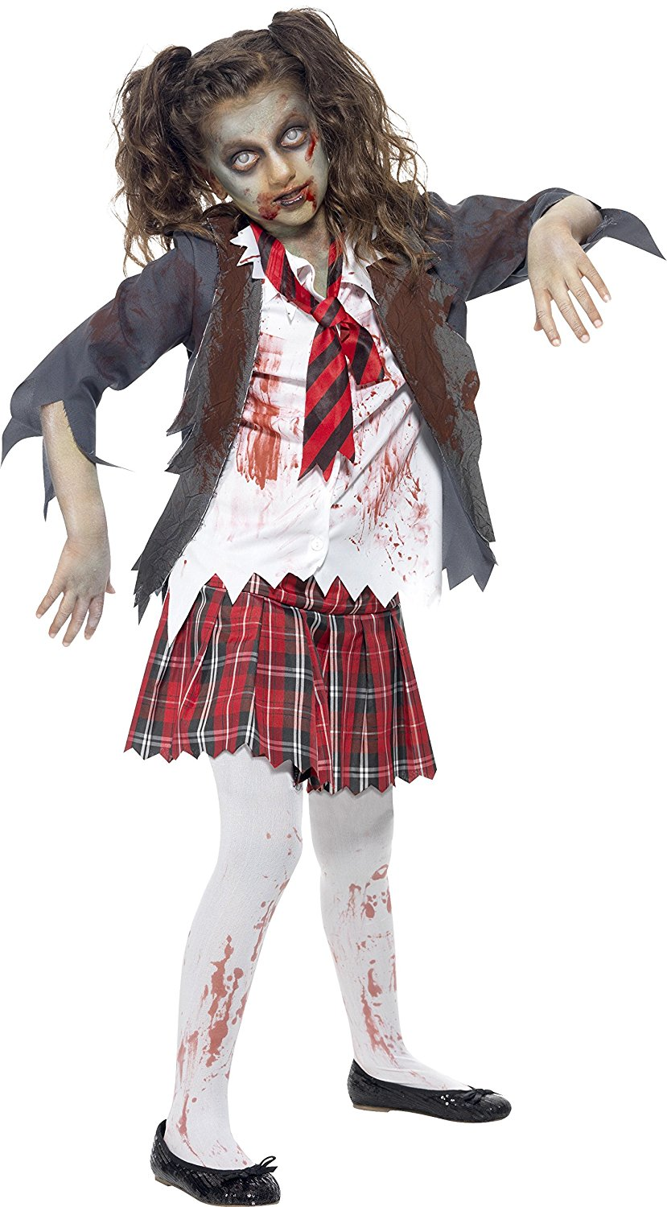
When They're on the Prowl
A responsible adult should accompany young children on the neighborhood rounds
If your older children are going alone, plan and review a route acceptable to you
Agree on a specific time children should return home
Teach your children never to enter a stranger's home or car
Instruct children to travel only in familiar, well-lit areas and stick with their friends
Tell your children not to eat any treats until they return home
Children and adults are reminded to put electronic devices down, keep heads up and walk, don't run, across the street

Slide 4
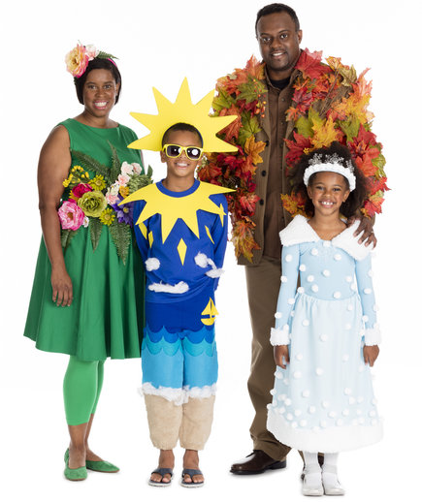
Safety Tips for Motorists
Additional safety tips for parents – and anyone who plans to be on the road during trick-or-treat hours
Watch for children walking on roadways, medians and curbs
Enter and exit driveways and alleys carefully
At twilight and later in the evening, watch for children in dark clothing
Discourage new, inexperienced drivers from driving on Halloween

