Slide 1
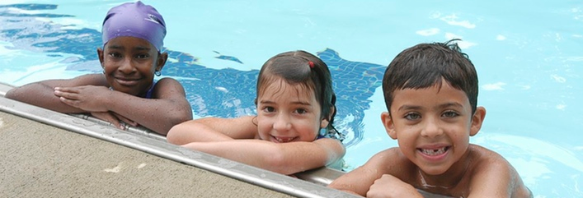
May is National Water Safety Month
As the weather warms up, pools are preparing to open and crowds are gearing up to head to the beach. National Water Safety Month is the perfect time to ensure you and your family are prepared to spend a fun, safe day by the water!
Contact your local aquatic facility to find Lifeguarding and Swimming classes, including:
Learn to Swim Course
Preschool Aquatics (Swimming Course for Children)
Parent and Child Aquatics
Home Pool Essentials
Swimming is the most popular summer activity. While the best thing you can do to help your family stay safe is to enroll in age-appropriate swim lessons, it is also important to follow these water safety tips whenever you are in, on or around water:
Swim in designated areas supervised by lifeguards.
Always swim with a buddy
Never leave a young child unattended near water
Have young children or inexperienced swimmers wear U.S. Coast Guard-approved life jackets around water, but do not rely on life jackets alone.
Establish water safety rules for your family and enforce them without fail.
If you go boating, wear a life jacket! Most boating fatalities occur from drowning.
Avoid alcohol use. Alcohol impairs judgment, balance and coordination; affects swimming and diving skills; and reduces the body’s ability to stay warm.
Take a minute today to sign up for a swimming course and review water safety tips before summer arrives.

Slide 2
https://www.jmu.edu/recreation/aquatics/pool-hours.shtml
Take advantage of the facilities here at JMU for your swimming and learning needs!
JMU Swim Lessons @ UREC
https://www.jmu.edu/recreation/aquatics/lessons.shtml
Presented by:
JMU Department of Risk Management
https://www.jmu.edu/pubsafety/SafetyOffice.shtml

