Slide 1
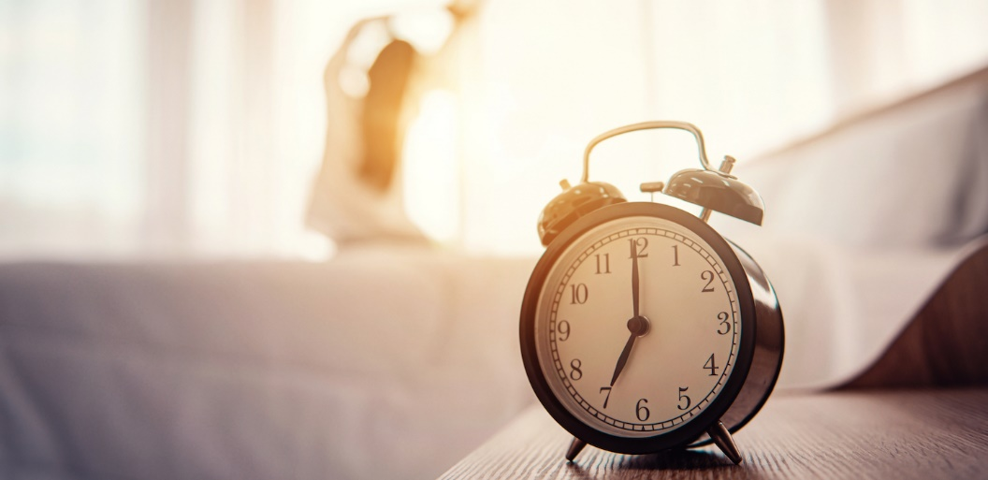
How Does Daylight Saving Time Affect Sleep?
Learn How DST can disrupt your circadian rhythm
James Madison University
Department of Risk Management

Slide 2
Daylight Saving Time (DST) is the yearly practice of setting clocks forward one hour1 between the months of March and November. The idea behind DST is to conserve – or “save” – natural light, since spring, summer, and early fall days typically get dark later in the evening compared to late fall and winter days. The non-DST period between November and March is known as Standard Time.
Daylight Saving Time
Adjusting the time by one hour may not seem like too drastic a change, but sleep experts have noted troubling trends that occur during the transition between DST and Standard Time. These include upticks in heart problems, mood disorders, and motor vehicle collisions. Furthermore, DST can cause sleep problems if circadian rhythms are not aligned with natural cycles of light and darkness. Some people also experience insomnia symptoms due to time changes

Slide 3
How Does Daylight Saving Time Affect Sleep?
Humans and other mammals are guided by circadian rhythms, which are 24-hour cycles that regulate sleep and other key bodily functions such as appetite and mood. These rhythms are largely dependent on light exposure. In order to reset each day, they must be synchronized with natural light-darkness cycles in order to ensure healthy, high-quality sleep.
The transition between DST and Standard Time is characterized by more morning darkness and evening light. This can essentially “delay” your sleep-wake cycle, making you feel tired in the morning and alert in the evening. Circadian misalignment can contribute to sleep loss, as well as “sleep debt,” which refers to the cumulative effect of not getting enough sleep on a regular basis.
Humans are most vulnerable to sleep deprivation in early March, as they transition from Standard Time to DST. One study found that the average person receives 40 minutes less sleep on the Monday after “Springing Forward” compared to other nights of the year. Researchers have also noted negative effects that occur during the transition from DST to Standard Time in November. In addition to sleep loss, people are at greater risk of mood disturbance, suicide, and being involved in traffic accidents during both bi-annual transition periods. However, experts suggest that long term, there is a reduction of accidents as more people drive home from work in daylight.
While many people adapt to time changes, some studies have suggested the human body never fully acclimates to DST. Rather, their circadian misalignment may become a chronic or permanent condition. This can lead to more serious health problems, especially for those who experience “social jet lag” because their demands at work or school take precedence over a full night’s sleep. Social jet lag has been linked to a higher risk of obesity, depression, and cardiovascular disease. The effects of DST subside gradually after a few weeks.
DST is associated with many negative outcomes and risk factors that some experts advocate for abandoning the system altogether in favor of a year-round time. They argue a permanent standard time is more in line with human circadian rhythms, and that this schedule would carry benefits for public health and safety. On the side of the argument, people in favor of DST argue that at least 70 countries around the world observe DST as it decreases energy consumption, reduces costs, and protects the environment. There is also evidence that crime rates decrease with the use of DST due to the lack of dark hours.
Arizona, Hawaii, Puerto Rico, and the U.S. Virgin Islands do not practice DST, and in 2020, 32 other states have pursued legislation to adopt DST as the permanent year-round time.

Slide 4
Daylight Saving Time Sleep Tips
In the days and weeks leading up to time changes, you can prepare yourself for the adjustment by taking the following precautions:
Practice Good Sleep Hygiene: Sleep hygiene refers to practices that can influence sleep for better or worse. In order to ease the transition of the time change, you should avoid caffeine up to four hours before bedtime. Also, refrain from consuming alcohol before bed. While drinking can cause you to feel sleepy initially, alcohol also causes sleep disruptions and leads to poor sleep quality. Heavy dinners and snacks before bedtime can also negatively affect how well you sleep that night.
Establish a Consistent Sleep Routine: Going to bed and waking up at the same time each day – including the weekends – is a healthy sleep hygiene practice that can also prepare you for time changes. Make sure you get at least seven hours of sleep9 each night before and after transitioning to or from DST.
Gradually Alter Your Bedtime: Two to three days before the transition between Standard Time and DST in early March, sleep experts recommend waking up 15-20 minutes earlier than usual. Then, on the Saturday before the time change, set your alarm clock back by an additional 15-20 minutes. Adjusting your wake-up time can help the body make a smoother transition when the time change occurs.
Spend Time Outdoors: Since natural light is a driving force behind our circadian rhythms, exposure to sunlight can alleviate feelings of tiredness during the day that often accompany time changes. Spending time outside during the day also suppresses the production of melatonin, a hormone released in the evening to help you feel tired and ready for bed.
Nap in Moderation: People who experience sleep debt as a result of DST may find some relief by taking short naps during the day. These naps should never exceed 20 minutes in length; otherwise, you may wake up feeling groggy. Rather than adjusting your wake-up time on Sunday morning immediately following a time change, consider a nap that afternoon instead.

Slide 5
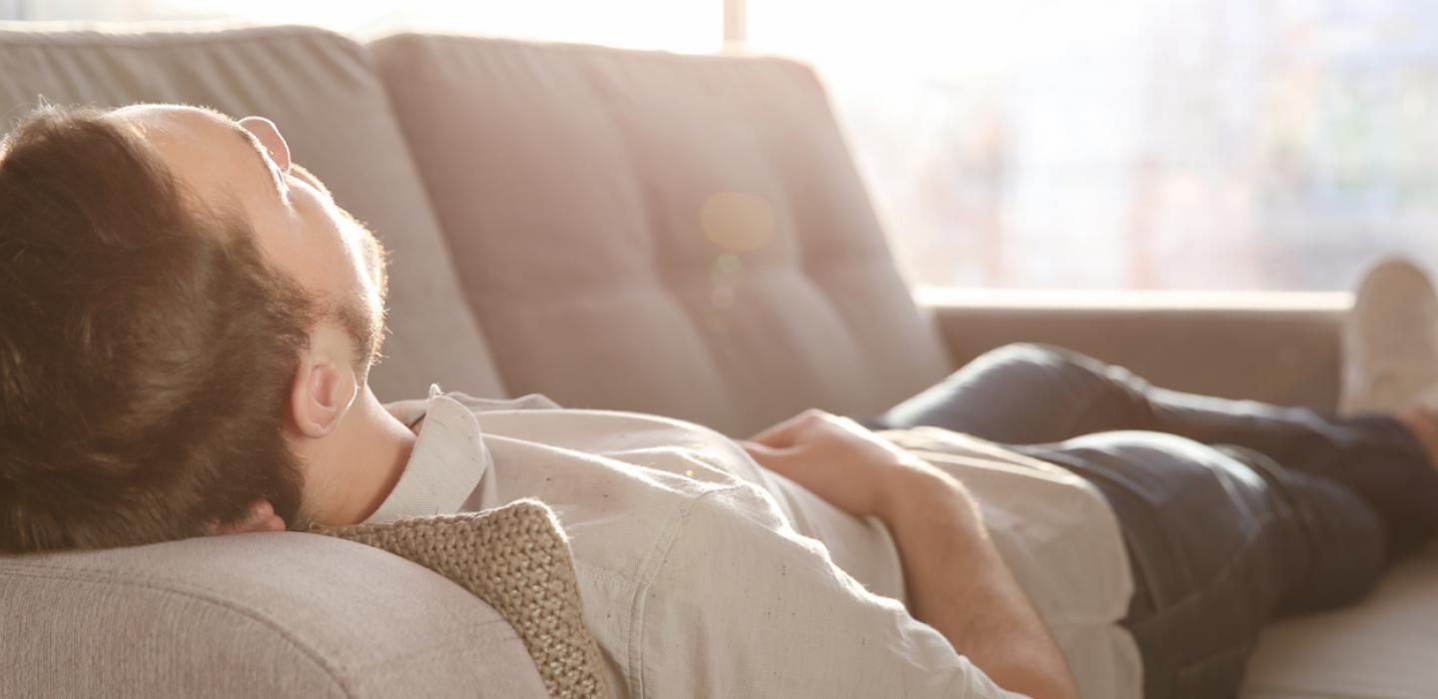
https://www.sleepfoundation.org/

