Slide 1
CORONAVIRUS RESOURCES TO KEEP KIDS SAFE FROM INJURIES
During this time when the world is working together to prevent the spread of COVID-19, Safe Kids Worldwide is committed to the safety and well-being of children and their families.
As kids of all ages are spending more time at home, we have created several coronavirus resources and blogs on home, road and play safety to help educators and families protect children.

Slide 2
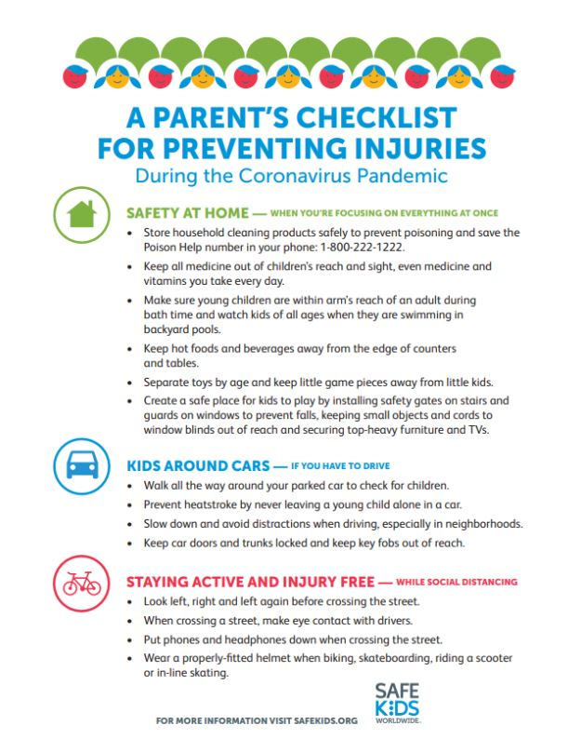

Slide 3
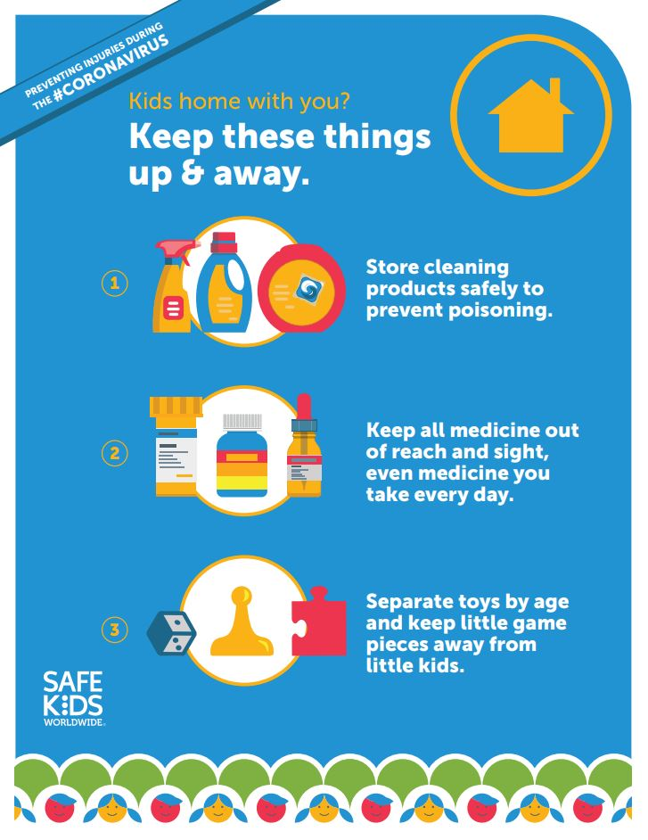

Slide 4
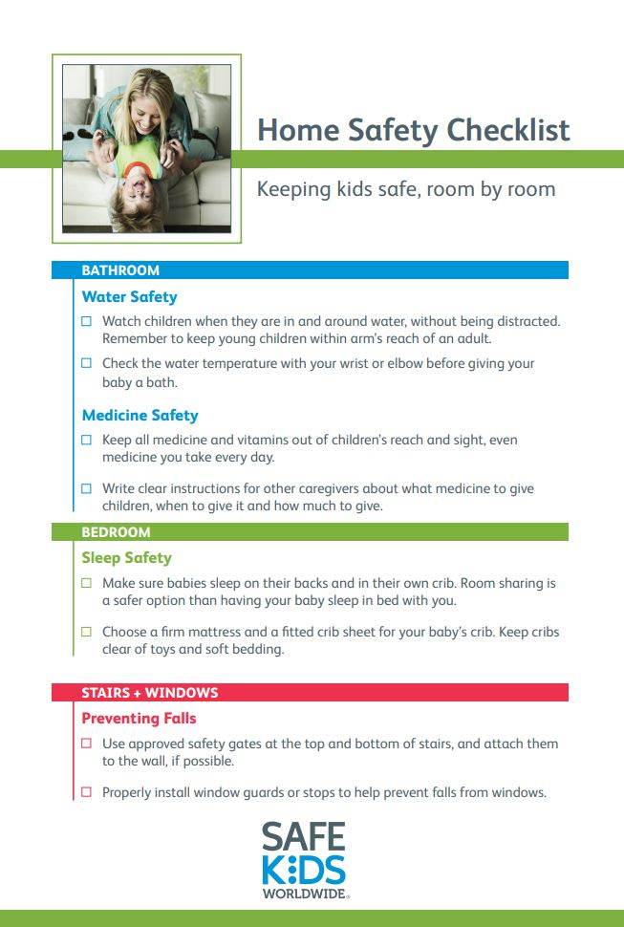
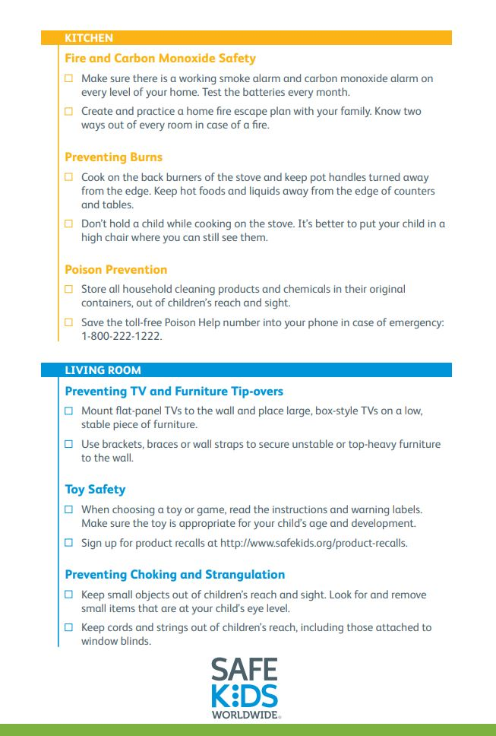

Slide 5
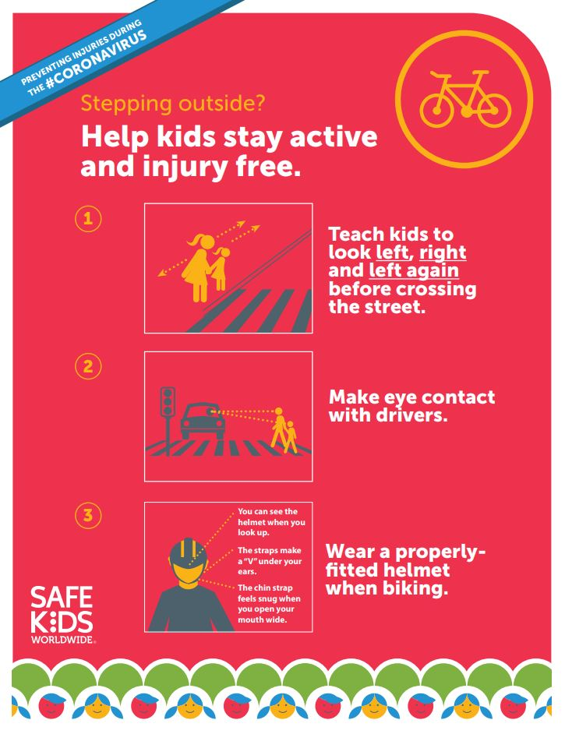

Slide 6
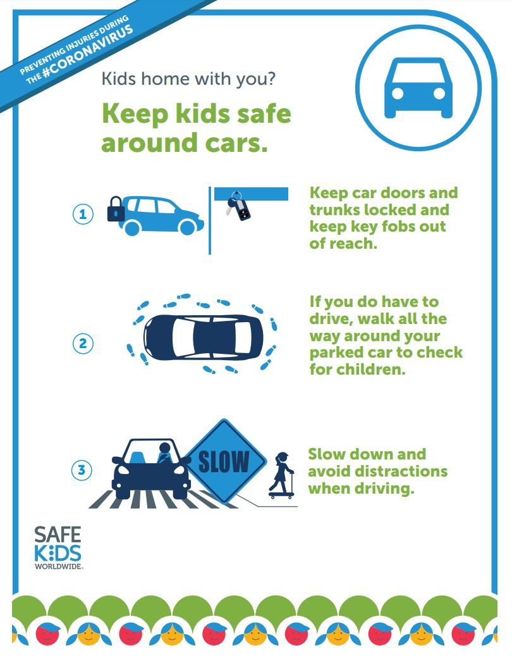

Slide 7
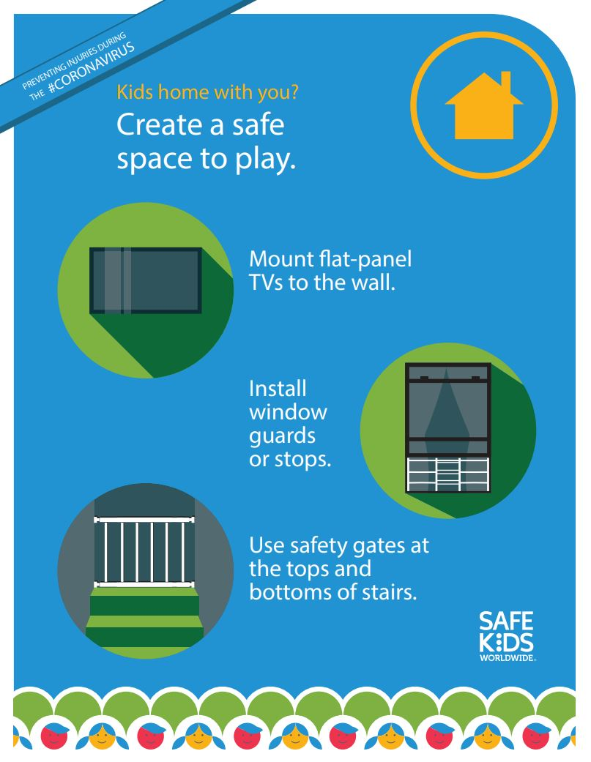

Slide 8
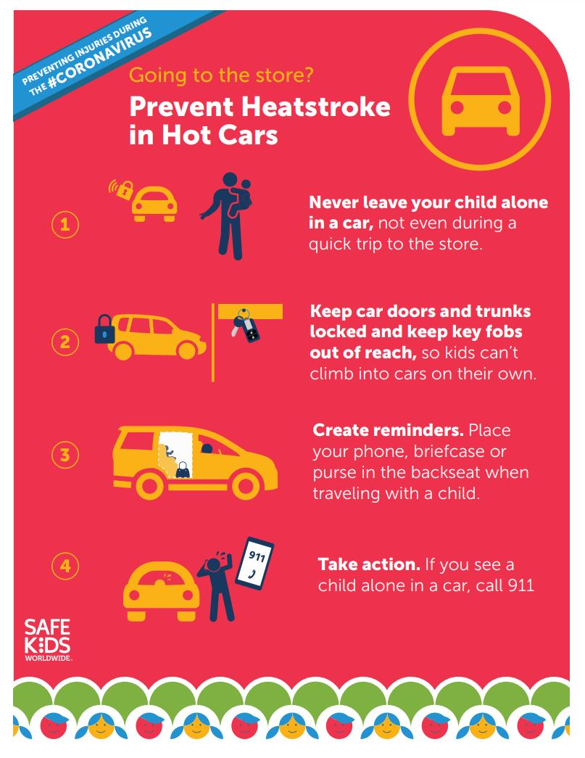

Slide 9
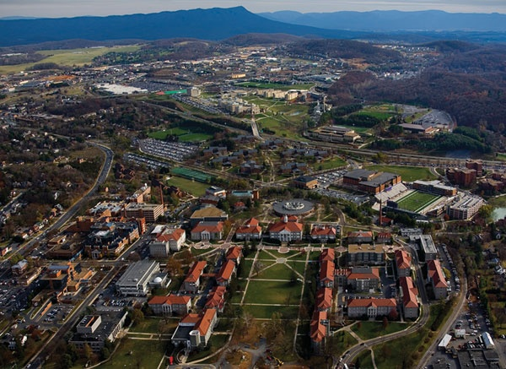
James Madison University
Department of Risk Management
www.jmu.edu/riskmgmt

