Slide 1
Welcome Treasurers

Slide 2
Sport Club Council
Mission: To govern and promote both competitive and non-competitive recreational opportunities for undergraduate and graduate students who choose to participate in the sport club program.

Slide 3
Chris Jones
Assistant Director of Sport Clubs
jones4cr@jmu.edu
•Coordination and administration of the Sport Club program
•Risk management, allocation of facilities, final approval over sport club budgetary issues

Slide 4
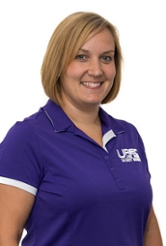
Lisa O’Fallon Assistant Director for Budget and Finance
ofallolr@jmu.edu
Responsible for daily business functions for all UREC programs and operations

Slide 5
Donna Bitar Payroll and Budget Manager
bitardd@jmu.edu
Responsible for student payroll and budget reporting

Slide 6
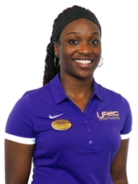
Nora Osei
Graduate Assistant
•Shares in in the coordination and administration of the Sport Club program
•Ensures that club offerings represent the current needs of students
•Works 15-20 hours per week
osei3mx@jmu.edu

Slide 7
MAILBOXES
Your Clubs mailing address:
James Madison University Recreation, CO/Club’s name, MSC 3901 Harrisonburg, VA 22807
All club mailboxes are located in the Sport Club Office, 3rd floor UREC room #313
All forms should be turned in to the SCC Treasurer. If not available, put them in the SCC Treasurer mailbox
Make sure to check your mailbox weekly for mail
Expecting reimbursment? Check your mailbox before you email
If you’re expecting mail during the summer make sure to let Chris Jones know to make a note to check for you

Slide 8
BUDGETS
Clubs should prepare and maintain a yearly budget
Budgets help determine what to charge for dues and how much fundraising is needed.
Focuses on planning for:
Tournaments
Hotels
Vans
League fees
UNFORESEEN EXPENDITURES such as broken equipment, etc.
Your SCC contact will ask you about your Club’s Peronsal Budget when they check in for your Core-Four Meeting
Notes:
Kelly– Stress importance of sharing with the club where their money is going

Slide 9
BUDGET EXAMPLE
Item
Revenue
Expense
Date
Beginning Balance
$
1,130.00
Dues
$2,000.00
Fundraiser
$435.09
8/24/2014
Cookout
$56.44
8/26/2014
Entry Fee for Race
$300.00
9/29/2014
Team Uniforms
$1,200.00
10/22/2014
11/4/2014
$3,565.09
$1,556.44
$2,008.65
Revenue
Expense
Total
Notes:
Kelly-clubs should estimate expenses for all events, they should include their dues in their budget as well. Really anything that has money attached to it, league fees, official fees, equipment, coaches, etc….Equestrian has a really well done budget each year, I’m sure they would share their template with other clubs.

Slide 10
CHECKING ACCOUNT
There should be two officers on the account
President
Treasurer
The checkbook and check-cards should only be handled by these two people
You are responsible for keeping track of revenues and expenses
Deposit all cash/checks within 5 days of receiving it
Loose money can get lost or stolen
Notes:
Kelly– Ask to see if they all have accounts, if not, get a list of who doesn’t and we will work with them to make it happen!

Slide 11
UREC Account
Handled by the SCC Treasurer
How your money is determined:
Last school year your club got points for:
Community Service
Attending meetings
Turning reports in on time
Each point is worth approx. $46
These accumulated points are now reflected in your UREC account balance
What you do this year will carry through to next year
Beginning Balances have been sent out
Notes:
Possible to have example
Your club earned 44 points last year: 44 x $46 = $2,024.00 for this year
What you do this year is reflected in the following year, so be a leader and earn money for your team!
Let them know at the end of the slide that we have their allotted amount for each club today if they would like to see it after the presentation.

Slide 12
UREC Account (cont.)
Income for your UREC Account:
Supportive Funds
Sport Club of the Month ($50)
Expenses from your UREC Account:
Hotels
JMU Vans (email Chris Jones)
Team uniforms
Team equipment
Referees/Umpires/Judges
Trainers/Coaches
Airfare to tournaments
Tournament and league fees
Notes:
Kelly
-Talk about Supportive Funds, done on an application basis with a presentation to follow. Applications are accepted starting Oct 1. This is really based on need and the application must be thorough to be evaluated. Let them know that more information is on the www.jmu.edu/recreation under sports club page and forms
-Describe what we are looking for in SCOTM
-emphasize that all vans go through Chris Jones, jones4cr@jmu.edu
-We will go over the different scenarios later (for expenses)

Slide 13
UREC Account (cont.)
You cannot use your UREC account for:
Gas (except for a state vehicle)
Food
Social events
Items under $50
Using your UREC account takes time
UREC to prepay with card – 3 weeks ahead
League fee’s, tournament fee’s, airfare
Your UREC Account does not roll-forward to the next year
It must be used by May 1, 2017
Must be a planned expenditure including all TA’s handed into me by April 1st
Notes:
Kelly
The 3 weeks early is a very STRICT deadline. No forms will be accepted less than 2 weeks when the event or money will be happening/needed.

Slide 14
Supportive Funds
Proposals submitted to Jamie (SCC President)
To be considered submit between October 1st – February 28th
Approval is based on the big picture and your clubs standing with the council
Include budgets from UREC and personal accounts
Funds awarded throughout year

Slide 15
Foundation Account
The JMU Foundation is for handling private gift funds given to James Madison University (or Sport Clubs)
Not all clubs have a Foundation Account
Income:
Donations from individuals
Club members can write letters asking for donations
The donors can get a tax write-off
Expenses:
Same as the UREC Account
Contact the SCC Treasurer if you need to use your Foundation Account
This money rolls forward from year to year
Notes:
Lisa – foundation money is reimbursed only, not paid out front
Hotels
JMU Vans (email Chris Jones)
Team uniforms
Team equipment
Referees/Umpires/Judges
Trainers/Coaches
Airfare to tournaments
Tournament and league fees

Slide 16
Quick Summary
UREC Account
Uniforms
Equipment
Entry fee
Hotel rooms
Your club’s checking account
Goods for pre-tournament dinner
Team wristbands (personal item)
What About transportation?
If you are driving, you must use your club’s checking account to pay for the gas
You can rent a JMU van using your UREC Account.
Contact Chris Jones (jones4cr@jmu.edu)
Notes:
Kelly
Talk about! Ask them which ones they would put into where.
1st click: title
2nd click: UREC Account
3rd click: Checking
4th click: transportation

Slide 17
Travel Authorization
When looking to get reimbursed from your UREC account
Entry Fees (tournament fees) and Hotels are done using the same form
Travel Authorization forms are needed every time that you are traveling and using your UREC account to pay for part or all of the trip
The complete TA packet must be turned in at least 3 weeks prior to travel.
Roster
Invoice
If you are not traveling (you have an event at JMU) then you do not need a TA
Meet with the SCC Treasurer or SCC President
Notes:
Lisa – any fee associated with being able to participate in a tournament
-university vehicles are done through an email with Chris, do not need to be included on TA
-we will try our best to be flexible with deadlines, but if you want something paid for guaranteed, we need 3 weeks!

Slide 18
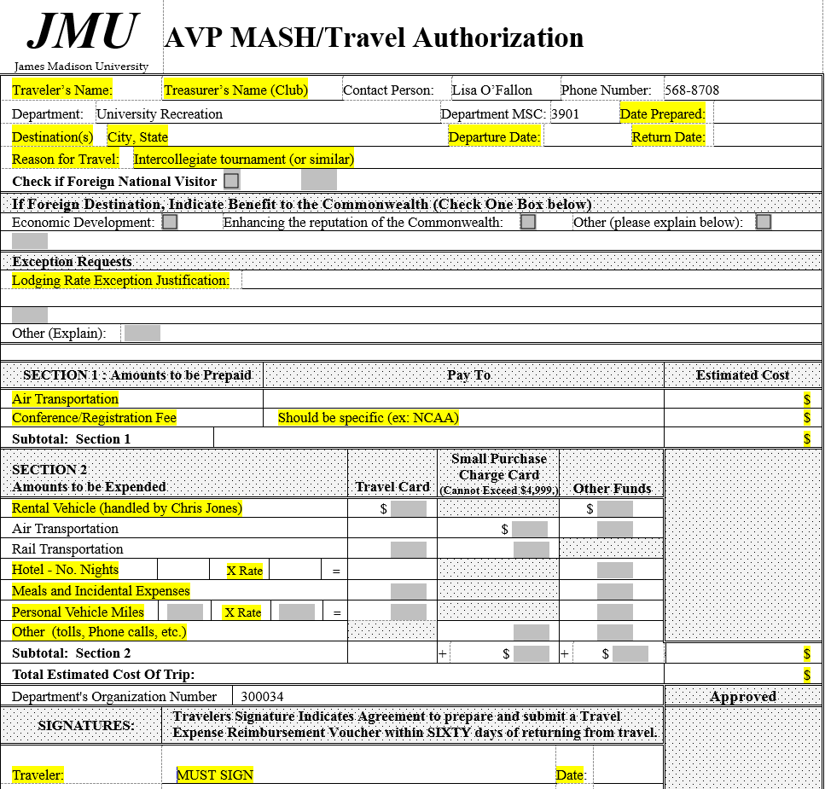
1
2
3
4
5
Notes:
This is going to be small. Print out copies for everyone. It’s under your file, folder Treasurer Documents labeled “TA_DESCRIPTIVE”

Slide 19
I. Basic Information
This form is found online
Make sure you fill out all the highlighted areas.
Contact person should say “Lisa O’Fallon”
Destination: if you are traveling to a university, make sure you include the city in which it is located
Reason for travel: “college tournament” or “club competition” or the name of the event

Slide 20
II. Entry Fees
This is where you put information for the entry fee
Make sure you fill out the “Pay To” column
For example, if you will be writing a check out to NCAA, write “NCAA” in the “Pay To” column
Write in the amount of the entry fee
Highly encourage an attached invoice of entry fee

Slide 21
III. Hotels
Hotels need to be under per diem.
https://www.jmu.edu/financemanual/procedures/4215mie.shtml
Know the zip code of the hotel to verify per diem rates
Not under per diem? Your club will only be reimbursed up to the per diem amount!
Example: Per diem is $88, you find a hotel room for $92. Your club will only be reimbursed $88 for the room.
Hotels cannot be considered a spa, resort, or luxury hotel
They need to be standard, 4-person room hotels

Slide 22
III. Hotels (cont.)
You’ve found the hotel you want to stay in, what now?
You may book the necessary hotel rooms that you need if you have already turned in your TA packet
DO NOT pay for them until the TA has been approved
You will receive an email
On the TA fill out the number of nights, number of rooms, and price per room for hotel
Attach a printout with hotel information to the TA
Address and price
Notes:
Kelly

Slide 23
On Your Return
All receipts must be turned in within 5 business days
Copy of bank statement showing that your club has paid (Club name must be shown on statement)
Itemized Hotel Reciept showing zero balance
Entry Fees
Turn in a Reimbursement Receipt Form
Found online
http://www.jmu.edu/recreation/Programs/SportClubs/forms.html
Must be signed by the person you are giving the payment to
Example: tournament director, president of competing school team
Notes:
Kelly– at check in to hotel it is very important to tell them you will need a receipt after your stay showing your balance at $0

Slide 24
Please Take Note
Once the paperwork has been turned in to JMU Accounts Payable, it is out of our hands
Reimbursements take 30-40 business days
We have no control on speeding up the process
Reimbursements do not happen within a few days of turning it in to Accounts Payable
Please be understanding of this, and realize we can not guarantee the reimbursement by a certain date
You will be emailed when the check has arrived at UREC, and will be put into your club’s mailbox on the 3rd floor of UREC
Notes:
Lisa

Slide 25
Where Are These Forms?
www.jmu.edu/recreation
Click on “Sport Clubs”
Click on “Club Resources”
Click on “Forms”
Scroll down to “Expenditure and Reimbursement”
Travel Authorization
Reimbursement Receipt
Purchase Request
Merchandise Approval Form
Notes:
Tatum

Slide 26
Tax Info
W-9 Forms
The W-9 form states your club’s Federal Identification Number
Your team should have a W-9 on file with UREC
If not, you will be emailed
In order to be reimbursed, your team must have one on file
Feb-April be on the lookout for forms from the IRS in mailbox
Don’t ignore them
Filing Tax Return
Must fill out a 990 form every year by May 15th
Please see a Certified Public Accountant if you need assitance with getting your tax exempt status reinstated.

Slide 27
Wrapping Up
If you need anything, please email us!
JMUSCCTreasurer@gmail.com
JMUSCCPresident@gmail.com
Remember, the sooner you turn in forms, the better!
That way, if something is wrong we have time to get it fixed
Have a Great school year!
Notes:
Kelly
Tell them you will be emailing this PowerPoint out to them, it’s a good source of information

