Slide 1
Spring Flowers
Learn about flowers and different plants in your neighborhood!

Slide 2
Learning Outcomes
Identify three common plants (Red Deadnettle, Downy Serviceberry, Blue Violet) covered in the presentation.
Understand the biology of spring blooms and how they contribute to the reproduction of plant species.
Be able to identify at least one non-native plant species.
Describe how non-native plants can affect the native plants in an ecosystem.
Notes:
Disclaimer: It is not recommended to ingest edible plants due to possible serious consequences of misidentification and ingestion of pesticides and fertilizer.

Slide 3
Spring Blooms and Pollination
Flowering begins when the days grow longer
Flowers in bloom produce pollen
Pollinated flowers fall off the plant, leaving fruit or seeds for reproduction
Common pollinators: Bees, hummingbirds, butterflies
Notes:
The days growing longer emits more light and heat, which awakens the plant from its dormant winter state.
Pollen produced by the flowers is transferred between flowers and plants by insects, animals, and the wind.
This pollen transfer allows the plants to reproduce and produce seeds.
4. These common pollinators are all attracted to the nectar in the flowers, which they consume as the pollen collects on their bodies and is transferred to the next plant that the pollinator drinks from.

Slide 4
Plant Identification: Red Deadnettle
Scientific name: Lamium purpureum
Non-Native Species (Native to Europe and Asia)
Purple hue in upper leaves
Leaves clustered together with intermittent purple flowers
Part of the mint family (Lamiaceae)
Notes:
Very common plant, can be found in 38 states and Canada.
Very invasive species
Does not sting, nettles on these plants are considered “dead”, hence the name “deadnettle”, plants evolved to look like nettles to defend against predators
Edible, leaves taste grassy and floral and the top purple parts have sweet tones.
Toxic to dogs, can be found on edges of sidewalks so look out while walking your dog.
Mashing the leaves to create a paste can be used to disinfect external wounds

Slide 5
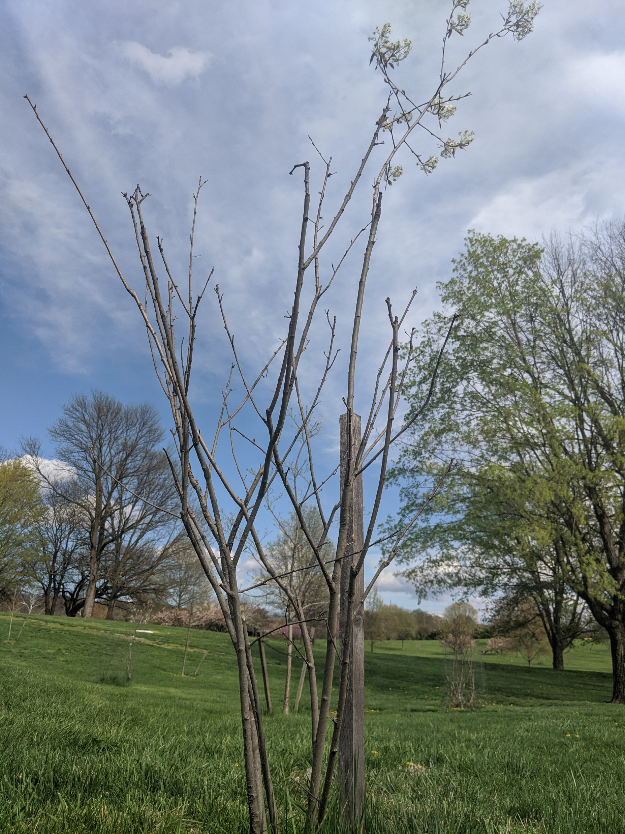
Plant Identification: Downy Serviceberry
Scientific name: Rosaceae Amelanchier arborea
Native Species
Identified by 5 elongated white petals to each flower with many flowers clustered together in bunches.
The bark of this tree is ashy grey in color with long vertical cracks up and down the trunk.
Can be confused with the American beech tree due to color similarity.
Notes:
Native to Eastern U.S.
Named the “serviceberry” because by the time it flowers it is usually warm enough to dig a grave and have a funeral service
Cherokees used this tree for many purposes:
Used berries to make a tea which was believed to aid digestion and remove intestinal worms.
Used the straight wood produced by the branches to make arrow shafts

Slide 6
Plant Identification: Blue Violet
Scientific name: Viola sororia
Native
Very short plant, less than 8” tall.
Wide, heart-shaped leaved that are deep green in color
Vibrant purple flowers with 5 petals.
Notes:
Another variety called “Confederate Violet” has white petals with purple hues.
Hosts he eggs of the Fritillary butterfly, whose caterpillars eat the leaves.
Edible, flowers and young leaves are edible, older leaves and stems are not edible.
Bland flavor.
Mashed paste of the leaves historically used to externally relieve headaches and colds (Works like Vicks VapoRub or other similar products).
Some believe that the flowers on these plants can lower cancer risk.

Slide 7
What is a non-native plant?
Native plants: Can be found in a specific geographic region and was not introduced by human interference
Non-Native plants: Introduced to a region by human influence
Tourism
Settlers
Travelers
Notes:
Some non-native plants can be beneficial to an ecosystem, for example the Crested Wheatgrass plant, which is commonly used for soil stabilization in arid climates and forage material for predators to distract them from eating native plants.
Most non-native plants are not beneficial and can actually be quite harmful to an ecosystem.

Slide 8
What is an invasive species
Invasive plants: Non-native plant species which steal the nutrients and space from native plants
Can drive a native species to extinction
Identifies most non-native plant species
Notes:
Earlier in this presentation, I described the Red Deadnettle plant. This plant is non-native and very invasive. It can be found almost anywhere and steals the soil nutrients and space away from native plant species.
1. Some vine varieties and similar plants can physically suffocate native plants by wrapping around leaves and stems to prevent sunlight access

Slide 9
How can we prevent native extinction?
“Leave no Trace”
Follow the 7 principles:
Plan ahead and prepare
Travel and camp on durable surfaces
Dispose of waste properly
Leave what you find
Minimize campfire impacts
Respect wildlife
Be considerate of other visitors
For more information about “Leave no Trace”, visit lnt.org!
Notes:
Overall, we should “leave no trace” and leave things the way we found them when we go out in nature
While these rules are all important, these four should be emphasized for native plant protection:
2. This rule will help to ensure that you aren’t crushing native plants with your tent while camping
3. Properly disposing of waste can help prevent soil pollution, which keeps the soil nutritious and in good condition for the roots of native plants.
4. Refrain from picking flowers, bringing plants home, and stick to taking pictures and admiring the plant in its natural habitat.
5.Responsible campfire management can prevent large forest fires and maintain the environment in an ecosystem.

Slide 10
How to identify new plants
Google lens
PlantSnap app (available on Android and iPhone)
Books

Slide 11
Challenge
Go out in your neighborhood or backyard (maintaining a 6-ft distance from others and remaining in permitted areas) and take note of different plant species that you find. Use one of the identification books and apps to confirm the species. Take note of any rare or invasive species.
Notes:
How can the information gathered affect the ecosystem? Can this explain the abundance of deer in this area? Is this plant the reason why there is a beehive nearby?

Slide 12
Resources
https://www.jmu.edu/oir/oir-research/statsum/2017-18/T2-8_2017.pdf
Provides data concerning the geographical location of where JMU students are resourced. Derived most popular states by which had over 500 students attending JMU.
https://www.nrcs.usda.gov/wps/portal/nrcs/detail/national/technical/nra/nri/results/?cid=stelprdb1041704
Provides information about non-native plant species. Goes over how they can be beneficial.
https://www.invasiveplantatlas.org/subject.html?sub=5175#maps
This website lists out all reported plant species in the united states and identifies them as native or non-native
https://uswildflowers.com/detail.php?SName=Lamium%20purpureum
This website lays out information about red deadnettle plants
http://dendro.cnre.vt.edu/DENDROLOGY/SYLLABUS/factsheet.cfm?ID=9
This website lays out information about downy serviceberry
https://www.gloucesterva.info/DocumentCenter/View/4071/Common-Blue-Violet-April-2016-PDF
Lays out information about common blue violet
https://uswildflowers.com/detail.php?SName=Viola%20sororia
Also lays out information about common blue violet
https://www.uky.edu/hort/Downy-Serviceberry
Fun facts about the downy serviceberry
https://www.hgtv.com/outdoors/gardens/garden-to-table/edible-common-blue-violet-for-your-supper-plate
Fun facts about violets
https://www.wildflower.org/expert/show.php?id=972
Information about what defines a plant as native
https://lnt.org
The official website for Leave no Trace

