Slide 1
How to Operate your HVAC system
Apartments on Grace

Slide 2
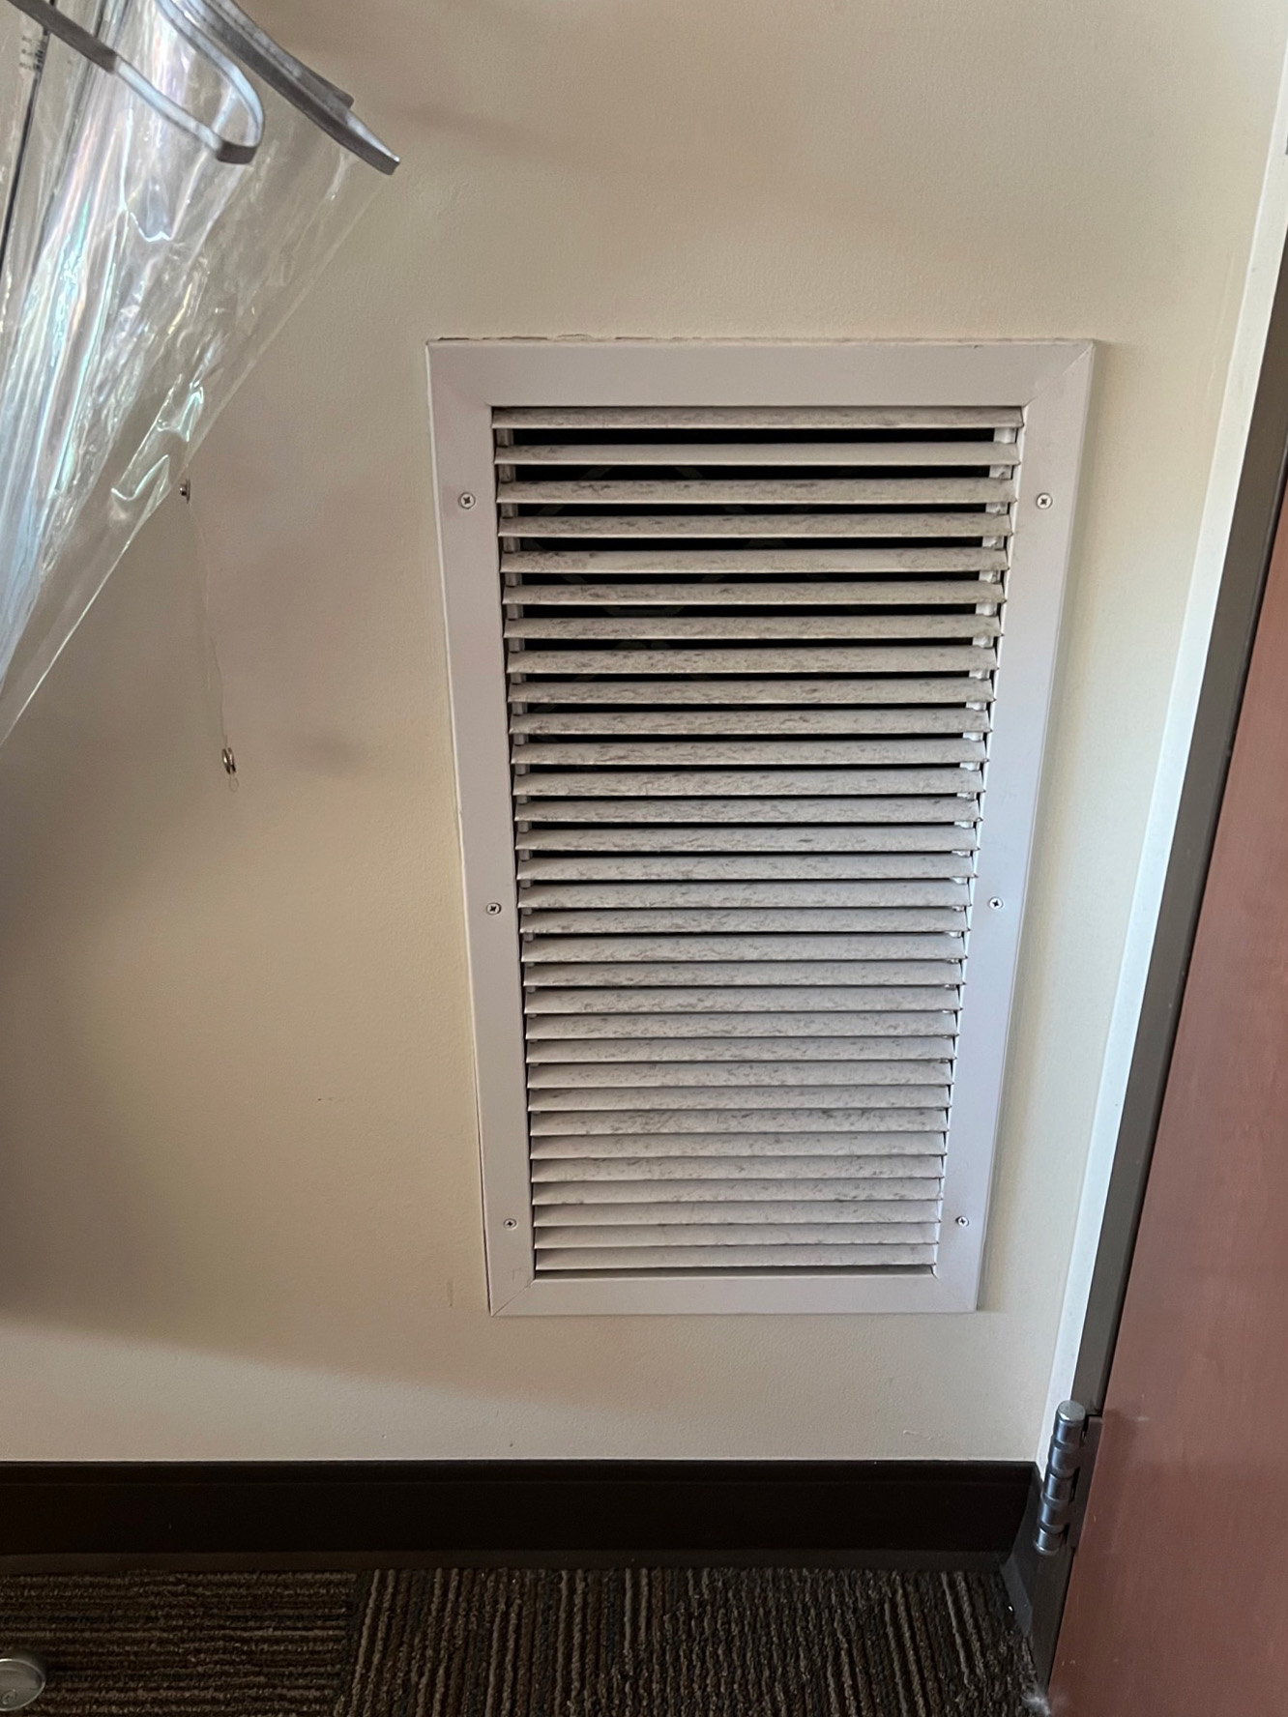
Avoid Restriction of Air Flow

Slide 3
Setting your HVAC Unit Residents can control the temperature of their rooms with their thermostat; please be sure to keep the temperature between 68-76 degrees (does not depend on outside air temperature).

Slide 4
Temperature Regulations
Above 60 degrees
Below 60 degrees

Slide 5
HVAC Operation Tips
Keep WINDOWS CLOSED when cooling
Do not set temperature below 70 degrees when cooling
Do not place furniture or other items on top or within 12 inches of the unit
Report leaks, moisture intrusion and/or signs of microbial growth on our online work order system

Slide 6
How to report a non-functioning unit…
To fill out a maintenance request to fix the unit visit: http://www.jmu.edu/orl/maintenance/
An air conditioning unit that is not functioning properly is not considered an emergency. It may take 3 to 5 business days for the unit to be serviced.
Only non-functioning heating units are an emergency.

Slide 7
THANK YOU!
We look forward to seeing you on campus!
GO DUKES!

