Slide 1
Payroll Services Automated Student & Wage Employee Timesheet Training Last Updated: November 2016
Contact Information:
Jessica Hensley - henslejg@jmu.edu / 8-6233

Slide 2
Course Agenda
Why does JMU need to use a new timesheet?
What’s different about the new version?
How to navigate the timesheet
How to fill out the timesheet
Reminders from Payroll Services
User Tips
Additional Resources

Slide 3
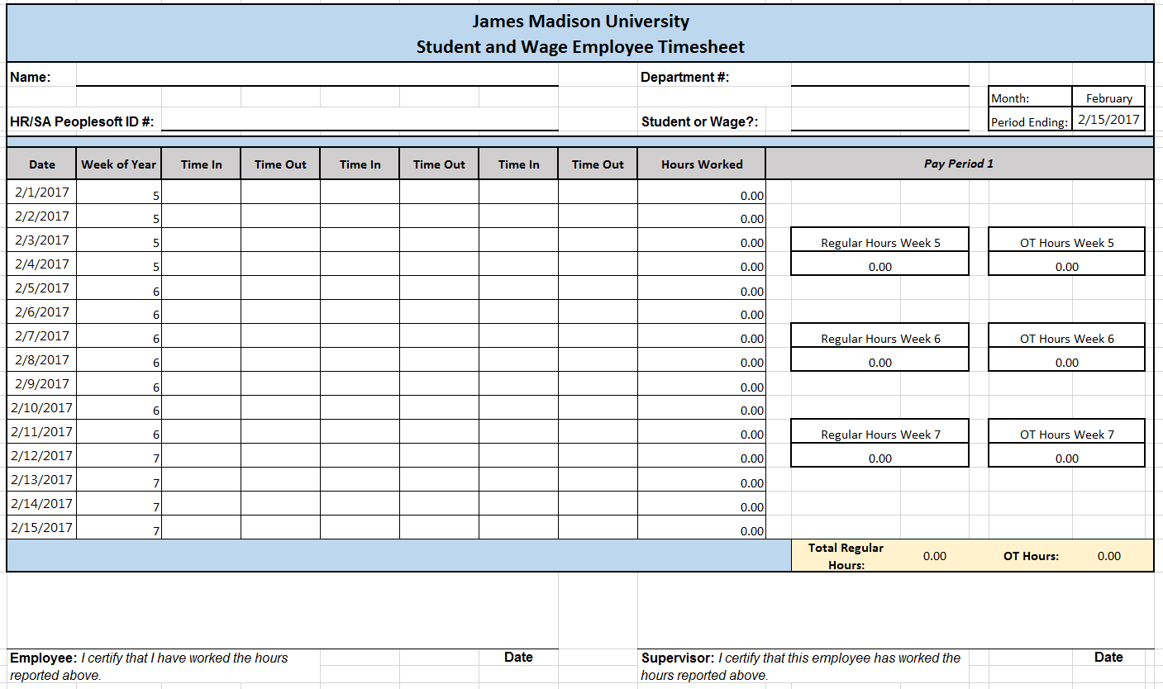
Why does JMU need to use a new timesheet?
Concerns over the improper calculation of overtime pay using manual timesheets prompted the University to look for a better solution.
Accounting Technology came up with a new Excel based timesheet that will automatically do all of the regular and overtime hours subtotaling and totaling based off of the user’s time entry selections.

Slide 4
What’s different about the new version?
The main feature of the timesheet is its ability to reference back to the prior pay period tabs to determine hours already worked within a particular calendar week.
This is what allows for proper overtime pay calculation, and addresses the problems that JMU was seeing in manually calculated timesheets.
The ‘Employee Information’ tab allows the user to enter their identifying information one time, and have it carry over to all pay period tabs. There are also some helpful user instructions and payroll reminders on this tab.

Slide 5
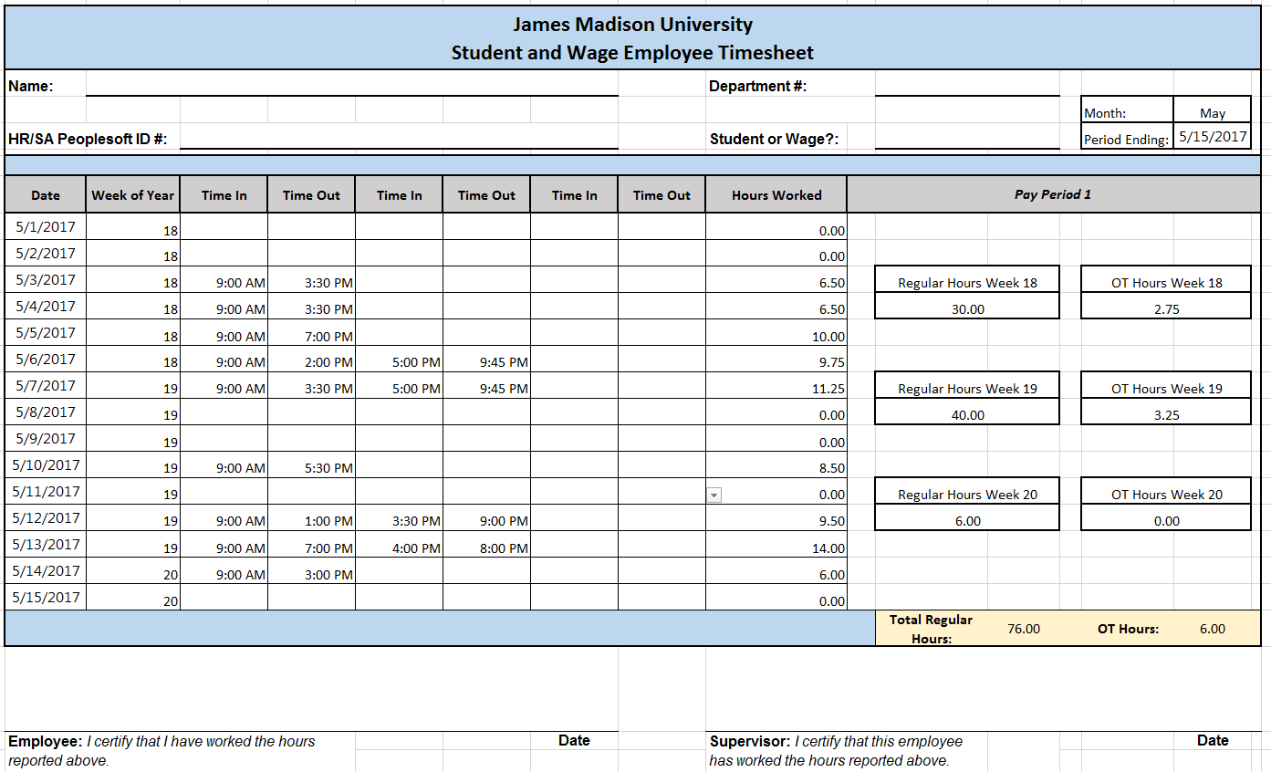
What’s different about the new version? (continued)
All cells on the pay period tabs are locked except for the ‘Time In’ and ‘Time Out’ cells. The user simply needs to select their ‘Time In’ and ‘Time Out’ information, using the drop-down functionality in each cell. The spreadsheet will then automatically do all of the subtotaling and totaling of both regular and overtime hours.
The bottom bar that displays the ‘Total Regular Hours’ and ‘OT Hours’ is what will get keyed into HRMS Time-Entry for each pay period.

Slide 6
How to navigate the timesheet
There are 25 tabs total in the workbook.
1 for employee information and user instructions/reminders.
24 that represent each pay period throughout the calendar year.

Slide 7
How to fill out the timesheet
Fill out the Student/Employee Information boxes on the ‘Employee Info’ tab. This one-time entry will carry your Name, Department #, Employee Type, and HR or SA # into the corresponding fields in all of the pay period tabs.
Navigate to the current pay period tab and choose the correct ‘Time-In’ and ‘Time-Out’ selections by using the drop-down functionality.
Only fill out cells in the pay period you are being paid for. Any time retroactively entered into a previous pay period will cause improper calculation of hours for future ones.
If a time adjustment needs to be made to a prior pay period, due to missing a pay period cut-off or incorrect entry, please reference the instructions on how to handle those situations in Slide 8 of this presentation.
Once you have completed the timesheet for the current pay period and reviewed your entries for accuracy, print out the form in landscape orientation, sign it, and submit to your supervisor to review and sign.

Slide 8
Reminders from Payroll Services
The new timesheet is required to be used by all hourly wage employees and student employees, except for those departments who are currently using electronic time keeping systems that comply with the Financial Procedures Manual.
The supervisor is responsible for verifying all hours, including validating that the previous pay period’s hours have not been modified since the last submission (unless additional hours are owed as a result of the pay period being cut-off or a needed correction, see below).
In situations where the department may need to make corrections to a prior pay period or cut-off a pay period early due to an early time entry deadline, the employee will need to adjust their timesheet accordingly.
If a department needs to cut-off their pay period to meet our designated deadline, they can, but they should not project hours. Hours must be cut-off too. Any hours worked after the cut-off date must be submitted on the next pay cycle.
If a prior pay period’s timesheet is adjusted after hours have already been processed for that pay period, then the employee will need to provide the corrected timesheet(s) to their supervisor and/or timekeeper.
Any hours previously paid will need to be subtracted from the revised timesheet by comparing the two versions.
Additional hours owed will need to be manually added to the current pay period’s hours and keyed via Time Entry.
The revised timesheet should be signed and attached to the former timesheet and maintained for audit purposes.

Slide 9
Reminders from Payroll Services (continued)
If no break was taken during the day, ‘Time Out’ must be reported in the first available ‘Time Out’ field in order for the spreadsheet to properly calculate the hours.
i.e. Cannot use ONLY ‘Column D’ & ‘Column G’, ‘Column D’ & ‘Column I’, or ‘Column F’ & ‘Column I’
Pay close attention to the yellow “carry-over” box on the last pay period in December. This amount will need to be keyed into the corresponding yellow “carry-over” box on the first pay period in January for the next year’s timesheet.
These hours will not be paid a 2nd time, but it is what allows for proper OT calculation in the event a student or wage employee is working over Winter Break, when the work week is split across two separate calendar years.
Always make sure you are using the correct year’s timesheet.
Using a prior or future year’s timesheet will improperly calculate hours, as the excel calendar function is what drives the calculations.
The upcoming year’s timesheet will be made available on Payroll Services’ web-page each December, in advance of Winter Break.

Slide 10
User Tips
Always validate the calculation of regular and OT hours.
Not only does this ensure that regular and OT hours are properly calculated and paid, it will allow Accounting Technology to receive valuable feedback about any bugs that exist so that fixes can be implemented.
Make sure that the correct time entry is selected from the drop-down lists.
i.e. AM vs PM.
‘Copy and Paste’ functionality works in this spreadsheet and is especially helpful for students or wage employees that work similar shifts on a day-to-day basis.
Verify that the hours are calculated properly when using copy/paste.
Avoid using autofill functionality.
Avoid using ‘Cut and Paste’ functionality. This will cause the locked calculated cells that use the time entry cells for the calculation to error due to a bad cell reference.

Slide 11
Thank you for your cooperation in adopting the new timesheet!
Please let us know of any questions you may have.
Payroll Services Contact Information:
Jessica Hensley - henslejg@jmu.edu / 8-6233

