Slide 1
COVID-19: Supporting Students’ (and Our Own) Mental & Emotional Health & Well-Being
Jeffrey Ng, Psy.D. Director Counseling & Psychological Services Fordham University

Slide 2
What to Expect: Grief
Notes:
Our students have experienced many abrupt and unexpected losses and will need time and space to grieve.

Slide 3
What to Expect: Stages of Grief
Denial – Shock; Avoidance; Disorientation; “This is not really happening!”
Anger, Anxiety & Fear
Anger about imposed disruptions/restrictions and loss of agency/control
Anger towards decision makers (politicians, health authorities, Fordham) & perceived source(s) of pandemic (China, Asians, Asian-Americans)
Health & safety concerns for ourself and others
Worry about academics, internships, job market, finances
Uncertainty about duration and implications of pandemic, and what the future holds
Bargaining – negotiating to change the reality of the situation or circumstance
Depression
Sadness about abrupt and unexpected losses (milestones, celebrations, future plans, relationships, etc.)
Loneliness, Boredom and Helplessness
Acceptance – Reconciliation; Meaning Making; Pivoting; Planning; → Resiliency/Growth

Slide 4
What to Expect: Stages of Grief
Notes:
Grieving is not a linear or pre-determined process

Slide 5
Students Who May be More Vulnerable
Students with pre-existing mental and behavioral health concerns, such as anxiety, depression and substance abuse/dependence.
Graduating seniors who are grieving the abrupt loss and disruption of their anticipated "senior experience."
Asian and Asian-American students who may be experiencing sinophobic and anti-Asian bias, stigmatization, discrimination, prejudice, stereotyping, etc.
International students due to travel related restrictions and potentially extended separations from family and friends.
Students who experience being in school and campus life as protective factors.
Students who struggle with loneliness and social isolation.
Students who are returning to family or home environments that may compromise their mental and emotional health.
Low income students who may not have secure housing, food, wifi, or other essential resources for online and remote instruction.

Slide 6
Strategies for Coping & Protecting Mental Health
Practice Self-Compassion
Be kinder, gentler and more patient w/ ourselves rather than judgmental, punitive or harsh
Recognize and accept that imperfection and vulnerability are inevitable and part of the human experience
Be flexible w/ expectations and goals
Set reasonable boundaries for ourselves and w/ others
Limit Social Media & News Consumption
Reduces risk for vicarious trauma
Increases likelihood that our emotional & behavioral responses are proportional to actual rather than hypothetical or sensationalized situations.
Stay informed, but not be flooded or overwhelmed
Sustain Social & Relational Connections
“Social distancing” involves physical distancing not relational or emotional distancing

Slide 7
Social Distancing ≠ Social Disconnection

Slide 8
Strategies for Coping & Protecting Mental Health
Maintain Reasonable Structure & Routine
Attend to Basic Needs (sleep, nutrition, exercise, etc.)
Gratitude – research demonstrates that practicing being thankful enhances resiliency, happiness and well-being
Accept Vulnerability- acknowledge, lean into and process negative emotions rather than denying, neglecting or suppressing them; healthy distractions, however, are ok when feelings are too overwhelming as long as we return to the feelings; embrace uncertainty and impermanence
Get Outside (while maintaining physical distancing)
Strengthen Self Care Practices - exercise, yoga, reading, journaling, art, video games, movies, cooking, music, etc.
Internal Locus of Control – focus on internal rather than external locus of control

Slide 10
Mindfulness Meditation
Reduces anxiety &“fight or flight” response by de-escalating autonomic nervous system arousal/activation.
Promotes moment to moment awareness of internal experiences (feeling, thoughts, bodily sensations, etc.) while decreasing over-identification with those experiences.
Cultivates equanimity or the mental capacity to relate to experiences non-reactively and with evenness, calmness and composure.
Promotes living and being in the present moment.

Slide 11
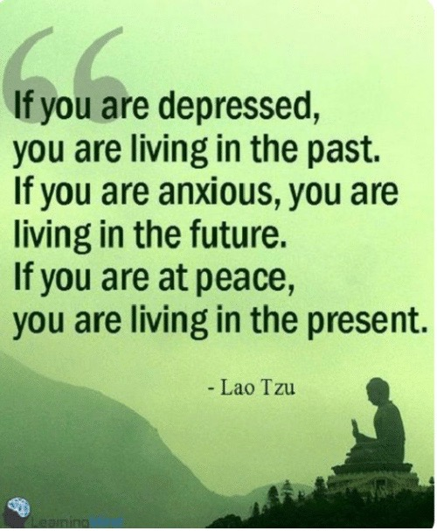
Mindfulness Meditation

Slide 12
https://www.healthline.com/health/mental-health/top-meditation-iphone-android-apps
Recommended Mindfulness Resources
Koru Mindfulness for College Students
https://student.korumindfulness.org/free-guided-meditations.html

Slide 13
When to Seek Professional Help, Support & Consultation
Persistent sadness, anxiety, anger, hopelessness, worthlessness, loss of interest in pleasurable activities, and/or feelings of being overwhelmed.
Significant impairments or changes in functioning, such as sleep, getting out of bed, appetite, concentration, and/or hygiene.
Impulsive, reckless or risky behaviors (substance abuse, self-injury, etc.)
Thoughts or expressions about death, dying and/or suicide

Slide 14
Fordham Resources
Counseling & Psychological Services
Office for Disability Services
Academic Advisors/Mentors
Campus Ministry
Office for Residential Life
Dean of Students Office
Each Other
Fordham News Article
news.fordham.edu/campus-life/managing-fears-anxieties-around-covid-19

Slide 15
Off Campus Resources
National Suicide Prevention Lifeline
800-273 –TALK (8255)
Crisis Text Line
Text HOME to 741741
NYS COVID-19 Emotional Support Helpline
844-863-9314

