Slide 1
Colonial Academic Alliance Debate for Civic Learning
Alysia Davis, Mike Davis, Paul Mabrey, Macon Thompson
James Madison University

Slide 2
Today’s Goals
Participants will make progress towards:
  Understanding how debate pedagogy can foster student civic learning in and beyond the classroom
  Identifying ways in which incorporating debate in the classroom and other learning spaces can add rigor and innovation
  Creating classroom learning outcomes, activities, and assessments that engage students in debate as part of a coherent pedagogical approach.

Slide 3
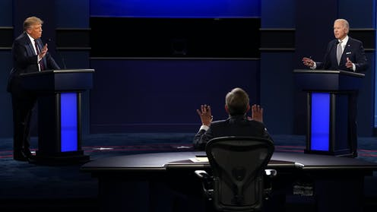
Need for debate-based pedagogy?

Slide 4
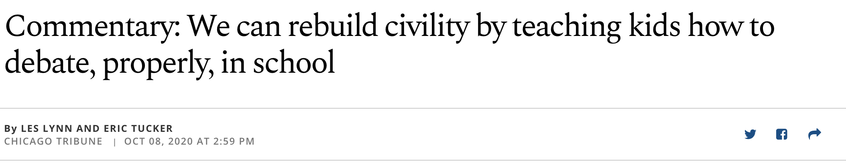
Need for debate-based pedagogy?

Slide 5
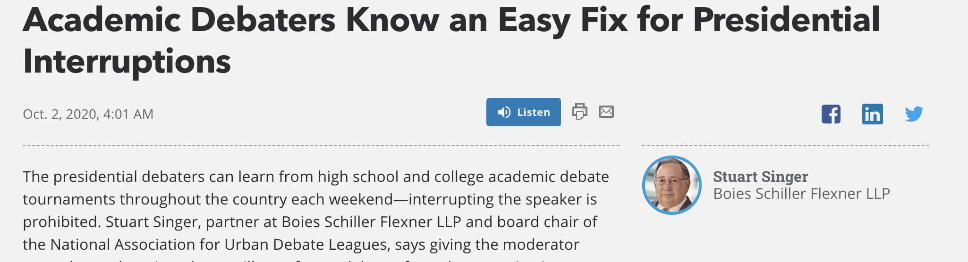
Need for debate-based pedagogy?

Slide 6
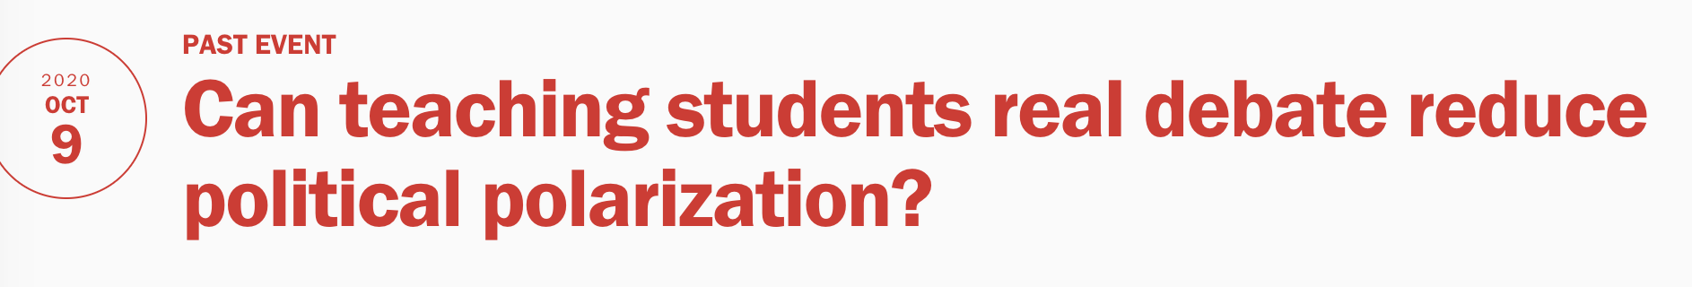
Need for debate-based pedagogy?

Slide 7
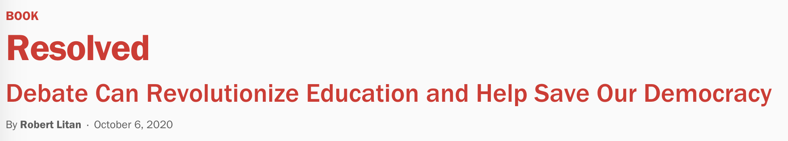
Need for debate-based pedagogy?

Slide 8
Debate-based pedagogy as civic learning
Open-minded inquiry that seeks relevant evidence to analyze & advocate within a given public controversy (Rowland, Gormley Jr., own experiences)
Reasoned advocacy
Evidence-based
Perspective-taking
Communicate clearly to knowledge/passions of audience

Slide 9
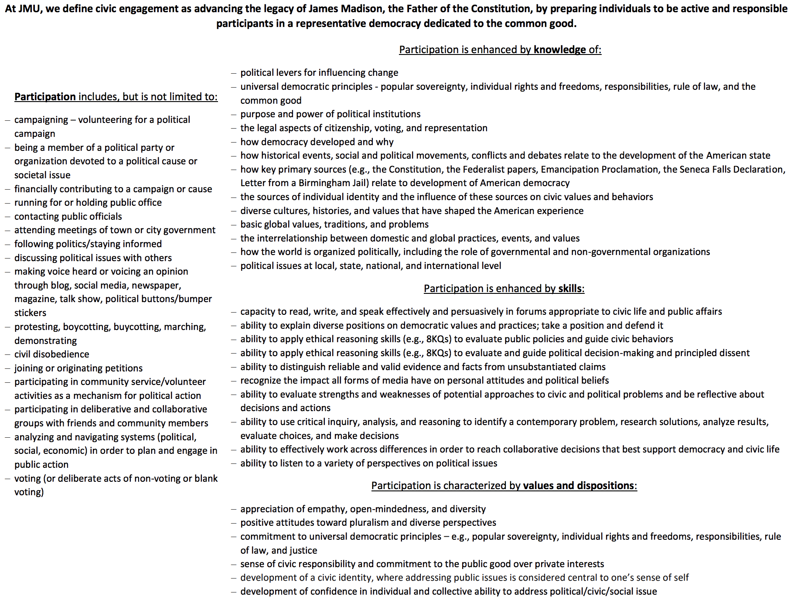
Civic learning & civic engagement

Slide 10
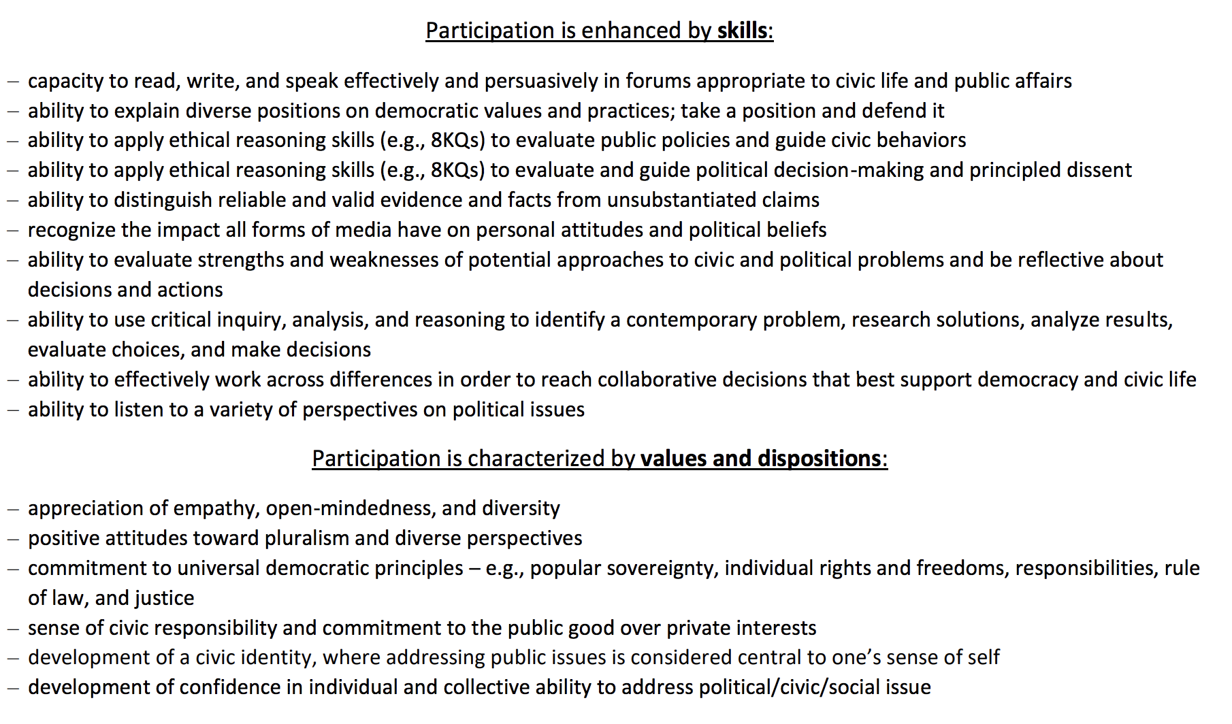
Civic learning & civic engagement

Slide 11
Civic learning & civic engagement assessment
PEPS Political Efficacy Items | Control Agreement |  | Debate Agreement
 | Pre (n=124) | Post (n=39) | Pre (n=184) | Post (n=115)
I feel that I have a pretty good understanding of the political issues facing our country. | 83% | 82% | 86% | 91%
I believe that I have a role to play in the political process. | 89% | 92% | 84% | 88%
When policy issues or problems discussed, I usually have something to say | 71% | 85% | 76% | 84%
I think I am better informed about politics and government than most people. | 53% | 59% | 58% | 78%
I consider myself well qualified to participate in the political process. | 66% | 79% | 69% | 80%

Slide 12
Civic learning & civic engagement assessment
 | Control Pre (n=38) | Control Post (n=38) | Debate Pre (n=78) | Debate Post (n=78) | Control Mean Difference | Debate Mean Difference | Within Control Cohen's D | Within Debate Cohen's D
Good understanding | 4.45, .95 | 4.39, 1.08 | 4.64, .99 | 4.83, .97 | -0.06 | 0.19 |  | 0.84
Role to play | 4.56, 1.10 | 4.64, 1.01 | 4.55, 1.28 | 4.81, 1.23 | 0.08 | 0.26 |  | 1.06
Something to say | 4.13, 1.22 | 4.36, .96 | 4.35, 1.27 | 4.74, 1.25 | 0.23 | 0.39 |  | 0.96
Better informed | 3.46, 1.37 | 3.87, 1.36 | 3.88, 1.40 | 4.37, 1.43 | 0.41 | 0.49 | 1.02 | 1.05
Well qualified to participate | 3.77, 1.39 | 4.10, 1.12 | 3.99, 1.42 | 4.47, 1.44 | 0.33 | 0.48 | 0.96 | 1.15
statistically significant < .05
statistically significant < .001

Slide 13
Civic learning & civic engagement assessment
PEPS Civic Learning Skills Items | Control Can do these things |  | Debate Can do these things
 | Pre (n=124) | Post (n=39) | Pre (n=184) | Post (n=115)
Listen to a variety of perspectives on political issues | 85% | 95% | 91% | 95%
Write effectively & persuasively in forums appropiate to civic life and public affairs | 51% | 59% | 57% | 81%
Speak effectively & persuasively in forums appropiate to civic life and public affairs | 46% | 64% | 58% | 79%
Explain diverse positions on democratic values and practices; take a position and defend it | 66% | 74% | 61% | 83%
Take a position on democratic values and practices and defend it | 73% | 79% | 70% | 84%
Distinguish reliable and valid evidence and facts from unsubstantiated claims | 83% | 85% | 73% | 83%
Recognize the impact all forms of media hvae on personal attitudes and political beliefs | 86% | 85% | 88% | 89%
Evaluate strengths and weaknesses of potential approaches to civic and political problems | 75% | 79% | 75% | 90%
Use critical inquiry, analysis, and reasoning to identify a contemporary problem, research solutions, analyze results, evaluate choices, and make decisions | 71% | 74% | 72% | 90%
Effectively work across differences in order to reach collaborative decisions that best support democracy and civic life | 77% | 79% | 80% | 90%

Slide 14
Civic learning & civic engagement assessment
 | Students agreed or strongly agreed that the debate or argumentation activities (n=114-115):
86% | made me see the real-world relevance of the concepts better
85% | helped me learn how to analyze a real-world issue and how to draw meaningful conclusions
84% | were helpful in understanding the concepts debated
84% | added to my learning and understanding of the course
82% | taught me to think more critically
79% | promoted collaborative learning
77% | challenged my perspective
77% | helped me be more confident in my ability to advocate for something I care about
77% | made the course more interesting and enriching
76% | forced me to think more critically than other assignments in the course
74% | helped me improve my research skills
62% | made me feel comfortable to defend my point of view and respond to opposing viewpoints
62% | may not help be get a better grade but they helped me learn more about the class concepts
58% | will help me get a better grade in the course
30% | made me feel uncomfortable

Slide 15
COVID-19 in Perspective Public Debate Activity
College sporting events should be suspended during the COVID pandemic.
Stakeholders
Student athlete (scholarship)
Fan
University medical director
Student athlete (non-scholarship)
Head football coach
Decision Makers
NCAA Board of Directors (4x)
Athletic Director (2x)
University President (2x)
Athletics booster
Conference Commissioner

Slide 16
COVID-19 public debate student reflection:
This assignment brought to my attention perspectives that I honestly never considered. I consider myself a pretty open minded person so I was kind of shocked that I had never considered the perspectives of individuals such as student athletes or even the people that are in charge of making these incredibly huge and difficult decisions….Overall, this assignment was a great learning tool to help people empathize with everyone throughout this pandemic crisis.
The majority of the words used I had seen before in other classes and know are relevant to this field, but I was never forced to really learn what they meant and how they interacted with one another and this assignment forced me to do that. I was also able to explain it to my parents in a way they understood which was informative to them and helped me further with the assignment. This is the first time in a while I have felt a homework assignment actuality helped me have a deeper understanding of the material and enjoyed it a lot. I think this concept should be used more often in science-related courses because it is a great way to not only memorize me truly learn the definitions that will be relevant in the field in future professions.
I feel as now that I am prepared for the future, if I ever need to have a public debate again in another course or just in life in general, so this debate was an awesome way to end the course and just bring together everything that we have learned in the past six weeks. Other courses at JMU should definitely consider implementing public debates, if appropriate to the class, because it really aids other people and challenges them to think critically, as well as see the perspectives of people with different opinions.

Slide 17
Introductions

Slide 18
Course design overview
L. Dee Fink’s Creating Significant Learning Experiences
Learning Objectives
Coursework
Assessment

Slide 19
Learning outcomes
Critical Thinking
Argumentation
Public Speaking
Advocacy
Information Literacy
Teamwork
Research
Writing Research Briefs
Civic Engagement
Empathy
Cultural Acceptance
Content Expertise

Slide 20
Sample learning outcomes
Demonstrate knowledge of controversial health issue from multiple perspectives
Identify, use and evaluate health information resources
Synthesize perspectives, information and relevant resources to make informed decisions
Demonstrate ability to advocate on behalf of one's self, their agency and/or a constituency
Compare and contrast approaches to research

Slide 21
Coursework
Lectures
Written exercises
In-class debates
Role-playing exercises
Student teaching
Simulations
Podcasts
Video debates
Community engagement
Blog posts

Slide 22
Assessment
Papers
Exams
Peer review
Ballots
Bibliographies
Reflection
Portfolios
Pre/post: knowledge
civic attitudes
public speaking
written communication
perspective taking
information literacy
argumentation

Slide 23
Crucial Pivot Points
Meta-cognition
Curricular alignment
Scaffolding
Class-time
Group selection
Format
Topic selection
Team collaboration
Audience role
Instructional needs
Grading
Scholarship opportunities
Reflection

Slide 24
Resources
Debate Across Curriculum Faculty Associates
  Individual consultations
  Classroom lectures
Debate Across Curriculum Website
  Discipline specific scholarship
  Classroom examples
  Assessment examples
Communication Center
  Direct student support via consultations
  Faculty & course support via fellows
Debate Across Curriculum Faculty Cohort

Slide 25
Next Steps
Fall 2021 design/redesign
Late Oct/early Nov – 90 minute curriculum sharing/discussion (Drew)
Nov – individual consultation
December – 60 minute wrap-up and report out
Spring 2022 implement, assess, reflect
Jan – 90 minute classroom/program assessment
Feb – In-person day-long workshop
March – 60 minute check-in
May – 60 minute wrap-up

Slide 26
Next Steps
February 2022 Workshop Day
Breakfast
9-10am Session
1030-1130 Session
1130-1230pm Lunch
1-230 Round 1
3-430 Round 2
Dinner
Evening social programming
3 | Hofstra | 2 rooms x 1 night
3 | Towson | 2 rooms x 1 night
3 | Northeastern | 2 rooms x 2 nights
3 | William & Mary | 2 rooms x 1 night
3 | CoC | 2 rooms x 2 nights
3 | UNC-W | 2 rooms x 2 nights

Slide 27
Next Steps
Send bio information to Paul for communications
Work with institution lead for pay paperwork
Schedule workshops for end of semester/year?
Identify times to check-in with institutional lead and JMU team
Begin course design & redesign

