Slide 1
Dream Big
Making lemonade out of lemons!

Slide 2
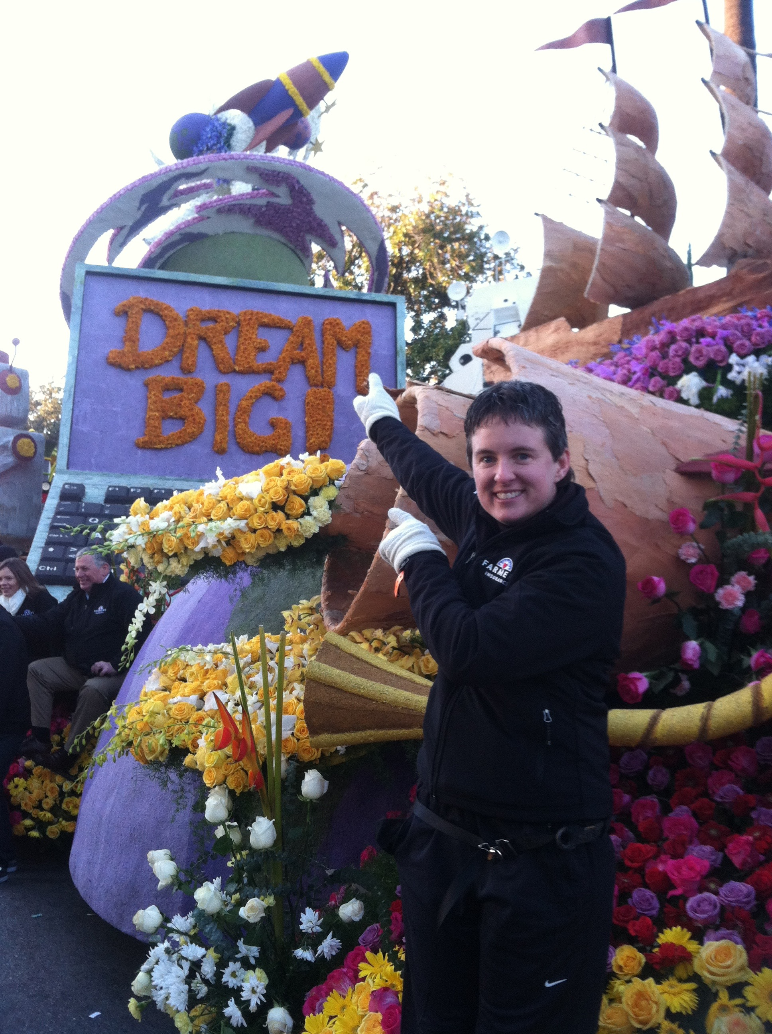
What dreams do you have for this year? Next year? Your career?

Slide 3
When we think of buying a car and getting a lemon, what comes to mind?
So how do we handle those situations in life (curveballs) that come at us unexpectedly and try to derail our plans?

Slide 4
Write down some things that have happened in your life that were hard, unexpected or things you would never have selected for yourself?

Slide 5
When we reflect and look back, those are usually the times we grow the most , find out what we are made of and how we refine our character, develop tenacity and bring perseverance to the forefront of our lives.

Slide 6
Will I become bitter OR will I become better? We get to decide which road we take!

Slide 7
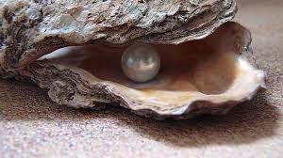
Pearls and oysters
How is a pearl formed?
What are some irritants in your life?
Can those hard things in life smooth the rough edges in us and become something valuable?
If you have irritants now, look for a pearl later!

Slide 8
What is something you went after really hard, devoted yourself to it, and did not get it/ achieve it?

Slide 9
2018- retirement from the school system and a full time flight instructor
Building the trail
Teaching at 5000’

Slide 10
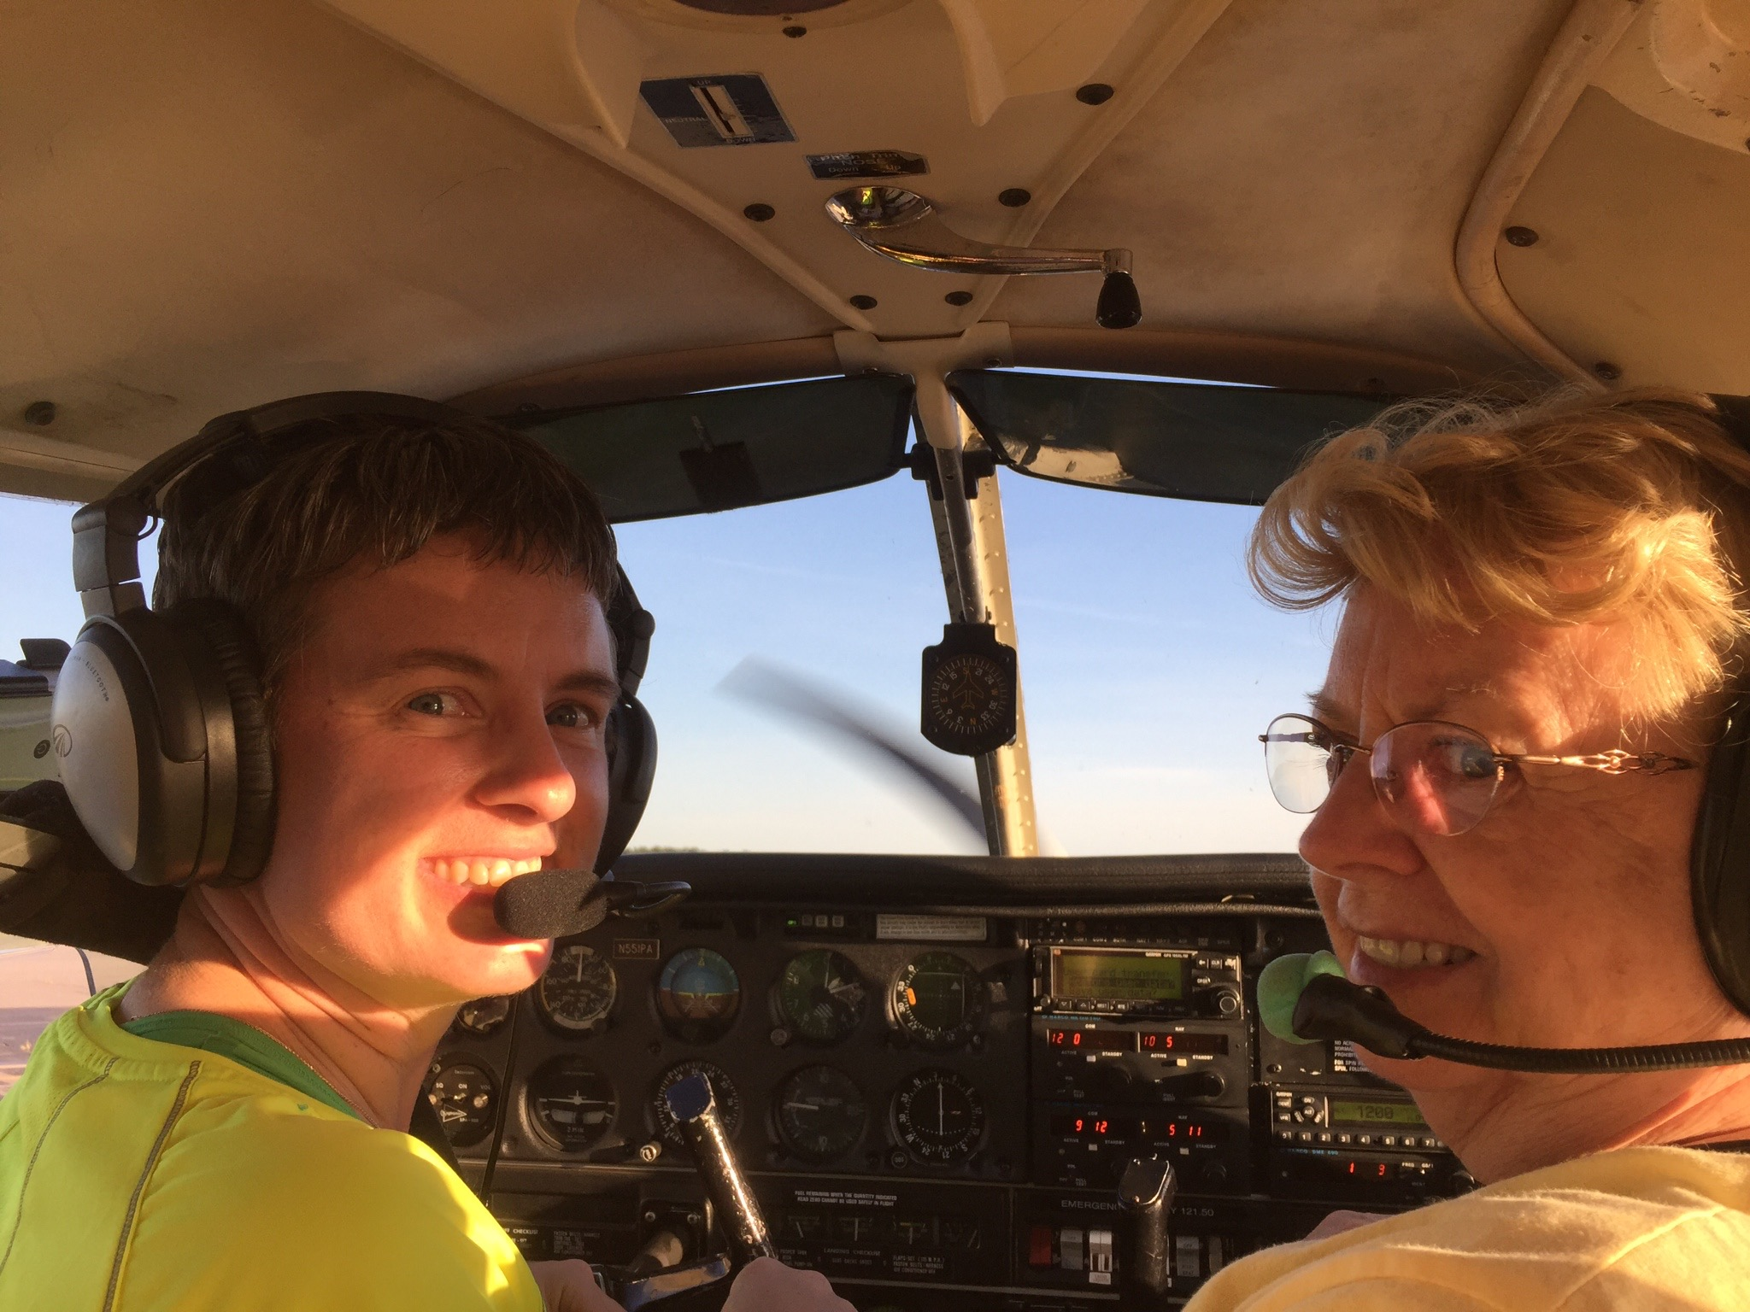
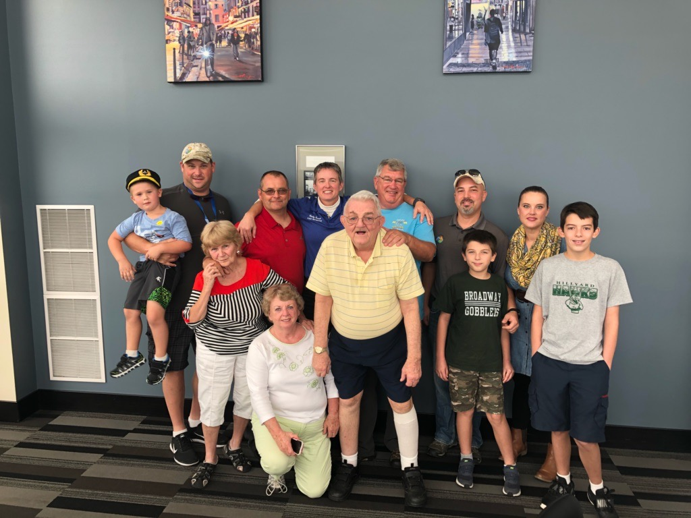
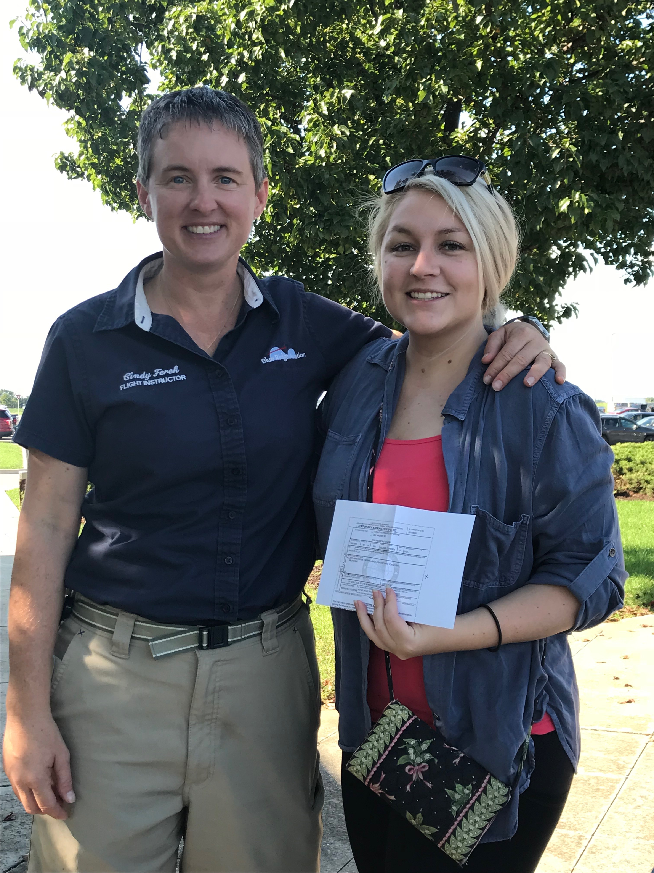
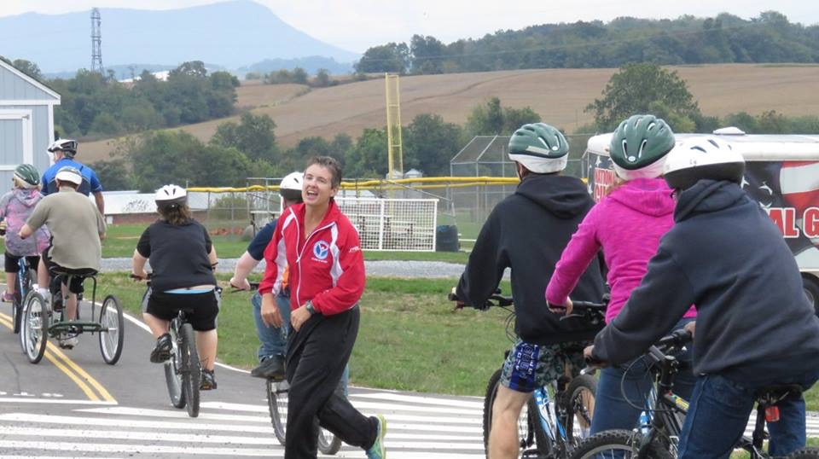
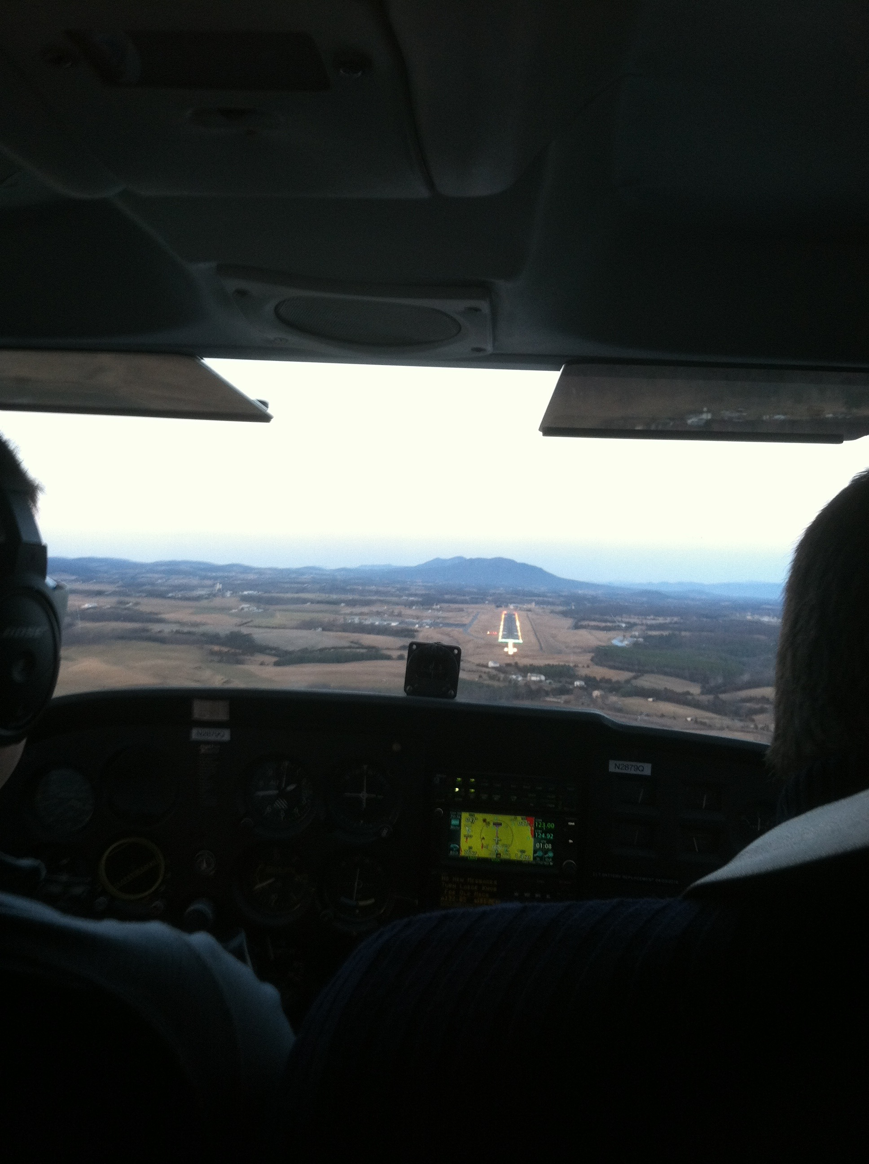
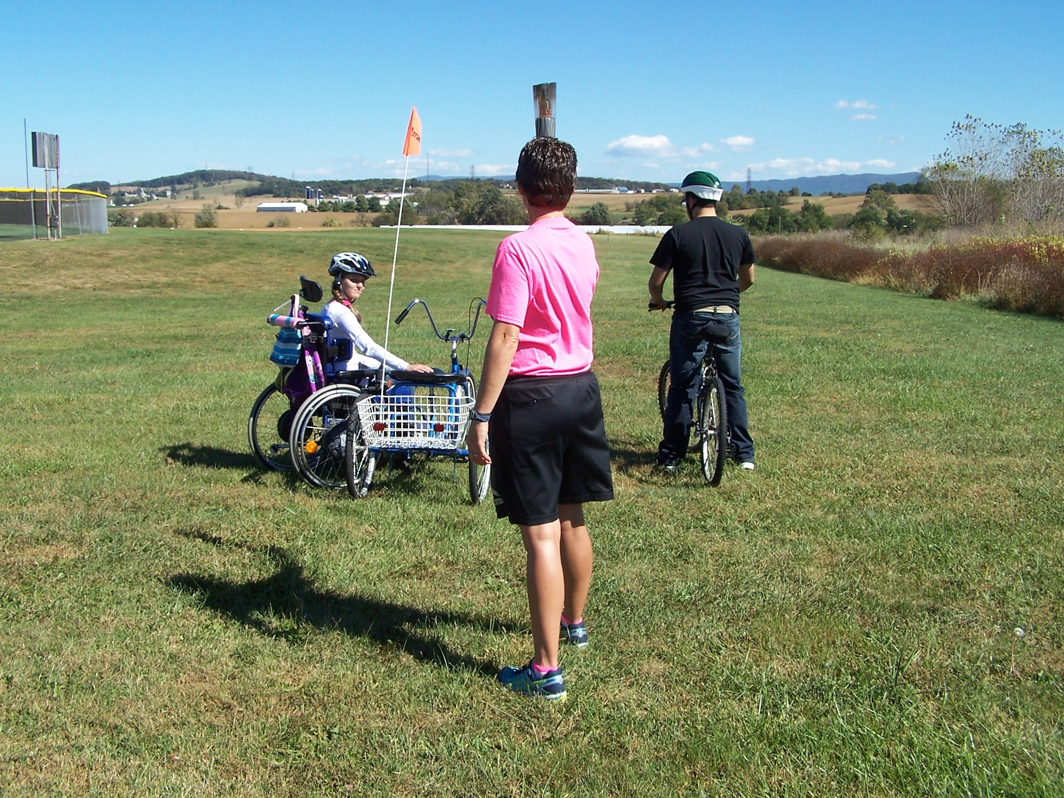
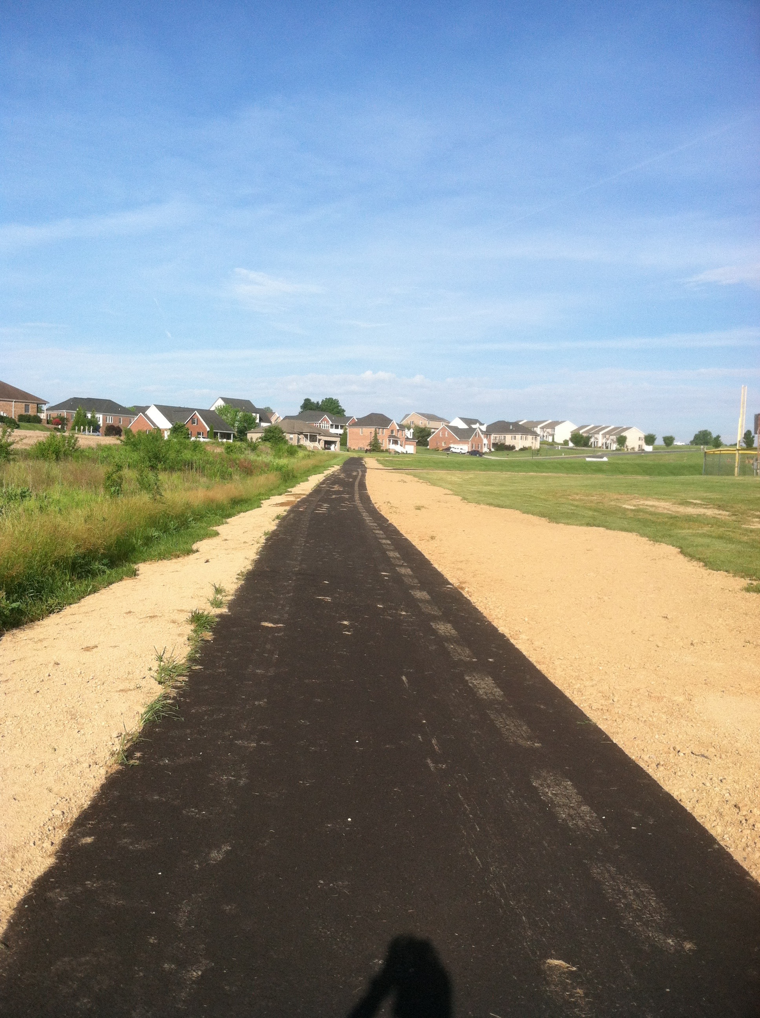
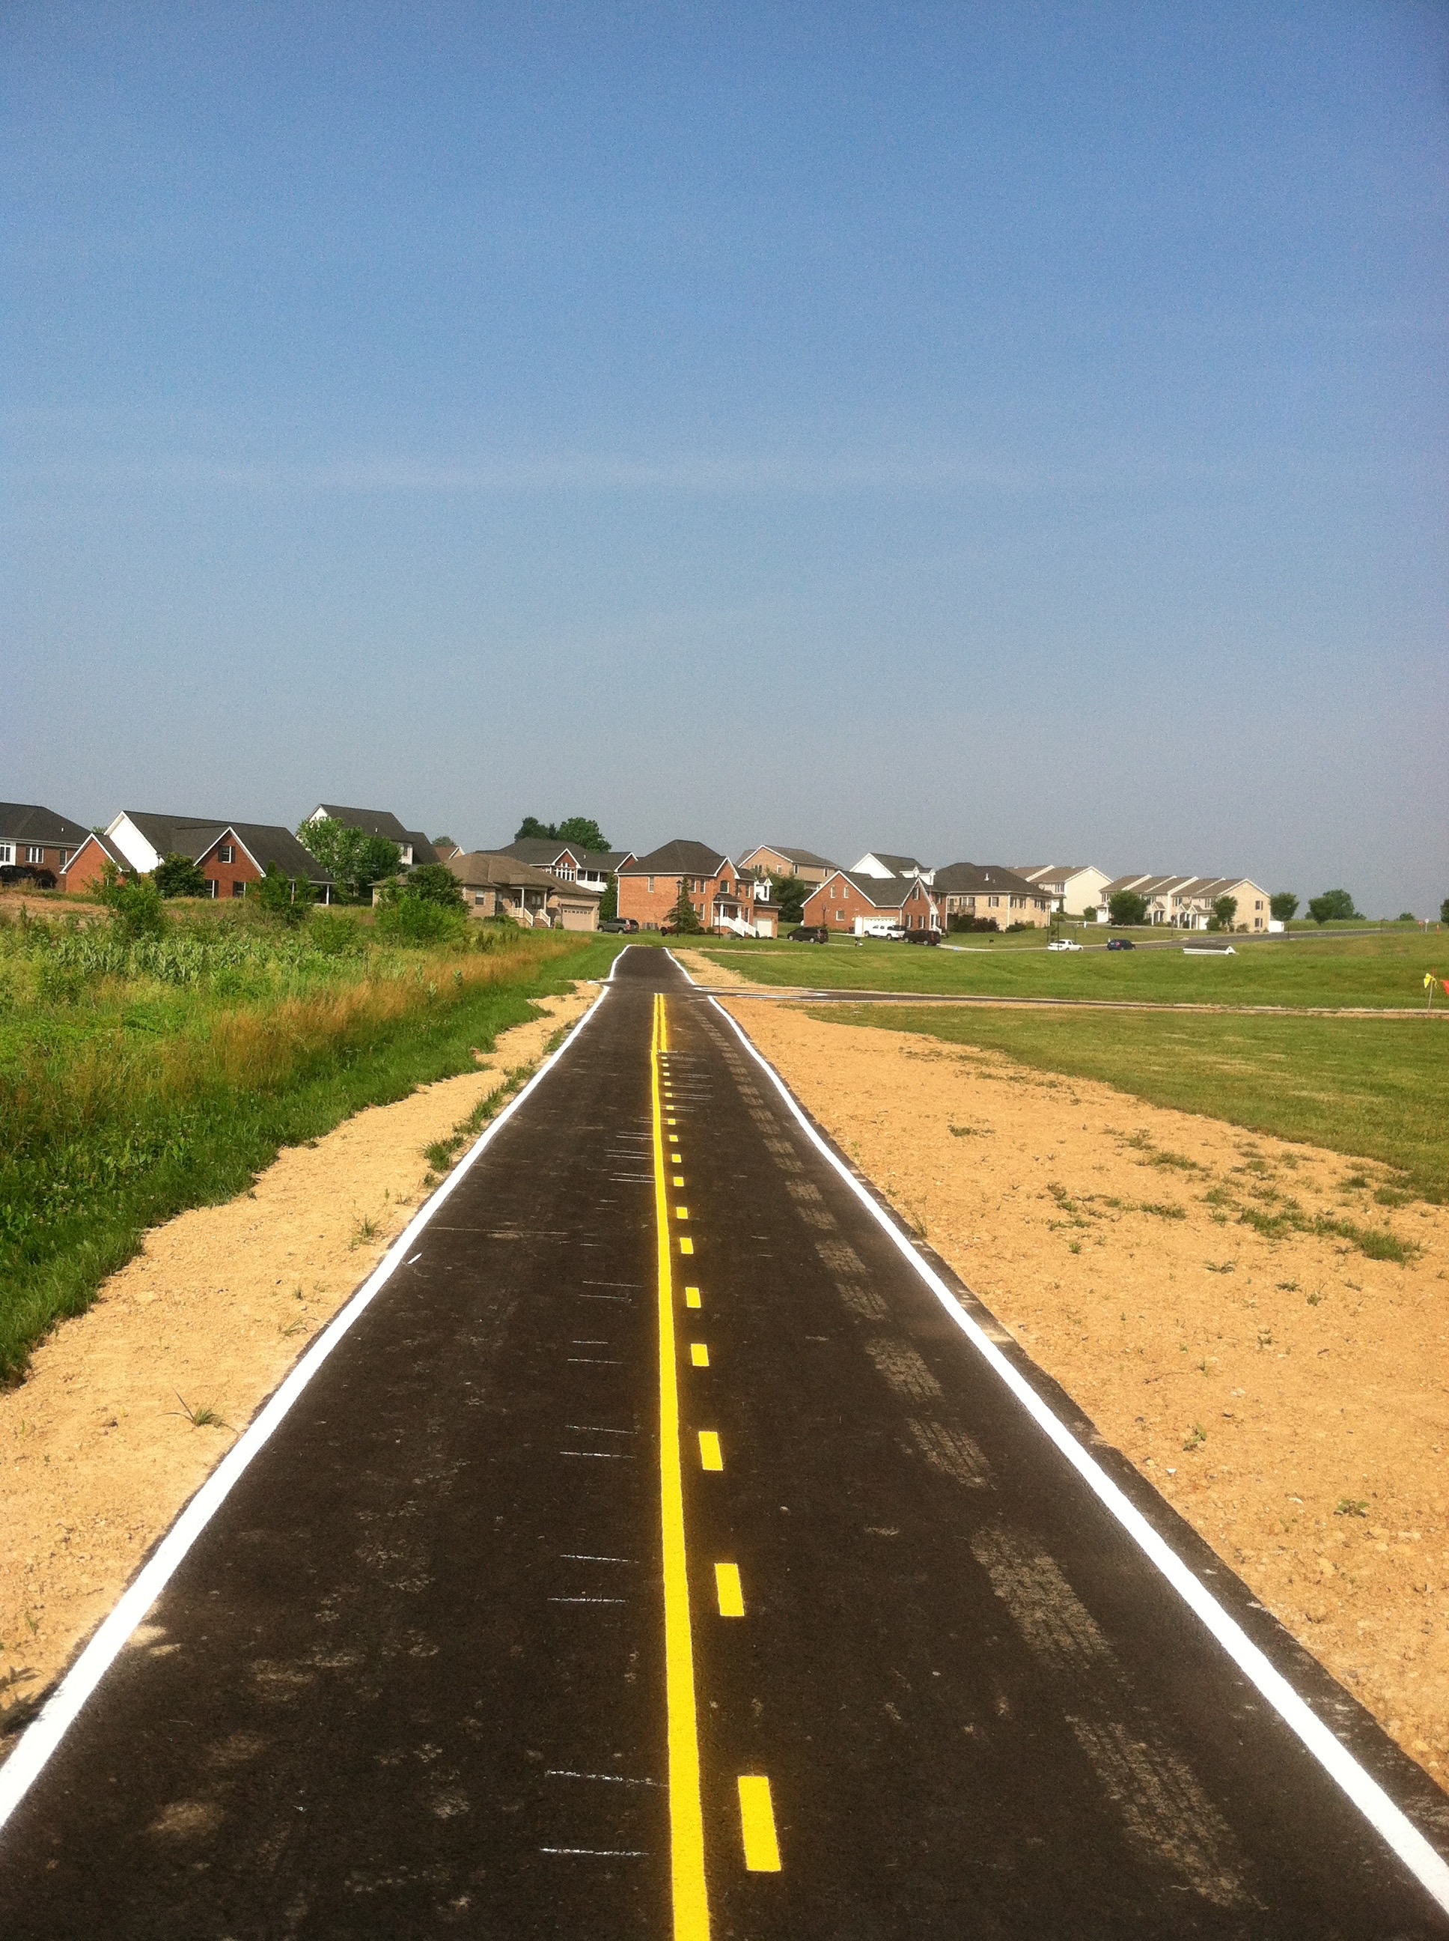
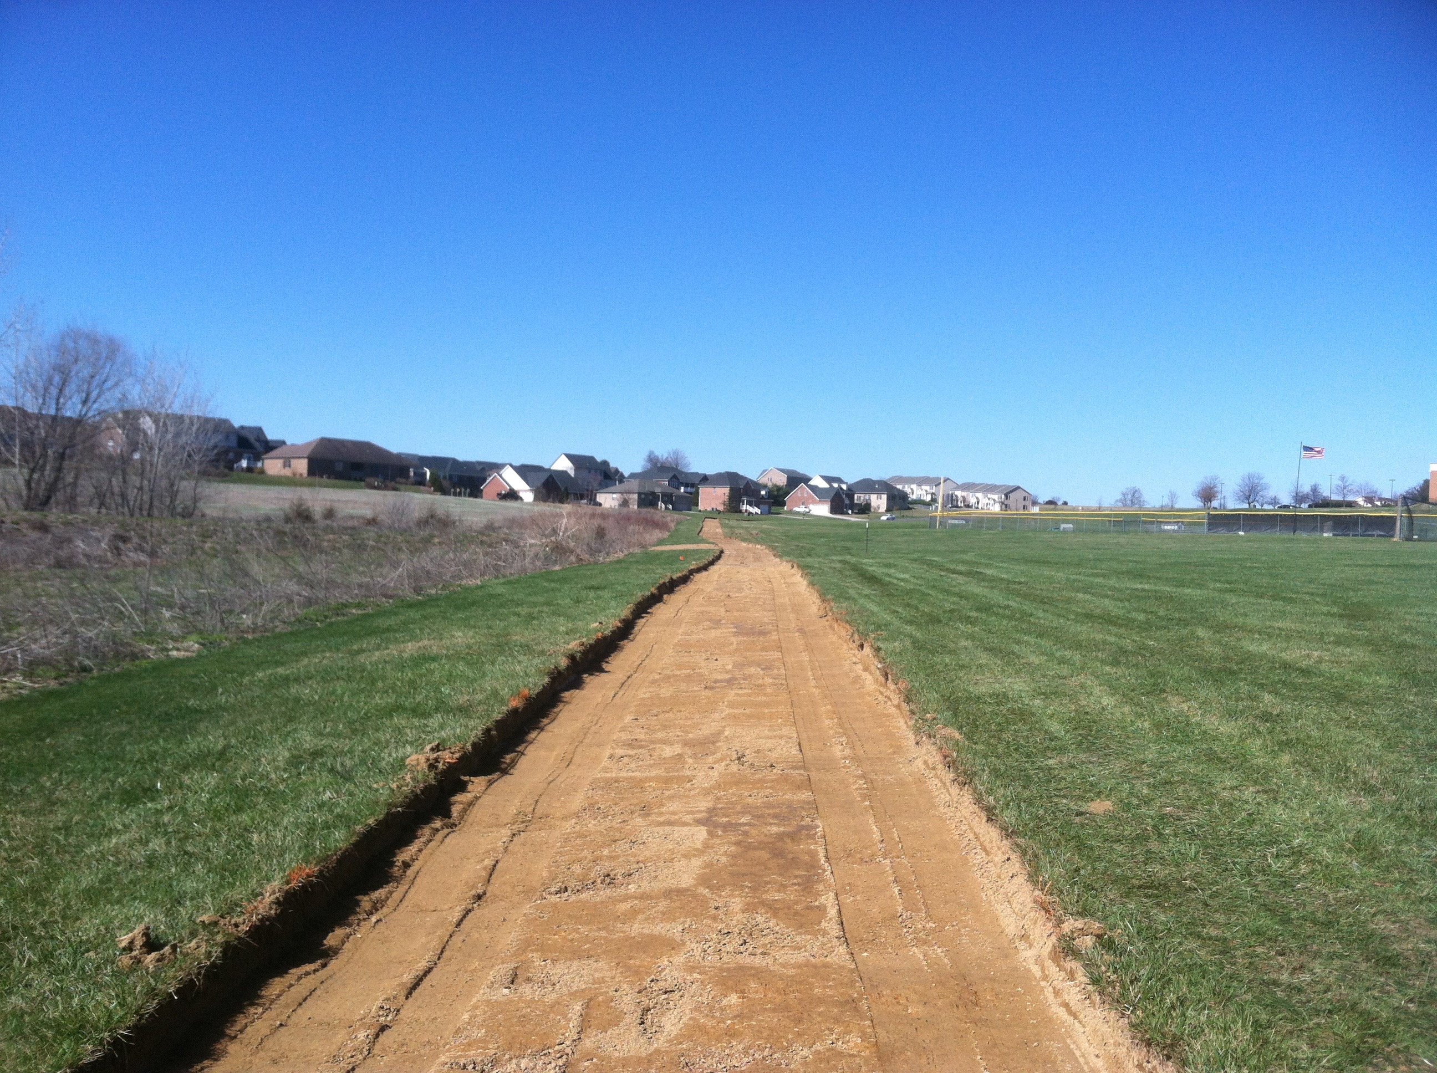
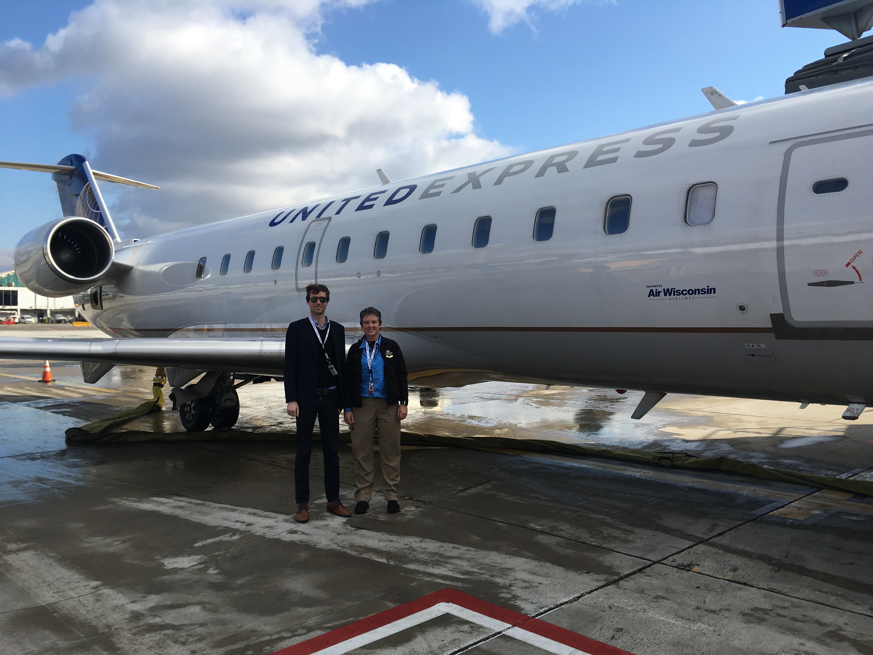

Slide 11
October 2018- Air Wisconsin
Appleton Wisconsin to fly a CRJ 200 (50 passenger jet)
6 weeks of ground school
ATP written exam – 98%
Simulator training (4 months)
6 months of studying everyday, training
Turn in your stuff, resign and mail your ipad back

Slide 12
Company kept 3 out of the 12 students in my class
I was sent home
Devasted
Depressed
Evaluating what is next
6 months and nothing to show for it

Slide 13
How do we handle: Failure Defeat No

Slide 14
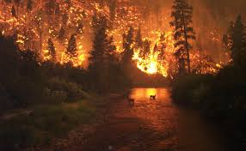
When I say forest fire what comes to mind?
Destruction
Loss
New growth?

Slide 15
Before
After in Colorado

Slide 16
There are times we go thru loss and then there is new on the other side

Slide 17
What have you lost?
A parent or a child
A job
A friend
A section of classes you have always taught
An investment
A home

Slide 18
Are you……
Bitter or
BETTER!
Make lemonade when you have lemons

Slide 19
Get up, brush yourself off and keep moving forward!
Family illness/crisis (pneumonia, hospital stays)
Don’t burn bridges. Return to former job
Valuable piece of paper…..nothing is a waste! Mentors invest in us. Who are your mentors?
Perseverance and timing is everything
Patience- with others and ourselves

Slide 20
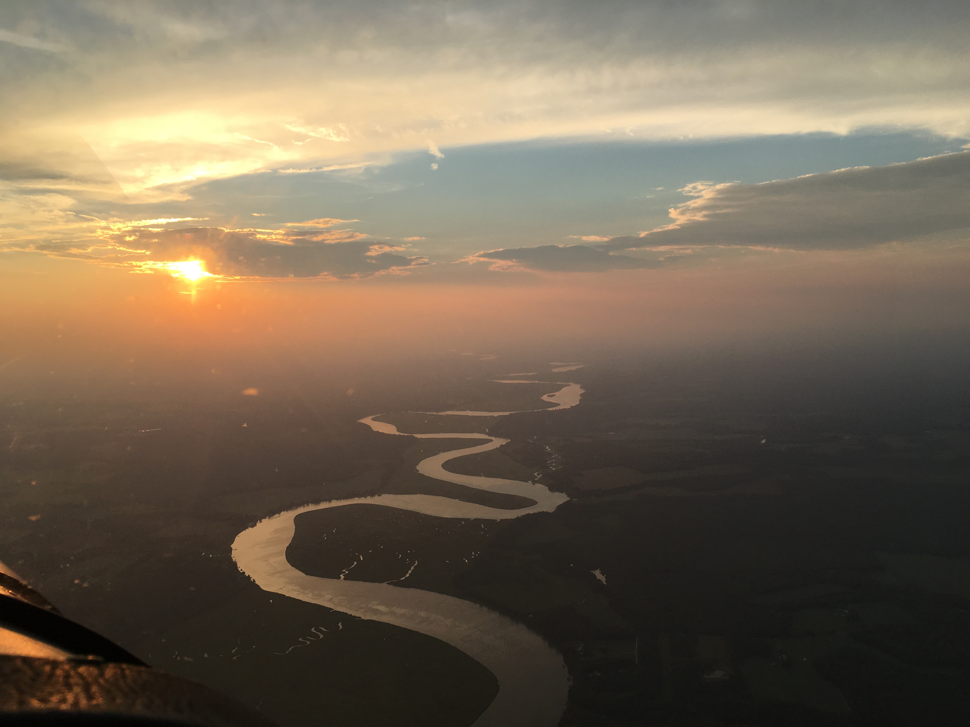
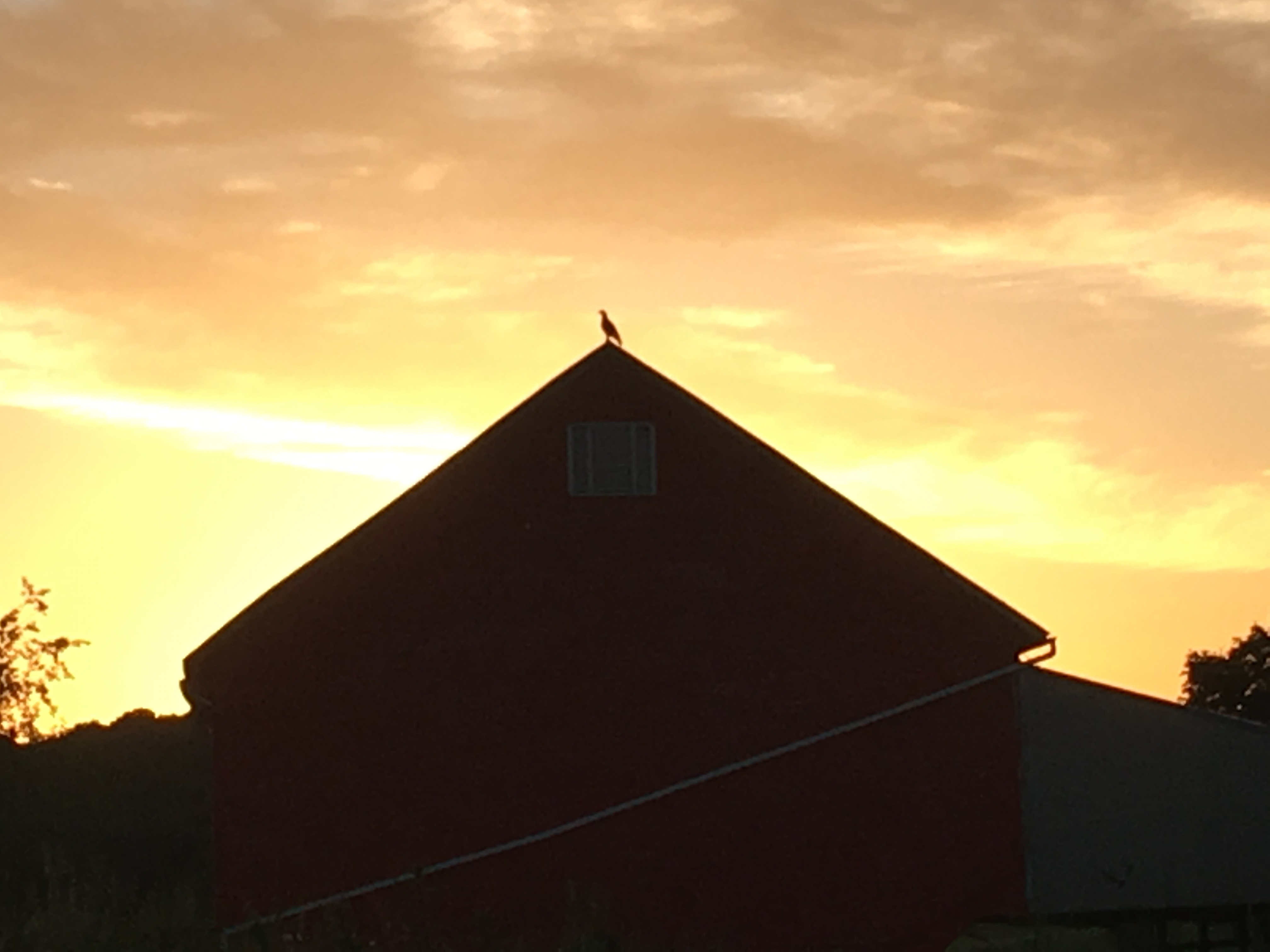

Slide 21
Where did you go, what did you do when you had to make an unexpected detour in your life?

Slide 22
We have to take care of ourselves to be able to fully give to others. How do you take care of you each day? We can’t give what we don’t have

Slide 23
Relationships- the building blocks of our lives
List the relationships you have in your life
Family
Spouse
Friends
Students
Neighbors
Colleagues

Slide 24
Be content where you are
Grow each day
Pull out any roots of bitterness so they don’t grow like a cancer inside of you
Reflect
Stay positive as you move forward

Slide 25
Love each person who has a relationship with you while they are still here

Slide 26
Pop
Drive to please growing up, no alcohol decision age 9
Forgiveness- one of the hardest things I had to do. Is there someone who has hurt you that you need to forgive?
Transition to adulthood, road to sobriety
I Can Only Imagine Movie
6 weeks of love and redemption

Slide 27
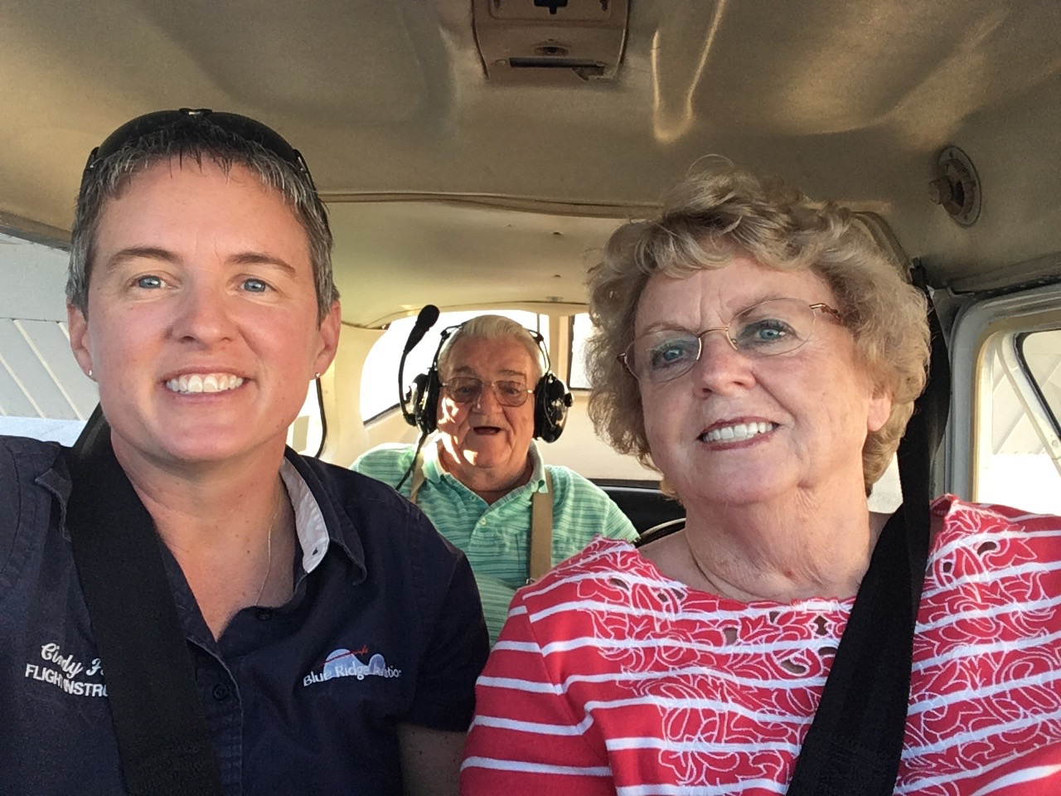

Slide 28
Our plans sometimes …….
Hit the pause button
We ask what is next?
What plans have you put into motion and something unexpectedly changes?

Slide 29
The Perfect Storm-2023
The fall
Back surgery number 2
My surgery

Slide 30
Provision in so many ways
Meals
Visits
Car Tires
Trainers- PT

Slide 31
What are ways you have been blessed by others in a time of crisis?

Slide 32
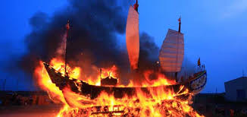
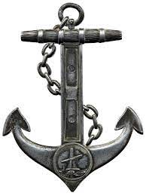
Burn the ships……
Can you put the past behind you and embrace what is ahead of you?
Are there any anchors holding you back from a new beginning?

Slide 33
Open doors
Saturday sent in the application
Wed phone call- interview tomorrow in Ohio
Thurs offered the job on the spot during interview
Started that Monday November 28th, 2022
ABX Air Cargo- ground school 767 jet training
May 2023 First Officer, 6 month evaluation and training complete

Slide 34
What have you experienced that is so challenging and hard and incredibly rewarding once you cross the finish line?

Slide 35
What is a new challenge you want to experience this year?
Start working on your Masters Degree/Doctorate
Get certified in archery, fly fishing, biking,etc.
Teach a new unit / curriculum
Take/teach a yoga class
Buy a bike and start riding/ Hike the App. Trail
Pick a goal and go after it this year! Here are some ideas…….

Slide 36
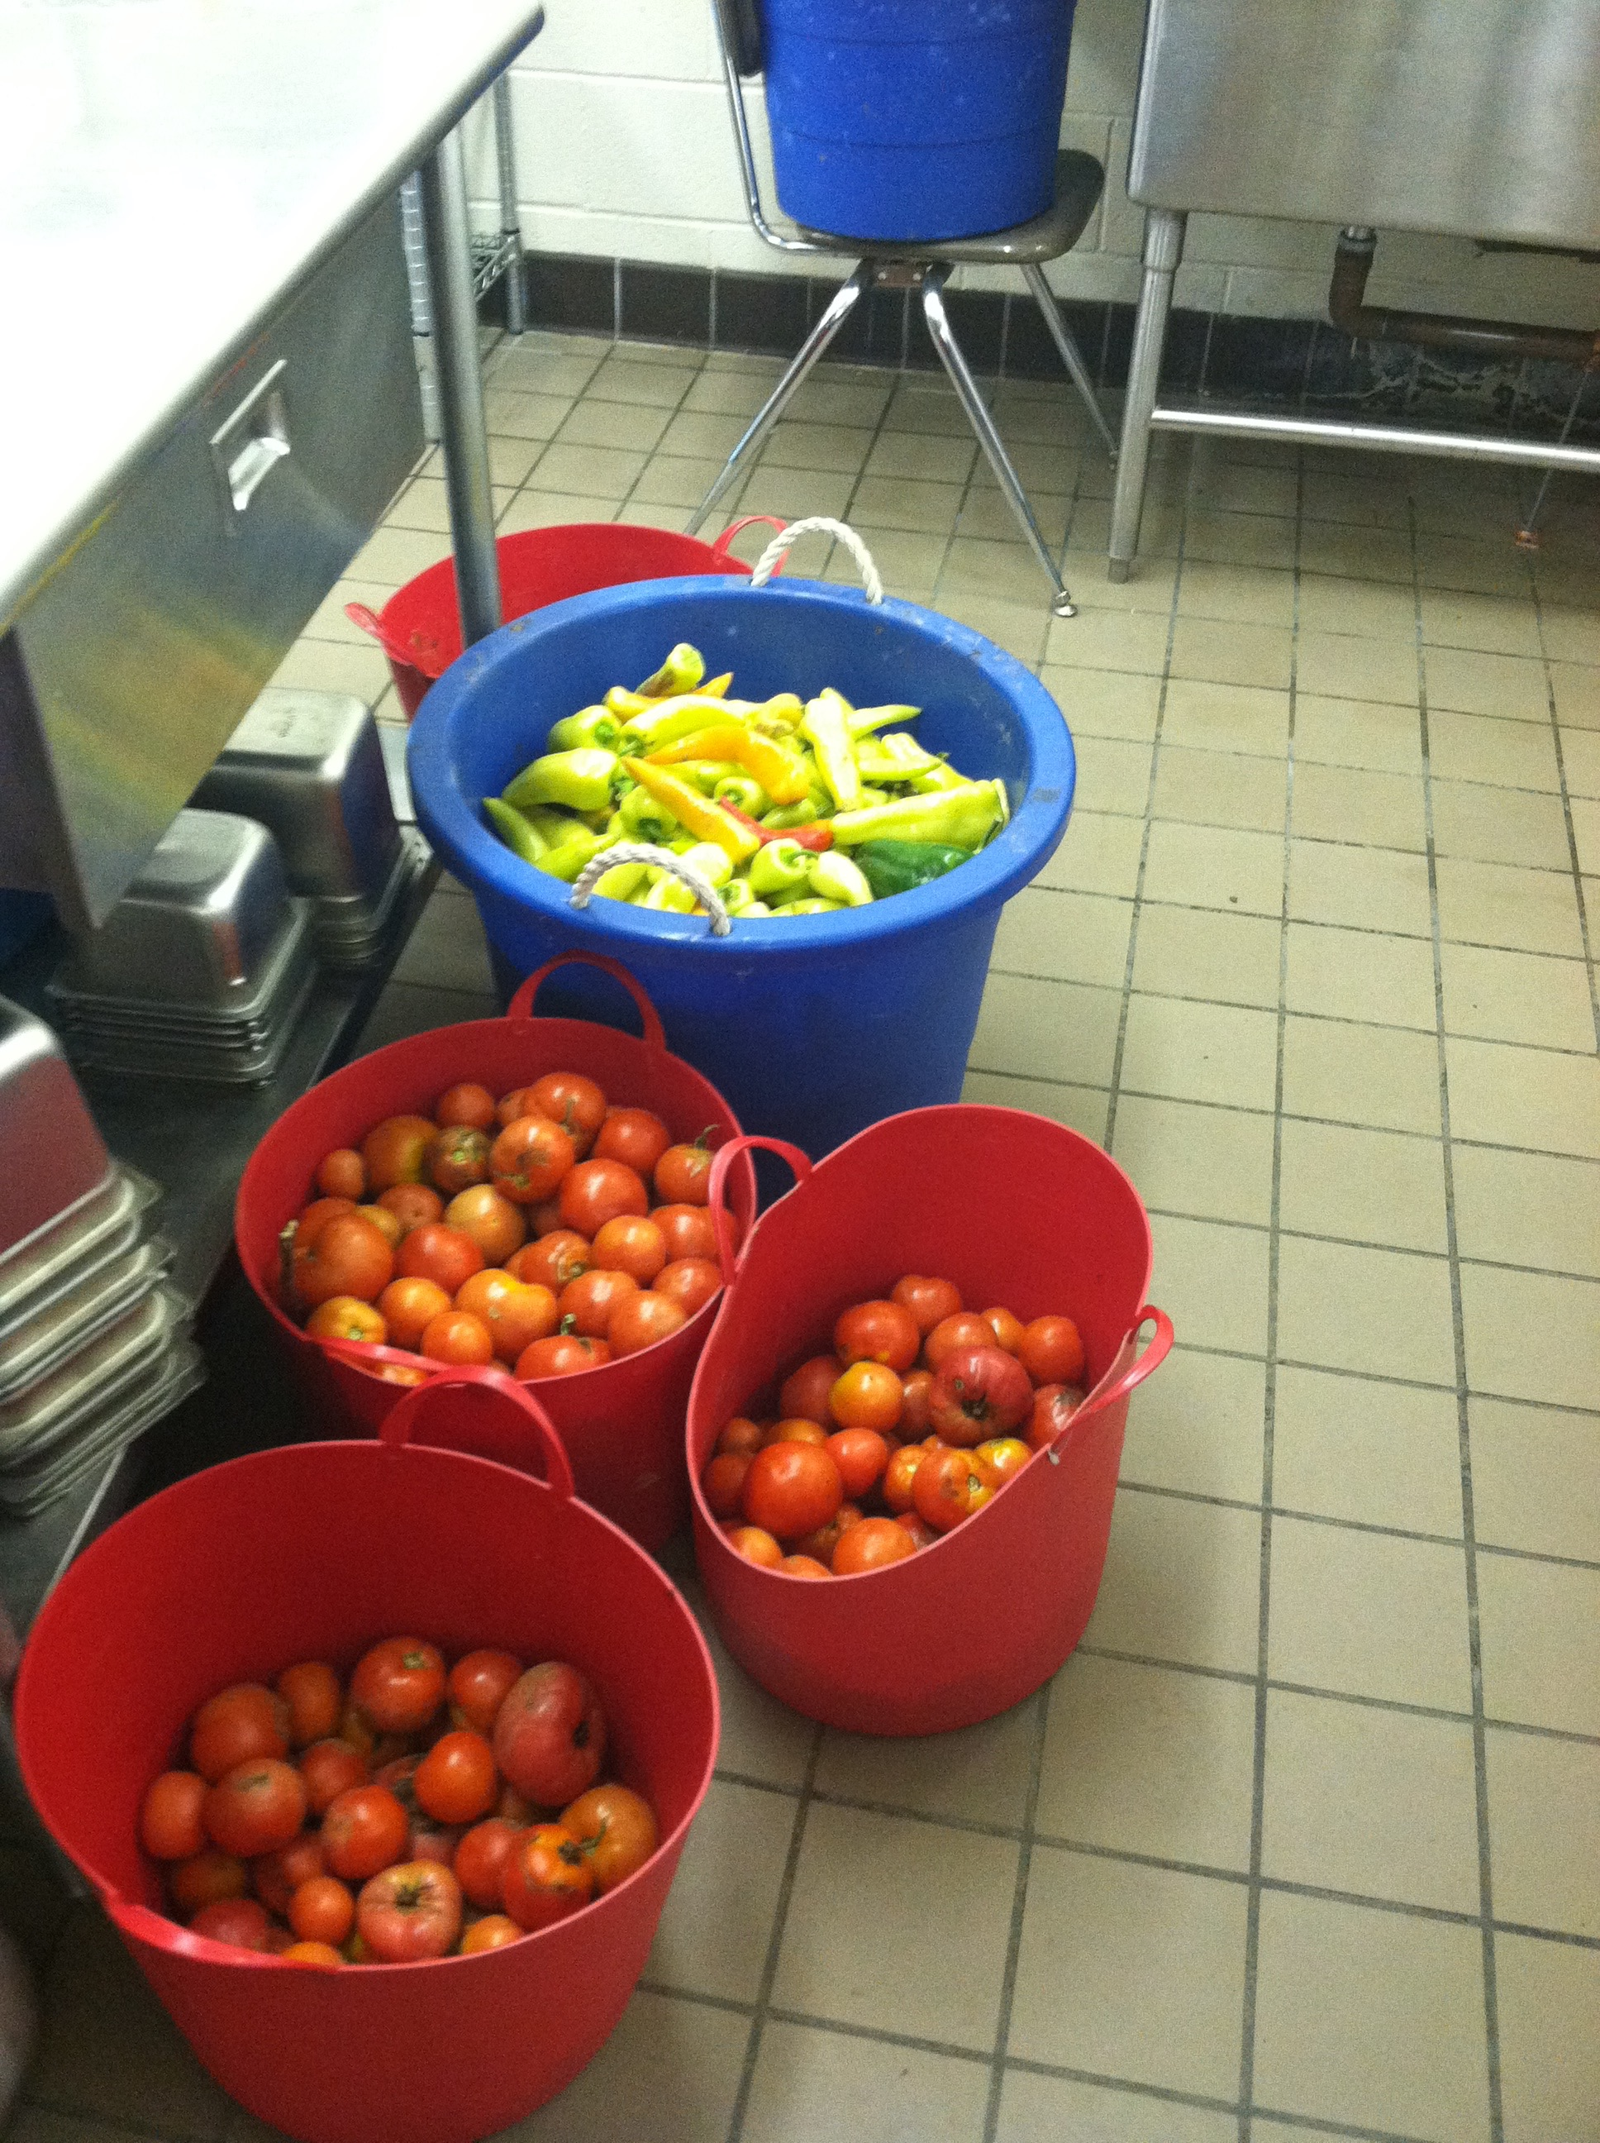
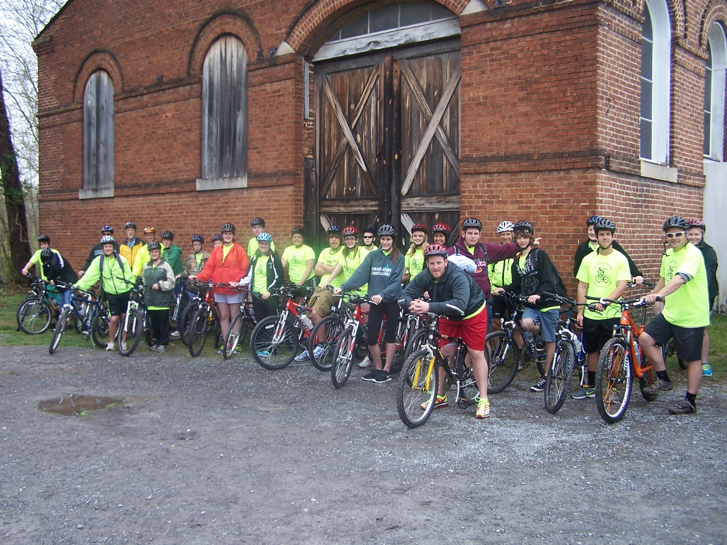
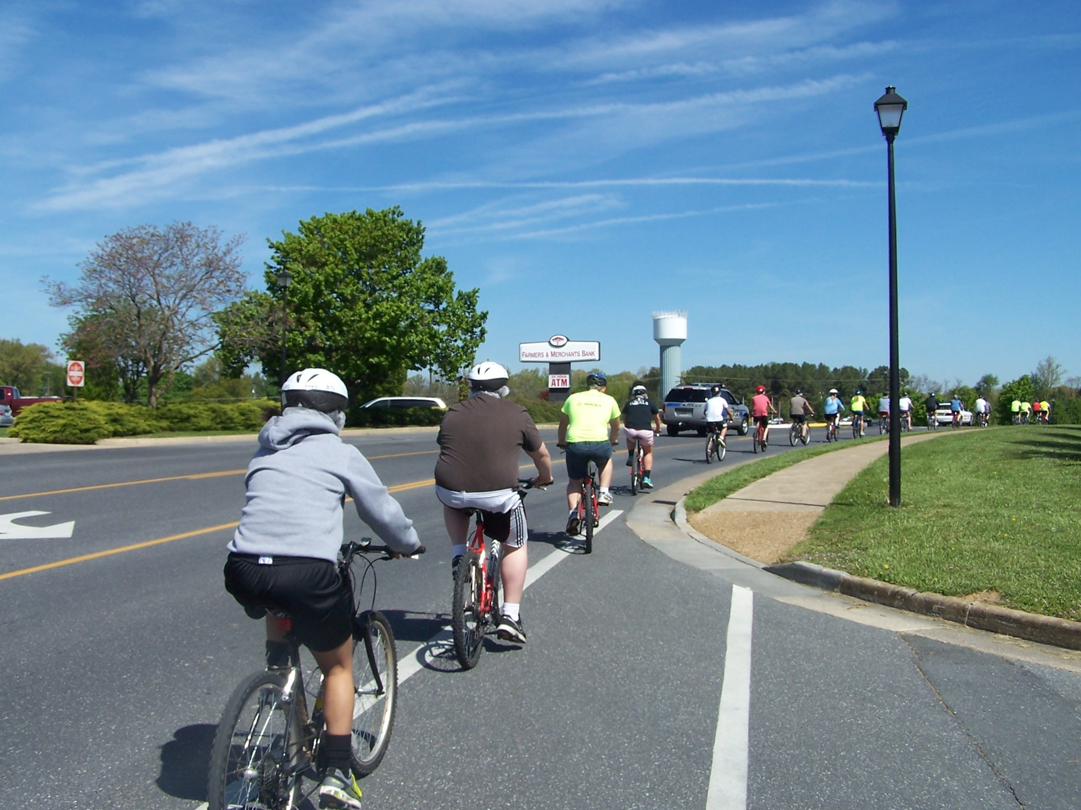
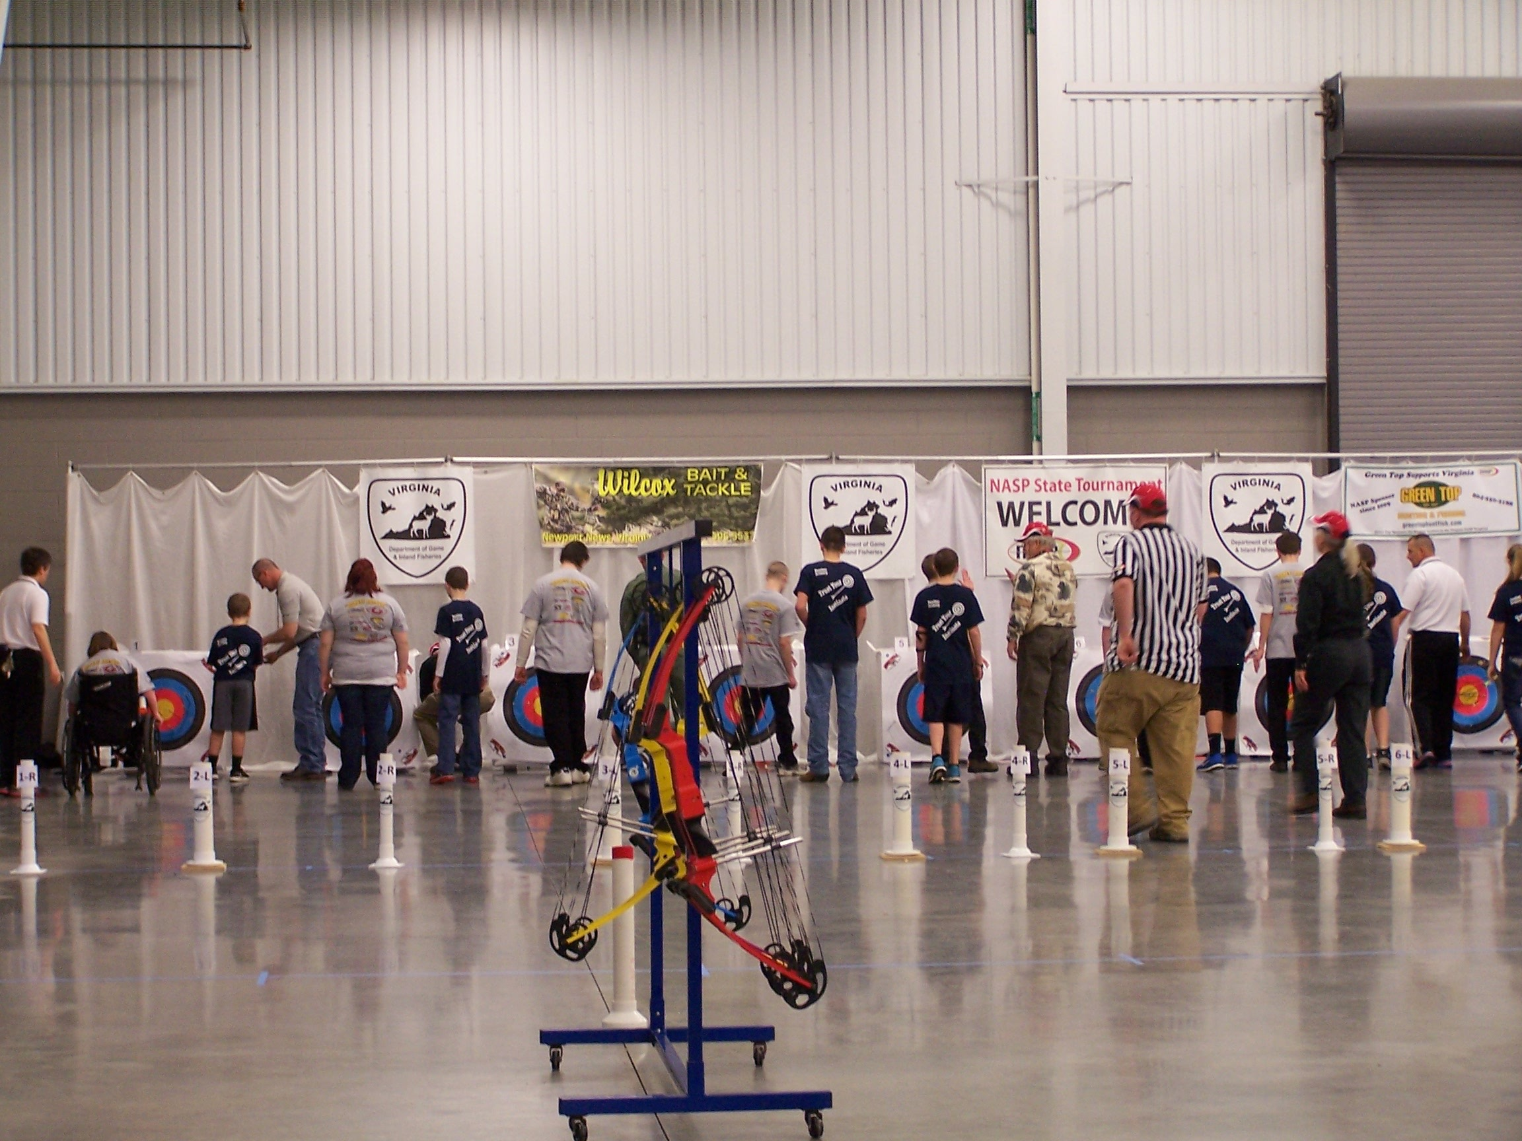
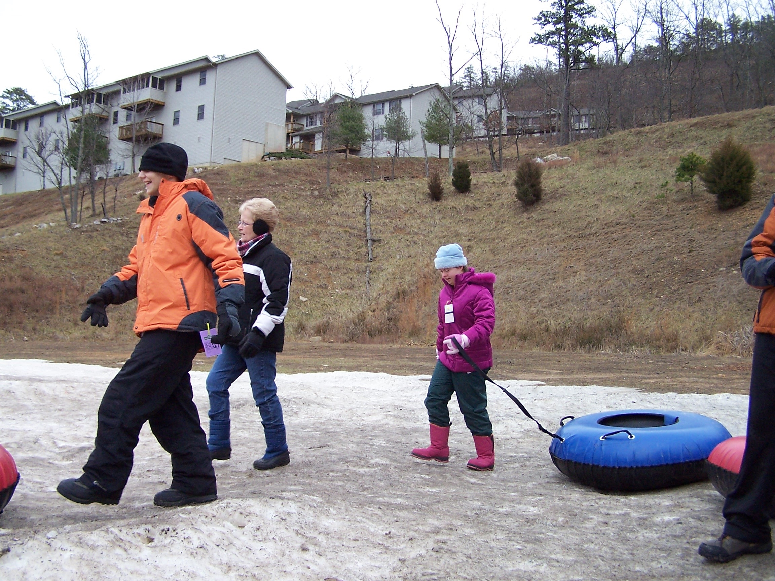
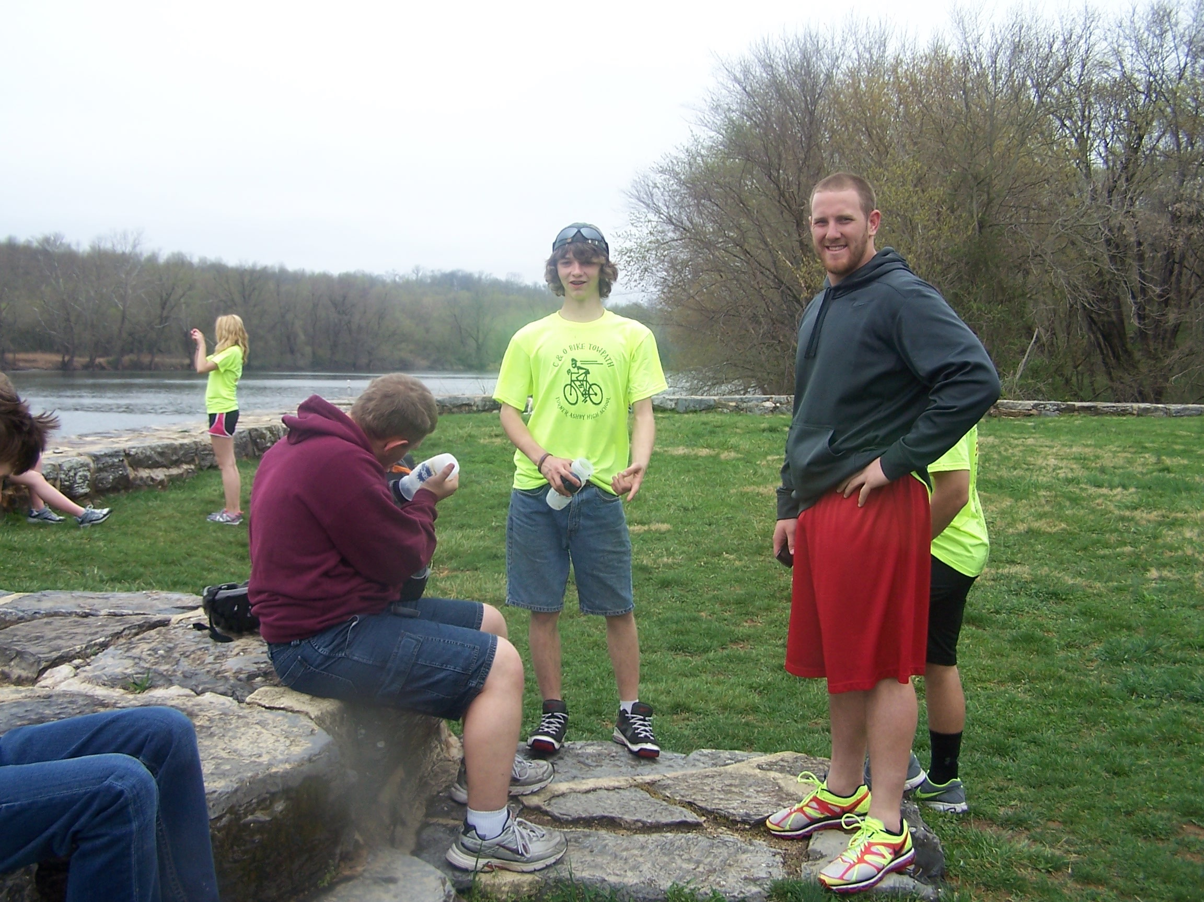
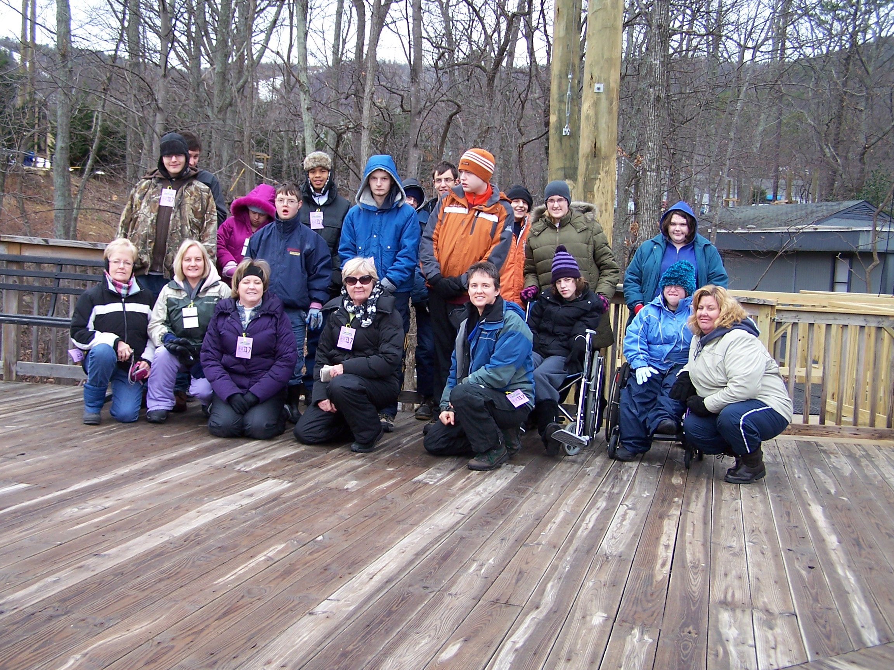
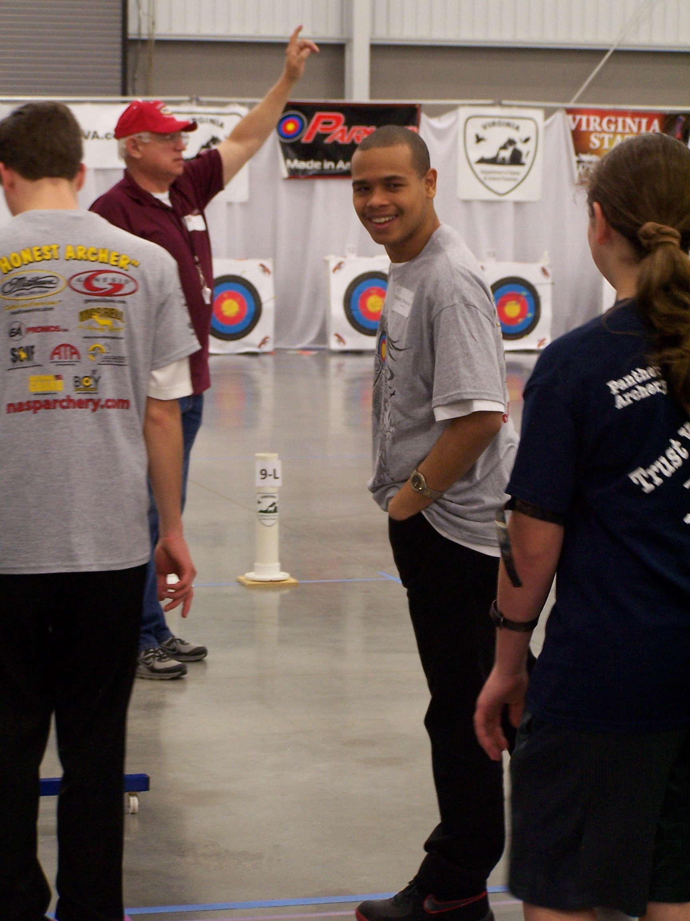
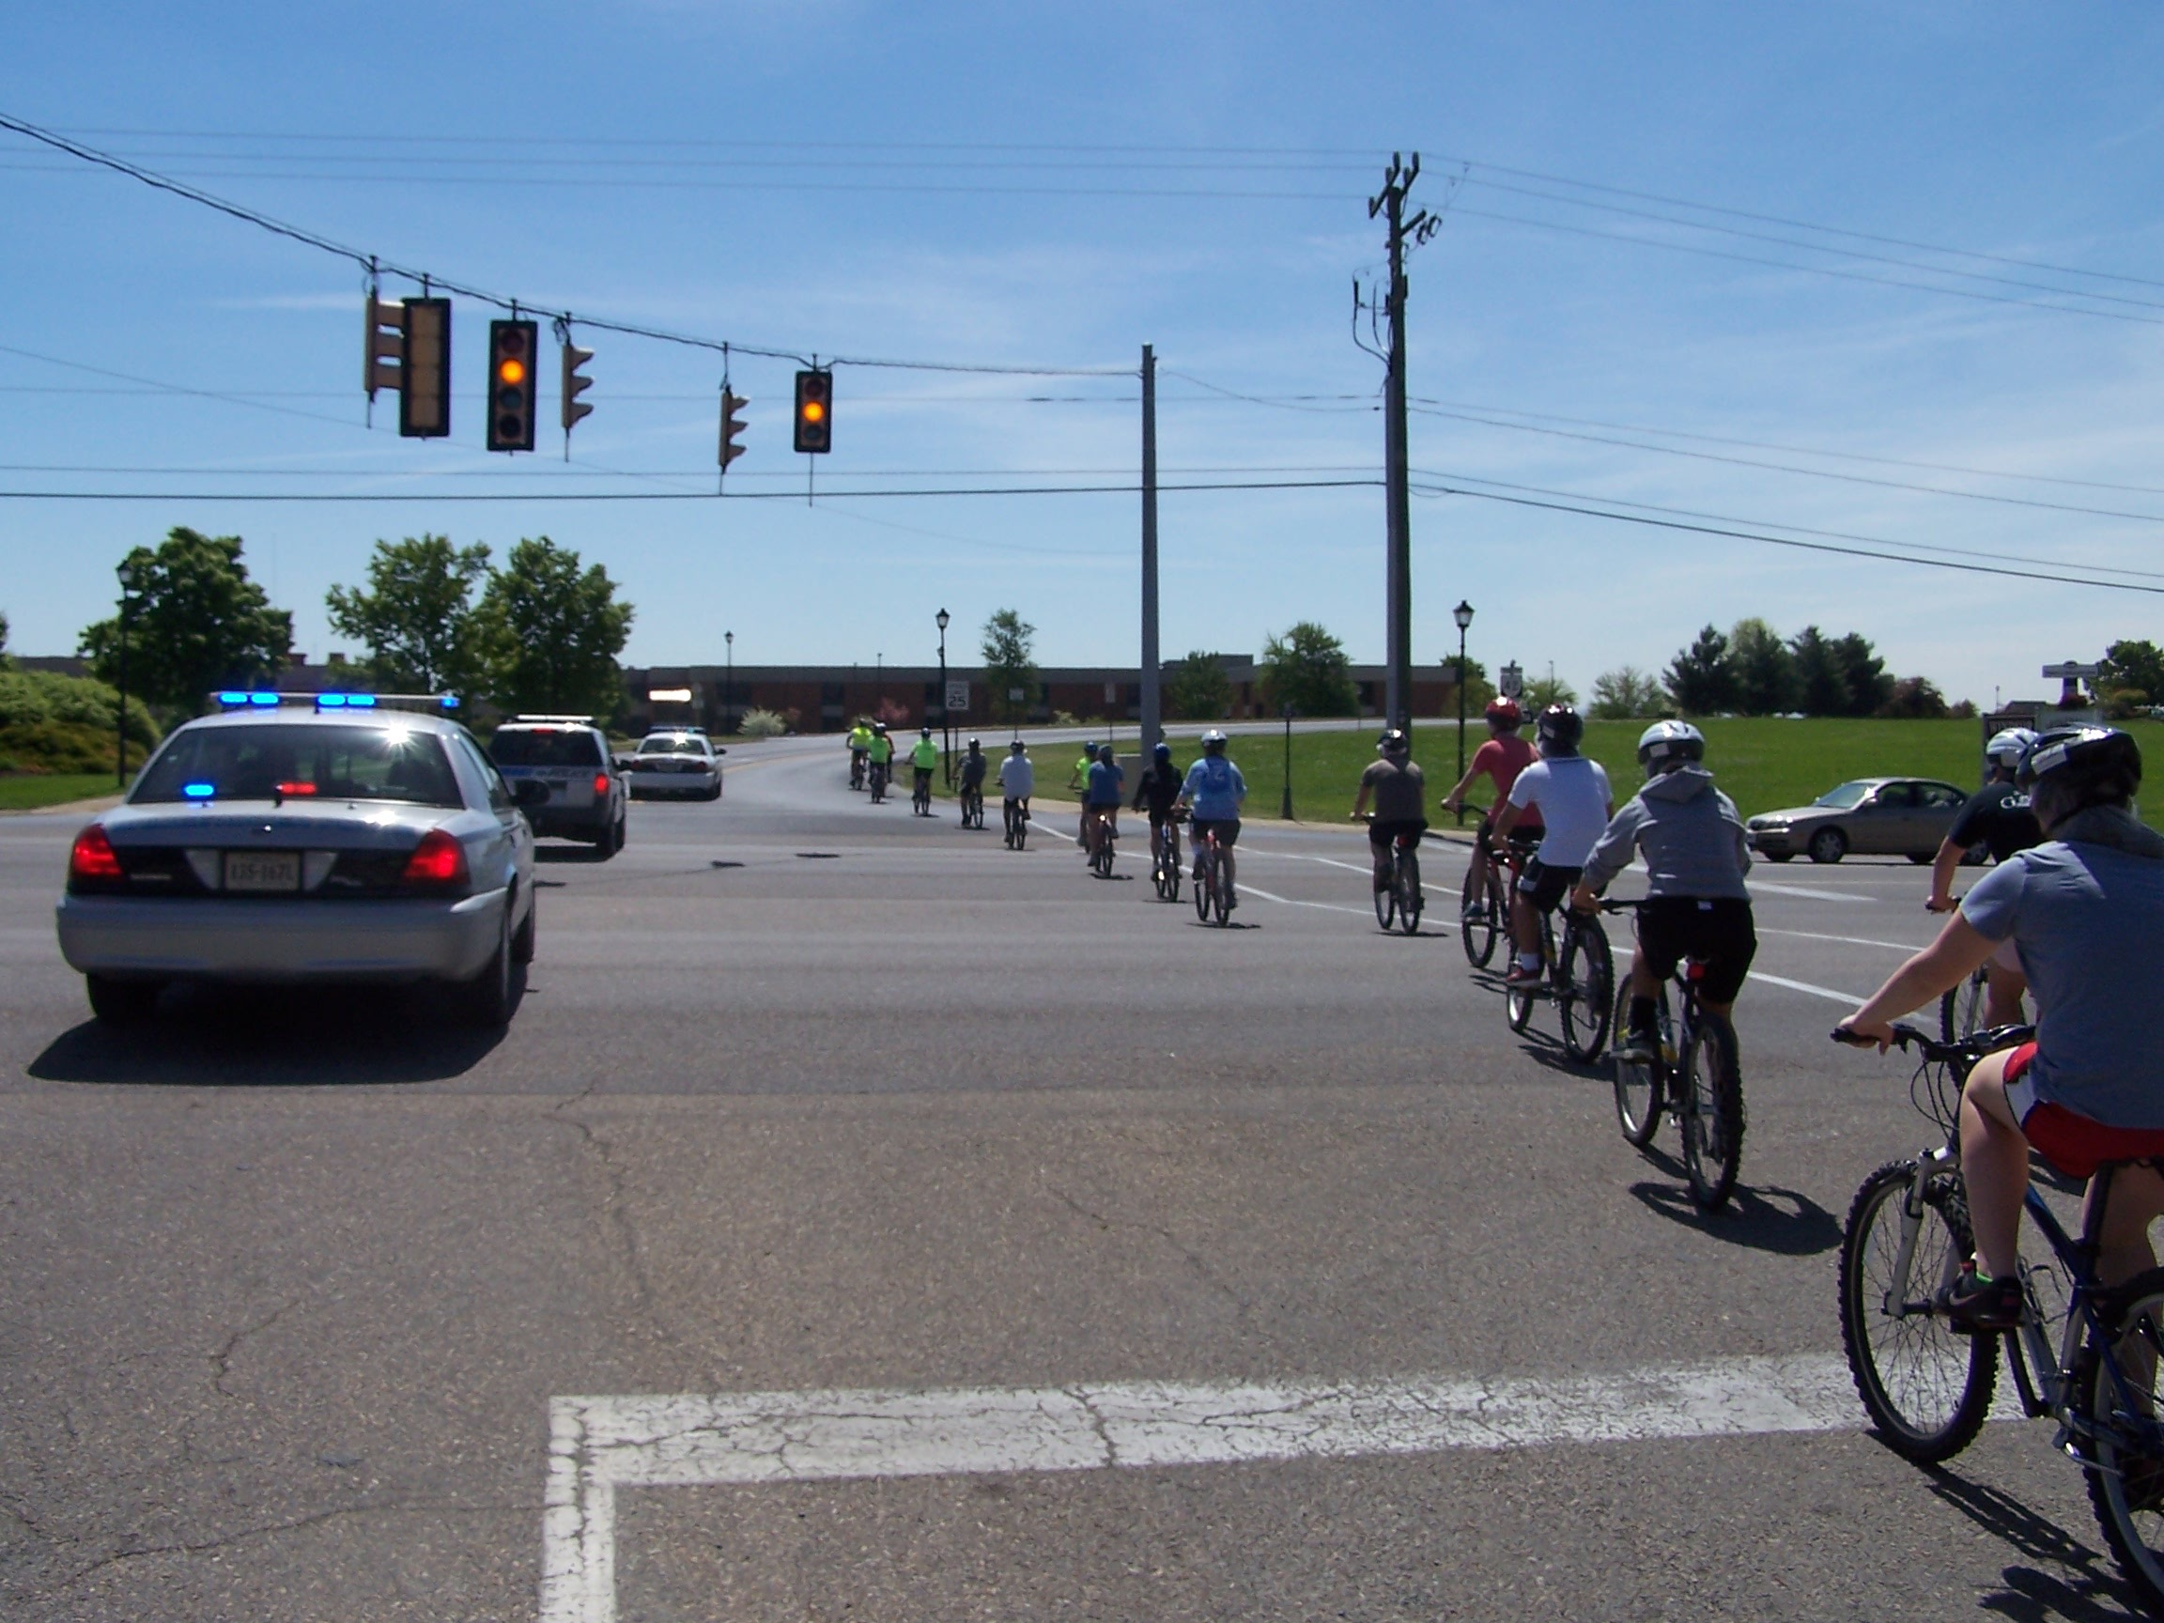
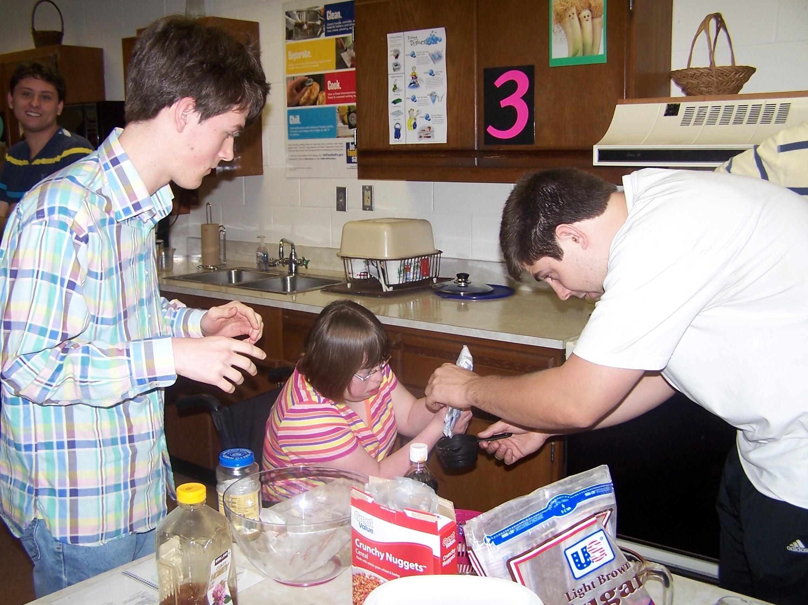
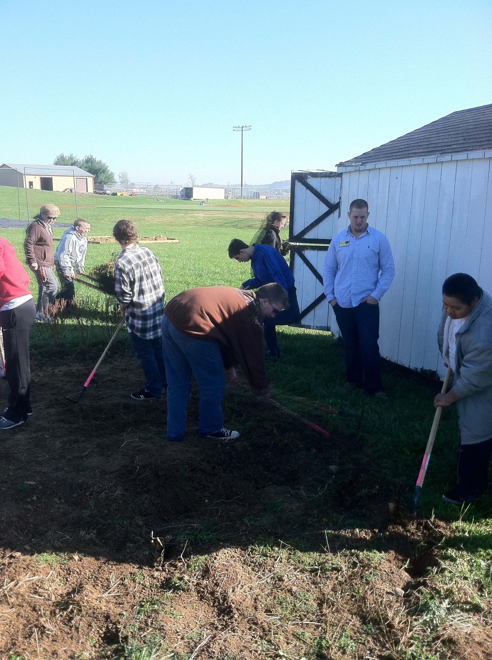
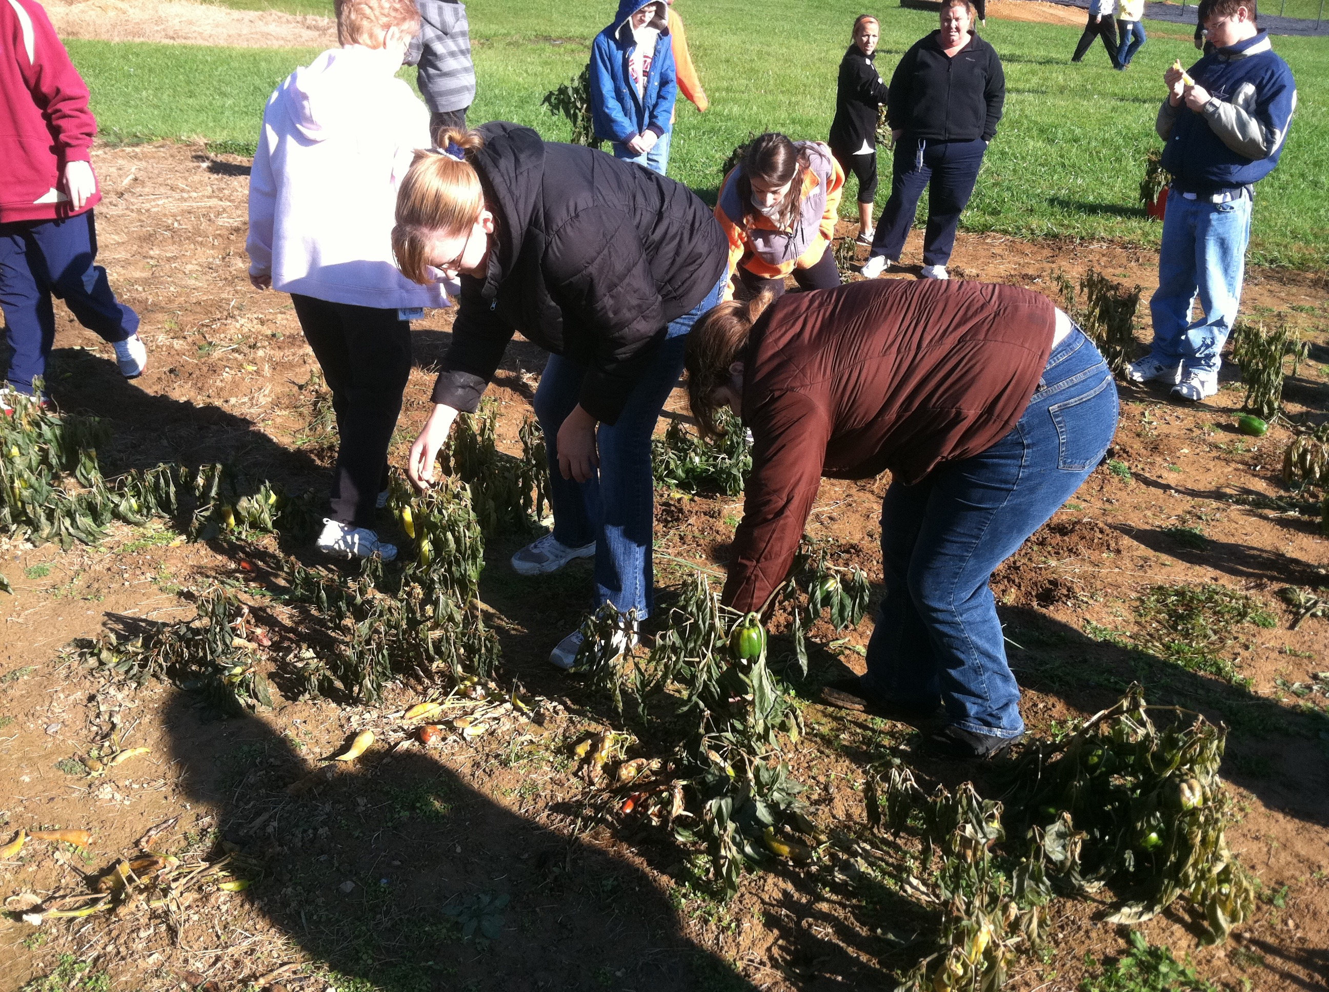
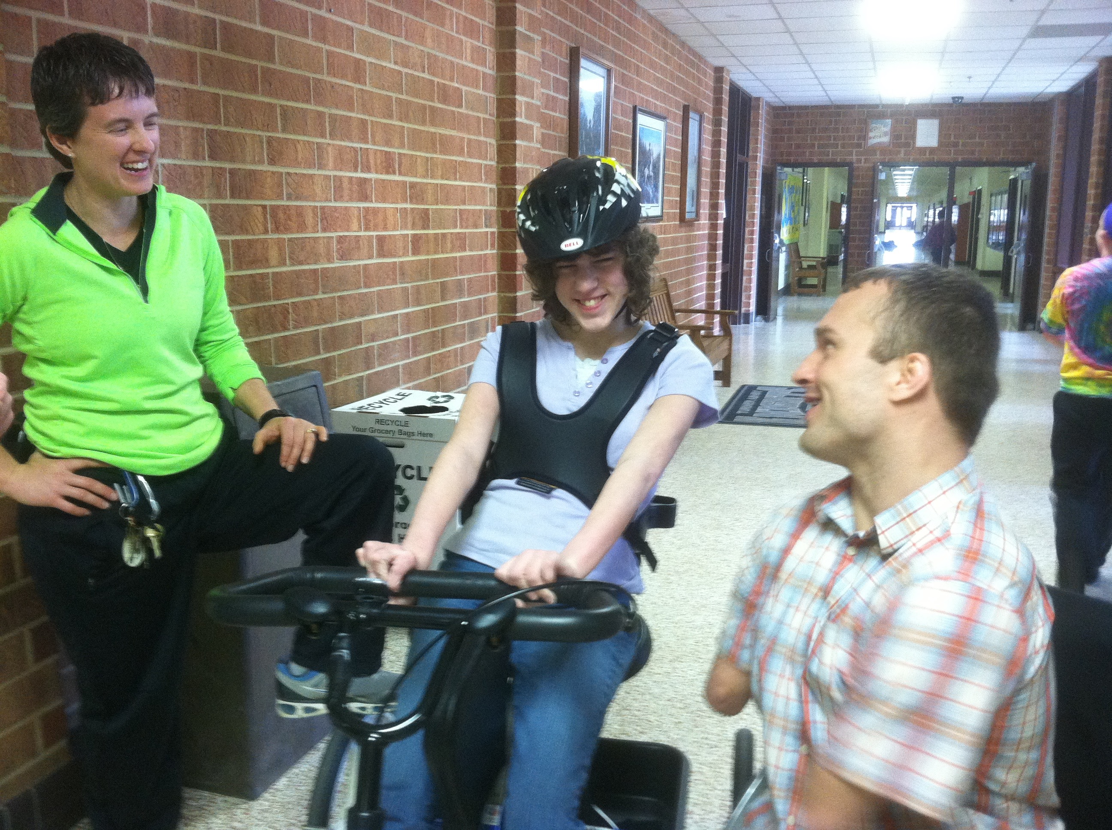
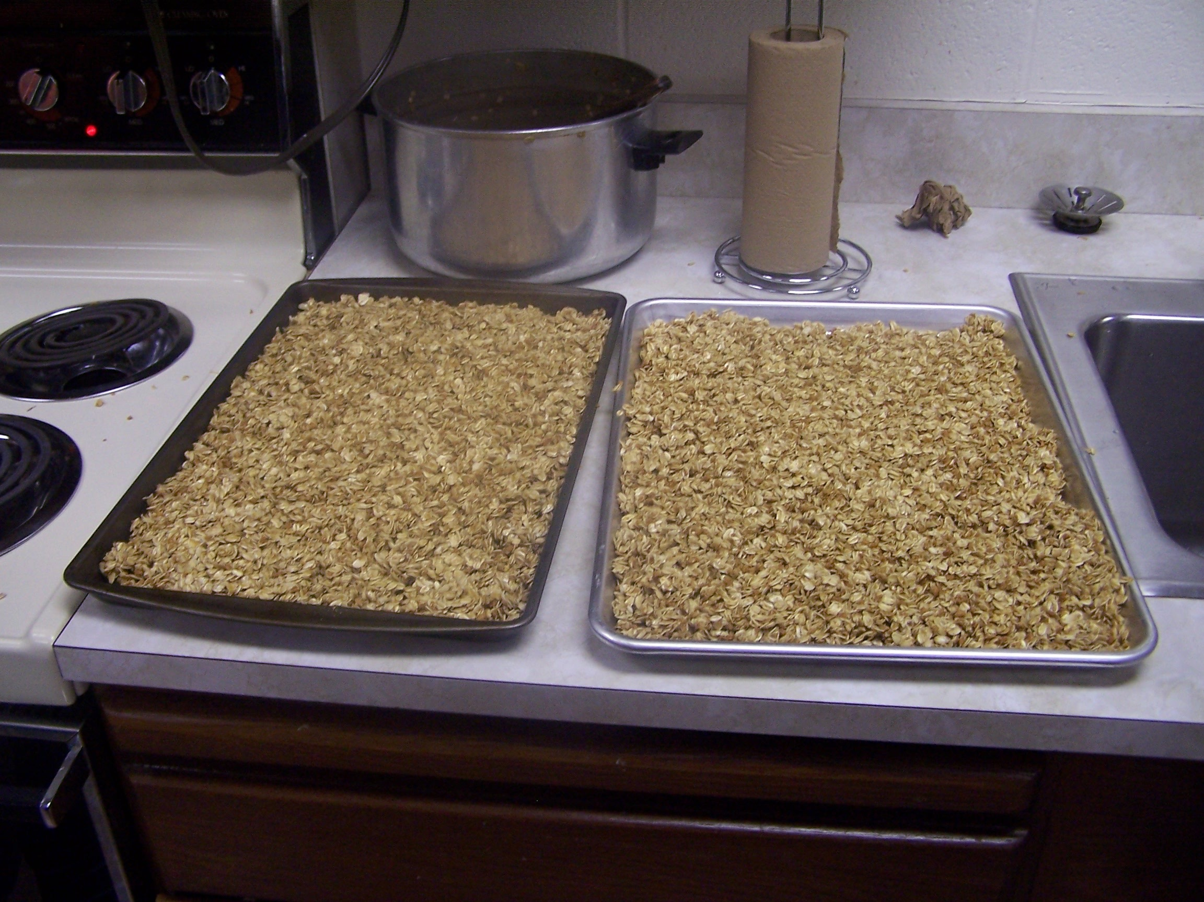

Slide 37
767 Cargo jet pilot
I never would have dreamed I would be flying a jet this big all over the country, Europe and to South America.
Truly unbelievable and the timing just took longer
Thankful I never gave up

Slide 38
Dream Big!
What dreams do you have for yourself?
What dreams do you have for your family?
What dreams do you have for your students?
What dreams do you have for your friends?

Slide 39
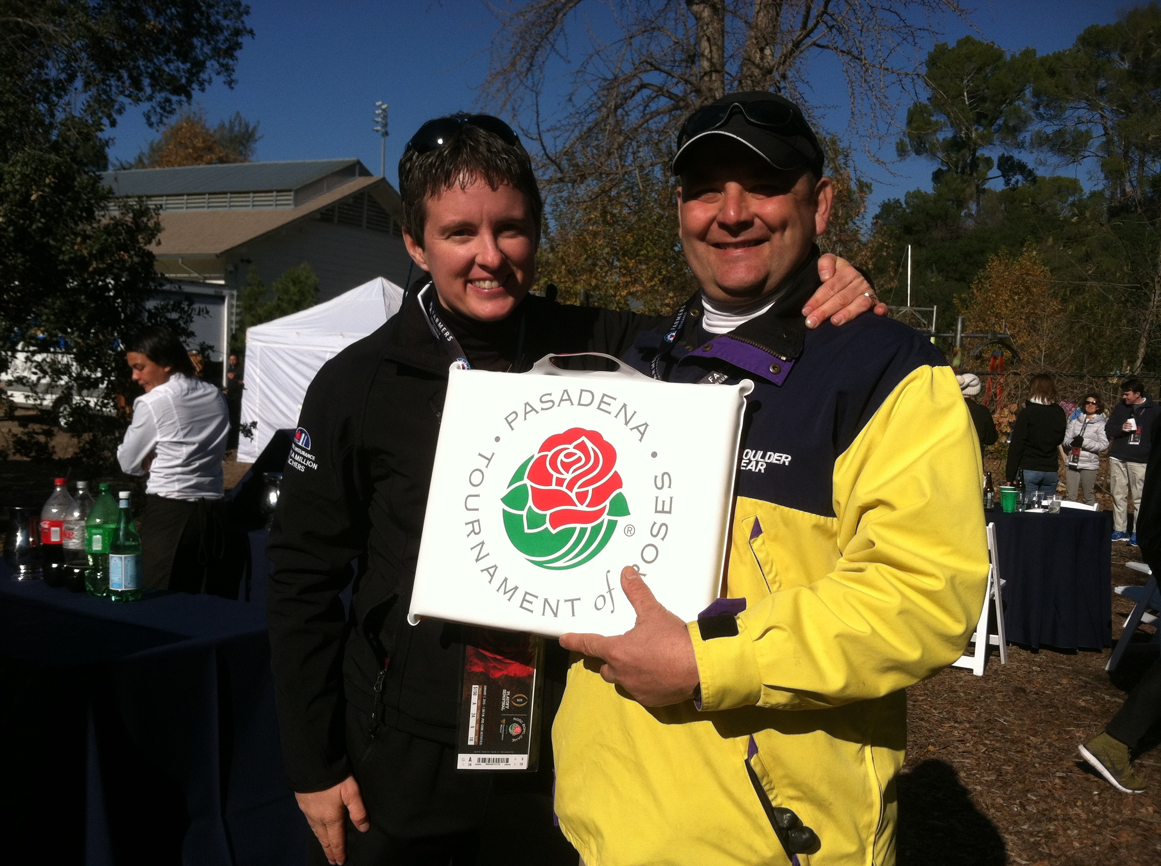
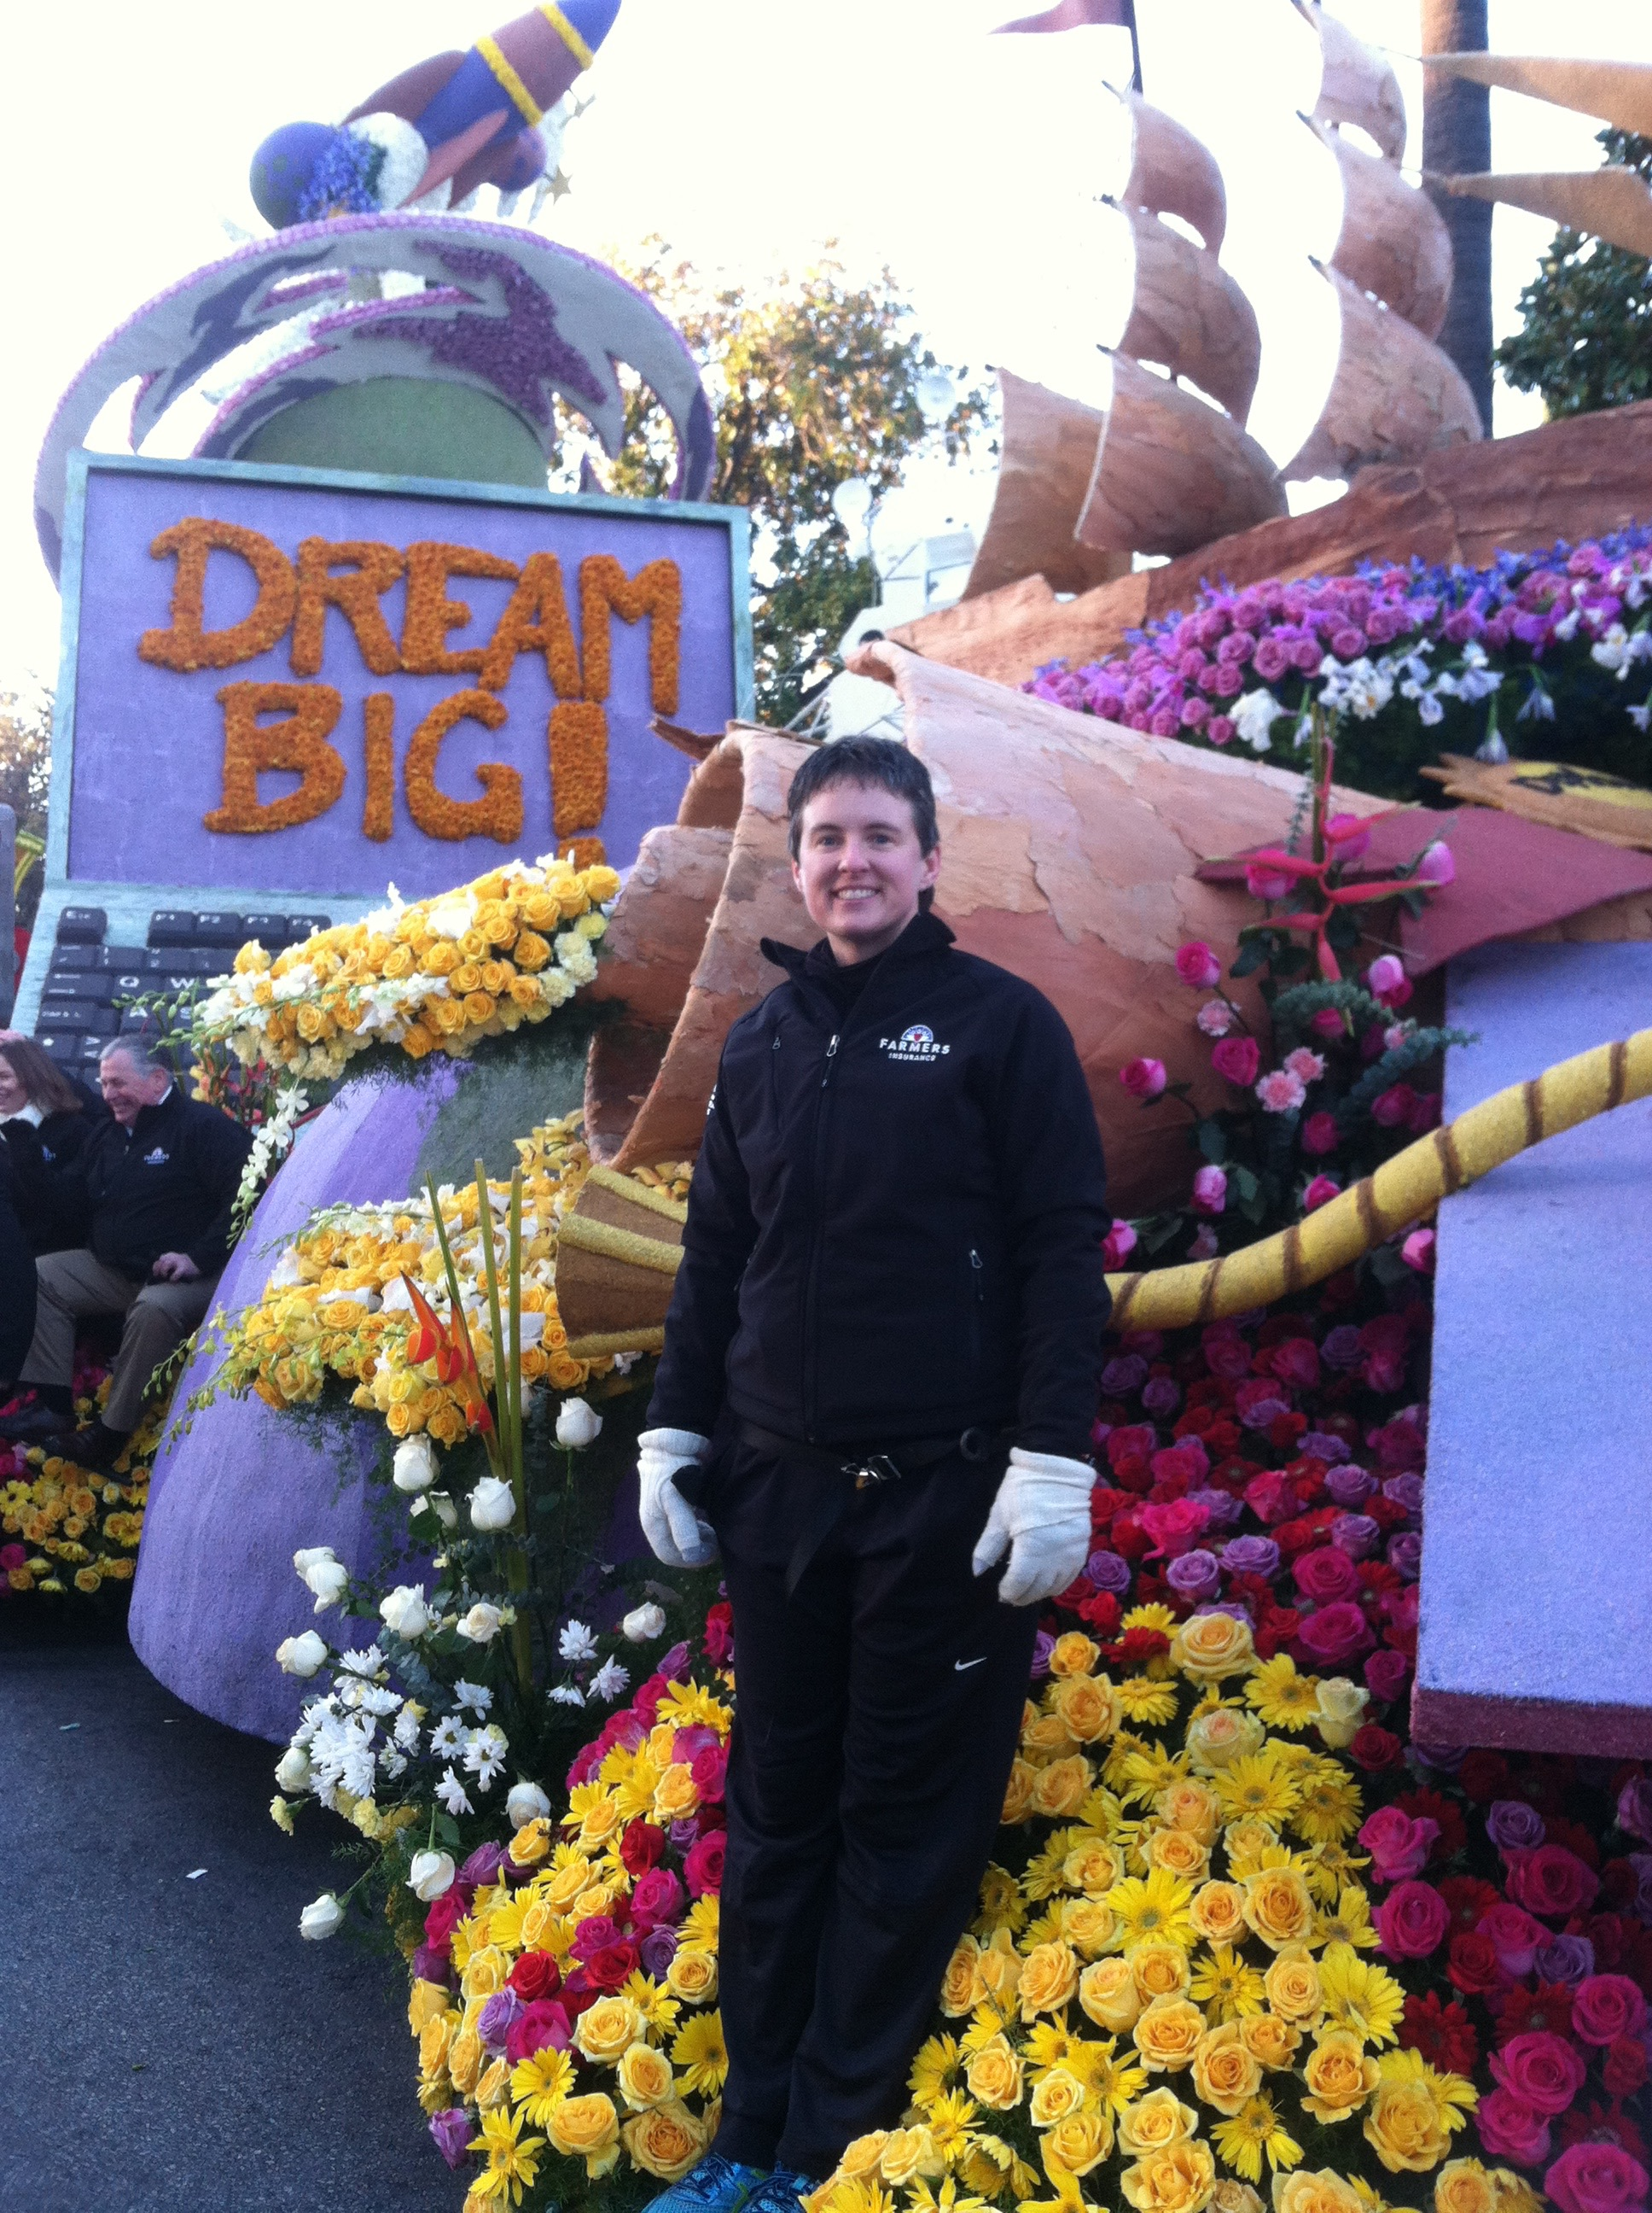
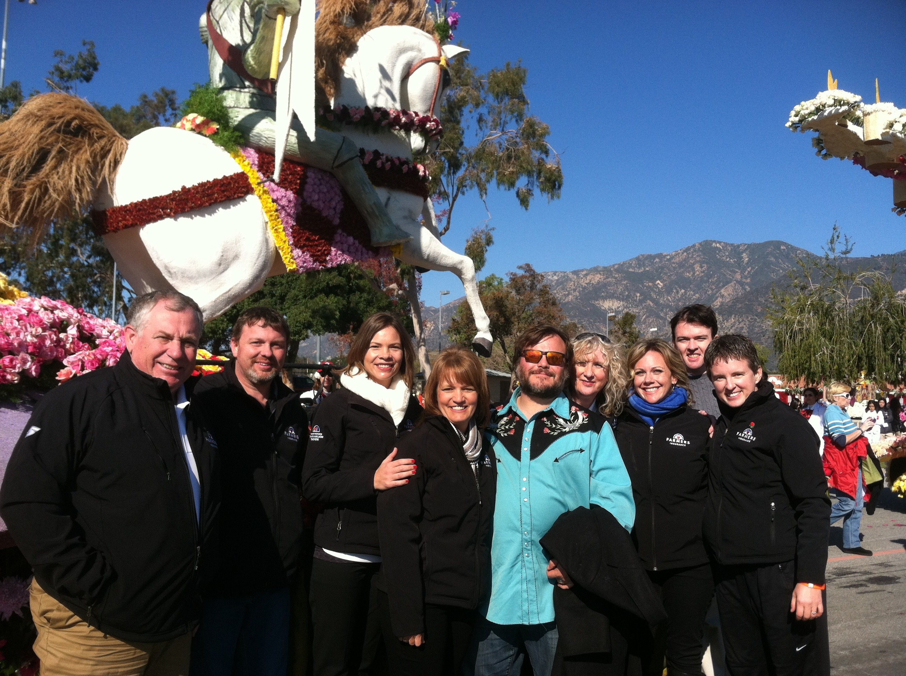
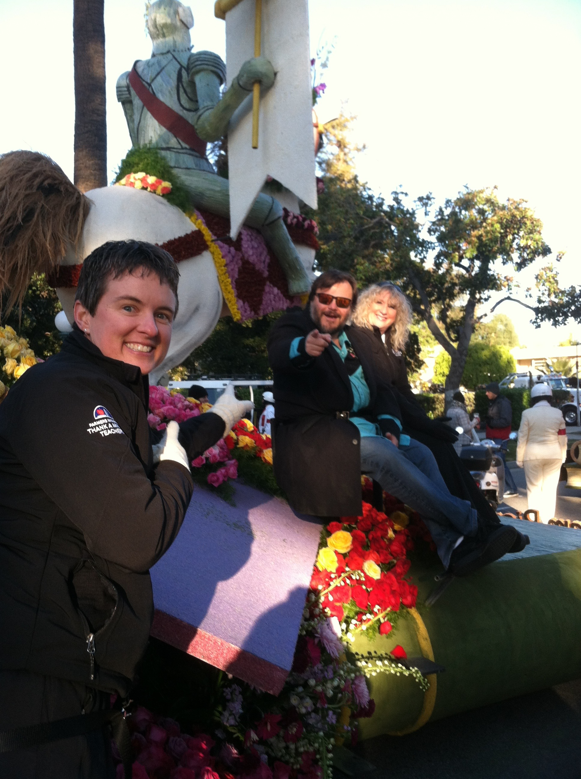

Slide 40
Get into small groups and
brainstorm ideas for this year
and beyond
Grants
New units

Slide 41
cindyferek.wordpress.com
Go to the dash marks to the
top left and select presentations
Email: pilotcferek@gmail.com

