Slide 1
Promoting Inclusion to Meet Standard 4 in Middle School PE
Amanda Campbell, Ph.D.
Bridgewater College

Slide 2
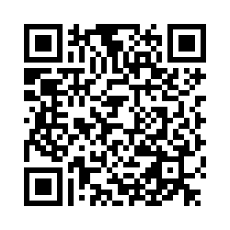
Survey
We invite you to participate in a research project examining healthcare and education professionals’ skills and confidence communicating with individuals with disabilities. We are asking you to take just 5 minutes to complete an anonymous survey about your feelings, comfort, abilities, and experiences communicating with individuals with disabilities. While there are no direct benefits to you, the results of this survey will help us to develop training resources to improve the education/healthcare experience for individuals with disabilities.
In appreciation for your time, at the end of the survey you will directed to a separate page where you will be entered into a drawing to win a $25 VISA gift card.
A complete consent document can be found on the first page of the survey, and is attached to this email. The survey can be found at this link: https://jmu.co1.qualtrics.com/jfe/form/SV_3mxcOVYdkx6oi7I
This study has been approved by the IRB, protocol #22-3325.
We sincerely appreciate your time and your honest responses.
Thank you,
Dr. Jill Lassiter, James Madison University
Dr. Amanda Campbell, Bridgewater College
Dr. Andrea Taliaferro, West Virginia University

Slide 3
New Inclusion SOLs
Grade 6:
6.4(f): Participate in developing student-led classroom activities that promote feelings of inclusion, which support feelings of acceptance, belonging, and being valued, for all students.
Grade 7:
7.4(c): Explain the importance of cooperating with classmates and demonstrate supportive behaviors that promote feelings of inclusion and safety of others.
7.4(i): Identify and describe instances that do not support feelings of inclusion (e.g., marginalization).
Grade 8:
8.4(e): Apply relationship skills and strategies (e.g., trust, compassion, empathy) that promote team/group dynamics and inclusion.
8.4(i): Develop plans to enhance inclusion and reduce social exclusion/marginalization.

Slide 4
Define Inclusion
What does it look like?
What does it sound like?
What does it feel like?
Notes:
What does inclusion look/sound/feel like? Define inclusion and identify key vocabulary. Have participants discuss with a partner.
Defining inclusion and identifying what it looks/sounds/feels like should be the first thing we do for our students so that we have a common language to talk about it.
Look like – classmates are not alone, not outside the group
Sounds like – invitations to join a group or be a partner, asking each other questions, checking in on each other (hey, are you doing ok?
Feel – feel connected to others, know you can count on someone, know that someone cares about you

Slide 5
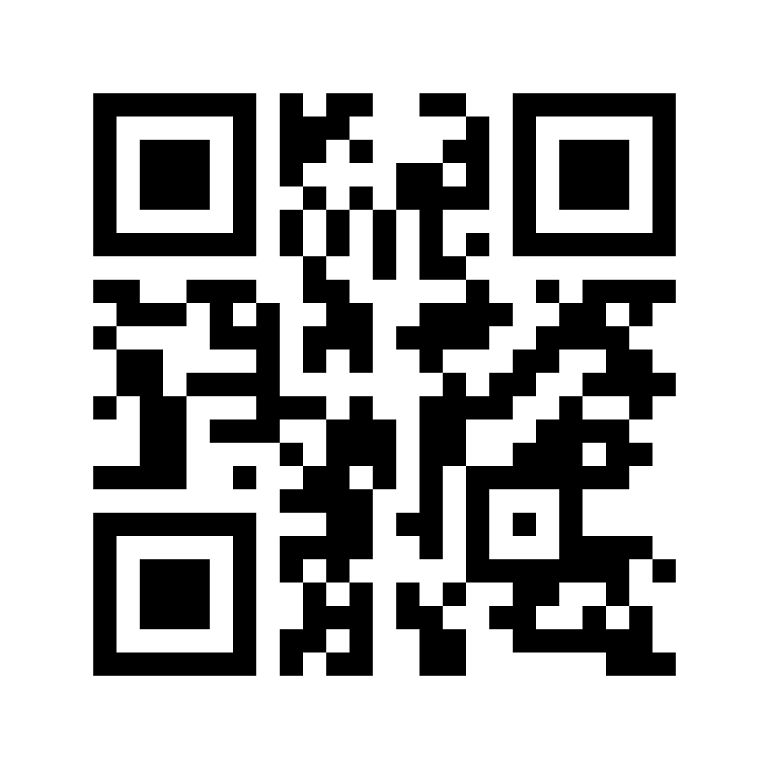
In your own words, how do you define ”inclusion”?
Or go to www.menti.com and enter the code 6934 8219
Notes:
https://www.mentimeter.com/app/presentation/5b6573840df211fd48dcebdce3097fcb/03b4df8b21e7/edit

Slide 6
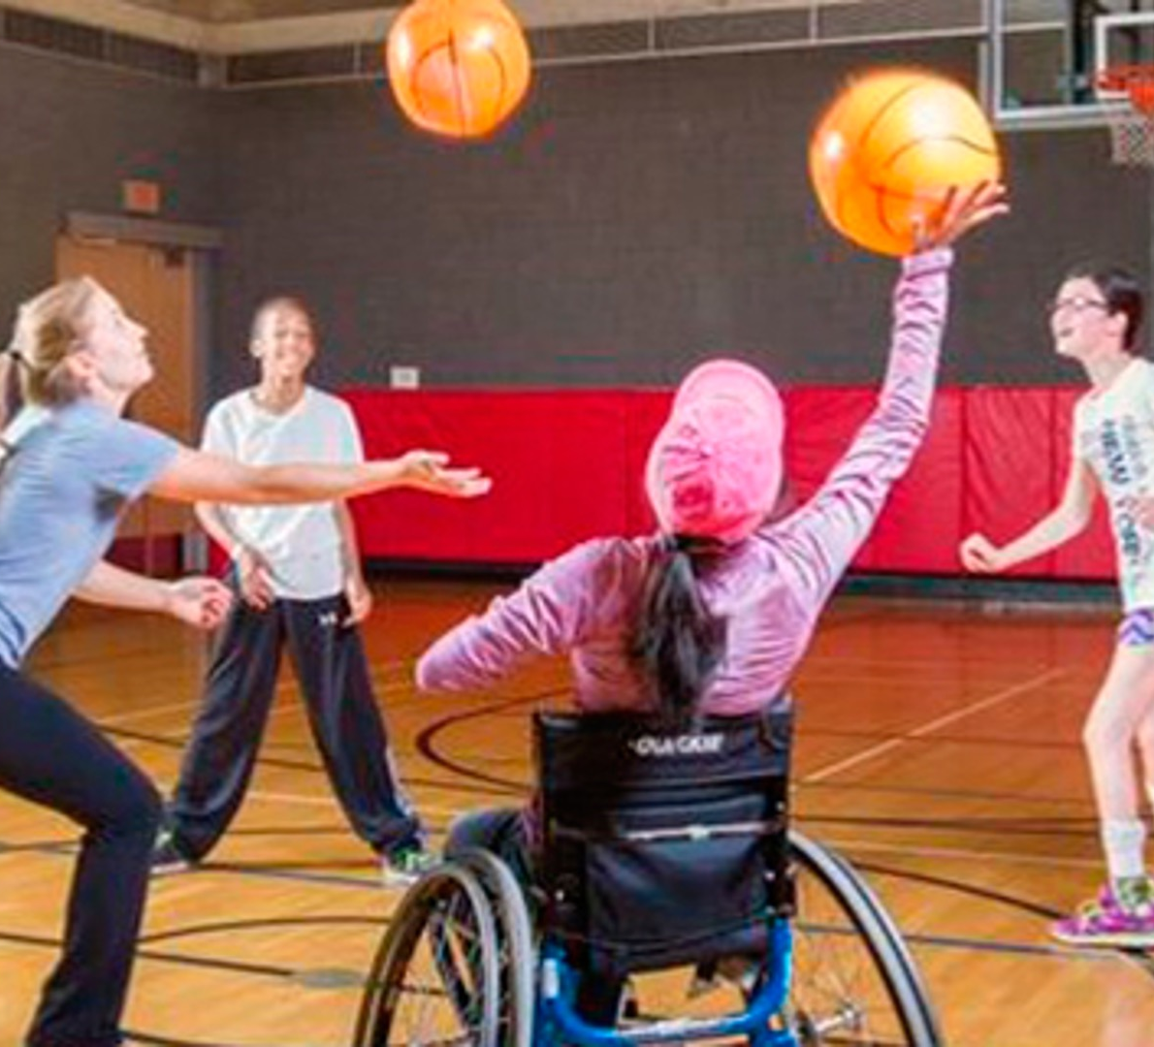
INCLUSION
The act of creating an environment in which any individual or group will be welcomed, respected, supported and valued as a fully participating member. An inclusive and welcoming climate embraces and respects differences.
Diversity, Equity and Inclusion Glossary. College of the Environment. University of Washington. https://environment.uw.edu/about/diversity-equity-inclusion/tools-and-additional-resources/glossary-dei-concepts/#:~:text=Inclusion%3A%20The%20act%20of%20creating,climate%20embraces%20and%20respects%20differences.
Notes:
Let’s see if our definition matches an official definition.
Diversity, Equity and Inclusion Glossary. College of the Environment. University of Washington. https://environment.uw.edu/about/diversity-equity-inclusion/tools-and-additional-resources/glossary-dei-concepts/#:~:text=Inclusion%3A%20The%20act%20of%20creating,climate%20embraces%20and%20respects%20differences.

Slide 7
Notes:
Directly matches the definition of social awareness, on of the SEL competencies.

Slide 8
Teaching Personal and Social Responsibility (TPSR) (Hellison 2003)
Level 3: Self-Direction
On-task independence
Goal setting progression
Level 2: Participation
Self-motivation
Effort - try new tasks
Level 1: Respect
Level 4: Caring
Level 5: Outside
Self-control and respect the rights and feelings of others
Right to peaceful conflict resolution
Right to be included and to have cooperative peers
Keep going when the going gets tough!
Helping peers in need
Listening and responding to others
Inner strength and courage to resist peer pressure
Be a role model outside the gym!
INCLUSION

Slide 9
Standard 4: Demonstrate the aptitude, attitude, and skills to lead responsible, fulfilling, and respectful lives.
(Social and Emotional Development)
Prompting & Awareness
Relationship Building
Empowerment
Reflection
Reinforcement
Word Wall
Instant Activity
Choices and Challenges
Transitions and Closure
Recognition
(Hellison, 2013; Watson & Clocksin, 2013)
Notes:
Once we define inclusion, we need to think about how we can integrate the concepts into our teaching to help students meet the standards.
Use poster on wall to prompt and build awareness of what these desired behaviors and actions look like in PE each day. I prompted and asked questions of my students each day when they entered the gym and before they would begin activities to get them thinking about what these things would look like in the lesson/activities for the day.
E.g. How do you think you could show respect and self-control in PE today?
I also started taking pictures of students demonstrating responsible behavior and posted them on the wall in the category. I wish I had a picture of that to show you!
Provide opportunities for relationship building in all lessons…sometimes as an IA, sometimes as part of the skill-building activity.
Empower students by offering choices, giving them responsibilities, and challenging them to demonstrate self-direction. They had the power to make good choices, they had the power to earn a badge.
Reflecting during closure in each lesson, asking students to reflect on specific ways that they demonstrated effort, respect, etc. Because none of this matters if we leave out reflection – that is the mechanism by which students learn and develop.
Recognizing and reinforcing personal and social responsibility with the badges at the end of each lesson, referring again to the wall. I also took pictures of students demonstrating positive behavior and put them in the appropriate category on the wall. Students LOVED finding pictures of themselves on the wall.
As I was processing the new inclusion SOLs, I thought about how they fit into this framework and how we can reinforce them through reflection, relationship building, and empowerment.

Slide 10
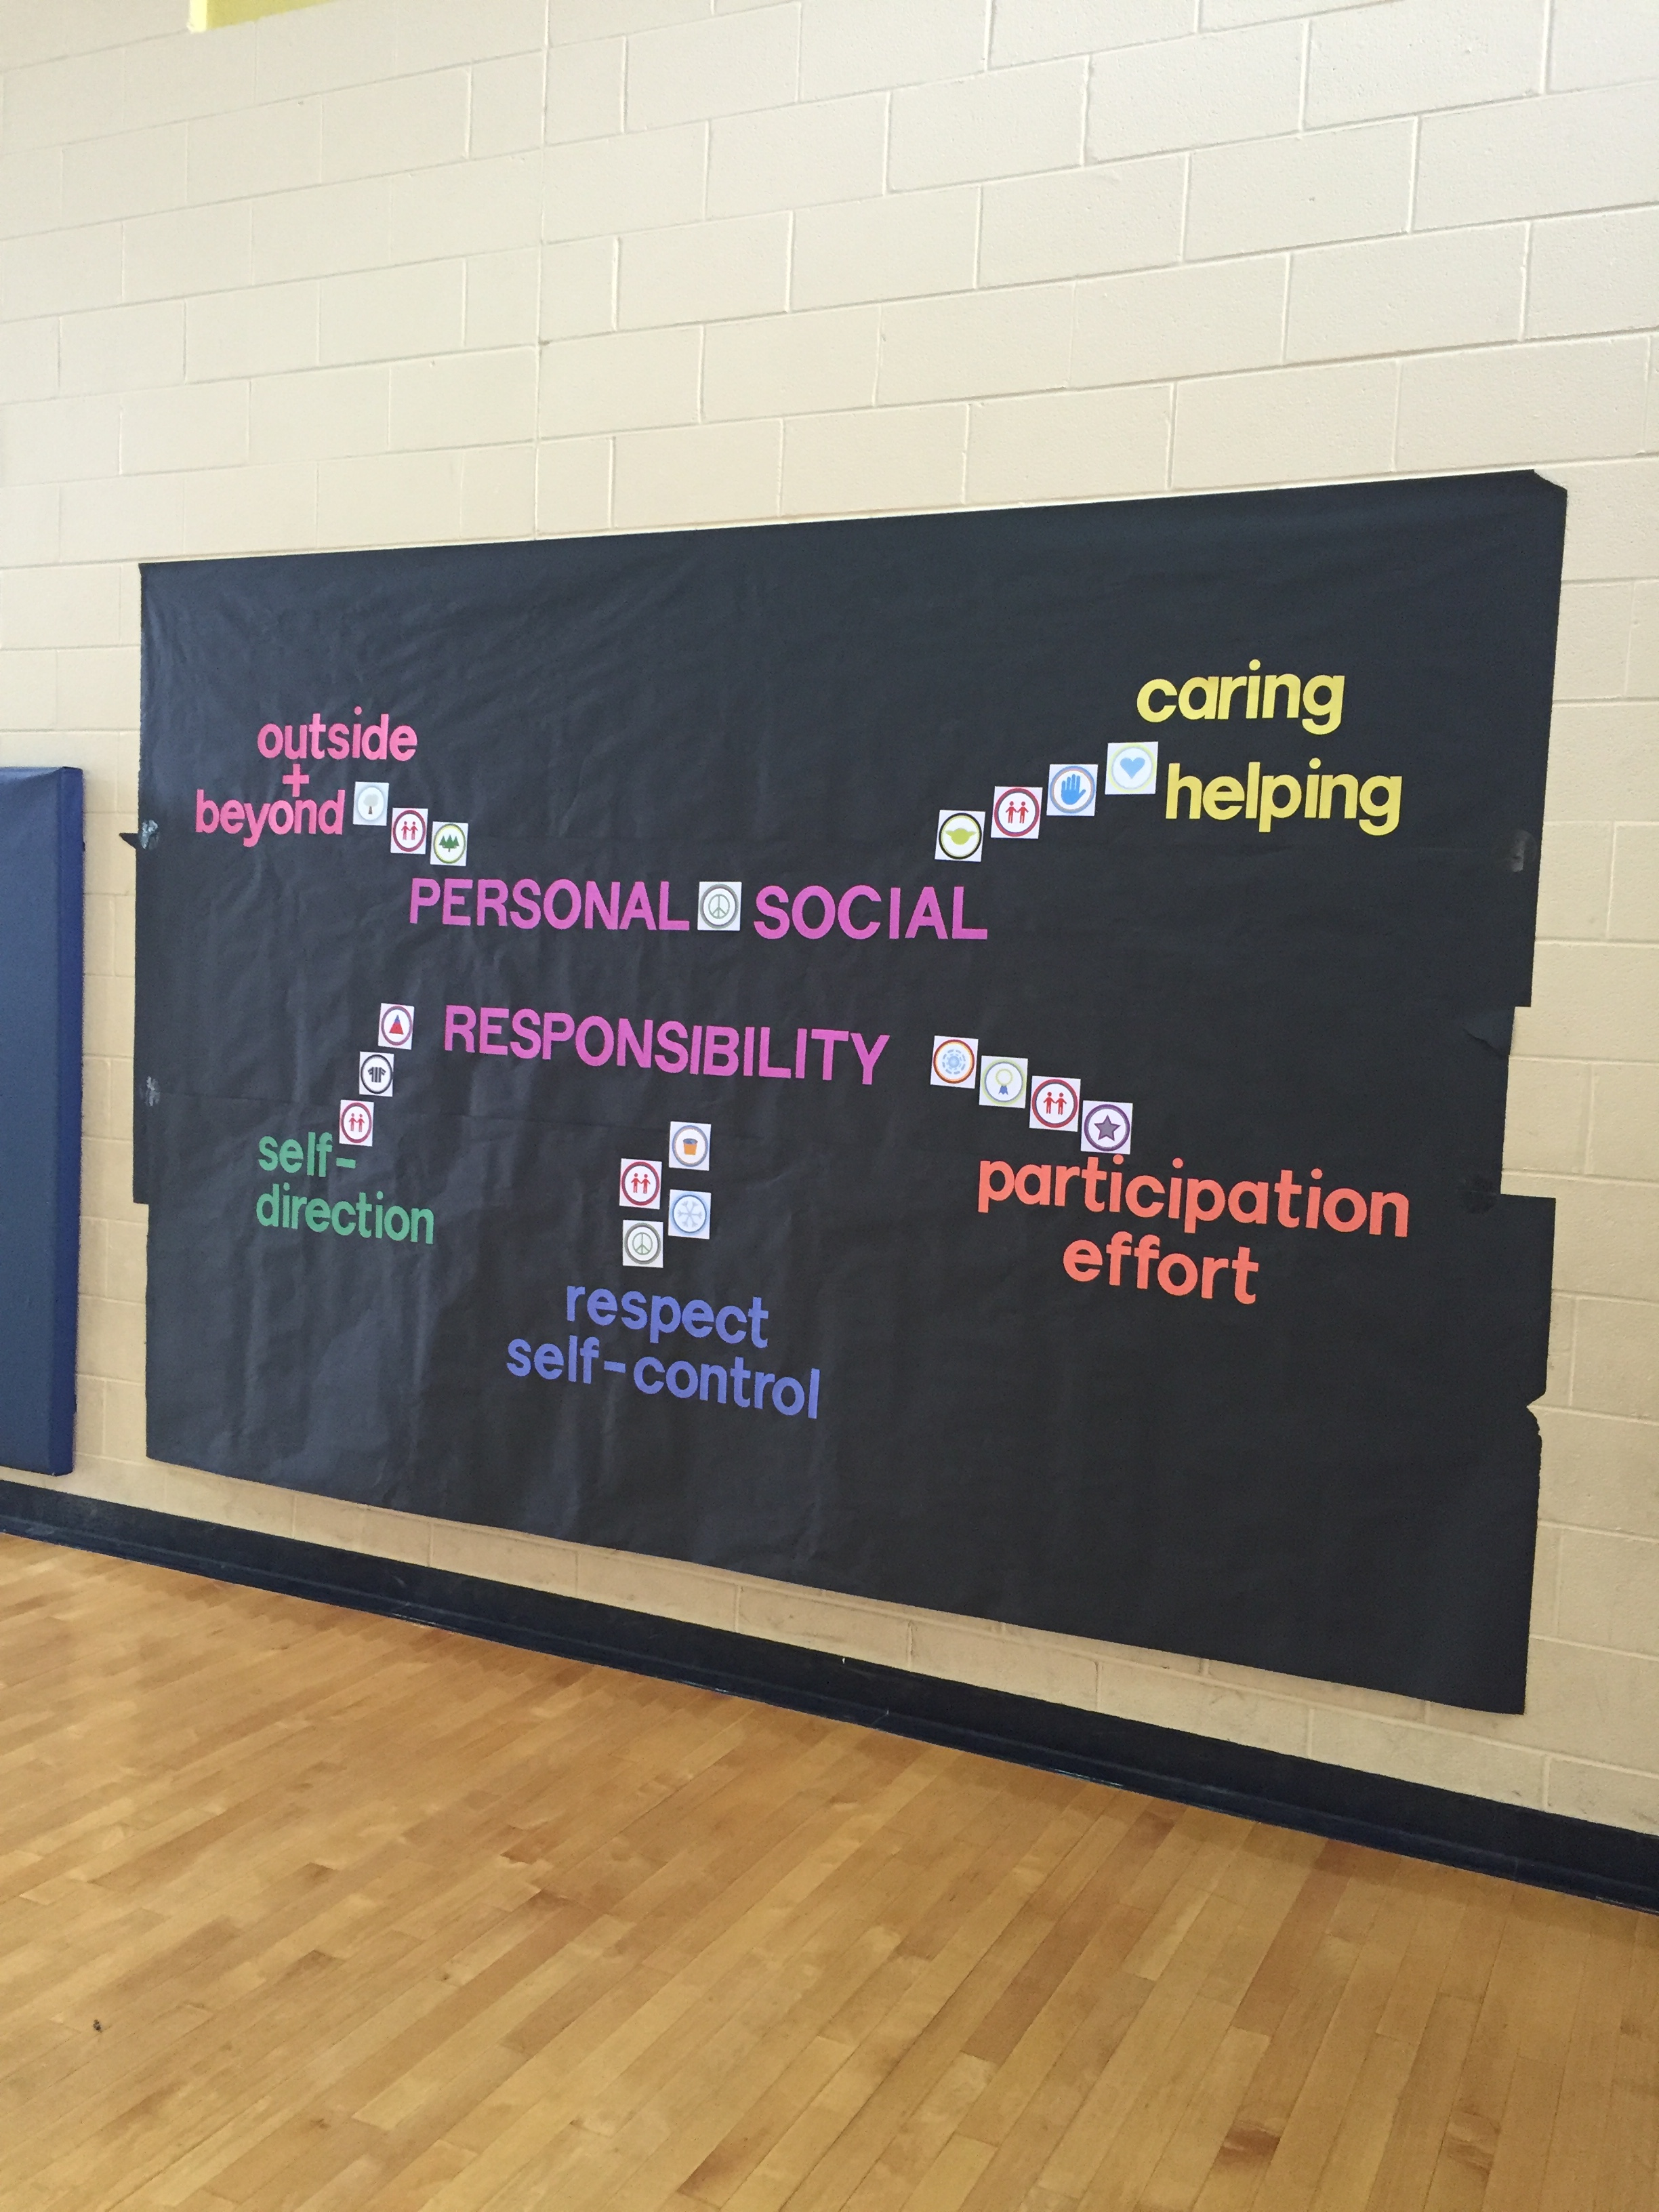
Notes:
Then I created a wall that they would see every day as they entered and exited the gym. I put the badges in the corresponding categories (some badges appeared in more than one category).

Slide 11
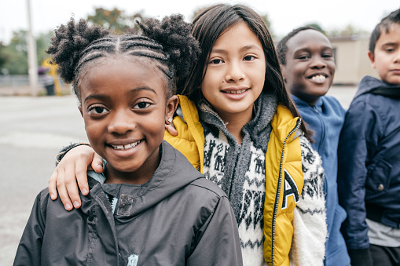
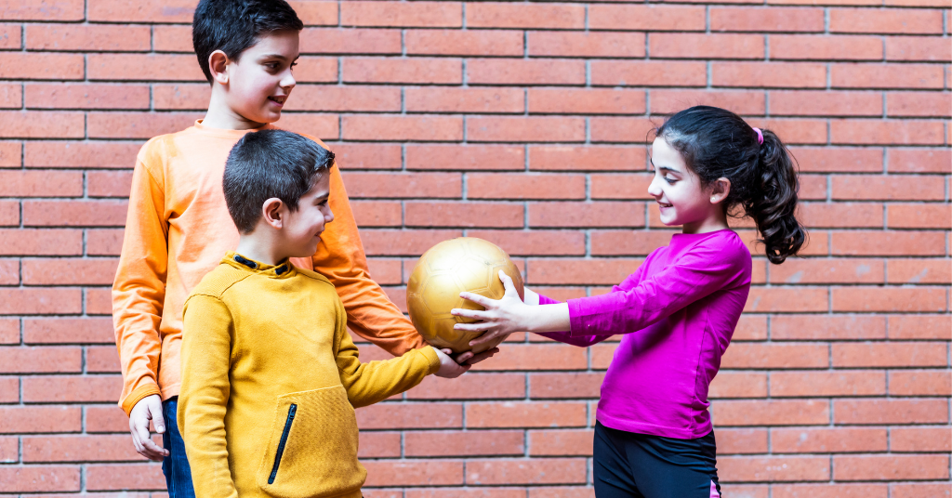
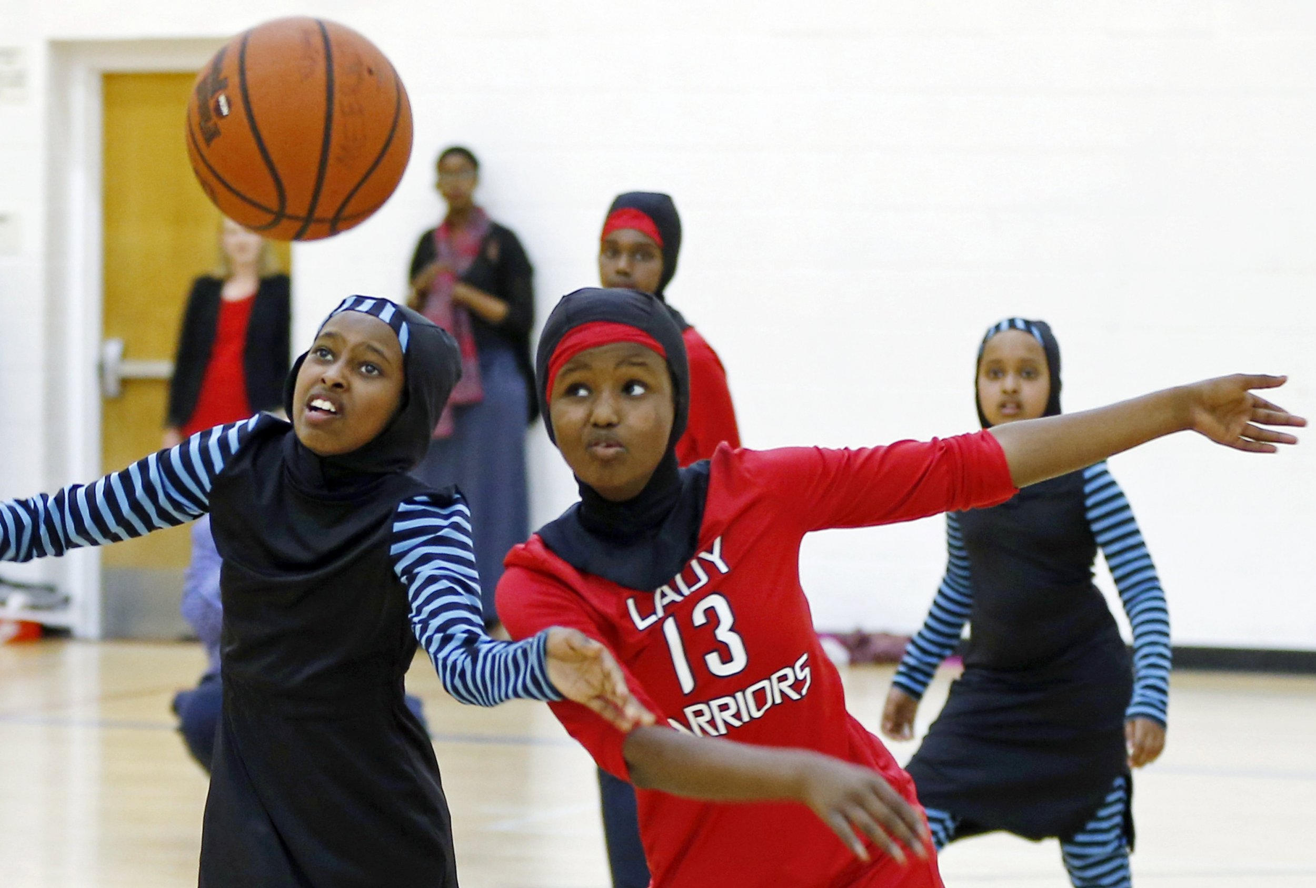
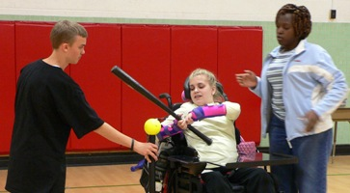
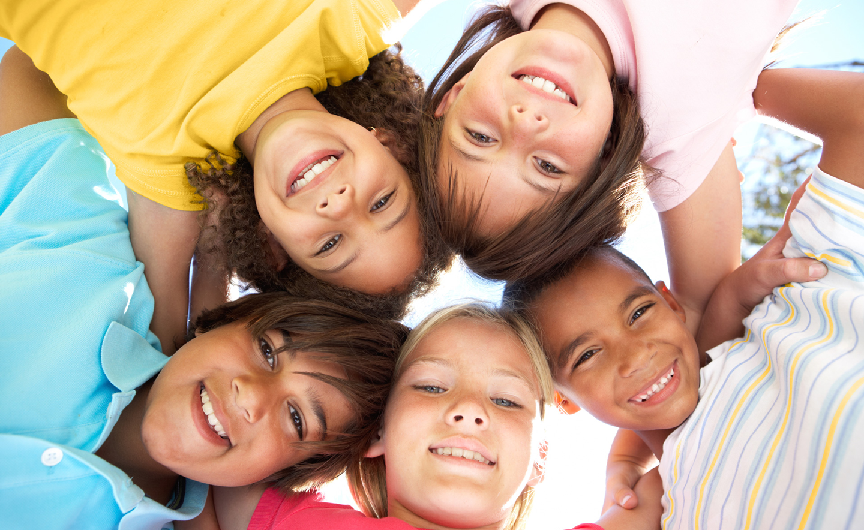
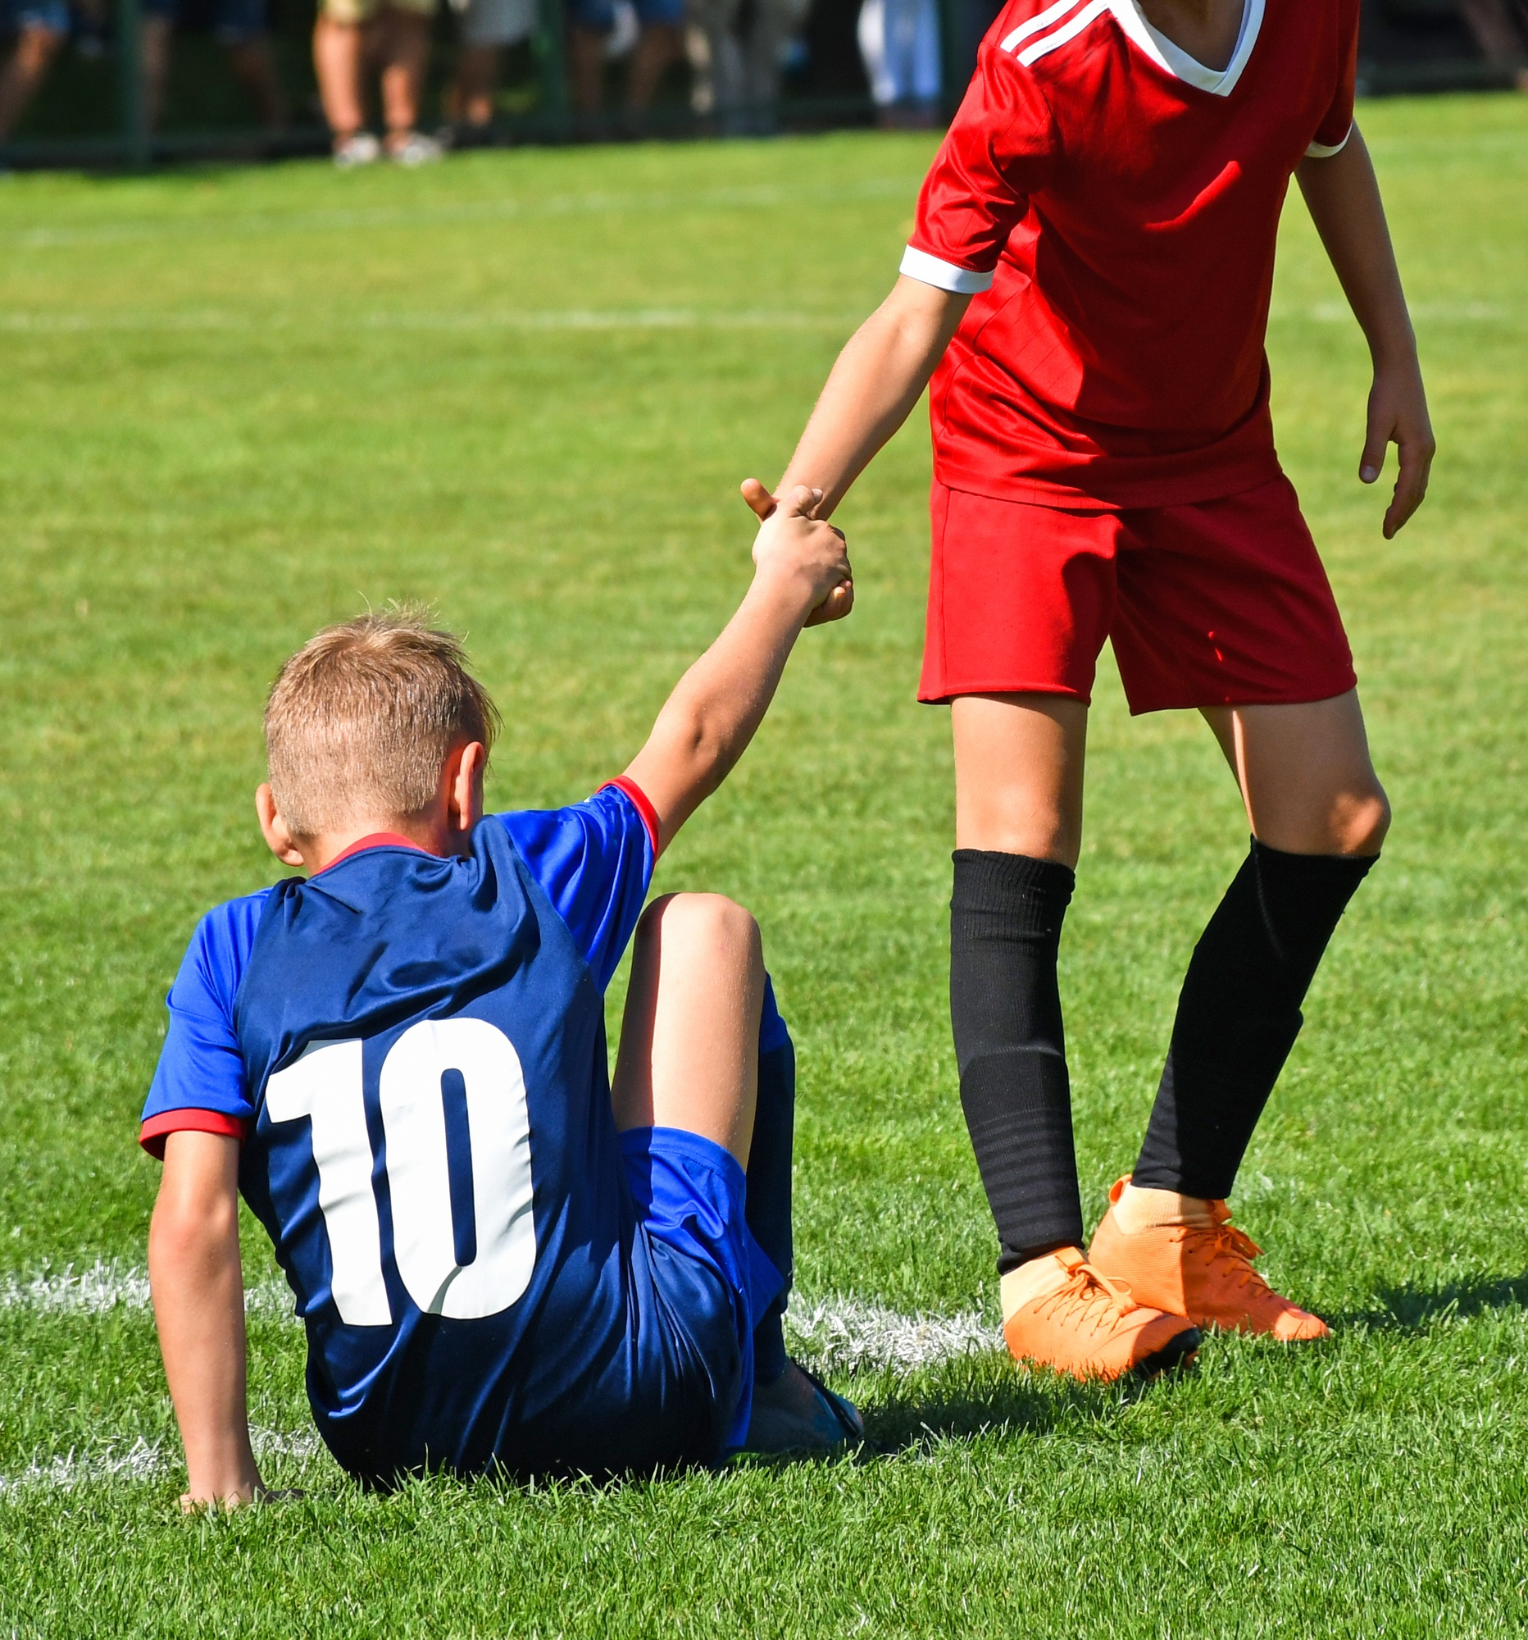
ACCEPTANCE
BELONGING
INCLUSION
VALUE
EMPATHY
Notes:
Ideas that don’t align with my ideas or beliefs are just as important than those that do

Slide 12
https://www.bsnsports.com/ib/inclusiontoolbox

Slide 13
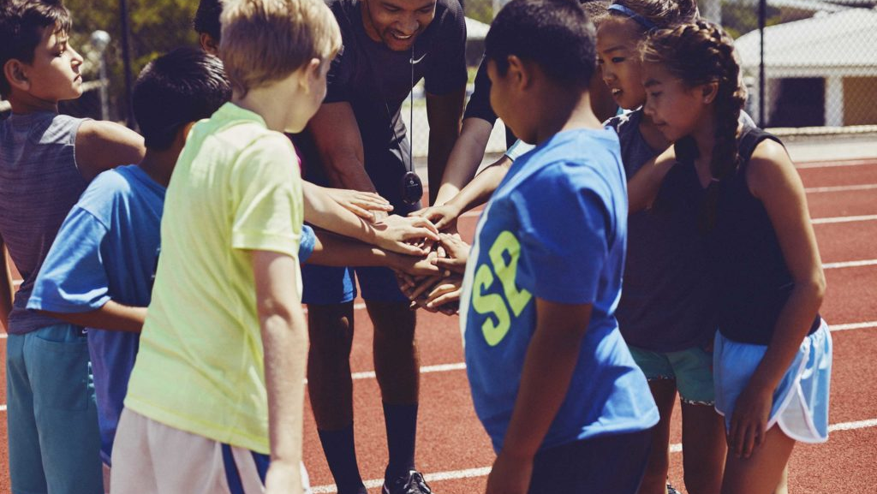
8.4(e): Apply relationship skills and strategies (e.g., trust, compassion, empathy) that promote team/group dynamics and inclusion.
BUILD RELATIONSHIPS
Questions of the Day:
Would you rather…eat a chocolate covered cricket or a chocolate covered ghost pepper?
Notes:
In order to apply relationship skills and strategies, they have to build relationships and practice the skills! The time when students are entering the gym and the instant activities are perfect times to build relationships. We’re talking about relationships between the teacher and the students, as well as among the students. So, for example, I try to make connections with as many students as possible as they enter the gym by asking them a question or saying something positive. I especially try to connect with those that typically struggle with motivation or behavior issues.
To help students connect with each other, you could have a question of the day on the white board, where students have to find a partner and discuss the question of the day while doing a physical activity. You could build it into the instant activity or warm-up activity where there are fitness stations and a question at each station.
You can even have kids submit questions of the day in advance and they might be excited when their question is chosen. You could have a vocabulary word of the day and they discuss the meaning of the word with their group.
Play fish game
Mingle and trade fish while music is playing
Same color: Favorite food
Same number: Pet you have or pet you wish you had
Different color: Siblings
Different number: Favorite sport or physical activity
Could also do Fitness Corners with a different question at each corner or a partner practice activity with a different question of the day
See slides at end of presentation for sample questions.
Raise your hand if you learned something new about someone. We identified similarities and differences.

Slide 14
Reflect
Why is it important to learn about each other?
How does learning about each other contribute to belonging, acceptance, and valuing each other?
How did YOU show belonging, acceptance, and value when we played the fish game?
Notes:
Raise your hand if you learned something new about someone.
We can assess through an exit ticket, a reflective journal

Slide 15
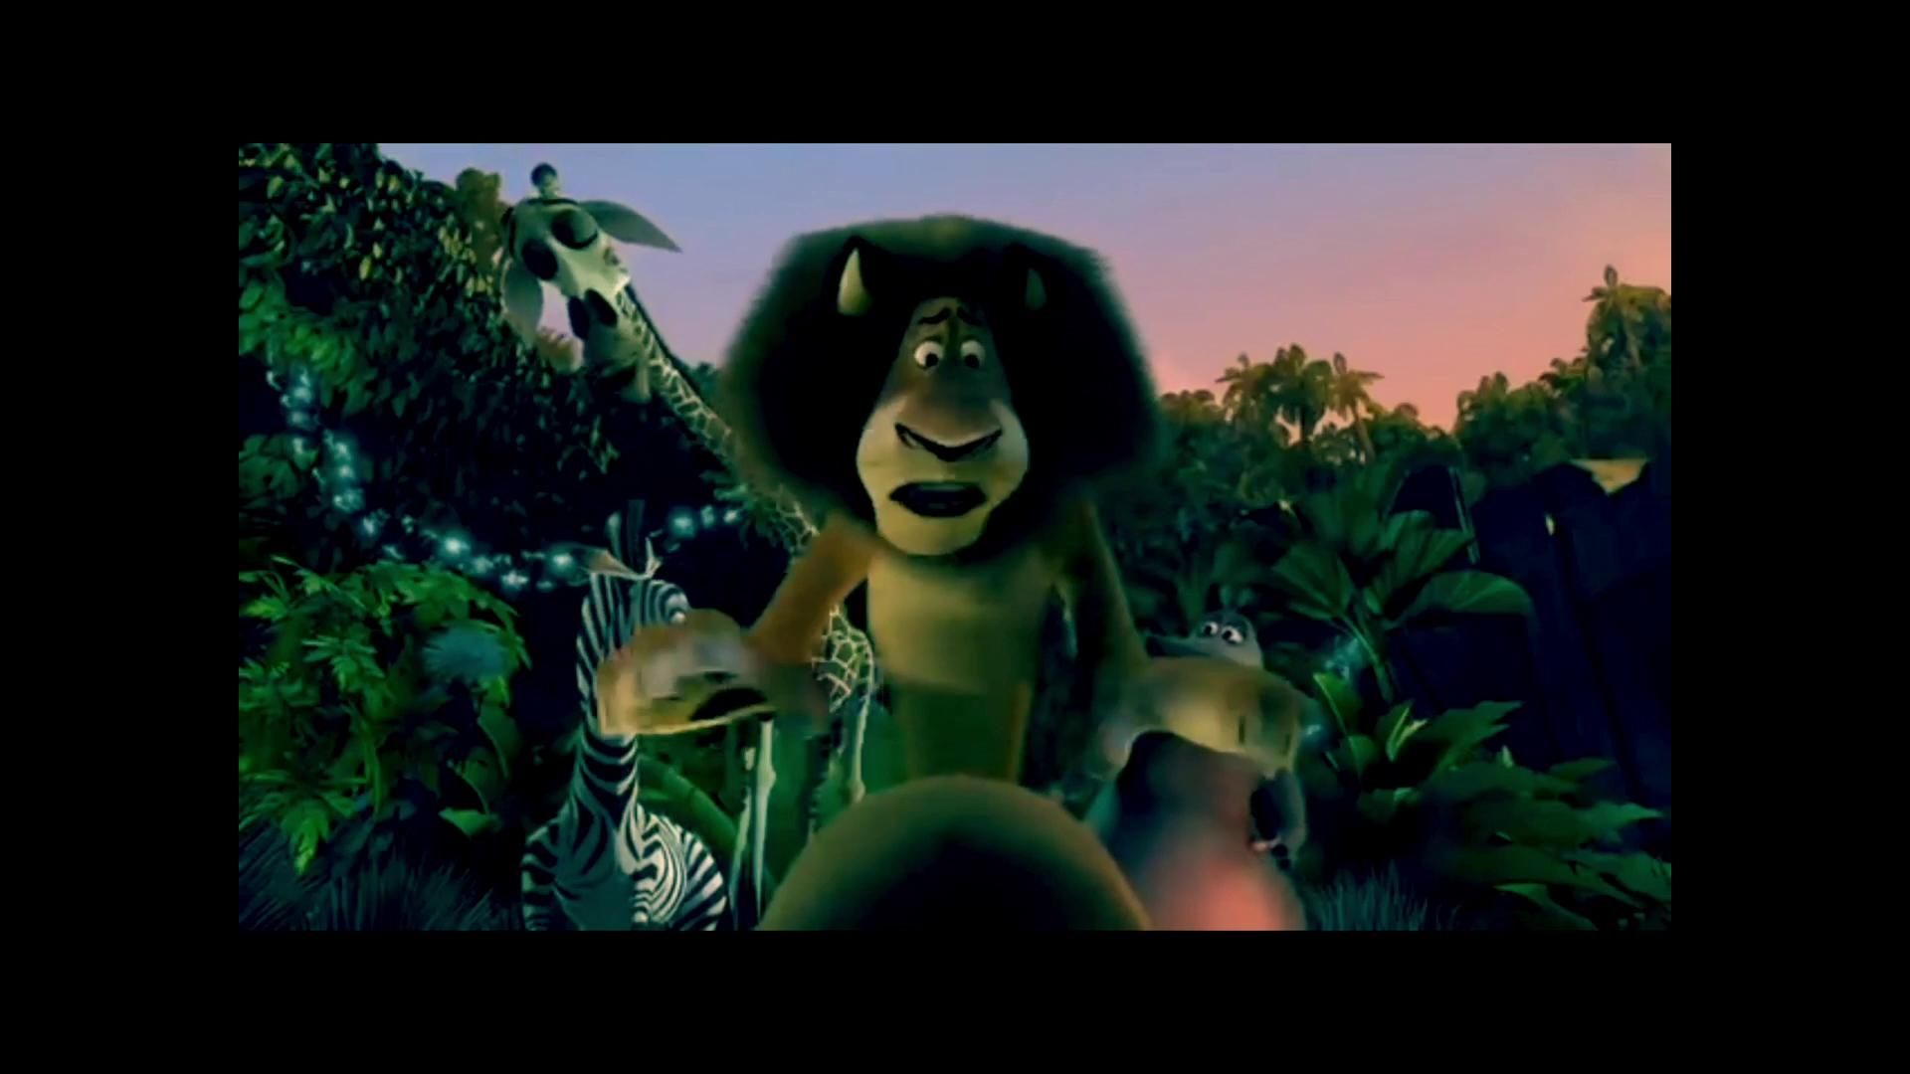
Partner Levels of Acceptance Video by Barb Borden, @BarbaraBorden9
This file pairs with this printable template:
bit.ly/2M8Zqzq by Sara Wood, @SaraWoodPE
And this file: bit.ly/2Bh6vYi by Stephanie Klaffke, @KlaffkePE

Slide 16
by Barb Borden @BarbaraBorden9

Slide 17
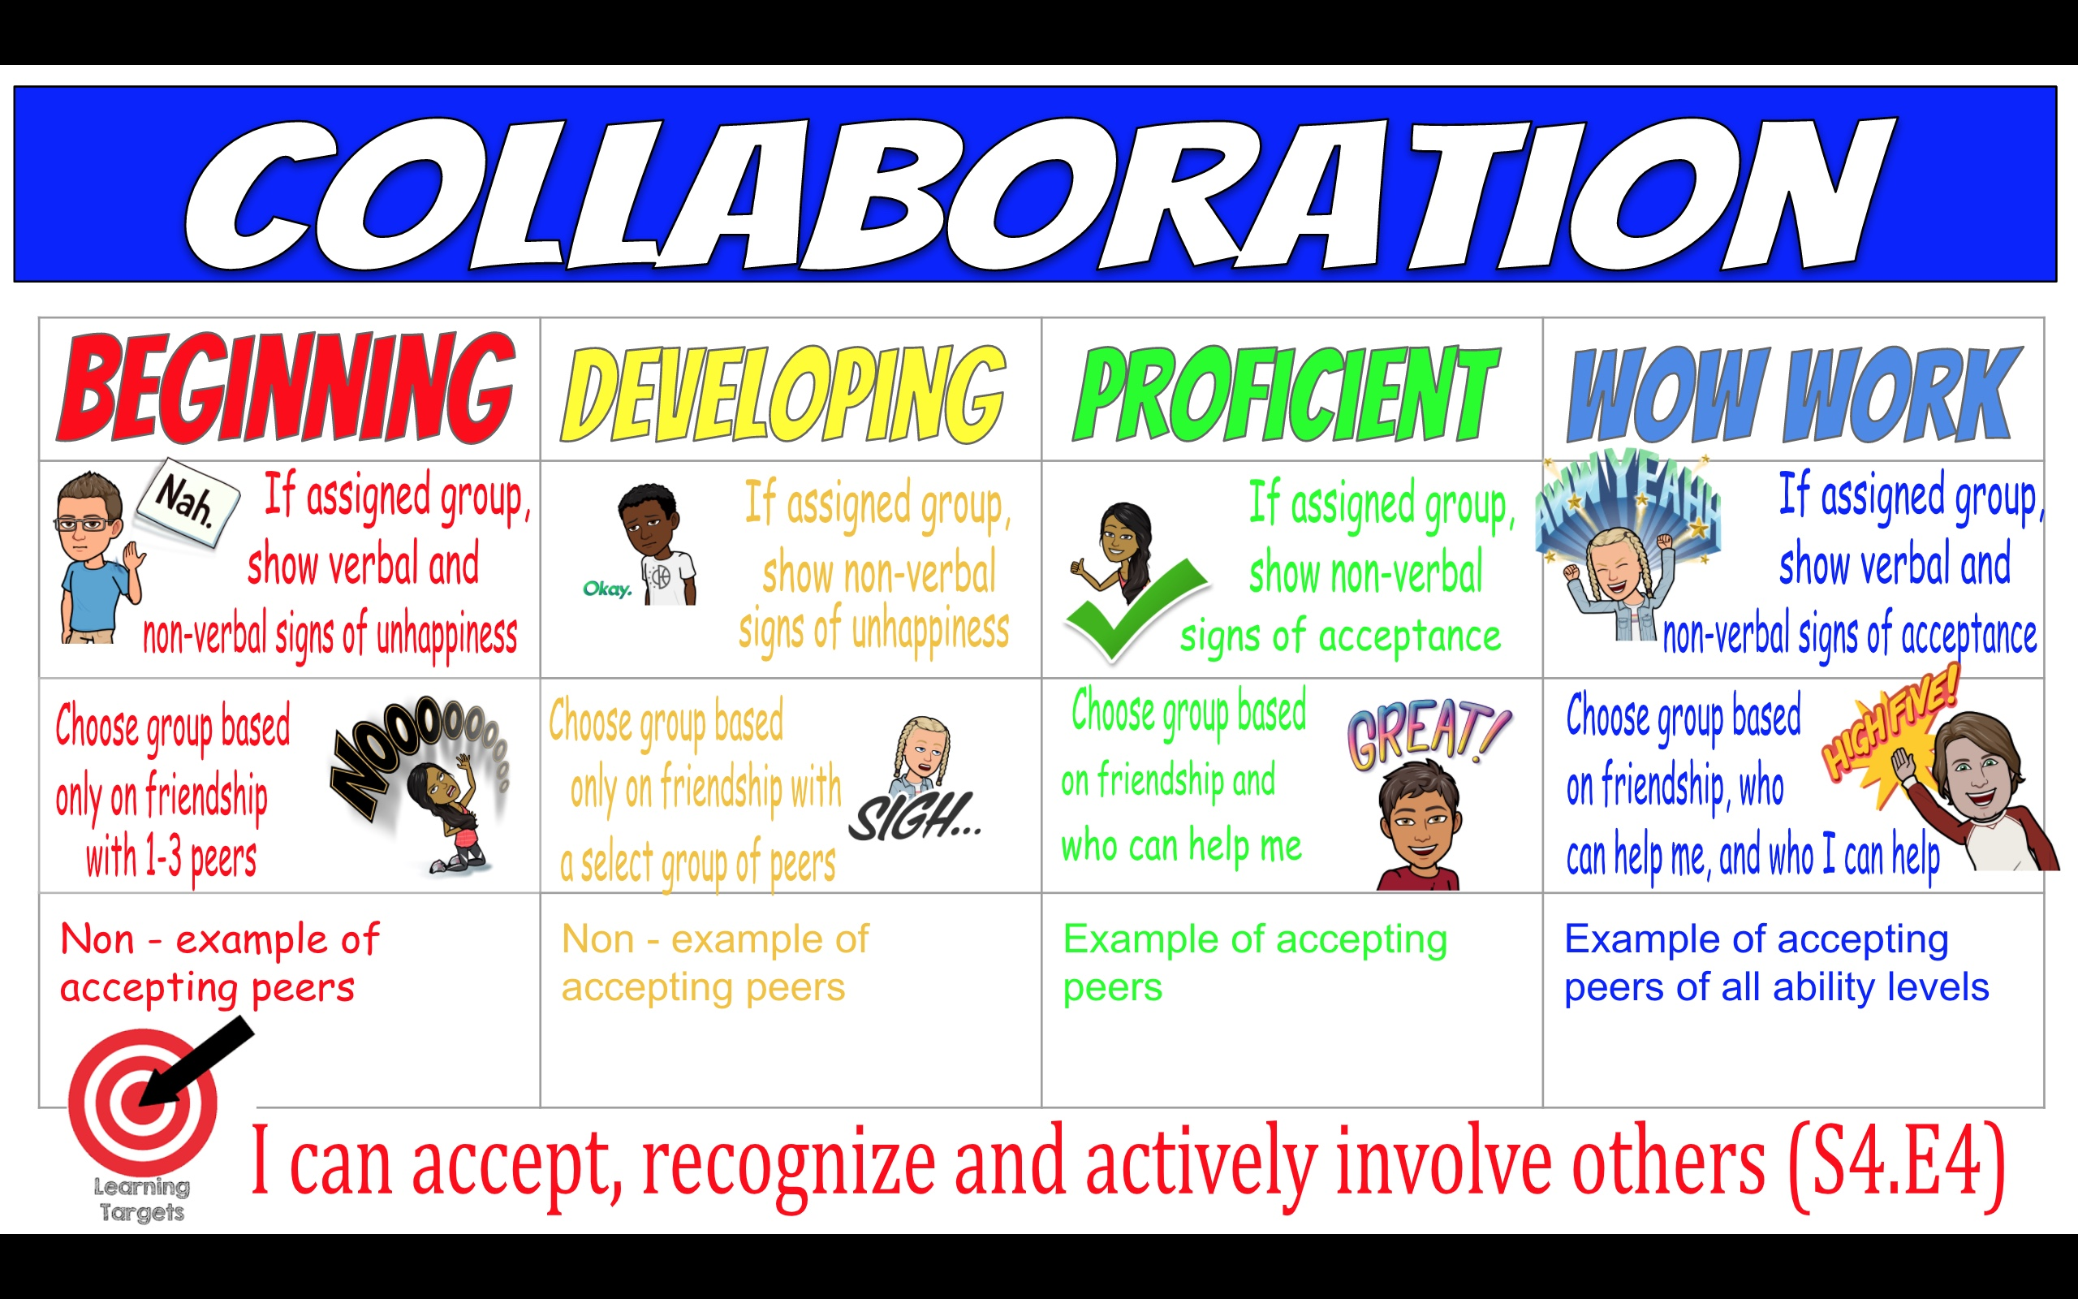
8.4(e): Apply relationship skills and strategies (e.g., trust, compassion, empathy) that promote team/group dynamics and inclusion.
By Stephanie Klaffke @KlaffkePE
Notes:
Also beware of unintentional exclusion

Slide 18
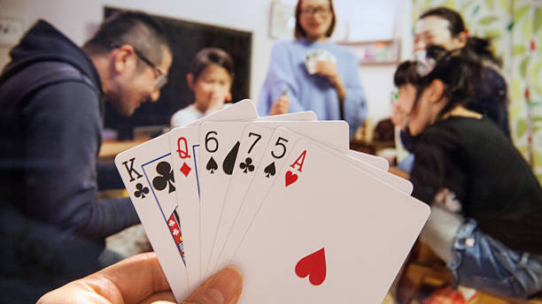
8.4(e): Apply relationship skills and strategies (e.g., trust, compassion, empathy) that promote team/group dynamics and inclusion.
Social Card Game
Notes:
Can also build relationships and practice skills that students will need for the main skill-building activity or unit.
Play Social Card Game

Slide 19
Reflect
What social skills did you use in this game?
In what ways do these skills contribute to an inclusive environment?
How can you apply these skills when we…?

Slide 20
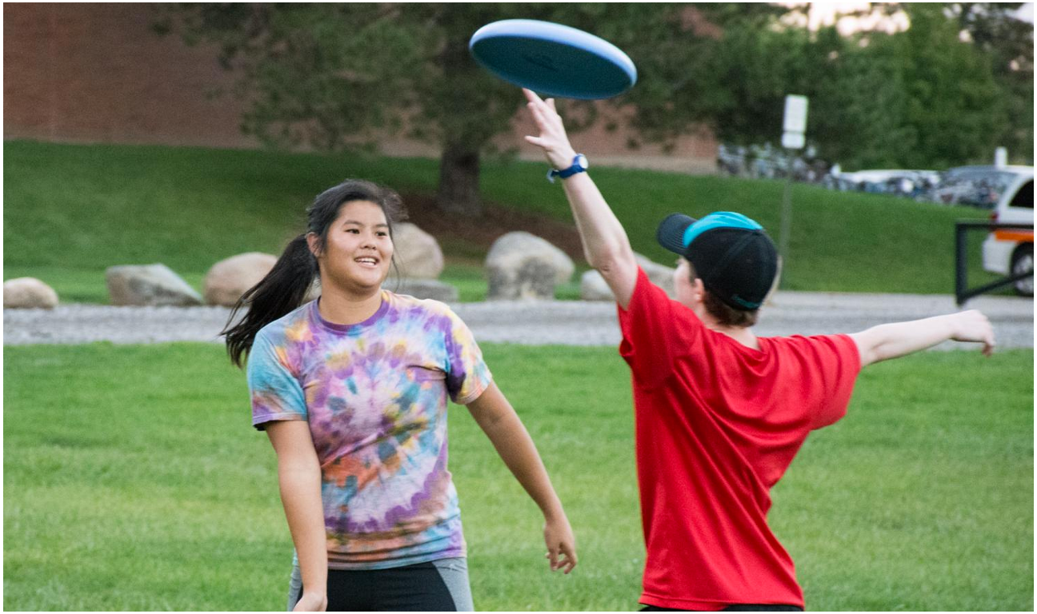
7.4(c): Explain the importance of cooperating with classmates and demonstrate supportive behaviors that promote feelings of inclusion and safety of others.
7.4(i): Identify and describe instances that do not support feelings of inclusion (e.g., marginalization).
Notes:
Play Mystery Circle Game

Slide 21
Reflect
What social skills did you use in this game?
In what ways do these skills contribute to an inclusive environment?
What makes a game inclusive?
Notes:
Another great example is rock/paper/scissors cheer game, but already played several times.

Slide 22
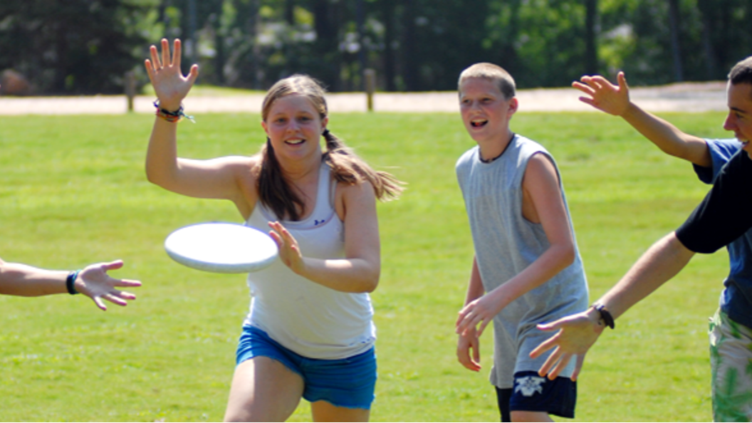
6.4(f): Participate in developing student-led classroom activities that promote feelings of inclusion, which support feelings of acceptance, belonging, and being valued, for all students.
Ultimate Frisbee
Notes:
Play 5v5 Ultimate
Then stop and ask:

Slide 23
Reflect
Discuss with your group:
What aspects of inclusion did you experience or feel were missing in the Ulitmate game?
What changes could your group make to make the activities more inclusive?
How can you show empathy or caring toward your group members?
Notes:
Was this game inclusive or exclusive? Talk in your groups about what aspects of the game were inclusive and what aspects were exclusive.
Remember to address how to make it more OR less challenging –

Slide 24
“CHANGE IT”
Coaching style – e.g. demonstrations, use of questions, role modeling, verbal instructions
How to score or win
Area – e.g. size, shape, or surface of playing area
Number of participants
Game rules – e.g. number of bounces or passes
Equipment – e.g. softer or larger balls, lighter, more/less bounce
Inclusion – e.g. everyone has to touch the ball before team can score
Time – e.g. “How many…in 30 seconds?”
Notes:
Challenge the group to make changes to the ultimate game to make it more inclusive.

Slide 25
Your Challenge: Use aspects of the “CHANGE IT” acronym to make the game more inclusive. Consider the following scenarios:
A new classmate, Ayaz, just moved from a different country. They do not speak English and they have never played Ultimate Frisbee before, so they are hesitant to join the game. They don’t understand the rules and they are afraid of messing up in front of their new classmates.
Jaylen is a classmate who loves Ultimate Frisbee but during the large games, he only gets to touch the frisbee a couple of times. Like many other students in the class, Jaylen needs some more skill practice to be more successful. He worries that his classmates won’t pass him the frisbee because he dropped it the last time.
Ava is a classmate who uses a wheelchair. She has always enjoyed PE but it has not been as fun in middle school. Ava worries that her classmates don’t want her on their team when they play invasion games and knows that she would need some adaptations to the game to be able to play.

Slide 26
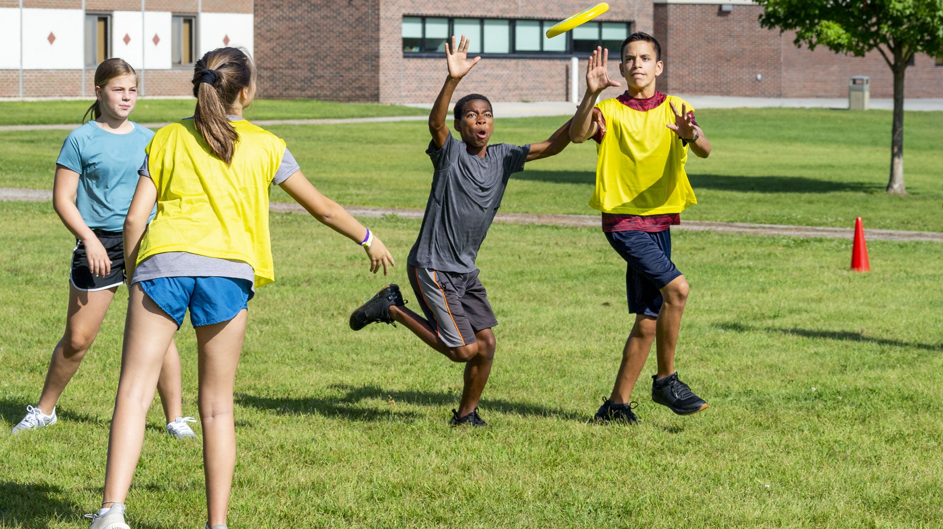
6.4(f): Participate in developing student-led classroom activities that promote feelings of inclusion, which support feelings of acceptance, belonging, and being valued, for all students.
”Change it up”
Notes:
https://www.coe.int/t/dg4/education/pestalozzi/Source/Documentation/TU/TU_SPORT_BARAN_EN.pdf
Play “Change It Up”

Slide 27
Survey
We invite you to participate in a research project examining healthcare and education professionals’ skills and confidence communicating with individuals with disabilities. We are asking you to take just 5 minutes to complete an anonymous survey about your feelings, comfort, abilities, and experiences communicating with individuals with disabilities. While there are no direct benefits to you, the results of this survey will help us to develop training resources to improve the education/healthcare experience for individuals with disabilities.
In appreciation for your time, at the end of the survey you will directed to a separate page where you will be entered into a drawing to win a $25 VISA gift card.
A complete consent document can be found on the first page of the survey, and is attached to this email. The survey can be found at this link: https://jmu.co1.qualtrics.com/jfe/form/SV_3mxcOVYdkx6oi7I
This study has been approved by the IRB, protocol #22-3325.
We sincerely appreciate your time and your honest responses.
Thank you,
Dr. Jill Lassiter, James Madison University
Dr. Amanda Campbell, Bridgewater College
Dr. Andrea Taliaferro, West Virginia University

Slide 28
Additional Resources
Link to activities: https://docs.google.com/document/d/1nrFi_LGvPSXurra7Ml4IdhDH9pI8n3TPU7kUwKbWMQ0/edit?usp=sharing
https://www.cbhpe.org/edi-social-justice
https://inclusiveschoolcommunities.org.au/resources/toolkit/art-inclusion-teaching-students-be-includers
https://www.coe.int/t/dg4/education/pestalozzi/Source/Documentation/TU/TU_SPORT_BARAN_EN.pdf
Inclusion Vocabulary & Journals - https://www.bsnsports.com/ib/inclusiontoolbox
EDI Classroom Posters - https://docs.google.com/presentation/d/1Oml1Xj9wpkoTYlePaoB-Bk7390_tFxDTOQx6xwtO338/edit#slide=id.gd6a793a294_0_13
Personal and Social Responsibility Badges - https://thephysicaleducator.com/2011/10/21/responsibility-badges-in-physical-education/

Slide 29
What is your favorite movie?

Slide 30
What is your favorite food?

Slide 31
What is one thing you are good at?

Slide 32
What is one thing you are not good at (yet)?

Slide 33
Describe your pet or the pet you wish you had

Slide 34
What is your favorite video game?

