Slide 2
Find a partner activities

Slide 4
Original | Move Your Feet | Jumping
Astronaut Gorilla Ninja | RPS - Evolution | RPS Fitness

Slide 6
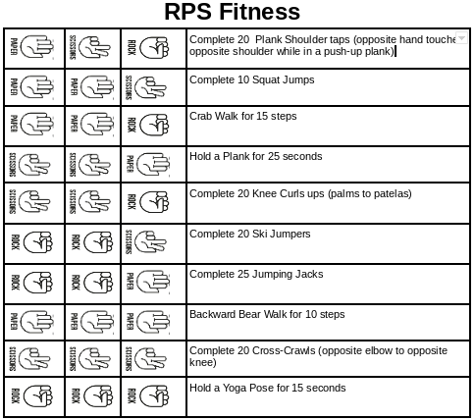

Slide 7
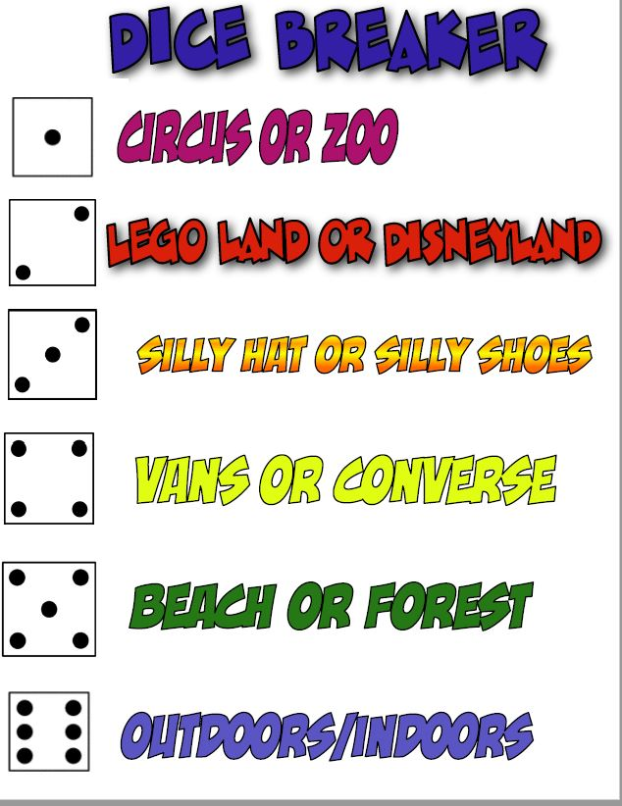

Slide 13
RPS
Team
Challenge
(RPS Cheerleader)

