Slide 1



INSTANT ACTIVITIES
1st
2nd
3rd
5th
HYDRATE
CHECK IN
PREPARE
Drink at least 4 oz of water or try the Orange Crush Mocktail
Scan the QR Code to receive the end of session survey and presentation
Grab a yoga card, hold pose for 30 seconds, trade with a colleague

Slide 2
Gamifying Assessment
Lei Dunn, CHES
HPAI 2022

Slide 3
Hi, I’m Lei!
Nationally Certified Health Education Specialist, Instructional Specialist for K-12 Health and PE for Virginia Beach City Public Schools, Adjunct Faculty at Old Dominion University, member of the School Health Professional Learning team

Slide 4
Today’s Objectives
01
02
Describe assessment and identify benefits of using technology for assessment in HPE
Learn to gamify assessment
03
04
Scaling PE games to test
Discover and explore 3 free platforms/tools for assessment in HPE

Slide 5
Today’s Objectives
01
02
Describe assessment and identify benefits of using technology for assessment in HPE
Learn to gamify assessment
03
04
Scaling PE games to test
Discover and explore 3 free platforms/tools for assessment in HPE

Slide 6
WHAT ACTUALLY IS ASSESSMENT?
01
TEST
The tool used
Must be valid and reliable
DEFINITION
The process of gathering information, analyzing the data or information, and then making an evaluation based on these results
02
MEASUREMENT
Individuals knowledge or ability
Only accurate if test is valid and reliable
03
EVALUATION
Comparing measurement to predetermined criteria or objectives
Objective

Slide 7
WHY INFUSE HEALTH CONCEPTS and ASSESSMENT WITH PHYSICAL ACTIVITY?
TIME
Consider how many class meetings you have for students to master a learning target
60 MINUTES
How much physical activity are your students truly getting in a day?
CONNECTION
Our health and physical activity are not mutually exclusive
DIFFERENTIATION
Combing objective allows students to demonstrate their learning in a variety of ways
PRIOR KNOWLEDGE
Review opportunities

Slide 8




How do your assess?
A Paper and pencil | B Observation
C Recording | D Something completely different

Slide 9
Today’s Objectives
01
02
Describe assessment and identify benefits of using technology for assessment in HPE
Learn to gamify assessment
03
04
Scaling PE games to test
Discover and explore 3 free platforms/tools for assessment in HPE

Slide 10


Slide 11
Today’s Objectives
01
02
Describe assessment and identify benefits of using technology for assessment in HPE
Learn to gamify assessment
03
04
Scaling PE games to test
Discover and explore 3 free platforms/tools for assessment in HPE

Slide 12
CHICKEN NUGGET TAG
1) Place 1 hoop on the ground per 4 students (or make circles with poly spots, 1 spot per student).
2) Music starts, students toss and catch the chicken nugget naming the type of food for the food group coloring they are standing at; no repeat foods.
3) Music stops, whoever has the chicken nugget is the tagger.
4) Students who are tagged go to the nugget box, complete designated exercise, return to the game.
5) Music starts, Ss return to the plates rotating one to the left.
SOL
TARGET
1.5.a) Name the food groups as identified by the U.S. Department of Agriculture (USDA).
b) Name one food from each (USDA) food group.
I can name at least 1 food from each food group.
TIME
AFFECTIVE
15-20 minutes
Cooperation to achieve the goal; moving in open space
DIFFERENTIATION
IT’S TAG!
Change groups, multiple languages
Easy to change the parameters as necessary for your students and space

Slide 13

MY PLATE RELAY
SOL
TARGET
6.5.a)Create a one-day meal and snack plan based on Recommended Dietary Allowance (RDA), portions, hydration, and sugar.
I can create a 3 meals and 1 snack with USDA recommended amounts of calories, carbohydrates, fats and proteins.
TIME
AFFECTIVE
15-30 minutes
Cooperation to achieve the goal; allow students time to discuss cultural food differences
DIFFERENTIATION
FITNESS TESTING
Cards with nutrition information, have calculators available
Set the distance as that of the pacer, make sure students are aware of the practice

Slide 14
Today’s Objectives
01
02
Describe assessment and identify benefits of using technology for assessment in HPE
Learn to gamify assessment
03
04
Scaling PE games to test
Discover and explore 3 free platforms/tools for assessment in HPE

Slide 15
CONSIDERATIONS
TIME
LEVEL
How much time do you have with your students, each class and during a unit?
The younger the student easier the tech.
DIVISION REQUIREMENTS
OBJECTIVES
Do you have standardized tests to administer or rules with technology to consider?
Where can your tech do double duty?

Slide 16



A FEW OF MY FAVORITE THINGS
NEARPOD
FLIPGRID
GOOSECHASE
One stop shop
Visual learning and assessment with a social media feel
Scavenger hunts on the highest level

Slide 17
NEARPOD
Slide Shows
Collaboration Boards
Polls/Check Ins
Differentiation Tools
Formative Assessment
Create basic slides in the program or upload from Google
Encourage student conversation and collaboration
Use as milepost and help keep students on track
Drawing, read aloud and voice recording options
Quizzes, Time to Climb or link directly to external web based assessments

Slide 18

Join.Nearpod.Com
CODE:
PG7M2

Slide 19
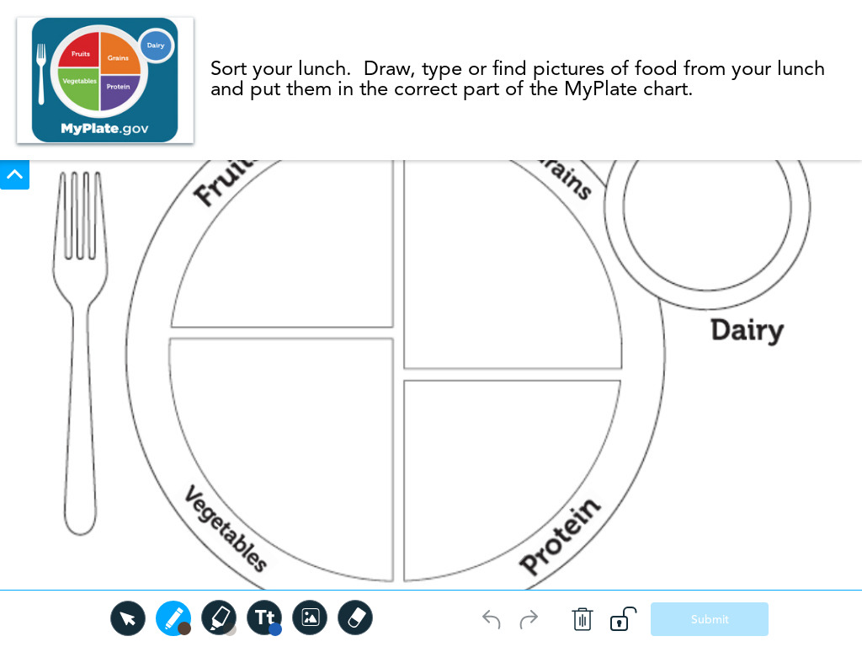
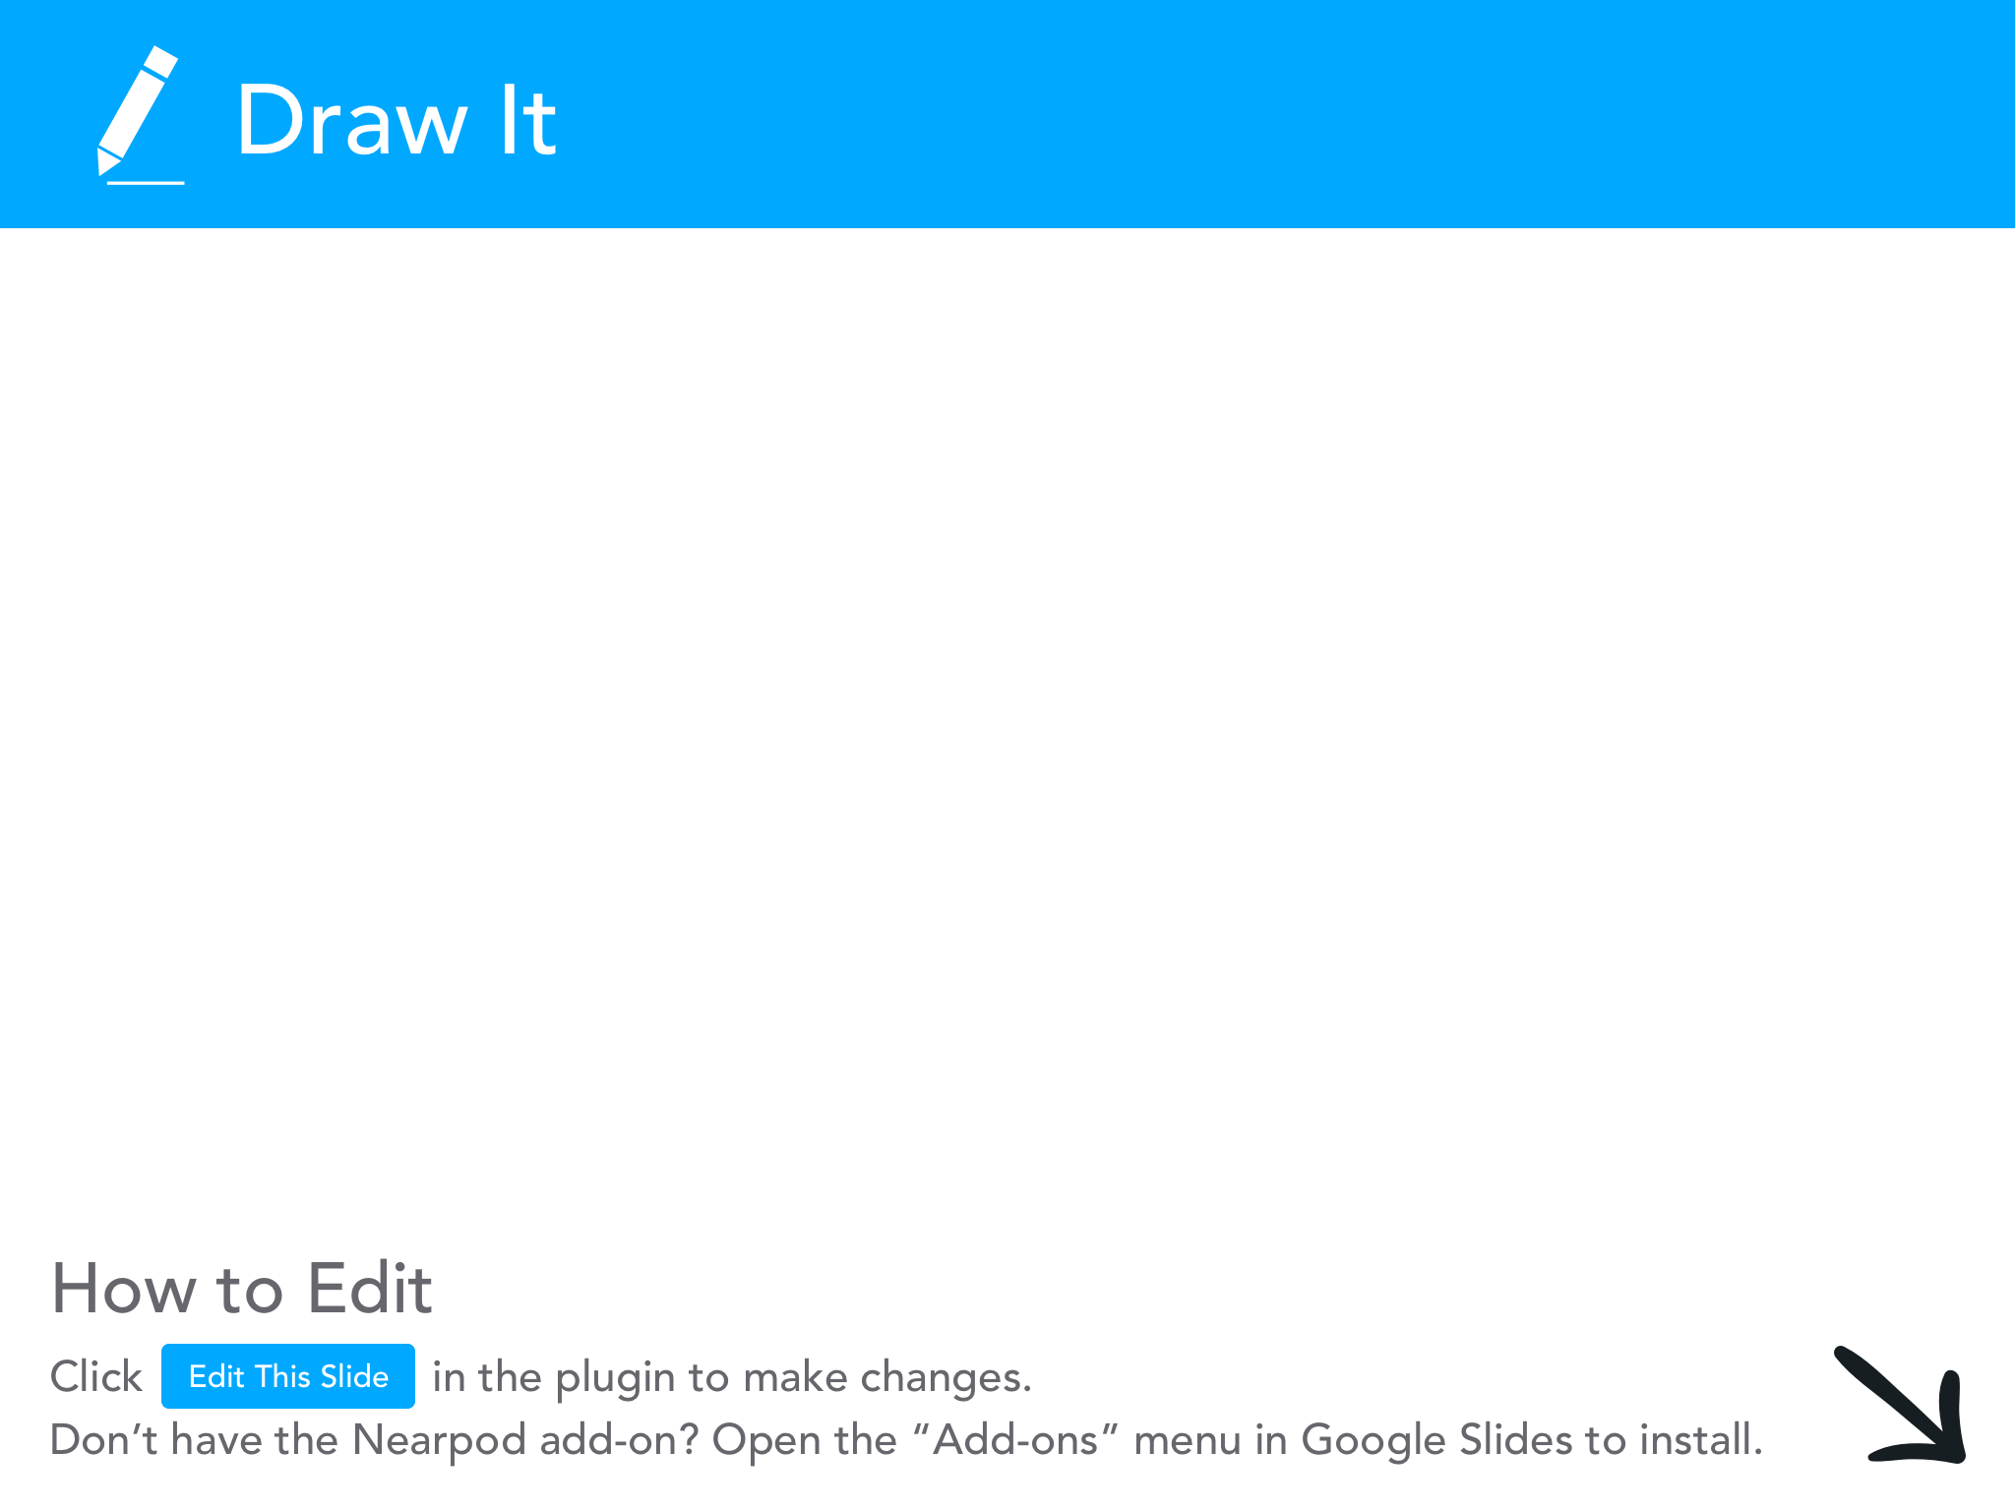

Slide 20
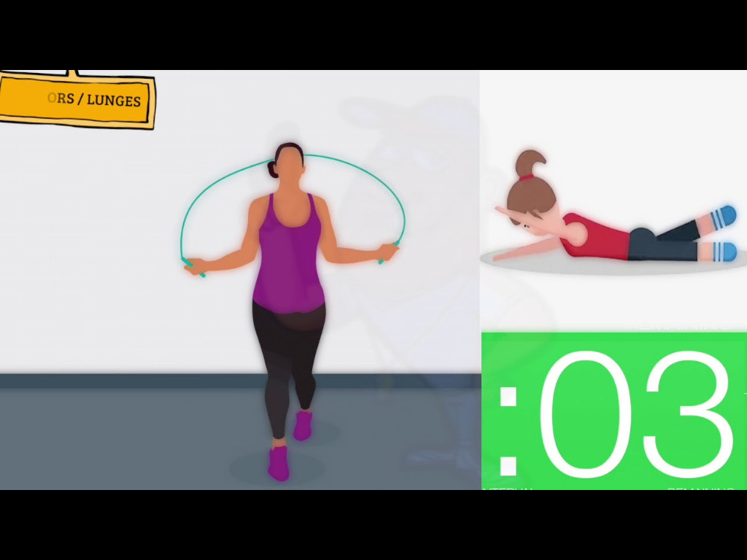


Slide 21

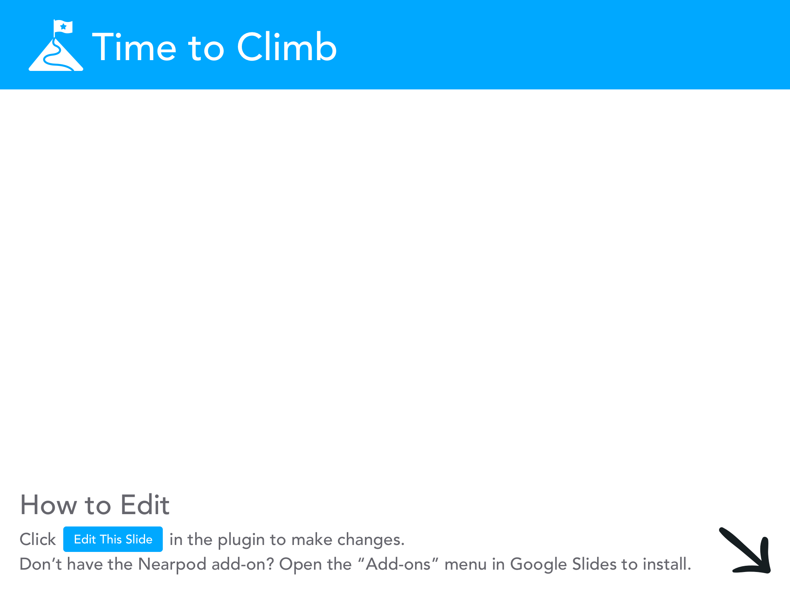

Slide 22

A UNIQUE OPPORTUNITY
SOCIAL
COLLABORATIVE
Interaction regardless of where your students are
Work with other educators in your building or across the world
TIME
FEEDBACK
Give students the time they need to gather their thoughts and the time you need to gather yours
Give in depth feedback to students or give them the opportunity to offer each other feedback
CHOICE
SO MUCH FUN!
Student style in every post
It’s great to see what they come up with

Slide 23
From Summative to Formative
FORMATIVE
Pulse checks throughout the Nearpod Lesson
IN NEARPOD
SUMMATIVE
Cultural Dance Workshop
IN FLIPGRID
RUBRIC
Proficiency expected, clear options for advancement given
STATED IN BOTH

Slide 24

GOOSECHASE is an amazing tool to gamify learning and assessment
GOALS
COMPETITION
OBJECTIVES
TEAMWORK

Slide 25

Let’s go on a GOOSE CHASE
Find your Justice League Matches and the team tablet.

Slide 26
WHAT DID WE DO TODAY
CONSIDERED
Reasons behind cross curricular work and assessment
MOVED
You completed 15 minutes of physical activity
GEEKED OUT
By using simple, free tech
DIGESTED
Higher level thinking on a variety assessment techniques
DID THE LEG WORK
By exploring the set up required to gamify learning and assessment

Slide 27

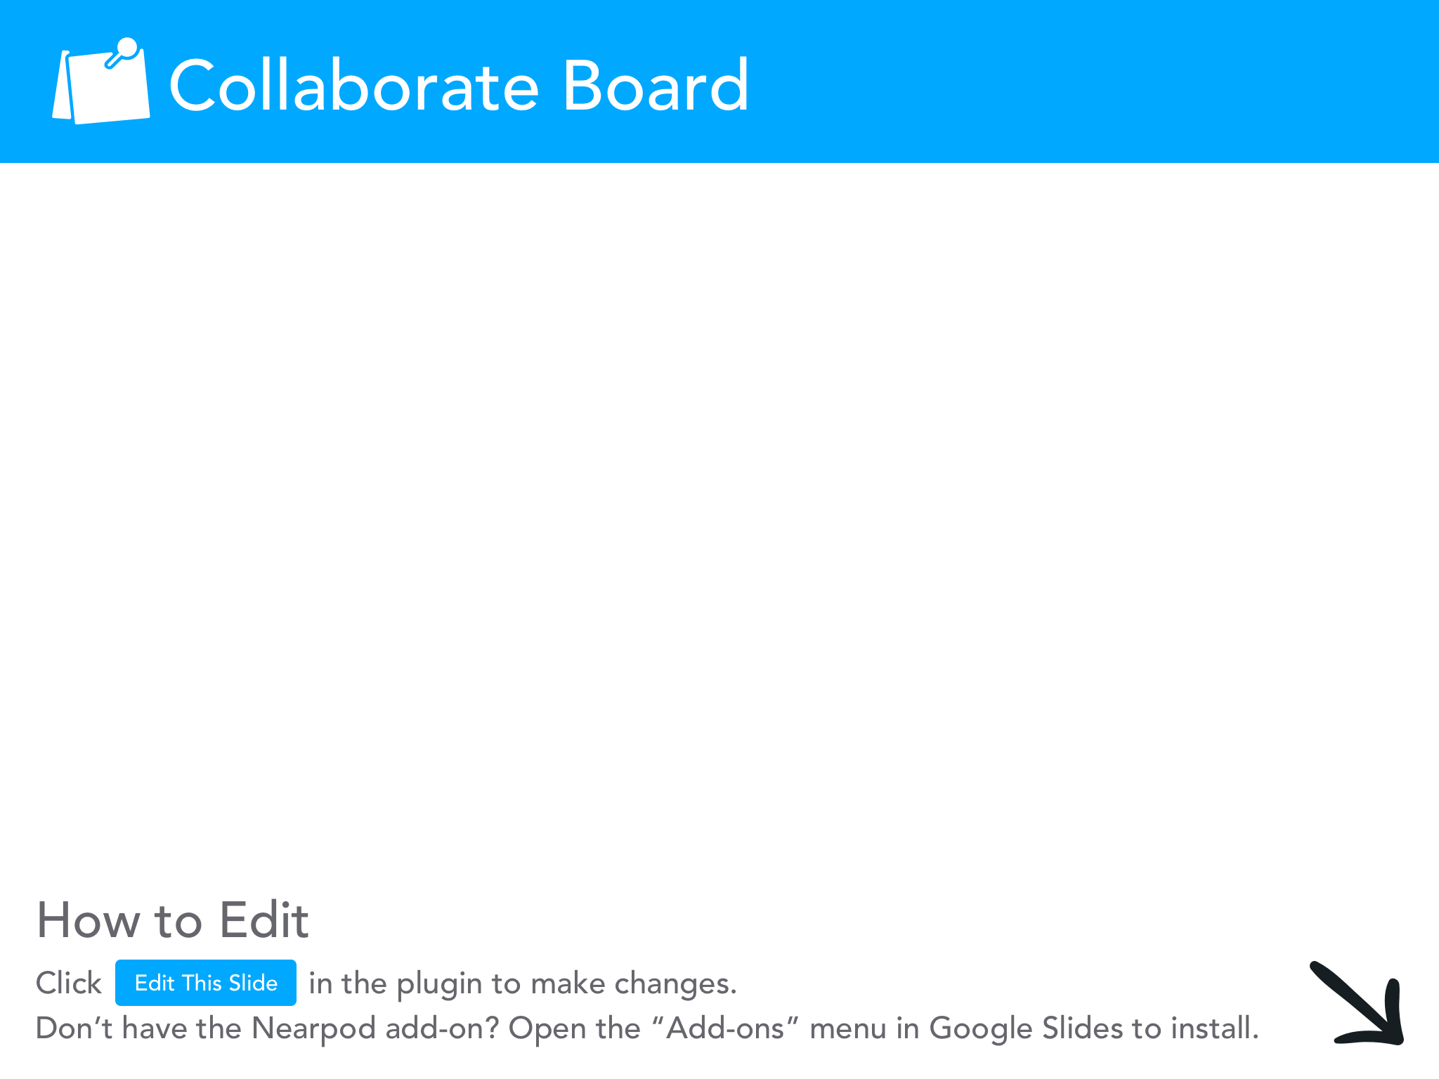

Slide 28

THANKS!
@leidunn_vb
Slideshow and graphics courtesy of Slidesgo
https://slidesgo.com/faqs and https://slidesgo.com/slidesgo-school

