Slide 1
HRMS TUTORIAL Budget Inquiry
Budget Inquiry pages allow you to view budget information for current or previous fiscal years about positions in departments where you have PAR and Budget signature authority.
Next

Slide 2
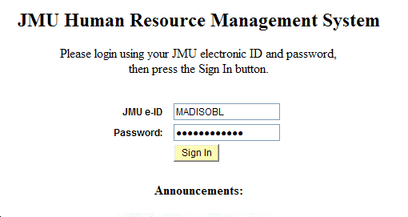
Log in to HRMS
Enter your JMU eID and Password, then click Sign In to log in to the JMU Human Resource Management System (HRMS).
Back
Next
Budget Inquiry

Slide 3
Menu
Three options on the menu:
Original Budget Info – search for position data by budget year, position number, department, or employee name.
Position Summary – view history of position-related actions.
Budget Expenditures Report – generate a PDF of payroll expenditures to date by fiscal year and position number or by fiscal year and department.
On the menu, under JMU Applications, choose
JMU Budget.
Back
Next
Budget Inquiry

Slide 4
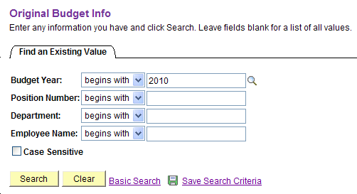
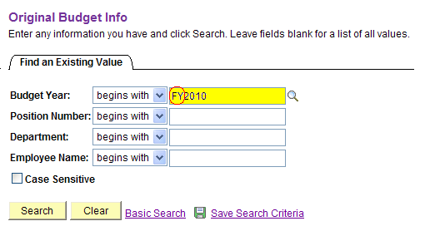
Select Original
Budget Info
Search by entering the budget year, position number, department or employee name. Click Search. Include “FY” as part of the budget year or you will receive an error message. For example, enter FY2010 rather than 2010.
Back
Next
Budget Inquiry

Slide 5
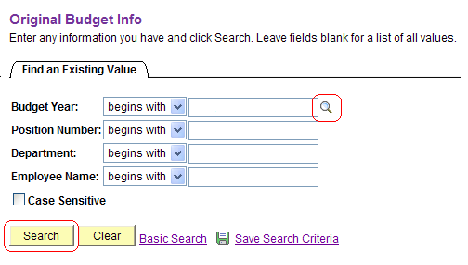
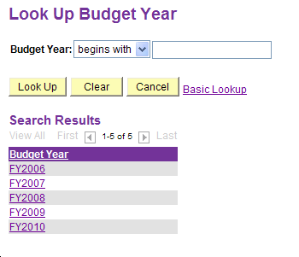
Use Look Up or Search Feature
You can also use the Look Up feature to look up a budget year or simply leave all search fields blank and click Search to view a list of all departments for which you have PAR & budget signature authority.
Back
Next
Budget Inquiry

Slide 6
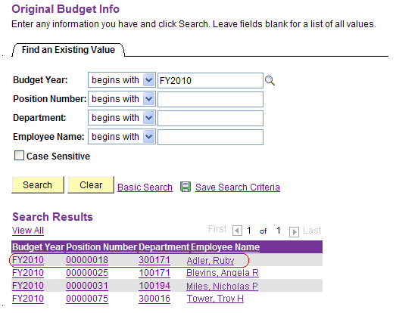
Select Person or Position
Select any of the hyperlinks for the person or position for which you want to view budget information.
Back
Next
Budget Inquiry

Slide 7
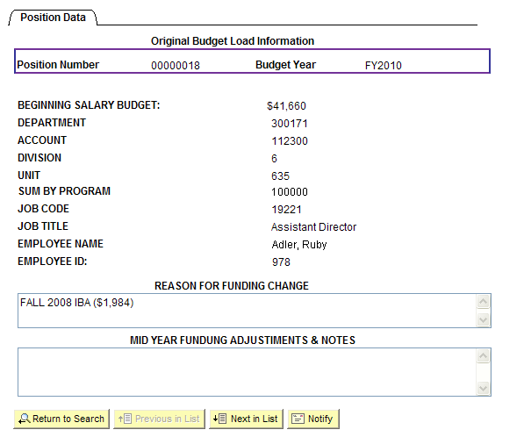
View Original Budget
Load Information
View budget information by position number. If you want to view additional positions, select Return to Search or Next in List.
Back
Next
Budget Inquiry

Slide 8
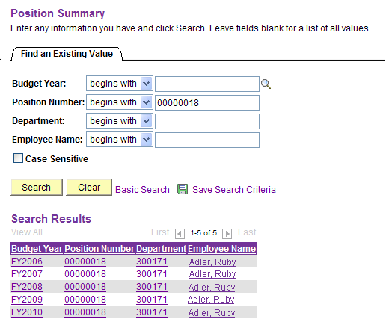
Menu –
Select Position Summary
View history of position-related actions such as a title change or position transfer to another department. Search by entering the budget year, position number, department or employee name. Click Search. When searching by position number, note that all previous budget years appear as an option, but all reflect the same historical data once you drill down.
Back
Next
Budget Inquiry

Slide 9
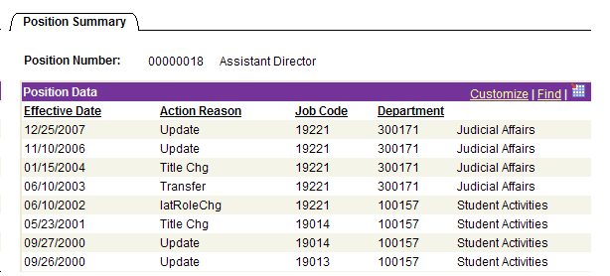
Select Position to View History
Previous actions taken on the position are visible.
Back
Next
Budget Inquiry

Slide 10
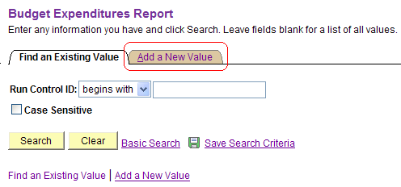
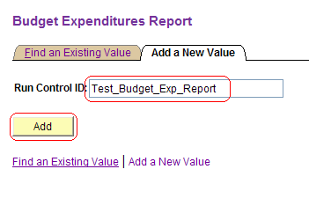
Menu – Select Budget Expenditures Report
The first time you run the Budget Expenditures Report, select the Add a New Value tab to establish a report format or Run Control ID. Enter a Run Control ID and click Add.
Back
Next
Budget Inquiry

Slide 11
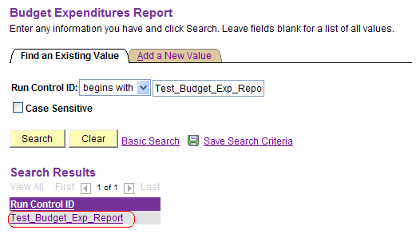
Search Run Control IDs
To find an existing Run Control ID, enter the beginning of the name or leave blank to see a list of all Run Control IDs. Select the Run Control ID you wish to run.
Back
Next
Budget Inquiry

Slide 12
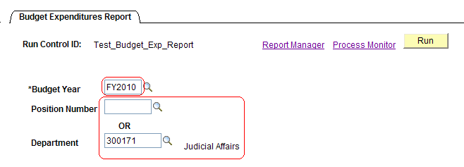
Enter or Confirm Report Criteria & Run
Enter the budget year (including “FY”), and either the position number or department number. Click Run.
Back
Next
Budget Inquiry

Slide 13
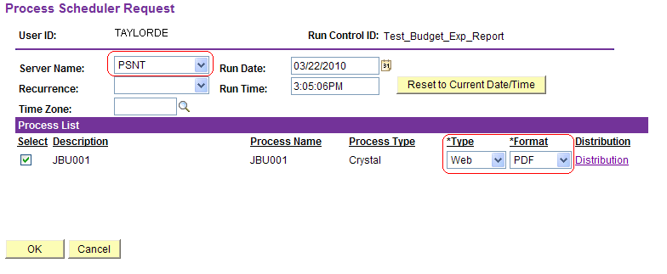
Enter or Confirm Server, Type & Format
After clicking Run, the Process Scheduler screen appears. Select PSNT for the Server Name and verify that the Type=Web and Format=PDF. Other types are not recommended due to formatting issues. Click OK.
Back
Next
Budget Inquiry

Slide 14
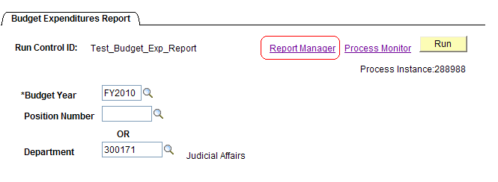
Review or Download Report
After clicking OK, you return to the Process Scheduler screen. Click Report Manager. Click the Administration tab (defaults to List tab). Click the Description hyperlink Budget Expenditures and the PDF should open in a separate tab or window. If the report doesn’t appear, click Refresh.
Back
Next
Budget Inquiry

Slide 15
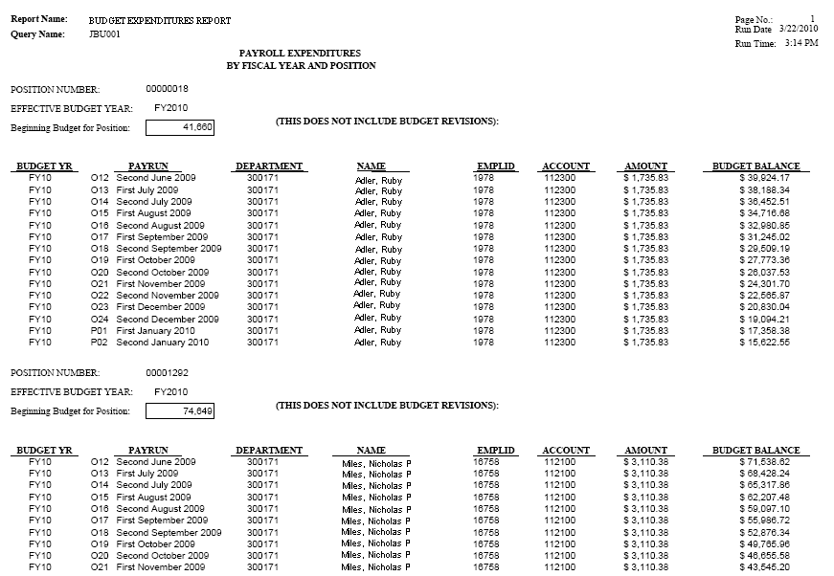
Budget Expenditures Report
In the example at right, the report was run using FY2010 and Department 300171. If the position number is used instead of the Department number, the report will contain budget data for that position only.
Back
Budget Inquiry

